Slide 1
Teaching Excellence Framework – the role of the Higher Education Academy
Dr Geoff Stoakes, Head of Research
ANTFs
30 July 2015

Slide 2

Purpose of presentation
‘INSPIRING TEACHING, TRANSFORMING LEARNING’
      To explain how the HEA has contributed to the debate about teaching excellence
      To explain how the HEA is contributing, and can continue to contribute to the development of the Teaching Excellence Framework (TEF)

Slide 3

Recognising teacher excellence
    UKPSF and individual recognition.
      Threshold
    UKPSF: Accredited provision.
    National Teaching Fellowship Scheme.
    Marker of excellence
Notes:
Moving beyond the award
Ntfs and ukpsf – excellence vs standards/threshold
Different perceptions-use within institutions
Indicator of excellence relative to context – drawing on the areas of work.
True for other schemes – there is work to recognise the diversity and the foci.
SLTAs are revealing – getting past the popularity concept by adopting a systematic approach particularly to criteria development. Not only focus on TE. But have used outputs to inform teacher development.

Slide 4
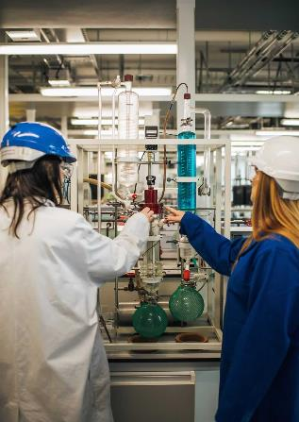
The HEA’s teaching excellence project
Aim:
To develop a shared understanding of what constitutes teaching excellence in higher education and to develop a framework to help the sector to identify and enhance quality in teaching.
TE project involves:
Reviewing literature, researching policy and practice around the world on teaching excellence, devising a framework and toolkit to help institutions identify and disseminate best practice.
Notes:
Important to note the work which the HEA has already undertaken as part of its own Teaching Excellence project and how this might feed into the discussion.

Slide 5
Defining dimensions of teacher excellence
Assessment
Contributing to the Profession
Planning & delivery
Evaluating & Reflecting
Gunn, V (2013), Considering Teaching Excellence in Higher Education: 2007-2013
Notes:
Gunn, V (2013), Considering Teaching Excellence in Higher Education: 2007-2013: provided an up-to-date review of literature and practice in relation to teaching excellence, and to identify further research. This slide illustrates the dimensions of teaching excellence.

Slide 6
Teacher excellence only part of teaching excellence
Institutions and cultures of excellence
Disciplinary concepts of excellence
Excellence in teaching leadership
Notes:
A key question is at what level do we want to measure excellence.

Slide 7

Understanding issues: teaching excellence
Land & Gordon, Teaching Excellence Initiatives: modalities and operational factors
Reviews and categorises the different conceptions of teaching excellence in use around the world.
Reviews a range of operational issues.
Proposes a framing tool for future teaching excellence initiatives, posing questions for the sector, for institutions and for faculties/departments.
HEA / HEFCE Teaching Excellence Roundtable (13 April), kick started discussion.
Notes:
This HEA-commissioned work provided the background to the HEA Roundtable held at HEFCE on 13 April. It raised an important distinction about how to measure teaching excellence – one (Murray Saunders 2009) between ‘low fidelity’ and ‘high fidelity’ approaches to rewarding excellence – high fidelity approach is prescriptive with the need to comply with requirements of a stated policy; low fidelity approach allows for more freedom and variability in how requirements are met and allows institutions to express ‘their own institutional culture – contextualised approach.
This work was used as a prompt for discussion along with responses from Rosemary Deem (Royal Holloway and Amy Tsui, U of Hong Kong.

Slide 8
‘Teaching at the heart of the system’,
Jo Johnson (1 July 2015)
‘Aims for the TEF’ :
to ensure all students receive an excellent teaching experience that encourages original thinking, drives up engagement and prepares them for the world of work;
to build a culture where teaching has equal status with research, with great teachers enjoying the same professional recognition and opportunities for career and pay progression as great researchers;
to stimulate a diverse HE market and provide students with the information they need to judge teaching quality – in the same way they can already compare a faculty’s research rating;
to recognise those institutions that do the most to welcome students from a range of backgrounds and support their retention and progression to further study or a graduate job.

Slide 9
Expectations of the TEF (Jo Johnson)
Clear set of outcome-focused criteria and metrics (emphasis added).
Underpinned by an external assessment process, undertaken by an independent quality body from within the existing landscape.
Avoiding the individual and institutional burdens of the REF.
External review to be ‘proportionate and light touch, not big, bossy and bureaucratic’.
Commitment to consult ahead of a Green Paper (Autumn).

Slide 10
Implications of the TEF (Jo Johnson) 1
TEF to include incentives to tackle ‘degree inflation’.
Green Paper also to look at the role played by External Examiners in underpinning standards (HEA’s ‘Review of External Examining Arrangements across the UK’).
TEF to encourage universities to adopt a grading system (Grade Point Average) – to motivate and engage students more
– ‘dual running’ of GPA alongside Honours Degree Classification (HEA’s ‘Grade point average: Report of the GPA pilot project 2013-14’).

Slide 11
Implications of the TEF (Jo Johnson) 2
TEF to include incentives that reward institutions that do best at retention and progression of disadvantaged students (emphasis added).

Slide 12
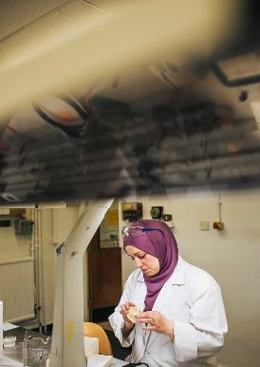
HEA’s continuing contribution to the development of the TEF
Membership of BIS Advisory Group
Membership of the BIS Expert Group
PVC TEF working group. (20 July-)
PVC External Examining working group (21 July -)
PVC Learning Gain working group
10

Slide 13
PVC TEF Working Group, 20 July
Before the meeting…
Provided evidence of what measures are currently in use in institutions to measure teaching excellence
Provided views on what measures might be used in a TEF
Notes:
Responses to pre-meeting questions:
Current measures – one reason for not measuring it was the lack of an institutional or indeed a sector-wide definition of TE
Proposed measures – included the no of NTFs at an institution; the number of HEA fellows; etc.
At the meeting..
The distinction between the long –term TEF – based on proven, robust measures ,preconditions for excellence – established policies to reward excellence (and their implementation)
TEF-Lite – need to use established data, retention data, NSS

Slide 14
A flavour of PVC responses to key issues
Defining teaching excellence
Underpinning principles
Metrics for ‘TEF-Lite’
Metrics not to include
Outstanding issues and questions
Notes:
At the meeting..
The distinction between the long –term TEF – based on proven, robust measures ,preconditions for excellence – established policies to reward excellence (and their implementation)
TEF-Lite – need to use established data, retention data, NSS
DEVELOP>>>>

Slide 15

Next steps
Continuing informal conversations with BIS prior to Green Paper.
Formal consultation on the Green Paper.
White Paper.
Role of the ANTFs
Notes:
Process
Views of ANTFs.. Feed back via HEA…

