Slide 1
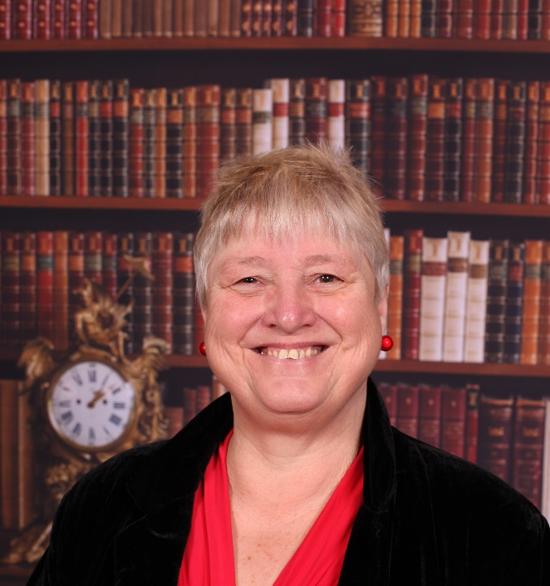
Academically moving forward
PEP National Dialogic Conference
July 14-15 2015
Sally Brown @ProfSallyBrown
sally@sally-brown.net
NTF, PFHEA,SFSEDA
Emerita Professor, Leeds Beckett University
Visiting Professor University of Plymouth & Liverpool John Moores University.

Slide 2
Current contextual issues:
Students;
Staffing;
University finances;
Technologies and data analytics to support learning and admin;
Changing learning paradigms;
The necessity to develop students’ skills/literacies;
Students as consumers;
The PTES and other performance indicators e.g. a TEF?
Preparing students for business and industry

Slide 3

Laurentius de Voltolina
2nd half of 14th Century
Italian Painter

Slide 4
What does helping students prepare for employment and industry involve for universities?
Being smart and fleet of foot in discerning trends from data and responding appropriately;
Foregrounding the student experience;
Building upon existing partnerships with students around quality assurance and enhancement;
Learning from experience about what works and doesn’t work, and using a scholarly approach to disseminating what we’ve discovered;
Fostering awareness of life beyond university.

Slide 5

From Jason Elsom
(@Jason Elsom)

Slide 6
Determining and reviewing subject material: currency, relevance, level
Enhancing quality, seeking continuous improvement
Designing and refining learning outcomes
Evaluating programmes, strengths and areas for improvement
Curriculum
Design
Essentials
Considering delivery modes: face-to-face, online, PBL, blended…
Assuring quality, matching HEI, national and PSRB requirements
Thinking through student support
Designing fit for purpose assessment methods and approaches

Slide 7
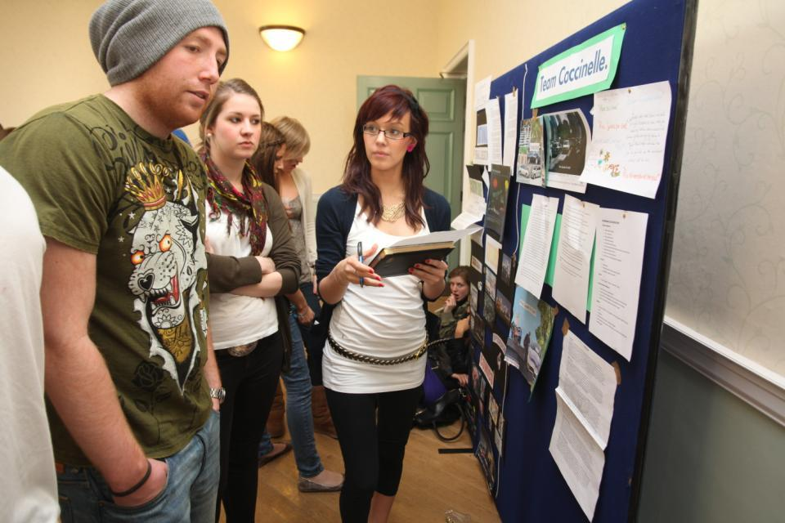
Do these students look engaged?

Slide 8
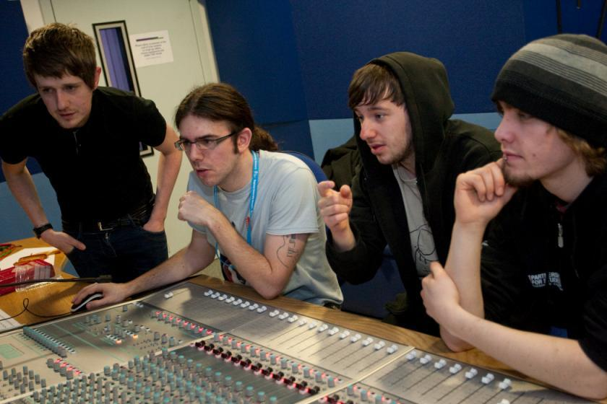
How about these?

Slide 9
High quality teaching…
…“implies recognising that students must be engaged with the content of learning tasks in a way that is likely to enable them to reach understanding…Sharp engagement, imaginative inquiry and finding of a suitable level and style are all more likely to occur if teaching methods that necessitate student energy, problem solving and cooperative learning are employed”. (Ramsden, 2003, p.97)

Slide 10
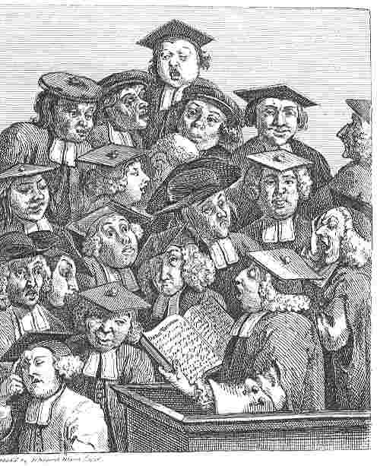
William Hogarth
1736
‘Scholars at a lecture’
How would the lecturer be rated in the PTES?

Slide 11
Engagement of international students: some important considerations
Is recruitment undertaken to ensure students have the potential to succeed?
Is induction framed appropriately to welcome international students?
Are steps taken proactively to ensure international students have a good chance of integrating with their study cohorts?
Is the curriculum international in scope and content? Are examples and case studies global?
Is the right kind of support offered (language, crisis support, befriending etc.)?

Slide 12


Slide 13
Mapping progression
Is there a coherent model of progression across the student life-cycle from induction to ‘outduction’ (Morgan 2011)?
Do you manage transitions well?
Is there some continuity in the sources of student support throughout the course (e.g. personal tutors)?
Are students offered support and guidance in relation to personal development and employability?

Slide 14
Helping universities academically move forward
Adopt a holistic approach to the development of skills, particularly academic, social & interpersonal, and information literacies, so that these are fully integrated into the learning programme;
Enable students to become self-aware and reflexive learners who become robust in the face of problems;
Help students build resilience through ‘a diet of early successes’ and positive reinforcement.

Slide 15
To better prepare learners we can:
Make use of real examples and hot-off-the-press data to keep content current;
Provide challenges to students’ thinking without letting individuals feel publicly exposed or humiliated;
Relate their classroom activiites to the forthcoming/ongoing assignment (without slavishly teaching to the exam);
Make spaces for dialogue, in live sessions and afterwards;
Fostering creativity.

Slide 16
What causes creativity? And how good are HEIs at doing it?
Confidence: ability to question without fear;
Observation: seeing problems/ideas;
Humility: knowing you don’t know everything;
Mindfulness: thinking on how to think;
Curiosity: exploring and experimenting;
Resourcefulness: something to tinker with;
Energy: to explore and tinker;
Action: not just thinking but doing.
via www.creativesomething.net

Slide 17
And some more from me
Resilience: responding to set backs and failures and recognising that intelligence is malleable (Dweck);
Persistence in the face of discouragement and cynicism;
A sense of humour: don’t take life too seriously;
Risk taking: frighten yourself at least once a week;
Emotional intelligence: thinking about how you come across to others and how you can get the best from the people you work with (Mortiboys, 2005);
Flexibility: managing complex and often competing demands in occasionally chaotic circumstances.

Slide 18
Some inspirational thoughts
A teacher affects eternity; he can ne’er tell where his influence stops: Henry Adams.
Let us think of education as the means of developing our greatest abilities, because in each of us there is a private hope and dream which, fulfilled, can be translated into benefit for everyone and greater strength for our nation: John F. Kennedy.
Anyone who stops learning is old, whether at twenty or eighty. Anyone who keeps learning stays young: Henry Ford.
Wisdom begins with wonder: Socrates.
Intelligence plus character - that is the goal of true education: Martin Luther King Jr.
Education is the most powerful weapon which you can use to change the world: Nelson Mandela.
Education is not the filling of a pail, but the lighting of a fire: William Butler Yeats.
Learning is the only thing the mind never exhausts, never fears, and never regrets: Leonardo da Vinci.

Slide 19
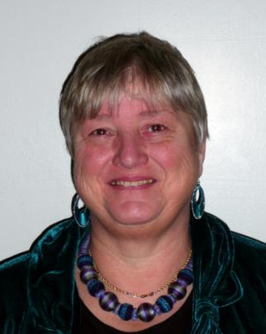
These and other slides will be available on my website at http://sally-brown.net

Slide 20
Useful references and further reading (1)
Biggs, J. and Tang, C. (2007) Teaching for Quality Learning at University, Maidenhead: Open University Press.
Boud, D. (1995) Enhancing learning through self-assessment, London: Routledge.
Brown, S. and Race, P. (2012) Using effective assessment to promote learning in Hunt, L. and Chambers, D. (2012) University Teaching in Focus, Victoria, Australia, Acer Press. P74-91.
Brown, S. (2015) Learning , Teaching and Assessment in Higher Education: Global perspectives, London, Palgrave.
Carroll, J. and Ryan, J. (2005) Teaching International students: improving learning for all. London: Routledge SEDA series.
Crosling, G., Thomas, L. and Heagney, M. (2008) Improving student retention in Higher Education, London and New York: Routledge
Dweck, C. S. (2000) Self Theories: Their Role in Motivation, Personality and Development, Lillington, NC: Taylor & Francis.

Slide 21
Useful references and further reading (2)
Dweck, C. S. (2013) Do you trust in your ability to grow? http://nilofermerchant.com/2013/09/27/do-you-trust-in-your-ability-to-grow/
Higher Education Academy (2012) A marked improvement; transforming assessment in higher education, York: HEA.
Meyer, J.H.F. and Land, R. (2003) ‘Threshold Concepts and Troublesome Knowledge 1 – Linkages to Ways of Thinking and Practising within the Disciplines’ in C. Rust (ed.) Improving Student Learning – Ten years on. Oxford: OCSLD.
Morgan, M. (ed.) (2011) Improving the student experience: a practical guide, Abingdon, Routledge. Nicol,
Mortiboys, A. (2005) Teaching with emotional intelligence, Abingdon: Routledge.
PASS project Bradford http://www.pass.brad.ac.uk/ Accessed November 2013.

Slide 22
Useful references and further reading (3)
Peelo, M. T., & Wareham, T. (Eds.). (2002). Failing students in higher education. Society for Research into Higher Education.
Rotheram, B. (2009) Sounds Good, JISC project http://www.jisc.ac.uk/whatwedo/programmes/usersandinnovation/soundsgood.aspx
Race P. (2015) The lecturer’s toolkit (4th edition), London: Routledge.
Rust, C., Price, M. and O’Donovan, B. (2003) Improving students’ learning by developing their understanding of assessment criteria and processes, Assessment and Evaluation in Higher Education. 28 (2), 147-164.
Ryan, J. (2000) A Guide to Teaching International Students, Oxford Centre for Staff and Learning Development.
Sadler, D. Royce (2010) Beyond feedback: developing student capability in complex appraisal,
Assessment & Evaluation in Higher Education, 35: 5, 535-550.
Yorke, M. (1999) Leaving Early: Undergraduate Non-completion in Higher Education, London: Routledge.

