Slide 1
Enhancing the student experience: fostering effective learning in challenging times
University of Bradford
July 2 2015
Please use hashtag #bfdconf15
Sally Brown @ProfSallyBrown
sally@sally-brown.net
NTF, PFHEA,SFSEDA
Emerita Professor, Leeds Metropolitan University
Visiting Professor University of Plymouth & Liverpool John Moores University.

Slide 2
Rationale
The University of Bradford is undergoing a significant programme of curriculum review and refreshment
In this keynote I aim to explore how we can foster a commitment to learning among our students and regenerate among ourselves the pleasures of teaching, using the best of educational innovations and scholarship to support us.

Slide 3
Waffle on for a bit about THE current HE context

Slide 4
So what have you got to say about:
Students;
Staffing;
University finances;
Technologies and data analytics to support learning and admin;
Changing learning paradigms;
The necessity to develop students’ skills/literacies;
Students as consumers;
The NSS and other performance indicators e.g. a TEF?

Slide 5
Curriculum enhancement in challenging times: Why talk about it? Because:
Universities work in a competitive global environment, where students can make more choices than ever about where and how to study;
Metrics of various kinds are gaining in importance (not only in terms of senior management’s positive feelings but also in relation to funding and external perceptions of the university);
Higher education funding has never been as uncertain (for example, in-year cuts of £450m to universities this year and prospectively much worse to come);
Actually, and most importantly, we owe it to the students.

Slide 6
What does enhancing the student experience involve?
Being smart and fleet of foot in discerning trends from data and responding appropriately;
Foregrounding the student experience;
Building upon existing partnerships with students around quality assurance and enhancement;
Learning from experience about what works and doesn’t work, and using a scholarly approach to disseminating what we’ve discovered.

Slide 7
From Jason Elsom
(@Jason Elsom)

Slide 8
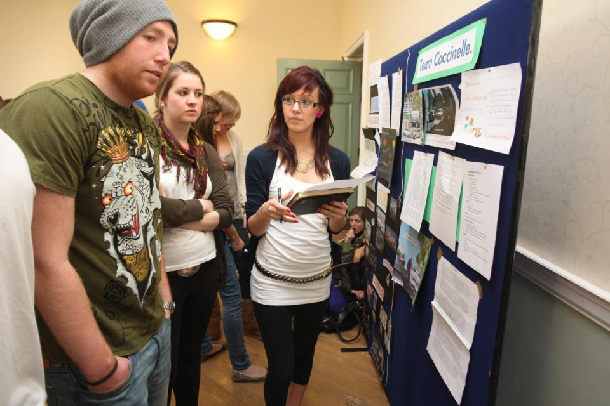
Do these students look engaged?

Slide 9
How about these?

Slide 10
Determining and reviewing subject material: currency, relevance, level
Enhancing quality, seeking continuous improvement
Designing and refining learning outcomes
Evaluating programmes, strengths and areas for improvement
Curriculum
Design
Essentials
Considering delivery modes: face-to-face, online, PBL, blended…
Assuring quality, matching HEI, national and PSRB requirements
Thinking through student support
Designing fit for purpose assessment methods and approaches

Slide 11
How do we know if we are offering excellent teaching?
Students are satisfied, learn well, achieve highly and have fulfilling learning experiences;
Students develop a range of competences they need including problem solving, working with others and self-management;
We as teachers are satisfied, motivated and find their workloads manageable;
Quality assurors and Professional and Subject bodies like what we do and have no complaints about systems and processes;
University managers are confident that the student experience offered is of high quality (and deal with few complaints).

Slide 12
Laurentius de Voltolina
2nd half of 14th Century
Italian Painter

Slide 13
Some characteristics of excellent teaching as described in the scholarly literature
Knows subject material thoroughly
Adopts a scholarly approach to the practice of teaching
Is reflective and regularly reviews own practice
Is well organised and plans curriculum effectively
Is passionate about teaching
Has a student-centred orientation to teaching
Regularly reviews innovations in learning and teaching and tries out ones relevant to own context
Ensures that assessment practices are fit for purpose and contribute to learning
Demonstrate empathy and emotional intelligence

Slide 14
Delivering content…..
is less like delivering a parcel (the postman model) and more like delivering a baby (the midwife model).
University staff can advise, guide, intervene when things go wrong, but in the end only the student can bring learning into life!!
Content can be gleaned from many sources (e.g. MIT and our UK Open University are putting more and more content into open access areas).

Slide 15
The Maieutic model
Maieutics is a complex procedure of research introduced by Socrates, embracing the Socratic method in its widest sense. It is based on the idea that the truth is latent in the mind of every human being due to her/his innate reason but has to be “given birth” by answering questions (or problems) intelligently proposed. The word is derived from the Greek “μαιευτικός,” pertaining to midwifery.

Slide 16
Characteristics of an effective university teacher (the research suggests)
Strong orientation towards student learning;
Well prepared;
Comfort with subject material;
Ability to perceive that some students find the subjects we love hard, and even uninteresting;
Passion (and sometimes quirkiness);
Ability to vary activities within a lecture to maximise student engagement.

Slide 17
William Hogarth
1736
‘Scholars at a lecture’
How would the lecturer be rated in the NSS?

Slide 18
High quality teaching…
…“implies recognising that students must be engaged with the content of learning tasks in a way that is likely to enable them to reach understanding…Sharp engagement, imaginative inquiry and finding of a suitable level and style are all more likely to occur if teaching methods that necessitate student energy, problem solving and cooperative learning are employed”. (Ramsden, 2003, p.97)

Slide 19
Things I wish I had known about effective teaching when I started doing it. It helps to:
Prepare diligently without being obsessive and be honest if you are asked questions you can’t immediately answer;
Spend as much time thinking about how you will structure learning activities within a teaching session as about the content of what is being taught;
Make convincing links between what you are teaching students today and what you have done previously, as well as signposting forward to future learning;
Build in flexibility so you finish on time;
On the days when you aren’t feeling inspired it is helpful to cultivate a convincing air of enthusiasm for your subject and student learning.

Slide 20
To better engage learners we can:
Make use of real examples and hot-off-the-press data to keep content current;
Give added-value to the person who bothers to turn up. Provide resources and text on-line that back up classroom activities (including audio/video recordings of your lectures) without ever letting it be perceived that this is a substitute for being there!
Provide challenges to students’ thinking without letting individuals feel publicly exposed or humiliated;
Relate their work to the forthcoming/ongoing assignment (without slavishly teaching to the exam);
Make spaces for dialogue, through clickers/ Twitter/ whatever, live and after the session.

Slide 21
How can we get students to fully engage? Some suggestions
Provide opportunities for students to get involved in authentic learning environments on campus or off;
Keep the curriculum current and life-relevant, without losing historical perspectives;
Give them real problems to solve and issues with which to engage;
Identify the skills they need to succeed and provide opportunities to rehearse and develop them;
Never compromise on the quality of the demands we make of them.

Slide 22
Engagement of international students: some important considerations
Is recruitment undertaken to ensure students have the potential to succeed?
Is induction framed appropriately to welcome international students?
Are steps taken proactively to ensure international students have a good chance of integrating with their study cohorts?
Is the curriculum international in scope and content? Are examples and case studies global?
Is the right kind of support offered (language, crisis support, befriending etc.)?

Slide 24
Enhancements to curriculum design and delivery: we can:
Explore how we can best use the first half of the first semester to induct students into good study patterns and practices to enhance learning and improve retention (Yorke 2009);
Reconsider the kinds of activities students engage with, to maximise ‘learning by doing’;
Rethink the way in which we use lecture periods to include activity as well as delivery;
Consider how we can best make use of technologies to support learning and engagement.

Slide 25
Mapping out the programme as a whole: some questions
Are you ensuring that students are immersed in the subject they have come to study from the outset?
Is induction a valuable and productive introduction to the course?
Do students have a positive and balanced experience across the programme?
Are there points in the academic year when there doesn’t seem to be much going on (e.g. an extended Christmas break) when going home (and not coming back) seems like a good option?

Slide 26
What can we do in the first six weeks?
Enable students to feel part of a cohort rather than a number on a list;
Help students acclimatise to the new learning context in which they find themselves;
Familiarise them with the language and culture of the subject area they are studying (Northedge, 2003);
Foster the information literacy and other skills that students will need to succeed;
Guide them on where to go for help as necessary;
Offer them immersive experiences.

Slide 27
Mapping progression
Is there a coherent model of progression across the student life-cycle from induction to ‘outduction’?
Do you manage transitions from year one to year two and year two to year three to ensure students remain committed and engaged?
Is there some continuity in the sources of student support throughout the course (e.g. personal tutors)?
Are students offered support and guidance in relation to personal development and employability?

Slide 28
Supportiveness: we must
Adopt a holistic approach to the development of skills, particularly information literacy, so that this is fully integrated into the learning programme;
Enable students to become self-aware and reflexive learners who become robust in the face of problems;
Help students build resilience through ‘a diet of early successes’ and positive reinforcement.

Slide 29
Robust quality: I argue that for engaged students we need
Rapid turnaround of assignments with detailed and useful feedback;
Proactive and positive initial training for teaching staff and ongoing CPD, ideally leading to HEA Fellowship at the appropriate level;
Regular developmental Peer Observation;
Teaching based on a supportive / reflective model;
Clear and widely publicised mutual expectations for students and staff;
Recognising and rewarding good teaching and learning support, and having obvious career pathways for those who dedicate their lives to enhancing the student experience;
Taking student feedback very seriously, and publicising widely action take as a result of feedback.

Slide 30
Using assessment for learning and thereby easing transitions
Assessment that is meaningful to students can provide them with a framework for activity;
“Students can escape bad teaching but they can’t escape bad assessment” (Boud, 1995);
Where assessment is fully part of the learning process and integrated within it, the act of being assessed can help students make sense of their learning;
Assessment should be formative, informative, developmental and remediable.

Slide 31
Mapping assessment
Are summative assessments undertaken throughout the course, or is everything ‘sudden death’ end-point?
Is there excessive bunching of assignments in different modules that is highly stressful for students and unmanageable for staff?
Are there plenty of opportunities for formative assessment, especially early on?
Are students over-assessed?
When you have introduced innovative assignments, have they been introduced instead of existing ones or simply added to the assessment diet?
Are students encouraged to make good use of the feedback they receive?

Slide 32
Bringing joy to the (live or virtual) classroom
Inspiring teachers tend to be systematic, consistent, well-prepared and compelling: they can usually work well at different levels and in diverse contexts;
It helps if we are able to teach with pleasure;
There are no standard recipes by which we can cook up engaging teaching, but there are some features we can combine in imaginative ways to create tasty and satisfying outcomes;
Engaging teaching comes in many different forms, and inspiring teachers develop their own styles and approaches that suit them (and their learners) well.

Slide 33
Joyful
Lucas Brown

Slide 34
These and other slides will be available on my website at http://sally-brown.net

Slide 35
Useful references and further reading (1)
Bain, K. (2004) What the best College Teachers do, Cambridge: Harvard University Press.
Biggs, J. and Tang, C. (2007) Teaching for Quality Learning at University, Maidenhead: Open University Press.
Bloxham, S. and Boyd, P. (2007) Developing effective assessment in higher education: a practical guide, Maidenhead, Open University Press.
Boud, D. (1995) Enhancing learning through self-assessment, London: Routledge.
Brown, S. and Glasner, A. (eds.) (1999) Assessment Matters in Higher Education, Choosing and Using Diverse Approaches, Maidenhead: Open University Press.
Brown, S. and Race, P. (2012) Using effective assessment to promote learning in Hunt, L. and Chambers, D. (2012) University Teaching in Focus, Victoria, Australia, Acer Press. P74-91.
Brown, S. (2015) Learning , Teaching and Assessment in Higher Education: Global perspectives, London, Palgrave.

Slide 36
Useful references and further reading (2)
Carless, D., Joughin, G., Ngar-Fun Liu et al (2006) How Assessment supports learning: Learning orientated assessment in action Hong Kong: Hong Kong University Press.
Carroll, J. and Ryan, J. (2005) Teaching International students: improving learning for all. London: Routledge SEDA series.
Crosling, G., Thomas, L. and Heagney, M. (2008) Improving student retention in Higher Education, London and New York: Routledge
Crooks, T. (1988) Assessing student performance, HERDSA Green Guide No 8 HERDSA (reprinted 1994).
Falchikov, N. (2004) Improving Assessment through Student Involvement: Practical Solutions for Aiding Learning in Higher and Further Education, London: Routledge.
Gibbs, G. (1999) Using assessment strategically to change the way students learn, in Brown S. & Glasner, A. (eds.), Assessment Matters in Higher Education: Choosing and Using Diverse Approaches, Maidenhead: SRHE/Open University Press.
Higher Education Academy (2012) A marked improvement; transforming assessment in higher education, York: HEA.

Slide 37
Useful references and further reading (3)
McDowell, L. and Brown, S. (1998) Assessing students: cheating and plagiarism, Newcastle: Red Guide 10/11 University of Northumbria.
Meyer, J.H.F. and Land, R. (2003) ‘Threshold Concepts and Troublesome Knowledge 1 – Linkages to Ways of Thinking and Practising within the Disciplines’ in C. Rust (ed.) Improving Student Learning – Ten years on. Oxford: OCSLD.
Nicol, D. J. and Macfarlane-Dick, D. (2006) Formative assessment and self-regulated learning: A model and seven principles of good feedback practice, Studies in Higher Education Vol 31(2), 199-218.
PASS project Bradford http://www.pass.brad.ac.uk/ Accessed November 2013.
Peelo, M. T., & Wareham, T. (Eds.). (2002). Failing students in higher education. Society for Research into Higher Education.
Pickford, R. and Brown, S. (2006) Assessing skills and practice, London: Routledge.
Rotheram, B. (2009) Sounds Good, JISC project http://www.jisc.ac.uk/whatwedo/programmes/usersandinnovation/soundsgood.aspx

Slide 38
Useful references and further reading (4)
Race, P. (2001) A Briefing on Self, Peer & Group Assessment, in LTSN Generic Centre Assessment Series No 9, LTSN York.
Race P. (2015) The lecturer’s toolkit (4th edition), London: Routledge.
Rust, C., Price, M. and O’Donovan, B. (2003) Improving students’ learning by developing their understanding of assessment criteria and processes, Assessment and Evaluation in Higher Education. 28 (2), 147-164.
Ryan, J. (2000) A Guide to Teaching International Students, Oxford Centre for Staff and Learning Development.
Stefani, L. and Carroll, J. (2001) A Briefing on Plagiarism http://www.ltsn.ac.uk/application.asp?app=resources.asp&process=full_record&section=generic&id=10
Sadler, D. Royce (2010) Beyond feedback: developing student capability in complex appraisal, Assessment & Evaluation in Higher Education, 35: 5, 535-550.
Yorke, M. (1999) Leaving Early: Undergraduate Non-completion in Higher Education, London: Routledge.

