Slide 1
Global perspectives on learning, teaching and assessment: avoiding unpleasant surprises and encouraging the love of learning SEDA conference : 15th May 2015
Sally Brown: NTF, PFHEA, SFSEDA
http://sally-brown.net
@ProfSallyBrown
Emerita Professor, Leeds Beckett University,
Visiting Professor, University of Plymouth and Liverpool John Moores University.

Slide 2


I am currently doing a fitness challenge and seeking sponsorship for Aphasia research.
For a chance to win this book today, please place at least 50p in the collection tin together with a slip of paper with your name and address and one lucky person will win a signed copy.

Slide 3
In a global higher education environment, student and academic mobility continues to increase, which many (including me) regard as a highly positive development, enriching learning opportunities for all.
However, many underestimate the significant differences in pedagogies, practices and patterns of learning that exist in universities across the world.
Too often HEIs problematise such diversity, ignoring the potential cross-cultural benefits. Being unprepared for difference can on occasions provide unwelcome shocks that can undermine positive learning experiences.

Slide 4
For this reason, using examples serendipitously gleaned from colleagues in many countries, in this presentation I aim to explore some of the misunderstandings and context gaps that are apparent when students, academics and staff developers hail from different national contexts.
I will suggest some helpful strategies for ourselves and our students who may not share common approaches and language, let alone core beliefs about what higher education is for.
I will argue that by embracing diversity we can encourage positive orientations towards learning, and this is likely to be uplifting as well as being mutually educative.

Slide 5
Some questions: the learning context
How should I address you?
What can I bring into the classroom?
What about the toilet arrangements?
Is it safe for me to come to university?
What time should I get to the classroom?
How long will you stay to talk to me after the class?
What shall I wear?

Slide 6
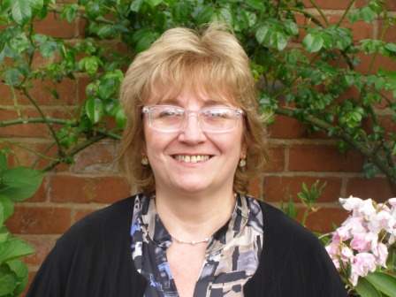
Marina Orsini Jones

Slide 7
How should I address you?
Marina Orsini Jones Coventry
Most international students are very surprised by the use of the first name encouraged by/for their tutors. They told me that they need to 'train' themselves to call their lecturers by their first name.

Slide 8
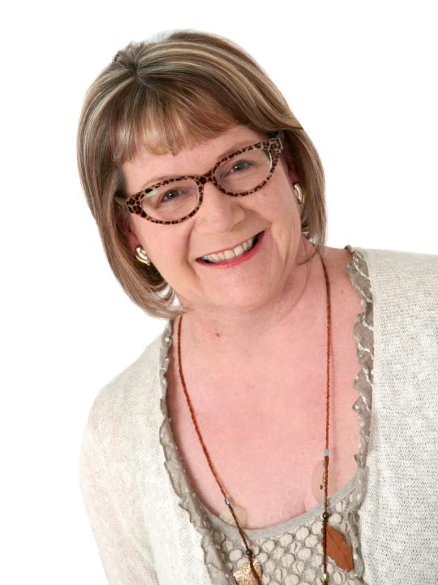
Debbie Holley

Slide 9
What can I bring to classes? Debbie Holley, Anglia Ruskin University
When teaching 200 students at a London University I arrived in class with a large box of handouts I realised I didn’t have anything to cut the ‘tickertape’.
I asked students sitting above me in the very traditional steep lecture theatre, did anyone have any scissors? And a little voice up the back said ‘here you are’ – I then observed the students ahead of me divide exactly like the films of the parting of the Red Sea as something flashed and a flick knife with a 6 inch blade came down to the front!
I said thank you, cut open the box (very easily) and retained the knife for the lecture, simply asking the student to collect on the way out. A small Lithuania girl came to collect and when I asked about carrying a blade said , ‘oh all of us girls from Lithuania do’ We then had a very interesting chat about this, and she agreed that this was not what was suitable for University, and she would leave it at home for subsequent classes…

Slide 10
What about the toilet arrangements? Kalyan Banerjee, Centurion University of Technology & Management, India
Centurion University also aims to create employability for young people from under-privileged sections of society offering not just training for skills but on cultural aspects of living an unknown society who study free, alongside students from privileged backgrounds pursuing sought-after professions. We take a holistic view of education, exploring, for example, big-city living, coping with long commutes, working in corporate environments with potentially impatient and sometimes insensitive managers, dealing with unfamiliar food issues and even getting acquainted with urban toilets. These lessons in inclusion are critical enablers to their success as professionals and in building responsible citizenship (from LT&A in HE)

Slide 11
Is it safe for me to come to university?
The problems for staff and students in working together is compounded by political and civil unrest, where political parties resort to hartals (general strikes), which cause havoc with the timetable and class scheduling, and 75% of classes can be lost. Hartals are dangerous times and lives are frequently lost to violent action. ULAB cannot demand that its staff and students attend, as it is deemed too dangerous to be on the streets or to take public transport. Consequently the University has developed a comprehensive rescheduling strategy with catch-up classes conducted on every available free day, including weekends
Jahirul Haque, University of Liberal Arts Bangladesh (ULAB), Bangladesh, Carolyn Roberts University of Oxford, UK and Brian Shoesmith ULAB, Bangladesh. Also discussed by Hala Mansour (now at university of Northampton) re Egypt. (from LT&A in HE)

Slide 12
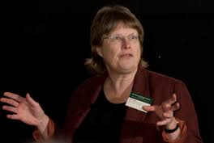
Jude Carroll

Slide 13
How long will you stay to talk to me after the class?
Jude Carroll describes the experiences of working with students from Confucian heritage nations, who find UK lecturers incredibly abrupt in how long they are prepared to stay after lectures and discuss work. She found out that ‘back home’ lecturers were often timetabled for up to an hour after the lecture to stay and talk informally, clarifying questions not answered in class

Slide 14
What time should I get to the classroom?
Ten minutes beforehand? On the dot? Anytime within the first half hour of the scheduled time? It depends on the local context
Lots of variables were reported by colleagues.

Slide 15
What shall I wear?
As described by Caroline Walker-Gleaves, University of Sunderland… The Business school student who turns up on day one for classes dressed in a suit and tie, embarrassed to find he is the only person formally dressed, because he had seen what students from the business school dressed like that in the prospectus and though that was what he had to wear.
As experienced by many correspondents: students from hot climates who come to the UK to study with no idea how cold it will be and arrive with a completely inadequate coat (or none at all).

Slide 16
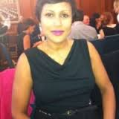
Shamini Ragavan

Slide 17
And this applies to staff too
I am a Visiting lecturer for the Marine Science School at Newcastle University and teach in Dubai and Singapore on an MSc programme that consist of 30 hours of intensive teaching run over a week and assessment takes place at the end of the week. The students are qualified marine engineers and so, teaching them has been a very pleasant experience, including invitations to have lunch with them. The students are also very keen to ask personal questions. Perhaps, they perceive me to be approachable. An example of this is how I was able to wear a jacket in that climate!
Shamini Ragavan

Slide 18
Some questions: assessment
Can my family come along to the final assessment session?
How can this work possibly just merit a C+?
How can my peers be in a position to judge my assignment?
What’s the problem with completion?
What resources should I use for my assignment?

Slide 19
Can my family come along to the final assessment session?
The situation: conducting a PhD viva in Portugal as the 'international external examiner'. Not surprising (I was prepared for): the level of formality, the respectful processional entrance, the seated panel of six of like a magistrates bench, fully gowned (but not wigged), the conduct of the viva in Portuguese - of course - bar my weak smattering of the language (better at reading than speaking). What was surprising: the level of animated debate from the public audience of some thirty or so people. Didn't quite come to blows but the chair did need to curtail and admonish some participants (the candidate's family members took exception and slight to some lines of comment). A damn sight more fun and lively than our traditional UK version. Mike Watts Brunel University London. Phil and I also experienced this at Whiteria Poly in New Zealand

Slide 20
How can this work possibly just merit a C+?
Students from diverse systems may well be puzzled by UK marking schemes
US students for example where A+ is a recognised mark, don’t see C+ as an acceptable grade and worry it will impact on their Grade Point Averages on return to their homes nation.
Some nations find our pass marks bizarre: “ You mean you let doctors practice where they have got more than half of the answers wrong exclaimed colleagues at Umea medical school in Sweden where the pass mark was 80%

Slide 21
How can my peers be in a position to judge my assignment?
Students who have never encountered peer assessment, or who are paying a lot, or who have come from highly privileged backgrounds, may find peer assessment a troublesome concept.

Slide 22
What's the problem with progression?
Why doesn’t your son, who just dropped out with what his university deemed an irredeemable fail, just pick up those credits for the final assignment he needs to get a degree? (from New Zealand colleagues. The system of credit accumulation in Australasia is much more flexible than ours)

Slide 23
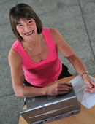
Cath Sanderson

Slide 24
What resources should I use for my assignment?
When [the students in Ethiopia] submitted their PFs for formative assessment we realised we had a problem ( and really should have realised it earlier . These were academics who had extremely limited or no internet Extremely limited library services and even limited access to things we took completely for granted like photocopiers . We knew that they were doing loads and were passionate about what they were doing but couldn't provide the paper work hard evidence So we decided that we would use their sparse PFs as a starting point for an assessed dialogue - a conversation where we would ask them to expand on entries in their PF and talk about their experiences. This work Spectacularly well . We got to 'see' a lot more than just flipping through PF hard copies and felt it was a far better ( and more equitable) way of assessing their engagement. So when we came home we implemented verbal dialogues to back up E Pfs on our Leeds Beckett PGCAP - with incredible success and that has been embedded in the course since then. Cath Sanderson, Leeds Beckett University

Slide 25
Some questions: teachers and educational developers
What am I supposed to be doing here?
What on earth is going on?
What’s for lunch (and is that your bottom on the table?)
Do we have share a common language?

Slide 26
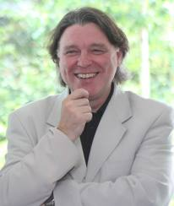
Mark Schofield

Slide 27
What am I supposed to be doing here? Mark Schofield Edge Hill University
Mark was representing his university in China and running sessions on university teaching and learning in the UK. Had had a very busy programme over a few days, and a very hectic morning morning and as far as he was concerned had finished for lunchtime, so he had a large beer. And then two more. Then he found he was being taken in a car to another university where he was expected to address a large audience. At first he was told it was staff, then he was told it would be students, and when he got there he found it was a mixture of both. He advises always having some film available for use while planning what to do next. He had a clip of a Chinese student talking about studying in the UK and the audience were delighted, mostly with being able to spot recognisably Chinese products in the background while she was talking​​​.
He added “Another one was being requested to run a mentoring workshop in Thailand …. Then two days before being told the workshop would be 150 people …. Was great …. Like a big game show!”

Slide 28
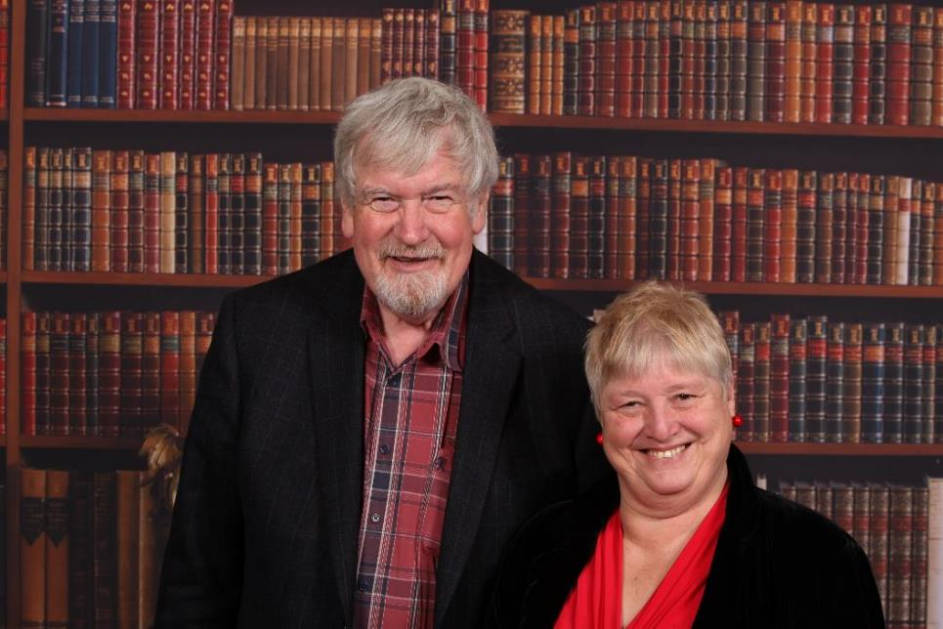

Slide 29
What on earth is going on?
Phil Race and I in Singapore were working with a group of school teachers and I became increasingly annoyed when there was a continuous babble of chatter while Phil was talking. I found myself getting so cross that I went outside the room for a walk around the block. One of the local staff came out to me and said “ you do know what’s going on don’t you?” When I replied that I didn't he said “ Well you don’t get a job round here if you are not fluent in English, but some of them actually aren’t but can’t own up about it so they are all translating for each other” !!!!

Slide 30
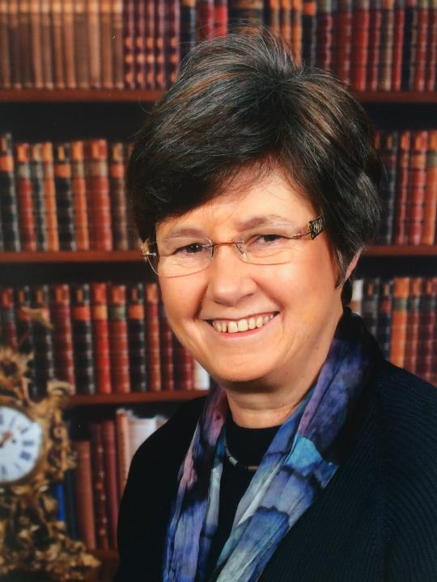
Pauline Kneale

Slide 31
What’s for lunch? Pauline Kneale, Plymouth University
(In Ethiopia) Construction of the University had not progressed to building catering facilities. We were collected from our hotel by taxi in the morning, and taken back to the hotel at lunchtime, coming back again for additional activities in the afternoon. A free bus toured the campus at 12 o'clock picking up the Academic staff and delivering them home around the town, so that they could get some lunch. The bus picked them up 50 minutes later to come back to campus. I gather the bus was essentially acting as senior common room discussion space. We later found a number of academics we met in and around the hotel bar and café because it had Wi-Fi

Slide 32
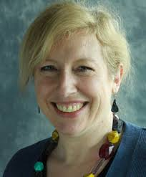
Celia Popovic

Slide 33
Do we share a common language? Celia Popovic
That old adage about being divided by a common language. Canadian is closer to UK English than American but even so, or perhaps because of the similarity I made several mistakes when I first got here and still do from time to time. A good example is the first time a prof (note the difference, this is what we call a lecturer here whether or not they are a full Professor) asked me for some literature on a teaching issue.
Wanting to make a good impression, but also because it was in an area that I was very familiar with, I provided an extensive array of resources including both theoretical and practical guidance. Imagine how deflated I felt when the prof sent me an email telling me my response was 'quite helpful'! I was somewhat insulted for a couple of days until in a chance conversation I realized that 'quite' is used differently in Canada, where in the UK that would mean 'not very', here it means 'very'. So my help had been appreciated after all!

Slide 34
Some questions for you to think about
Universities are keen to recruit international students. How can we make them feel welcome?
There are differences how universities globally perceive learning & teaching. What pedagogic surprises have you encountered?
What surprises international students when they come to study at your university?
Have you encountered real differences in students’ expectations reg assessment & other approaches from their home nations?
Please share examples of good practice in making the curriculum truly global (think of content, case studies etc.)
To what extent are international students regarded as enriching or seen as a problem?

Slide 35
What can I expect in my classes?
Some thoughts from the #lthe chat on 6th May 2015
https://storify.com/public/templates/card/index.html?src=//storify.com/LTHEchat/lthechat-21-learning-and-teaching-in-higher-ed-cha#
@santanuvasant said “Indian students for example expect more contact hours and a challenging curriculum. Neither is true in UK HEIs”
@AnneHole said “[We] have international students who won’t speak in seminars or discuss in small groups (but some home students same)”

Slide 36
What surprises do international staff and students experience?
@bashaierk said the surprise for some international students is “that many are still lecturing…..Higher Ed is still following traditional way of lecture centred approach”
@mahrukhmirza said “Power distance. Students from Asian countries feel that teachers have all the power in the world and they’re always right… and that’s why they don’t question in the class thinking that this might be considered rude or unacceptable… Teaching and learning style, social behaviour, food, climate”.

Slide 37
On surprises on assessment methods and approaches
@santanuvasant said “Yes any presentational or group work assessments are not seen as proper, exams are seen as proper”.
@cpjobling said “I think our progression rules confuse everyone- even staff”.
@AnneHole said “one students claimed copying ‘experts’ was expected at home- we call it plagiarism.”
@mahrukhmirza said “For some international students ‘plagiarism’ is a foreign word!... Peer assessment or formative assessment might not seem useful to some Int students #examination culture”

Slide 38
More assessment surprises
Rashid Ali @5BR said “They might not call it that but they are all guilty of that”
@AnneHole said “US students expect full range of marks - (70+) and ‘the curve’”.
@Plumsden said “In case study colleague changed marks and Spenser to Chinese firm, and essay to report. Module marks up by 15%”

Slide 39
A problem or a bonus?
@AnneHole said “Int[ernational] students enrich learning (and all students employability but home students often see them as hindrance at first”.
Simon Thomson @digisim said “Internationals students are definitely an asset. So much to offer in terms of adding global perspective to the subject areas”
Julie Tardy @jtardy81 said “Internat[ional] students can enrich learning techniques for all, thus impacting teaching>It’s a virtuous circle”

Slide 40
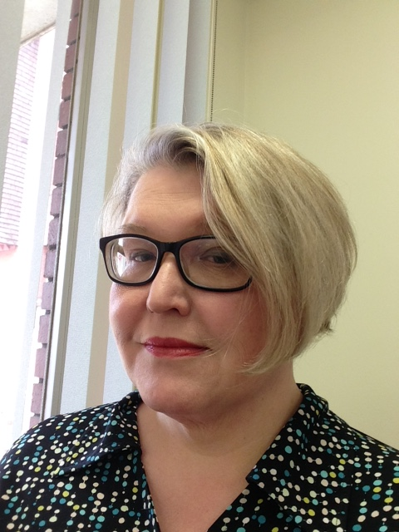
Jo Webb

Slide 41
Strategies and learning points for educational developers
I read Hofstefe 'Culture's consequences' years ago and I still find it useful to frame my understanding of other cultures when working abroad or with colleagues from outside the UK. It's particularly useful at making you remember that countries near to us can be more different than those more distant in terms of miles. (Jo Webb)

Slide 42
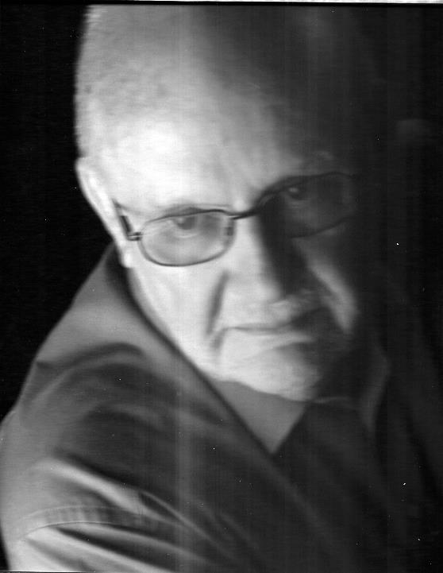
David Baume

Slide 43
Listen to what you're told about local custom and practice. But if it is important for you to go against local custom and practice, take precautions to make sure that your participants have little or no choice but go along! It is also good manners to justify what some may find an uncomfortable experience. Be prepared to ask difficult questions and express potentially difficult views. Learning is more important than comfort. (David Baume).

Slide 44
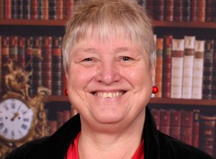
These and other slides will be available on my website at http://sally-brown.net

Slide 45
Some more strategies
Be open to practices different to your own and maybe introduce them when you get back (Cath Sanderson).
And some from me
If working outside your home nation, talk to people with local knowledge as much as you can in advance of your sessions to ensure you are briefed as fully as possible and try to arrive at least a day before you start;
If you sense that something weird is going wrong, don’t be afraid to ask participants about the issues;
Remember that universal principles and practices don’t exist so work with curiosity, openness and humility.

Slide 46
Postscript
We will all need to watch out for the implications of the potential ‘Teaching Ref’ i.e. the Organisation of Economic Cooperation and Development’s Assessment of Higher Education Learning Outcomes project (AHELO). The feasibility study is looking at the extent to which there can be a test of what students know and can do at graduation to allow international comparisons. See THES 7 May 2015 p6
There is likely to be a focus on transferable skills such as critical thinking or problem solving.
The Conservative party committed in its manifesto to introducing a framework to recognise universities offering the ‘highest quality teaching’ maybe favouring non-elite HEIs

Slide 47
References
Brown, S. (2015) Learning, teaching and assessment in higher education: global perspectives, London: Palgrave-MacMillan.
Carroll, J. and Ryan, J. (2005) Teaching International students: improving learning for all, Abingdon: Routledge SEDA series.
Jones, E., & Brown, S. (Eds.). (2007). Internationalising higher education. Routledge.
Jones, E. (Ed.) (2009) Internationalisation and the student voice: Higher education perspectives. Routledge.
Jones, E., & Killick, D. (2013) Graduate attributes and the internationalized curriculum: Embedding a global outlook in disciplinary learning outcomes, Journal of Studies in International Education.
Killick, D. (2011) Seeing ourselves-in-the-world: Developing global citizenship through international mobility and campus community. Journal of Studies in International Education.
Ryan, J. (2000) A Guide to Teaching International Students, Oxford: Oxford Centre for Staff and Learning Development
Scott, P. (Ed)Society for Research into Higher Education. (1998). The globalization of higher education. Buckingham: Open University Press.
Wisker, G. (Ed.). (2000). Good practice working with international students. Birmingham: SEDA.

