Slide 1
Engaging students in active learning, even when working in less than ideal spaces
London South Bank University
May 2015
Please use hashtag #LSBUengage2015
Sally Brown @ProfSallyBrown
sally@sally-brown.net
Emerita Professor, Leeds Metropolitan University
Visiting Professor University of Plymouth & Liverpool John Moores University.

Slide 2

I am currently doing a fitness challenge and seeking sponsorship for Aphasia research.
For a chance to win this book today, please place at least 50p in the collection tin together with a slip of paper with your name and address and one lucky person will win a signed copy.

Slide 3
Rationale
Most people working in higher education nowadays recognise that it is really important to engage students in learning in lectures and seminars, so that they can be ‘learning by doing’ (Race, 2014). Students completing their National Student Surveys are asked whether their teachers are inspiring, and most of us aim to do our best to be so. However, it’s hard work maintaining momentum day after day, particularly when working in rooms which make it difficult to get students engaging with peers, for example, in tiered lecture theatres with fixed seats. This session will aim to provide opportunities for participants to consider how we can best enable students to be positively active in class, and how to minimize the kinds of behaviors which are disruptive to learning.​

Slide 4

From Jason Elsom
(@Jason Elsom)

Slide 5
Engagement: Why talk about it? Because:
Academics and learning support staff report increasing levels of disengagement by students of the ‘iGeneration’;
The nature of the transaction seems to be changing in the light of high fees;
Potentially the nature of student behaviour in higher education is changing radically in terms of academic and other literacies;
Institutions need to ensure that new students enter with, or have the opportunity to acquire, the skills needed for academic success;
HEIs must devise programmes in which the emphasis is on maximising students’ development.

Slide 6

Do these students look engaged?

Slide 7
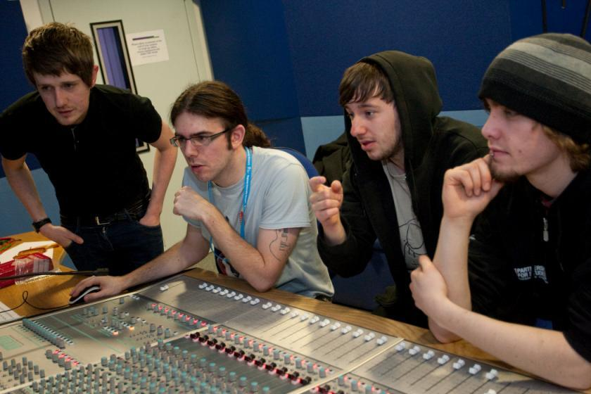
How about these?

Slide 8
Great teachers have a holistic approach to curriculum design, delivery and assessment
Look at the next slide, and thinking of a module you are involved in, as an individual, think about which areas of this module need most work

Slide 9
Determining and reviewing subject material: currency, relevance, level
Enhancing quality, seeking continuous improvement
Designing and refining learning outcomes
Evaluating programmes, strengths and areas for improvement
Curriculum
Design
Essentials
Considering delivery modes: face-to-face, online, PBL, blended…
Assuring quality, matching HEI, national and PRSB requirements
Thinking through student support
Designing fit for purpose assessment methods and approaches

Slide 10

Laurentius de Voltolina
2nd half of 14th Century
Italian Painter

Slide 11
What is an excellent teacher?
Talking to someone beside, above or below you, think about great teachers you know and identify some of their characteristics
Which of these characteristics do you think are most crucial to high NSS scores, and which to real student engagement?

Slide 12
Some characteristics of excellent teaching as described in the literature
Knows subject material thoroughly
Adopts a scholarly approach to the practice of teaching
Is reflective and regularly reviews own practice
Is well organised and plans curriculum effectively
Is passionate about teaching
Has a student-centred orientation to teaching
Regularly reviews innovations in learning and teaching and tries out ones relevant to own context
Ensures that assessment practices are fit for purpose and contribute to learning
Demonstrate empathy and emotional intelligence

Slide 13
How do we know if we are offering excellent teaching?
Students are satisfied, learn well, achieve highly and have fulfilling learning experiences;
Students develop a range of competences they need including problem solving, working with others and self-management;
We as teachers are satisfied, motivated and find their workloads manageable;
Quality assurors and Professional and Subject bodies like what we do and have no complaints about systems and processes;
University managers are confident that the student experience offered is of high quality (and deal with few complaints).

Slide 14
Delivering content…..
is less like delivering a parcel (the postman model) and more like delivering a baby (the midwife model).
University staff can advise, guide, intervene when things so wrong, but in the end only the student can bring learning into life!!
Content can be gleaned from many sources (e.g. MIT and our UK Open University are putting more and more content into open access areas).

Slide 15
The Maieutic model
Maieutics is a complex procedure of research introduced by Socrates, embracing the Socratic method in its widest sense. It is based on the idea that the truth is latent in the mind of every human being due to her/his innate reason but has to be "given birth" by answering questions (or problems) intelligently proposed. The word is derived from the Greek "μαιευτικός," pertaining to midwifery.

Slide 16
Characteristics of an effective lecturer (the research suggests)
Strong orientation towards student learning;
Well prepared;
Comfort with subject material;
Ability to perceive that some students find the subjects we love hard, and even uninteresting;
Passion (and sometimes quirkiness);
Ability to vary activities within a lecture to maximise student engagement.

Slide 17

William Hogarth
1736
‘Scholars at a lecture’
How would the lecturer be rated in the NSS?

Slide 18
A tall order?
Effective lecturers combine the talents of a scholar, writer, producer, comedian, showman and teacher in ways that contribute to student learning. Nevertheless it is also true that few college professors combine these talents in optimal ways and that even the best lecturers are not always on top form
McKeachie et al p.53

Slide 19
Send me a message
What do you wish you had known (that you know now) before you started working as a university teacher?

Slide 20


Slide 21
Things I wish I had known about effective teaching when I started doing it. It helps to:
Prepare diligently without being obsessive and be honest if you are asked questions you can’t immediately answer;
Spend as much time thinking about how you will structure learning activities within a teaching session as about the content of what is being taught;
Make convincing links between what you are teaching students today and what you have done previously, as well as signposting forward to future learning;
Build in flexibility so you finish on time;
On the days when you aren’t feeling inspired it is helpful to cultivate a convincing air of enthusiasm for your subject and student learning.

Slide 22
To engage learners we can:
Make use of real examples and hot-off-the-press data to keep content current;
Give added-value to person who bothers to turn up. Provide resources and text on-line that back up classroom activities (including audio/video recordings of your lectures) without ever letting it be perceived that this is a substitute for being there!
Provide challenges to students’ thinking without letting individuals feel publicly exposed or humiliated
Relate their work to the forthcoming/ongoing assignment (without slavishly teaching to the exam)
Make spaces for dialogue, through clickers/ twitter/ whatever, live and after the session.

Slide 23
How can we get students to fully engage? Some suggestions
Provide opportunities for students to get involved in authentic learning environments on campus or off;
Keep the curriculum current and life-relevant, without losing historical perspectives;
Give them real problems to solve and issues with which to engage;
Identify the skills they need to succeed and provide opportunities to rehearse and develop them;
Never compromise on the quality of the demands we make of them.

Slide 24
High quality teaching…
…“implies recognising that students must be engaged with the content of learning tasks in a way that is likely to enable them to reach understanding…Sharp engagement, imaginative inquiry and finding of a suitable level and style are all more likely to occur if teaching methods that necessitate student energy, problem solving and cooperative learning are employed”. (Ramsden, 2003, p.97)

Slide 25
Engagement of international students: some important considerations
Is recruitment undertaken to ensure students have the potential to succeed?
Is induction framed appropriately to welcome international students?
Are steps taken proactively to ensure international students have a good chance of integrating with their study cohorts?
Is the curriculum international is scope and content? Are examples and case studies global?
Is the right kind of support offered (language, crisis support, befriending etc.)?

Slide 26


Slide 27
What kinds of behaviours offer warning signs of risk of drop-out
Failure to register with the library, to download required resources, to return books on time;
Not engaging with fellow students;
Not participating in group tasks;
Not submitting work on time (or at all);
Poor marks on early assignments;
Not picking up or responding to assessed work;
Non attendance, or very poor or intermittent attendance.

Slide 28
Enhancements to curriculum design and delivery: we can:
Explore how we can best use the first half of the first semester to induct students into good study patterns and practices to enhance learning and improve retention (Yorke 2009);
Reconsider the kinds so activities students engage with the maximum ‘learning by doing’;
Rethink the way in which we use lecture periods to include activity as well as delivery;
Consider how we can best make use of technologies to support learning and engagment.

Slide 29
Draw a diagram of what students actually do in the first six weeks of the first semester of the first year

Slide 30
What can we do in the first six weeks?
Enable students to feel part of a cohort rather than a number of a list;
Help students acclimatise to the new learning context in which they find themselves;
Familiarise them with the language and culture of the subject area they are studying (Northedge, 2003);
Foster the information literacy and other skills that students will need to succeed;
Guide them on where to go for help as necessary
Offer them immersive experiences.

Slide 31
Mapping out the programme as a whole: some questions
Are you ensuring that students are immersed in the subject they have come to study from the outset?
Is induction a valuable and productive introduction to the course?
Do students have a positive and balanced experience across the programme?
Are there points in the academic year when there doesn’t seem to be much going on (e.g. an extended Christmas break) when going home (and not coming back) seems like a good option?

Slide 32
Mapping assessment
Are summative assessments undertaken throughout the course, or is everything ‘sudden death’ end-point?
Is there excessive bunching of assignments in different modules that is highly stressful for students and unmanageable staff?
Are there plenty of opportunities for formative assessment, especially early on?
Are students over-assessed?
When you have introduced innovative assignments, have they been introduced instead of existing ones or simply added to the assessment diet?
Are students encouraged to make good use of the feedback they receive?

Slide 33
Mapping progression
Is there a coherent model of progression across the student life-cycle from induction to ‘outduction’?
Do you manage transitions from year one to year two and year two to year three to ensure students remain committed and engaged?
Is there some continuity in the sources of student support throughout the course (e.g. personal tutors)?
Are students offered support and guidance in relation to personal development and employability?

Slide 34
Problems associated with reading
If 25% of your marks is from reading, you’ve got to try and show that, even if you haven’t read. I’m not going to sit there and read a chapter, and I’m certainly not going to read a book. But I’ll read little paragraphs that I think are relevant to what I’m writing, and it’s got me through, and my marks have been fine. But I can’t read. If I read too much, it goes over my head. If I’m writing something, I know what I want to say and I need something to back me up… then I will find something in a book that goes with that. I’m not going to try to take in the whole book just for one little bit. I have my book next to me and then I can pick out the bits. (Jenny, full-time community and youth work student). (Marion Bowl: Non-traditional entrants to Higher Education, 2003 p.89).

Slide 35
Teaching for learning
Is there a coherent model of progression across programmes?
Are there clearly way-marked sources of student support throughout their studies?
Are students using critical thinking and high levels of analytical thought sufficiently at each level of a programme?
Are students working autonomously as well?
Do students have meaningful and purposeful opportunities of working together?

Slide 36
Supportiveness: we must
Adopt a holistic approach to the development of skills, particularly information literacy, so that this is fully integrated into the learning programme;
Enable students to become self-aware and reflexive learners who become robust in the face of problems;
Help students build resilience through ‘a diet of early successes’ and positive reinforcement.

Slide 37
Using assessment for learning and thereby easing transitions
Assessment that is meaningful to students can provide them with a framework for activity;
“Students can escape bad teaching but they can’t escape bad assessment” (Boud, 1995);
Where assessment is fully part of the learning process and integrated within it, the act of being assessed can help students make sense of their learning;
Assessment should be formative, informative, developmental and remediable.

Slide 38
Robust quality: I argue that for engaged students we need
Rapid turnaround of assignments with detailed and useful feedback;
Proactive and positive initial training for teaching staff and ongoing CPD;
Regular developmental Peer Observation;
Teaching based on a supportive / reflective model;
Clear and widely publicised mutual expectations for students and staff;
Recognising and rewarding good teaching and learning support, and having obvious career pathways for those who dedicate their lives to enhancing the student experience;
Taking student feedback very seriously, and publicising widely action take as a result of feedback.

Slide 39
What kinds of management interventions can foster engaging teaching?
Promotion and reward systems that recognise the importance of teaching;
Identifying outstanding teachers and using them as advocates for commitment to teaching;
A culture of scholarship of teaching, that encourages evidence-based dissemination of good practice;
Dialogues around what makes for excellent teaching, particularly those associated with peer observation systems.

Slide 40
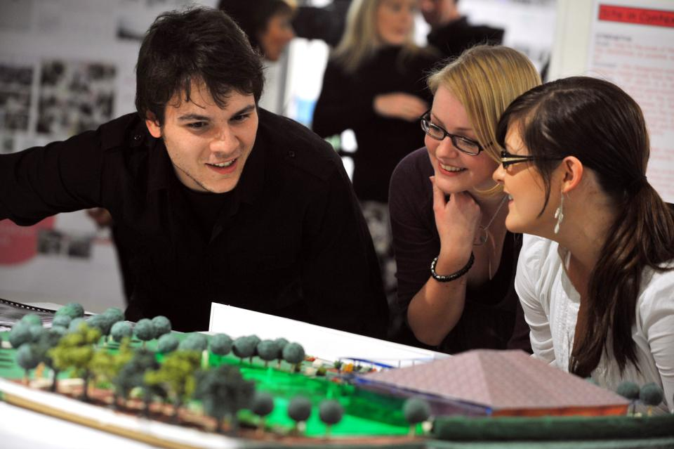
How can we make learning like this?

Slide 41
Bringing joy to the (live or virtual) classroom
Inspiring teachers tend to be systematic, consistent, well-prepared and compelling: They can usually work well at different levels and in diverse contexts;
It helps if we are able to teach with pleasure;
There are no standard recipes by which we can cook up engaging teaching, but there are some features we can combine in imaginative ways to create tasty and satisfying outcomes;
Engaging teaching comes in many different forms, and inspiring teachers develop their own styles and approaches that suit them (and their learners) well.

Slide 42

Joyful
Lucas Brown

Slide 43

These and other slides will be available on my website at http://sally-brown.net

Slide 44
Useful references and further reading (1)
Bain, K. (2004) “What the best College Teachers do” Cambridge Harvard University Press
Biggs, J. and Tang, C. (2007) Teaching for Quality Learning at University, Maidenhead: Open University Press.
Bloxham, S. and Boyd, P. (2007) Developing effective assessment in higher education: a practical guide, Maidenhead, Open University Press.
Boud, D. (1995) Enhancing learning through self-assessment, London: Routledge.
Brown, S. and Glasner, A. (eds.) (1999) Assessment Matters in Higher Education, Choosing and Using Diverse Approaches, Maidenhead: Open University Press.
Brown, S. and Race, P. (2012) Using effective assessment to promote learning in Hunt, L. and Chambers, D. (2012) University Teaching in Focus, Victoria, Australia, Acer Press. P74-91
Brown, S. (2015) Learning , Teaching and Assessment in Higher Education: Global perspectives, London, Palgrave

Slide 45
Useful references and further reading (2)
Carless, D., Joughin, G., Ngar-Fun Liu et al (2006) How Assessment supports learning: Learning orientated assessment in action Hong Kong: Hong Kong University Press.
Carroll, J. and Ryan, J. (2005) Teaching International students: improving learning for all. London: Routledge SEDA series.
Crosling, G., Thomas, L. and Heagney, M. (2008) Improving student retention in Higher Education, London and New York: Routledge
Crooks, T. (1988) Assessing student performance, HERDSA Green Guide No 8 HERDSA (reprinted 1994).
Falchikov, N. (2004) Improving Assessment through Student Involvement: Practical Solutions for Aiding Learning in Higher and Further Education, London: Routledge.
Gibbs, G. (1999) Using assessment strategically to change the way students learn, in Brown S. & Glasner, A. (eds.), Assessment Matters in Higher Education: Choosing and Using Diverse Approaches, Maidenhead: SRHE/Open University Press.
Higher Education Academy (2012) A marked improvement; transforming assessment in higher education, York: HEA.

Slide 46
Useful references and further reading (3)
McDowell, L. and Brown, S. (1998) Assessing students: cheating and plagiarism, Newcastle: Red Guide 10/11 University of Northumbria.
Meyer, J.H.F. and Land, R. (2003) ‘Threshold Concepts and Troublesome Knowledge 1 – Linkages to Ways of Thinking and Practising within the Disciplines’ in C. Rust (ed.) Improving Student Learning – Ten years on. Oxford: OCSLD.
Nicol, D. J. and Macfarlane-Dick, D. (2006) Formative assessment and self-regulated learning: A model and seven principles of good feedback practice, Studies in Higher Education Vol 31(2), 199-218.
PASS project Bradford http://www.pass.brad.ac.uk/ Accessed November 2013
Peelo, M. T., & Wareham, T. (Eds.). (2002). Failing students in higher education. Society for Research into Higher Education.
Pickford, R. and Brown, S. (2006) Assessing skills and practice, London: Routledge.
Rotheram, B. (2009) Sounds Good, JISC project http://www.jisc.ac.uk/whatwedo/programmes/usersandinnovation/soundsgood.aspx

Slide 47
Useful references and further reading (4)
Race, P. (2001) A Briefing on Self, Peer & Group Assessment, in LTSN Generic Centre Assessment Series No 9, LTSN York.
Race P. (2015) The lecturer’s toolkit (4th edition), London: Routledge.
Rust, C., Price, M. and O’Donovan, B. (2003) Improving students’ learning by developing their understanding of assessment criteria and processes, Assessment and Evaluation in Higher Education. 28 (2), 147-164.
Ryan, J. (2000) A Guide to Teaching International Students, Oxford Centre for Staff and Learning Development
Stefani, L. and Carroll, J. (2001) A Briefing on Plagiarism http://www.ltsn.ac.uk/application.asp?app=resources.asp&process=full_record&section=generic&id=10
Sadler, D. Royce (2010) Beyond feedback: developing student capability in complex appraisal,
Assessment & Evaluation in Higher Education, 35: 5, 535-550
Yorke, M. (1999) Leaving Early: Undergraduate Non-completion in Higher Education, London: Routledge.

