Slide 1
How can we better engage students to maximise student retention and achievement as well as fostering intellectual curiosity and (dare we say it) the joy of learning?
University of Sussex
25 March 2015
Sally Brown
Emerita Professor, Leeds Metropolitan University
Visiting Professor University of Plymouth & Liverpool John Moores University.

Slide 2
Rationale
Contextual factors including high fees, pressures to achieve well in the National Student Survey and competing demands on other aspects of academics’ roles sometimes get in the way of inspiring teaching.
Nevertheless students nowadays have high expectations of enhanced experiences in the classroom and effective lecturers are keen to foster real and purposeful engagement. ​
This presentation will explore some of the factors associated with excellent and inspiring teaching as well as reviewing how we can work with sometimes demotivated students to (re)discover the joy of learning.

Slide 3
Engagement: Why talk about it? Because:
Academics and learning support staff report increasing levels of disengagement by students of the ‘iGeneration’;
The nature of the transaction seems to be changing in the light of high fees;
Potentially the nature of student behaviour in higher education is changing radically in terms of academic and other literacies;
Institutions need to ensure that new students enter with, or have the opportunity to acquire, the skills needed for academic success;
HEIs must devise programmes in which the emphasis is on maximising students’ development.

Slide 4
Do these students look engaged?

Slide 5
How about these?

Slide 6
How do we know if we are offering excellent teaching?
Students are satisfied, learn well, achieve highly and have fulfilling learning experiences;
Students develop a range of competences they need including problem solving, working with others and self-management;
We as teachers are satisfied, motivated and find their workloads manageable;
Quality assurors and Professional and Subject bodies like what we do and have no complaints about systems and processes;
University managers are confident that the student experience offered is of high quality (and deal with few complaints).

Slide 7
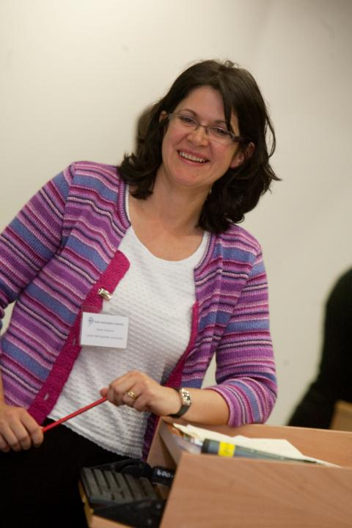
Ruth Pickford

Slide 8
Why is she a great teacher?
Unafraid to take risks but leaves nothing to chance;
Articulates a clear rationale of what she is trying to achieve in her teaching and makes detailed plans on how to achieve it;
Worries less about what students think about her than how much they are learning;
Capable of being seriously quirky without being ‘up herself’;
Continuously challenges students out of their comfort zones.

Slide 9
Characteristics of excellent university teachers:
Knows subject material thoroughly
Adopts a scholarly approach to the practice of teaching
Is reflective and regularly reviews own practice
Is well organised and plans curriculum effectively
Is passionate about teaching
Has a student-centred orientation to teaching
Regularly reviews innovations in learning and teaching and tries out ones relevant to own context
Ensures that assessment practices are fit for purpose and contribute to learning
Demonstrate empathy and emotional intelligence

Slide 10
Determining and reviewing subject material: currency, relevance, level
Enhancing quality, seeking continuous improvement
Designing and refining learning outcomes
Evaluating programmes, strengths and areas for improvement
Curriculum
Design
Essentials
Considering delivery modes: face-to-face, online, PBL, blended…
Assuring quality, matching HEI, national and PRSB requirements
Thinking through student support
Designing fit for purpose assessment methods and approaches

Slide 11
Delivering content…..
is less like delivering a parcel (the postman model) and more like delivering a baby (the midwife model).
University staff can advise, guide, intervene when things so wrong, but in the end only the student can bring learning into life!!
Content can be gleaned from many sources (e.g. MIT and our UK Open University are putting more and more content into open access areas).

Slide 12
The Maieutic model
Maieutics is a complex procedure of research introduced by Socrates, embracing the Socratic method in its widest sense. It is based on the idea that the truth is latent in the mind of every human being due to her/his innate reason but has to be "given birth" by answering questions (or problems) intelligently proposed. The word is derived from the Greek "μαιευτικός," pertaining to midwifery.

Slide 13
Laurentius de Voltolina
2nd half of 14th Century
Italian Painter

Slide 14
Characteristics of an effective lecturer (the research suggests)
Strong orientation towards student learning;
Well prepared;
Comfort with subject material;
Ability to perceive that some students find the subjects we love hard, and even uninteresting;
Passion (and sometimes quirkiness);
Ability to vary activities within a lecture to maximise student engagement.

Slide 15
Characteristics of an effective lecture
Students actively engage with the material being presented;
The period of time available is used constructively;
Students of all abilities are able to follow the train of thought of the lecturer to some extent and learn from the experience;
Learning happens.

Slide 16
William Hogarth
1736
‘Scholars at a lecture’

Slide 17
What goes wrong? (students)
Boredom, attention deficit, alternative activities, getting lost, getting annoyed with other students, getting irritated by the lecturer, sleeping, struggling to make links, finding the material going over your head, failing to keep up with note making, copying things down wrongly, failing to see the point, writing down without understanding… (you can extend this list a lot!)

Slide 18
A tall order?
Effective lecturers combine the talents of a scholar, writer, producer, comedian, showman and teacher in ways that contribute to student learning. Nevertheless it is also true that few college professors combine these talents in optimal ways and that even the best lecturers are not always on top form
McKeachie et al p.53

Slide 19
Some views about engaging teaching
The mediocre teacher tells. The good teacher explains. The superior teacher demonstrates. The great teacher inspires. William Arthur Ward.
The biggest enemy to learning is the talking teacher. John Holt.
Education is what survives when what has been learned has been forgotten. B. F. Skinner.
To know yet to think that one does not know is best; Not to know yet to think that one knows will lead to difficulty. Lao-Tzu (6th century B.C.)

Slide 20
More views about lectures
I would deliver lectures that got standing ovations, but later in the tests and essays, it was clear to me that the students just didn’t get it. (Daniel Greenberg)
The first duty of a lecturer – to hand you after an hour’s discourse a nugget of pure truth to wrap up between the pages of your notebooks and keep on the mantelpiece for ever. (Virginia Woolf)
The lecture should be the jewel in the crown of both the student and lecturer experience in the 21st century. Never before has there been such an opportunity to inspire in the lecture theatre. (Ruth Pickford).

Slide 22
Things I wish I had known about effective teaching when I started doing it. It helps to:
Prepare diligently without being obsessive and be honest if you are asked questions you can’t immediately answer;
Spend as much time thinking about how you will structure learning activities within a teaching session as about the content of what is being taught;
Make convincing links between what you are teaching students today and what you have done previously, as well as signposting forward to future learning;
Build in flexibility so you finish on time;
On the days when you aren’t feeling inspired it is helpful to cultivate a convincing air of enthusiasm for your subject and student learning.

Slide 23
To engage learners we can:
Make use of real examples and hot-off-the-press data to keep content current;
Give added-value to person who bothers to turn up. Provide resources and text on-line that back up classroom activities (including audio/video recordings of your lectures) without ever letting it be perceived that this is a substitute for being there!
Provide challenges to students’ thinking without letting individuals feel publicly exposed or humiliated
Relate their work to the forthcoming/ongoing assignment (without slavishly teaching to the exam)
Make spaces for dialogue, through clickers/ twitter/ whatever, live and after the session.

Slide 24
How can we get students to fully engage? Some suggestions
Provide opportunities for students to get involved in authentic learning environments on campus or off;
Keep the curriculum current and life-relevant, without losing historical perspectives;
Give them real problems to solve and issues with which to engage;
Identify the skills they need to succeed and provide opportunities to rehearse and develop them;
Never compromise on the quality of the demands we make of them.

Slide 25
Bain on how great teachers treat their students. They
Are willing to spend time with students, to nurture their learning.
Don’t foster a feeling of power over, but investment in, students.
Ensure their practices stem from a concern for learning.
Make the class user-friendly by fostering trust.
Employ various pedagogical tools in a search for the best way to help each student.
Have the attitude that “There is no such thing as a stupid question.”

Slide 26
High quality teaching…
…“implies recognising that students must be engaged with the content of learning tasks in a way that is likely to enable them to reach understanding…Sharp engagement, imaginative inquiry and finding of a suitable level and style are all more likely to occur if teaching methods that necessitate student energy, problem solving and cooperative learning are employed”. (Ramsden, 2003, p.97)

Slide 27
Disengaged students drop out and we know the kinds of things that are linked to poor retention:
Coming from low-participation neighbourhoods;
Being in receipt of Disabled students allowance;
Being mature undergraduate students;
Students having chosen (or been ‘sold’) ‘the wrong programme’;
Students lack of real commitment and/or interest in the programme, often as a result of having come through clearing;
Students’ expectations are not met (have a look at what you are projecting via your website/prospectus);
An academic culture that is unsupportive (even hostile) to learning;
Students experiencing financial difficulties;
Demands for other commitments supervening;
Poor quality of the university experience;
Inability to cope with course demands;
Being unhappy with social environment, the culture of the university, the campus set-up or fellow students.
(after Yorke 1999, Peelo and Wareham 2002, HESA data and own research)

Slide 28
Poor attendance also correlates with drop out:
Research at Southampton institute (Lim), Glasgow Caledonian University (Begg) and University of Kent (Van der Velden) shows associations between weak attendance patterns and attrition;
Whatever the cause, not being there exacerbates other problems with study;
Endeavours to monitor and follow-up poor attendance has high pay off in terms of improving retention.
Most universities now have or are developing attendance policies
(For me, the real issue is engagement rather than attendance)

Slide 29
Retention of international students: some important considerations
Is recruitment undertaken to ensure students have the potential to succeed?
Is induction framed appropriately to welcome international students?
Are steps taken proactively to ensure international students have a good chance of integrating with their study cohorts?
Is the right kind of support offered (language, crisis support, befriending etc?)

Slide 30
Assessment and its impact on retention
“Roughly two-thirds of premature departures take place in, or at the end of, the first year of full-time study in the UK. Anecdotal evidence from a number of institutions indicates that early poor performance can be a powerful disincentive to continuation, with students feeling that perhaps they were not cut out for higher education after all – although the main problems are acculturation and acclimatisation to studying.” (Yorke p37)
Implications: assessment in the first semester is critical: it should be formative, informative, developmental and remediable

Slide 31
What can HEIs do at a strategic level to minimise poor retention?
Have an institution-wide policy commitment to students' development;
Have in place structures and processes consistent with this policy;
Ensure that new students enter with, or have the opportunity to acquire, the skills needed for academic success;
Run programmes in which the emphasis is on maximising students' development;
Actively foster students’ academic, assessment, information management, digital and social literacies.

Slide 32
What kinds of behaviours offer warning signs of risk of drop-out
Failure to register with the library, to download required resources, to return books on time;
Not engaging with fellow students;
Not participating in group tasks;
Not submitting work on time (or at all);
Poor marks on early assignments;
Not picking up or responding to assessed work;
Non attendance, or very poor or intermittent attendance.

Slide 34
Enhancements to curriculum design and delivery: we can:
Explore how we can best use the first half of the first semester to induct students into good study patterns and practices to enhance learning and improve retention (Yorke 2009);
Reconsider the kinds so activities students engage with the maximum ‘learning by doing’;
Rethink the way in which we use lecture periods to include activity as well as delivery;
Consider how we can best make use of technologies to support learning and engagment.

Slide 35
What can we do in the first six weeks?
Enable students to feel part of a cohort rather than a number of a list;
Help students acclimatise to the new learning context in which they find themselves;
Familiarise them with the language and culture of the subject area they are studying (Northedge, 2003);
Foster the information literacy and other skills that students will need to succeed;
Guide them on where to go for help as necessary.

Slide 36
Mapping out the programme as a whole: some questions
Are you ensuring that students are immersed in the subject they have come to study from the outset?
Is induction a valuable and productive introduction to the course?
Do students have a positive and balanced experience across the programme?
Are there points in the academic year when there doesn’t seem to be much going on (e.g. an extended Christmas break) when going home (and not coming back) seems like a good option?

Slide 37
Mapping assessment
Are summative assessments undertaken throughout the course, or is everything ‘sudden death’ end-point?
Is there excessive bunching of assignments in different modules that is highly stressful for students and unmanageable staff?
Are there plenty of opportunities for formative assessment, especially early on?
Are students over-assessed?
When you have introduced innovative assignments, have they been introduced instead of existing ones or simply added to the assessment diet?
Are students encouraged to make good use of the feedback they receive?

Slide 38
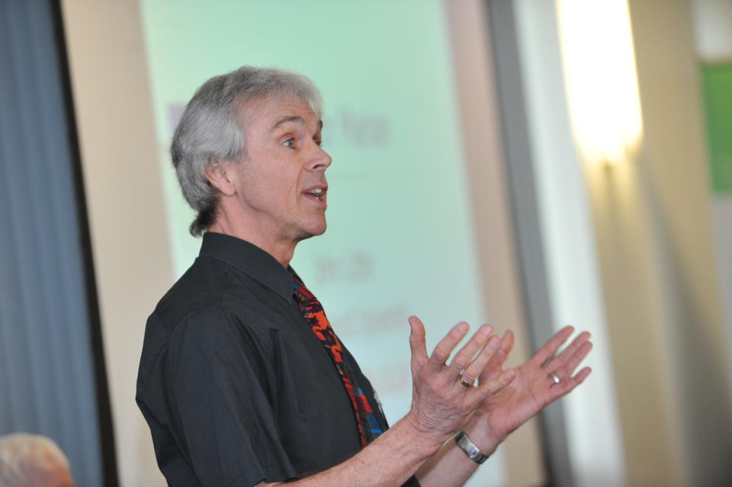
Bob Rotheram: JISC ‘Sounds Good’ project

Slide 39
Mapping progression
Is there a coherent model of progression across the student life-cycle from induction to ‘outduction’?
Do you manage transitions from year one to year two and year two to year three to ensure students remain committed and engaged?
Is there some continuity in the sources of student support throughout the course (e.g. personal tutors)?
Are students offered support and guidance in relation to personal development and employability?

Slide 40
The big issues: reading and writing
Do students have realistic expectations about how much reading they need to do for your course?
Are they seeking instant gratification in terms of finding what they need to read, or do they get disheartened if they don’t find it quickly on line?
Do they concentrate sufficiently when they are reading to maximise learning?
Do they recognise diverse academic conventions about writing?
Do they have a good grounding in acceptable academic conduct?
Are they realistic about how much they will have to write for your course?
Are they prepared to draft and redraft?

Slide 41
Problems associated with reading
If 25% of your marks is from reading, you’ve got to try and show that, even if you haven’t read. I’m not going to sit there and read a chapter, and I’m certainly not going to read a book. But I’ll read little paragraphs that I think are relevant to what I’m writing, and it’s got me through, and my marks have been fine. But I can’t read. If I read too much, it goes over my head. If I’m writing something, I know what I want to say and I need something to back me up… then I will find something in a book that goes with that. I’m not going to try to take in the whole book just for one little bit. I have my book next to me and then I can pick out the bits. (Jenny, full-time community and youth work student). (Marion Bowl: Non-traditional entrants to Higher Education, 2003 p.89).

Slide 42
Help students understand what is required with reading
Help them also to understand that there are different kinds of approaches needed for reading depending on whether they are reading for pleasure, for information, for understanding or reading around a topic;
Help them to become active readers with a pen and Post-its in hand, rather than passive readers, fitting the task in alongside television and other noisy distractions;
Give them clear guidance in the early stages about how much they need to read and what kinds of materials they need to focus on.

Slide 43
Helping students with writing. We can:
Devote energy to helping students understand what is required of them in terms of writing;
Work with them to understand the various academic discourses that are employed within the subject/institution;
Help them to understand when writing needs to be personal and based on individual experience, such as in a reflective log, and when it needs to be formal and using academic conventions like passive voice and third person, as in written reports and essays.

Slide 44
Engagement of international students: some important considerations
Is recruitment undertaken to ensure students have the potential to succeed?
Is induction framed appropriately to welcome international students?
Are steps taken proactively to ensure international students have a good chance of integrating with their study cohorts?
Are we training our staff to be aware of diverse international approaches to HE learning and teaching, or are we just expecting students to get on with our systems?
Is the right kind of support offered (language, crisis support, befriending etc.)?

Slide 45
Consistency and coherence Mapping the student experience
Will students feel from the outset that they are on the programme they signed up to?
Do students feel that they are immersed in the subject they have signed up to study?
Is induction a valuable and productive introduction to the course (or just the distribution of endless information)?
Do students have a positive and balanced experience across the programme?
Are there points in the academic year when there doesn’t seem to be much going on?

Slide 46
Teaching for learning
Is there a coherent model of progression across programmes?
Are there clearly way-marked sources of student support throughout their studies?
Are students using critical thinking and high levels of analytical thought?
Are students working autonomously?
Do students have opportunities of working together?

Slide 47
Supportiveness: we must
Adopt a holistic approach to the development of skills, particularly information literacy, so that this is fully integrated into the learning programme;
Enable students to become self-aware and reflexive learners who become robust in the face of problems;
Help students build resilience through ‘a diet of early successes’ and positive reinforcement.

Slide 48
Using assessment for learning and thereby easing transitions
Assessment that is meaningful to students can provide them with a framework for activity;
“Students can escape bad teaching but they can’t escape bad assessment” (Boud, 1995);
Where assessment is fully part of the learning process and integrated within it, the act of being assessed can help students make sense of their learning;
Assessment should be formative, informative, developmental and remediable.

Slide 49
Robust quality: we argue for
Rapid turnaround of assignments with detailed and useful feedback;
Proactive and positive initial training for teaching staff and ongoing CPD;
Regular developmental Peer Observation;
Teaching based on a supportive / reflective model;
Clear and widely publicised mutual expectations for students and staff;
Recognising and rewarding good teaching and learning support, and having obvious career pathways for those who dedicate their lives to enhancing the student experience;
Taking student feedback very seriously, and publicising widely action take as a result of feedback.

Slide 50
What kinds of management interventions can foster engaging teaching?
Promotion and reward systems that recognise the importance of teaching;
Identifying outstanding teachers and using them as advocates for commitment to teaching;
A culture of scholarship of teaching, that encourages evidence-based dissemination of good practice;
Dialogues around what makes for excellent teaching, particularly those associated with peer observation systems.

Slide 51
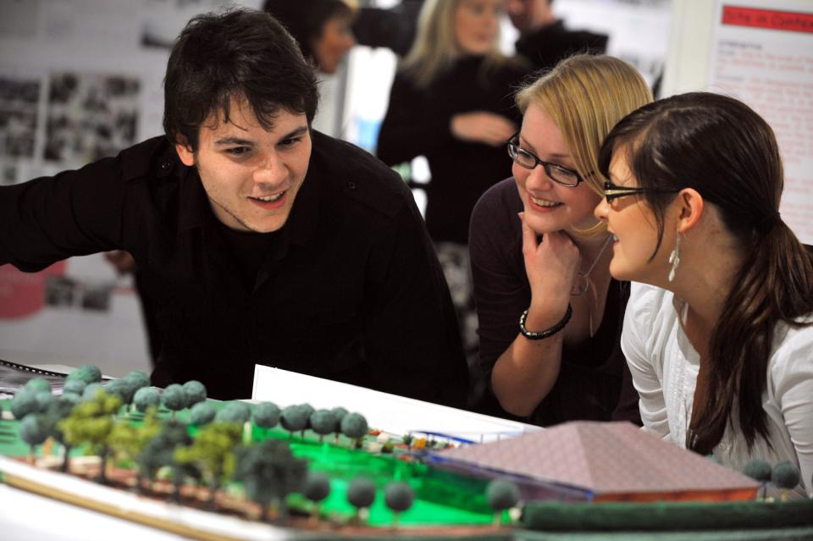
How can we make learning like this?

Slide 52
Bringing joy to the (live or virtual) classroom
Inspiring teachers tend to be systematic, consistent, well-prepared and compelling: They can usually work well at different levels and in diverse contexts;
It helps if we are able to teach with pleasure;
There are no standard recipes by which we can cook up engaging teaching, but there are some features we can combine in imaginative ways to create tasty and satisfying outcomes;
Engaging teaching comes in many different forms, and inspiring teachers develop their own styles and approaches that suit them (and their learners) well.

Slide 53
These and other slides will be available on my website at http://sally-brown.net

Slide 54
Useful references and further reading (1)
Bain, K. (2004) “What the best College Teachers do” Cambridge Harvard University Press
Biggs, J. and Tang, C. (2007) Teaching for Quality Learning at University, Maidenhead: Open University Press.
Bloxham, S. and Boyd, P. (2007) Developing effective assessment in higher education: a practical guide, Maidenhead, Open University Press.
Boud, D. (1995) Enhancing learning through self-assessment, London: Routledge.
Brown, S. and Glasner, A. (eds.) (1999) Assessment Matters in Higher Education, Choosing and Using Diverse Approaches, Maidenhead: Open University Press.
Brown, S. and Race, P. (2012) Using effective assessment to promote learning in Hunt, L. and Chambers, D. (2012) University Teaching in Focus, Victoria, Australia, Acer Press. P74-91
Brown, S. (2015) Learning , Teaching and Assessment in Higher Education: Global perspectives, London, Palgrave

Slide 55
Useful references and further reading (2)
Carless, D., Joughin, G., Ngar-Fun Liu et al (2006) How Assessment supports learning: Learning orientated assessment in action Hong Kong: Hong Kong University Press.
Carroll, J. and Ryan, J. (2005) Teaching International students: improving learning for all. London: Routledge SEDA series.
Crosling, G., Thomas, L. and Heagney, M. (2008) Improving student retention in Higher Education, London and New York: Routledge
Crooks, T. (1988) Assessing student performance, HERDSA Green Guide No 8 HERDSA (reprinted 1994).
Falchikov, N. (2004) Improving Assessment through Student Involvement: Practical Solutions for Aiding Learning in Higher and Further Education, London: Routledge.
Gibbs, G. (1999) Using assessment strategically to change the way students learn, in Brown S. & Glasner, A. (eds.), Assessment Matters in Higher Education: Choosing and Using Diverse Approaches, Maidenhead: SRHE/Open University Press.
Higher Education Academy (2012) A marked improvement; transforming assessment in higher education, York: HEA.

Slide 56
Useful references and further reading (3)
McDowell, L. and Brown, S. (1998) Assessing students: cheating and plagiarism, Newcastle: Red Guide 10/11 University of Northumbria.
Meyer, J.H.F. and Land, R. (2003) ‘Threshold Concepts and Troublesome Knowledge 1 – Linkages to Ways of Thinking and Practising within the Disciplines’ in C. Rust (ed.) Improving Student Learning – Ten years on. Oxford: OCSLD.
Nicol, D. J. and Macfarlane-Dick, D. (2006) Formative assessment and self-regulated learning: A model and seven principles of good feedback practice, Studies in Higher Education Vol 31(2), 199-218.
PASS project Bradford http://www.pass.brad.ac.uk/ Accessed November 2013
Peelo, M. T., & Wareham, T. (Eds.). (2002). Failing students in higher education. Society for Research into Higher Education.
Pickford, R. and Brown, S. (2006) Assessing skills and practice, London: Routledge.
Rotheram, B. (2009) Sounds Good, JISC project http://www.jisc.ac.uk/whatwedo/programmes/usersandinnovation/soundsgood.aspx

Slide 57
Useful references and further reading (4)
Race, P. (2001) A Briefing on Self, Peer & Group Assessment, in LTSN Generic Centre Assessment Series No 9, LTSN York.
Race P. (2015) The lecturer’s toolkit (4th edition), London: Routledge.
Rust, C., Price, M. and O’Donovan, B. (2003) Improving students’ learning by developing their understanding of assessment criteria and processes, Assessment and Evaluation in Higher Education. 28 (2), 147-164.
Ryan, J. (2000) A Guide to Teaching International Students, Oxford Centre for Staff and Learning Development
Stefani, L. and Carroll, J. (2001) A Briefing on Plagiarism http://www.ltsn.ac.uk/application.asp?app=resources.asp&process=full_record&section=generic&id=10
Sadler, D. Royce (2010) Beyond feedback: developing student capability in complex appraisal, Assessment & Evaluation in Higher Education, 35: 5, 535-550
Yorke, M. (1999) Leaving Early: Undergraduate Non-completion in Higher Education, London: Routledge.

