Slide 1
Working with taught Masters Level students:
Designing, teaching and assessing Taught Masters programmes
Carlow IT: 27th February 2015
Sally Brown: NTF, PFHEA, SFSEDA
http://sally-brown.net
@ProfSallyBrown
Emerita Professor, Leeds Beckett University,
Visiting Professor, University of Plymouth and Liverpool John Moores University.

Slide 2
Rationale for the workshop
Taught postgraduate programmes are becoming more common place and consequently, more staff are being asked to design and deliver PGT modules.
This workshop explores the differences between postgraduate and undergraduate students in terms of academic expectations and general differences in terms of their characteristics as learners, and how this influences design of assessments, feedback, and student experiences.

Slide 3
Today's workshop will enable you to:
Discuss issues concerning the boundaries between Masters and undergraduate level curriculum and assessment;
Discuss what kinds of outcomes are appropriate for masters programmes;
Consider some innovative approaches to assessing at masters level;
Review options for enhancing masters programmes.

Slide 4
The context in which we offer Masters programmes
Many HEIs see post-graduate provision as a key growth area;
However, there is significant competition between HEIs and nations for postgraduate students, with many European HEIs teaching all Masters programmes in English, thereby eliminating the traditional advantage of Irish, UK, Australasian and North American universities;
As graduates become debt-laden it is not clear how many will be prepared to take on further debt for a PG qualification;
Few HEIs have worked out viable business models for PG programmes.

Slide 5
So what about the Post-graduate student experience?
To what extent can universities assume the extent to which students will be coming to study with shared expectations, particularly around curriculum design, delivery, assessment and support?
What levels of information management, effective learning, self-efficacy, technological, inter-personal and other skills/ capabilities they will bring with them?
The nature of the transaction changes as students see themselves as customers and may expect higher service standards from teachers and institutions, leading to a changing relationship between HEIs and students (and their parents).

Slide 6
So which aspects of masters provision at Carlow are your strengths?
A unique curriculum offer, with specialisms which are attractive to both home and international students?
A highly-supportive learning environment, with better than average support for postgraduate students in a range of academic lieracies?
A good track record with student satisfaction at postgraduate level?
A great city to study in?

Slide 7
What are the most important features
of your M-level curriculum?
1
2
3
4
5
6
7
8
9

Slide 8
Determining and reviewing subject material: currency, relevance, level
Enhancing quality, seeking continuous improvement
Designing and refining learning outcomes
Evaluating programmes, strengths and areas for improvement
Curriculum
Design
Essentials
Considering delivery modes: face-to-face, online, PBL, blended…
Assuring quality, matching HEI, national and PRSB requirements
Thinking through student support
Designing fit for purpose assessment methods and approaches

Slide 9
Constructively aligning your masters programme
Explore the QAA expectations for M-level study;
Scrutinise any subject benchmarks at this level see
http://www.qaa.ac.uk/assuring-standards-and-quality/the-quality-code/subject-benchmark-statements/masters-degree-subjects
Think through the curriculum design essentials: learning outcomes, subject content, delivery modes, student support, assessment methods and approaches, quality assurance, evaluation of programmes, quality enhancement.

Slide 10
Masters level programmes according to QAA
The next slides are taken from Master’s Degree Characteristics see http://www.qaa.ac.uk/academicinfrastructure/benchmark/masters/mastersdegreecharacteristics.pdf
All UK courses at Master’s level need to take account of this document which cover purposes, differentiation from UG programmes, guidance on academic credit and European Credit Transfer, teaching and learning, T&L strategies, methods, assessment, quality and qualifications.

Slide 11
M level qualifications
Masters degrees are awarded after completion of taught courses, programmes of research, or a mixture of both. Longer, research-based programmes often lead to the degree of MPhil. Most Masters courses last at least one year (if taken full-time), and are taken by persons with Honours degrees (or equivalent achievement).
Some Masters degrees in science and engineering are awarded after extended undergraduate programmes that last, typically, a year longer than Honours degree programmes. Also at this level are advanced short courses, often forming parts of Continuing Professional Development programmes, leading to Postgraduate Certificates and Postgraduate Diplomas.
(Note: the MAs granted by the Universities of Oxford and Cambridge are not academic qualifications).

Slide 12
Higher education providers may offer a Master's degree with the specific intention of:
Enabling students to focus on a particular aspect of a broader subject area in which they have prior knowledge or experience through previous study or employment; and/or
Enabling students to focus on a particular subject area or field of study in greater depth than they encountered during the course of previous study or experience. This may include enabling students to develop knowledge of a new discipline or field of study in combination with a relevant subject area in which they have prior knowledge or experience; and/or
Enabling students to learn how to conduct research, often linked to a particular discipline or field of study.

Slide 13
QAA guidance on m-level qualifications
(Taken from The framework for higher education qualifications in England, Wales and Northern Ireland, 2008. Appendix 2a )
Characteristic outcomes of Masters degrees
i A systematic understanding of knowledge, and a critical awareness of current problems and/or new insights, much of which is at, or informed by, the forefront of their academic discipline, field of study, or area of professional practice.
ii A comprehensive understanding of techniques applicable to their own research or advanced scholarship.
iii Originality in the application of knowledge, together with a practical understanding of how established techniques of research and enquiry are used to create and interpret knowledge in the discipline.
iv Conceptual understanding that enables the student:
to evaluate critically current research and advanced scholarship in the discipline; and
to evaluate methodologies and develop critiques of them and, where appropriate, to propose new hypotheses.

Slide 14
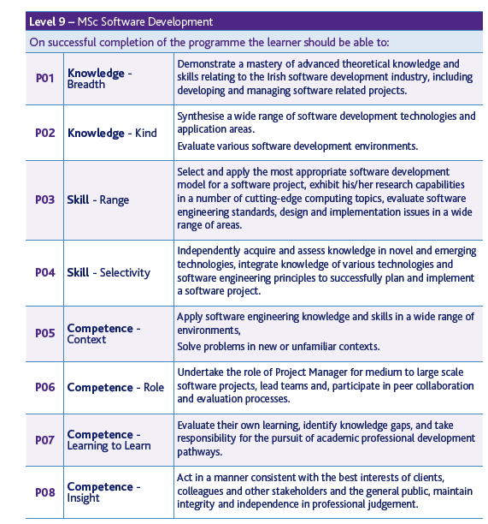
Example of M-level programme learning outcomes

Slide 15
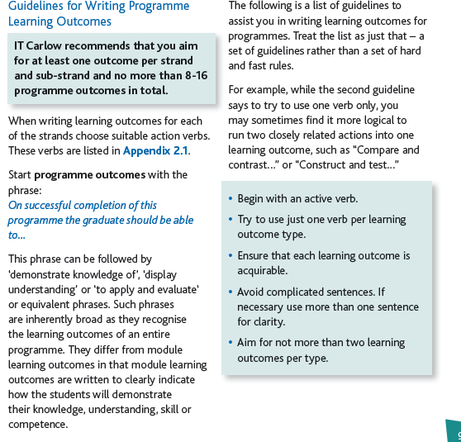

Slide 16
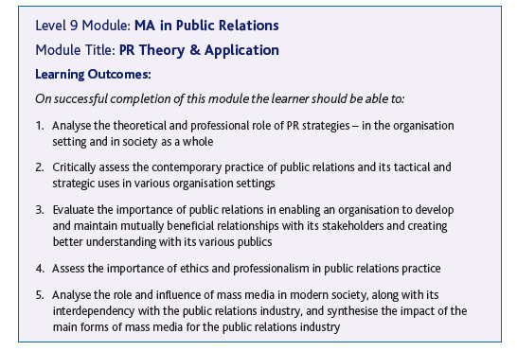
Example of learning outcomes for a M-level module

Slide 17
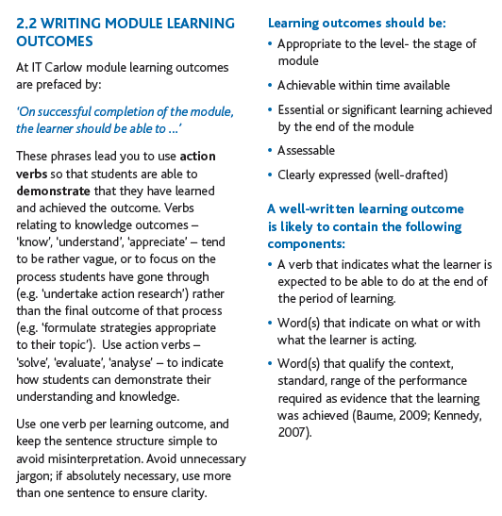

Slide 18
Typically, holders of the qualification will be able to:
deal with complex issues both systematically and creatively, make sound judgements in the absence of complete data, and communicate their conclusions clearly to specialist and non-specialist audiences;
demonstrate self-direction and originality in tackling and solving problems, and act autonomously in planning and implementing tasks at a professional or equivalent level;
continue to advance their knowledge and understanding, and develop new skills to a high level; and will have:
the qualities and transferable skills necessary for employment requiring: (i) the exercise of initiative and personal responsibility; (ii) decision-making in complex and unpredictable situations; and (iii) the independent learning ability required for continuing professional development.

Slide 19
New Zealand Qualifications Agency (2007) outcomes of a Masters degree
A graduate of a masters degree programme is able to:
show evidence of advanced knowledge about a specialist field of enquiry or professional practice;
demonstrate mastery of sophisticated theoretical subject matter;
research, analyse and argue from evidence;
work independently and apply knowledge to new situations; and
engage in rigorous intellectual analysis, criticism and problem-solving.

Slide 20
The Australian Qualification Framework (2011) specifies expectations in these terms:
Graduates at this level will have specialised knowledge and skills for research, and/or professional practice and/or further learning
Knowledge :Graduates at this level will have advanced and integrated understanding of a complex body of knowledge in one or more disciplines or areas of practice
Skills :Graduates at this level will have expert, specialised cognitive and technical skills in a body of knowledge or practice to independently:
  analyse critically, reflect on and synthesise complex information, problems, concepts and theories
  research and apply established theories to a body of knowledge or practice
  interpret and transmit knowledge, skills and ideas to specialist and non-specialist audiences
Application of knowledge and skills: Graduates at this level will apply knowledge and skills to demonstrate autonomy, expert judgement, adaptability and responsibility as a practitioner or learner.

Slide 21
Masters students at IoE are expected to be able to demonstrate:
Understanding of key aspects of the field of study and practice;
Highly developed ability to draw from and apply appropriate intellectual perspectives, including engagement with relevant research and scholarship
Outstanding grasp of issues and critical insight into professional pedagogic practice;
Highly sophisticated and complex understanding of learning processes and the various contexts of learning and teaching;
High levels of creativity, independence of thought and success in the application of knowledge in teaching and other work.

Slide 22
What distinguishes Masters’ level from undergraduate level in practice?
Lord (2008) suggests Masters level traits include the ability to:
Demonstrate originality in solving problems and applying knowledge
Critically evaluate current research in the field
Deal with complex issues both systematically and creatively
Clearly communicate conclusions to specialist and non-specialist audiences.

Slide 23
Mapping the student experience at Master’s Level
Will students feel from the outset that they are on a Master’s programme?
Are you ensuring that students are immersed in the subject they have come to study from the outset?
Is induction a valuable and productive introduction to the course (or just the distribution of bags and bags of paper)?
Do students have a positive and balanced experience across the programme?
Are there points in the academic year when there doesn’t seem to be much going on?

Slide 24
At Masters level, assessment really matters!
Many Masters programmes are professionally-orientated or vocational hence the need for a strong focus on authentic assessment;
Students have high levels of expectation from their tutors at Masters level;
Most M-level programmes are assessed very conservatively, using written assignments including dissertations, unseen time constrained exams and essays;
We need to distinguish our programmes from those offered by our competitors worldwide.

Slide 25
QAA Assessment expectations
Appropriate and effective assessment will enable students to demonstrate the outcomes of learning intended for the programme.
Assessment methods may be based on any or all of the following:
essay assignments
practical reports or portfolios
a dissertation or other output from research/project work, which may include artefacts, performances or compositions
written examinations
oral examinations
problem-solving exercises
oral presentations
posters
placement reports. (And others…..)

Slide 26
Assessment at Masters level: the Assimilate project
We explored innovative assessment at Masters level using research funding from the National Teaching Fellowship scheme.
Recognising that limited prior research had been undertaken in this area, we reviewed assessment methods used to assess at this level, particularly exploring authentic assessment.
Interviews were undertaken in the UK and internationally by students and team members to elicit information about diverse approaches and to produce case studies showcasing innovations.

Slide 27
The Assimilate compendium: Good practice M-level assessment examples include:
Highly authentic assignments, which relate closely to programme outcomes;
Multiple assessments which build incrementally to final submission;
Good feedback opportunities, giving students the chance to benefit from advice to improve performance;
Assignments that require teamwork and group activity;
Assignments that foster employability and that foster employer engagement;
Assignments that are enhanced and supported by technology;
Assignments requiring peer engagement / peer assessment.

Slide 28
Some learning points
It was interesting to observe how fuzzy are common understandings of the differences between M-level and undergraduate level assessment;
The importance of authentic assessment to professionally-orientated Masters programmes was highlighted;
We learned about variations in practice at M-level between different national systems, especially in terms of duration of programmes and funding arrangements.

Slide 29
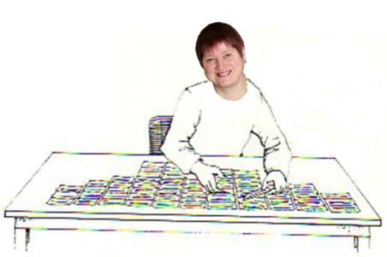
We used Q methodology to look for trends in M-level assessment
Acknowledgement: Thanks to Wendy Stainton Rogers for sharing this graphic, which was adapted from an original paper by Stainton Rogers, W. (2011) Social Psychology. OUP.

Slide 30
We identified five viewpoints
The innovative assessment and accreditation of learning for complex real life / workplace applications requires assessment training for both staff and students.
Standards and consistency can not be guaranteed by any means, but flexible assessment criteria and innovative assessment methods have their uses.
Introducing innovative assessment methods can be powerful but requires new perspectives on learning with institutional support and encouragement for successful wholesale change.

Slide 31
Viewpoints 4 and 5
Clear guidance to students in the form of high quality assessment criteria and timely tutor assessment feedback can help students to develop the skills that they and also employers want.
Improving assessment methods does not necessarily require a paradigm shift in thinking, but stakeholder consultation is important as benefits are not guaranteed and one size does not fit all.

Slide 32
Project overview
The project yielded more variety and diversity than we expected at the outset;
It was fascinating to explore practice in the UK, Denmark, Ireland, Spain, the Netherlands, Singapore, Australia and New Zealand;
More than 800 people have physically held an Assimilate booklet in their hands and used it to consider innovations in M-level assessment;
We are modestly confident that we have added helpfully to understanding of M-level assessment, particularly through our compendium and our analysis of data to identify viewpoints.

Slide 33
The take-aways from today
What are your priorities to review and potentially enhance:
The constructive alignment of your Masters programme?
The language of your learning outcomes?
The subject material to ensure it is at the right level?
The means by which you ‘deliver’ content?
The range of ways in which you assess your masters students?
How you can best support your M-level students?
How you evaluate the effectiveness of yoru programmes?

Slide 34
Selected references and further reading
Brown, S. (2012) Assimilate compendium, Leeds, Leeds Met Press
Brown, S. (2014) ‘What are the perceived differences between assessing at Masters level and undergraduate level assessment? Some findings from an NTFS–funded project’ Innovations in Education and Teaching International.
Brown, S., Deignan, T. Race, P. and Priestley, J. (2012) ‘Assessing students at Masters Level: learning points for Educational Developers’ Educational Developments, SEDA, Birmingham.
Brown, S (2012) ‘Diverse and innovative assessment at Masters Level: alternatives to conventional written assignments’ in AISHE-J: The All Ireland Journal of Teaching and Learning in Higher Education Vol 4, No 2.
Casey, J. (2002) On-line assessment in a masters-level policy subject: participation in an on-line forum as part of assessment, Centre for the study of higher education, Charles Sturt University, Australia.
Dunn, S. and Singh, K. A. (2009) Analysis of M-level modules in interdisciplinary nanotechnology education, Nanotechnology Centre, Department of Materials, School of Applied Sciences, Cranfield University.

Slide 35
References (contd.)
Engeström, Y. (2010). Studies of expansive learning: Foundations, findings and future challenges. Educational Research Review, (5):1-24
Fry, H., Pearce, R. and Bright, H. (2007) Re-working resource-based learning - a case study from a masters programme. Innovations in Education and Teaching International, 44(1), pp.79-91.
Geographical Association. (no date) GTIP Think Piece - Writing at Masters Level. Available online: http://www.geography.org.uk/gtip/thinkpieces/writingatmasterslevel/
Haworth, A., Perks, P. and Tikly, C. (no date) Developments with Mathematics M-Level PGCE Provision and Assessment, University of Manchester, University of Birmingham, University of Sussex.
Institute of Education (2006) Masters level criteria for Geography PGCE http://www.geography.org.uk/download/GA_PRGTIPBrooksMLevelCriteria.pdf
Lord, D. (2008) Learning to Teach a Specialist Subject: Using New Technologies and Achieving Masters Level Criteria. In: MOTIVATE conference 2008, 11 - 12th November 2008, Dunaujvaros, Budapest. (Unpublished) This version is available at http://eprints.hud.ac.uk/10892/

Slide 36
References (contd.)
NZQA (2007) http://www.nzqa.govt.nz/assets/Studying-in-NZ/New-Zealand-Qualification-Framework/theregister-booklet.pdf (accessed March 2012
QAA (2010) Masters Degree Characteristics
http://www.qaa.ac.uk/academicinfrastructure/benchmark/masters/MastersDegreeCharacteristics.pdf
Seymour, D. (2005) Learning Outcomes and Assessment: developing assessment criteria for Masters-level dissertations. Brookes eJournal of Learning and Teaching 1(2).
Van Eeten, Michel J.G. (2001) Recasting Intractable Policy Issues: The Wider Implications of the Netherlands Civil Aviation Controversy, Journal of Policy Analysis and Management, 20(3):391-414
Wharton, S. (2003) Defining appropriate criteria for the assessment of master's level TESOLAssignments. Assessment & Evaluation in Higher Education, 28(6), pp.649-664.

