Slide 1
Recognising and rewarding excellent work ALSS Assessment day Anglia Ruskin University December 2014
Professor Sally Brown
Part of the ARU-wide Transforming Assessment Project

Slide 2
Rationale
Students engage more fully in assessment tasks if the tasks required of them are authentic, and if they feel that their achievements will be duly recognised by those assessing them.
To do our best for students, we need to make sure each student has the chance to maximise their achievement in partnership with those teaching and assessing them.
They also have high expectations about the nature and quality of the feedback they receive, and its potential to enable them to do better on future assignments.

Slide 3
In this session, participants will have opportunities to:
Consider how we can ensure that assessment is for and not just of learning;
discuss how assessment can be made authentic and meaningful to students;
review how best to do assess students working in groups, particularly where self and peer assessment are required;
enable assessment activities to contribute to building student confidence and fostering employability.

Slide 4
We also aim to consider how to help students:
undertake what they need to do to achieve highly;
understand how marks relate to criteria and weightings, and recognise the fairness and transparency of the systems by which they are assessed;
recognise feedback as both detailed and useful;
take notice of and use detailed and constructive developmental feedback.

Slide 5
Two major UK assessment initiatives underpin the TAPs project:
The UK Quality Assurance Agency (QAA) Code of practice B6 on Assessment and APL.
The Higher Education Academy ‘A marked improvement’ project on bringing about change to institutional strategies on assessment.
Both groups have overlapping membership and therefore aligned perspectives.
Both initiatives draw on the work of previous generations of thinkers on assessment, and particularly the two Centres for Excellence in Teaching and Learning (CETLs) that focused on assessment, Oxford Brookes’ Assessment Knowledge Exchange (ASKe) and Northumbria's Assessment for Learning (A4L).

Slide 6
‘A Marked Improvement’ aims to improve assessment practice
Stems from firm evidence that assessment is not ‘fit for purpose’ (Race 2010, Brown, 2010);
Aims to take a radical approach, recognising that it is time for significant reappraisal of assessment policy and practice (ASKe, Weston Manor Manifesto);
Builds on expertise, evidence, perspectives, and previous work;
Takes an evidence-informed approach;
Encourages for assessment to be seen as an integral part of the learning experience.
The work aligns with the expectations of the new B6 section of the QAA code of practice, JISC initiatives and other current developments;
Together we are seeking to make assessment contribute to student achievement, engagement and retention by being fit-for-purpose and fully integrated into the learning process.

Slide 7
A Marked Improvement proposes 6 tenets
Summarised as:
Assessment for learning
Ensuring assessment is fit for purpose
Recognising that assessment lacks precision
Constructing standards in communities
Integrating assessment literacy into course design
Ensuring professional judgements are reliable
(See Marked Improvement document for exact wording and further explanation)

Slide 8
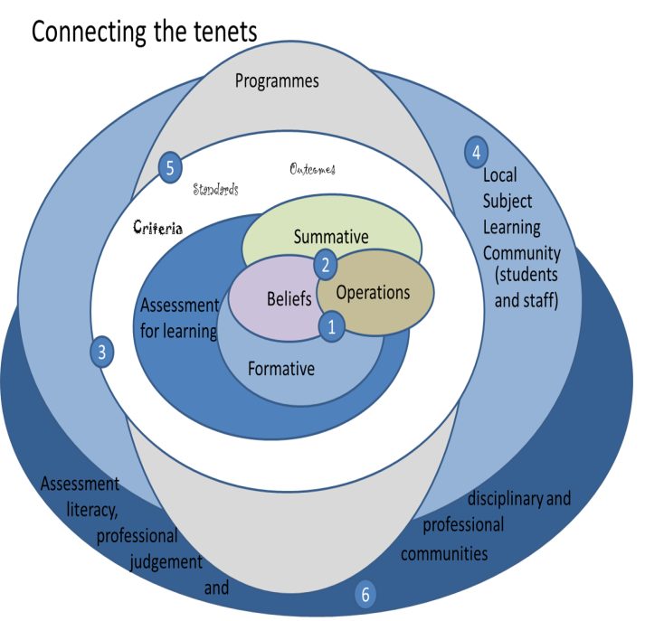

Slide 9
Progress of ARU project so far
Away-days, workshops, targeted sessions held involving:
Course leaders
Academics
Managers
Quality assurance staff
Summary of priorities identified
Developing programme approaches to assessment
Developing assessment literacy
Rebalancing summative and formative assessment

Slide 10
Key features of the project
Strategic transformation of assessment across the university working at all levels;
Improved NSS scores are not the specific aim of the project but better scores may well result;
Sharing expertise between course leaders, including those in the 85+ group is important;
Activity is being informed by Vision Visits to other universities;
External expertise from the ‘Marked Improvement’ team is supporting internal expertise.

Slide 11
Some thoughts from ARU working groups
The importance of giving both formative and summative feedback, and getting the balance right, and embedding formative feedback, using it for diagnostic purposes
Linking assessment to professional practice, and linking this in turn to professional practice;
Assessing group work fairly;
Giving assessors feedback on their assessment (including a traffic light system (RAG sheet);
The discussions.

Slide 12
More thoughts
The value of real life/authentic assessment
Feed forward as a way of integrating assessment as learning
The value of using a constrained variety of assessment formats;
A desire to make assessment exciting, interesting and instilling a sense of pride in achievement;
The importance of assessment literacy: familiarising students with the vocabulary of assessment.

Slide 13
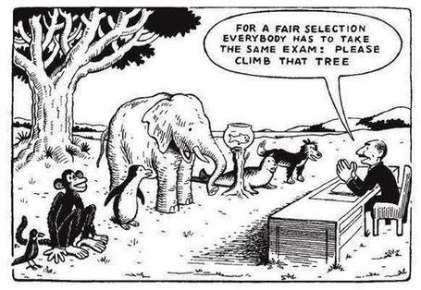

Slide 14
What is assessment for? What can it do? How much does it matter?
Assessment is crucially an integral part of the learning process rather than just a means of judging the extent to which learning has taken place;
Assessment activities can help students get the measure of their achievement and can motivate learning, but can also destroy confidence and undermine already disadvantaged students;
As far as I am concerned there is nothing we do for students that has as much impact as assessment and therefore it’s really worth thinking through how it adds value to the learning experience.

Slide 15
Assessment for learning
1. Tasks should be challenging, demanding higher order learning and integration of knowledge learned in both the university and other contexts;
2. Learning and assessment should be integrated, assessment should not come at the end of learning but should be part of the learning process;
3. Students are involved in self assessment and reflection on their learning, they are involved in judging performance;
4. Assessment should encourage metacognition, promoting thinking about the learning process not just the learning outcomes;
5. Assessment should have a formative function, providing ‘feedforward’ for future learning which can be acted upon. There is opportunity and a safe context for students to expose problems with their study and get help; there should be an opportunity for dialogue about students’ work;

Slide 16
Assessment for learning
6. Assessment expectations should be made visible to students as far as possible;
7. Tasks should involve the active engagement of students developing the capacity to find things out for themselves and learn independently;
8. Tasks should be authentic; worthwhile, relevant and offering students some level of control over their work;
9. Tasks are fit for purpose and align with important learning outcomes;
10. Assessment should be used to evaluate teaching as well as student learning.
(After Bloxham and Boyd)

Slide 17
The major success factors identified were:
Motivation of students to engage because they perceive assessment as authentic and constructively aligned;
Regular and incremental overview of assessment within a course;
Commitment to students’ success;
Developing students’ skills for learning;
The value of using students to give a ‘sense check’ on planned assignments.

Slide 18
More success factors
The value of immersive experiences
Having robust processes to quality assure assessment (moderation, external examiners etc) and letting students know about them;
Using training of those inexperienced in assessing at HE level to establish and maintain consistency and standards;
The importance of opening up the ‘black box’ of assessment ‘secrets’

Slide 19
Sadler, the most cited author on formative assessment argues:
“Students need to be exposed to, and gain experience in making judgements about, a variety of works of different quality... They need planned rather than random exposure to exemplars, and experience in making judgements about quality. They need to create verbalised rationales and accounts of how various works could have been done better. Finally, they need to engage in evaluative conversations with teachers and other students.”

Slide 20
Sadler continues…
Together, these ... provide the means by which students can develop a concept of quality that is similar in essence to that which the teacher possesses, and in particular to understand what makes for high quality. Although providing these experiences for students may appear to add more layers to the task of teaching, it is possible to organise this approach to peer assessment so that it becomes a powerful strategy for higher education teaching.
Sadler, D. Royce (2010)

Slide 21
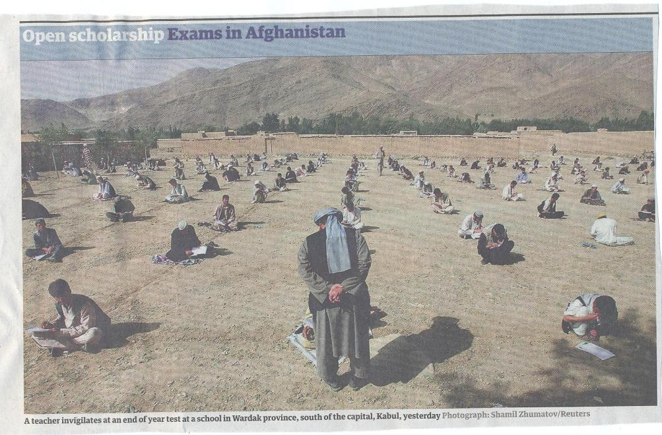

Slide 22
Assessment, confidence and retention
Crudely, student achievement is linked to students own beliefs about their abilities, whether these are fixed or malleable;
Students who subscribe to an entity (fixed) theory of intelligence need ‘a diet of easy successes’ (Dweck, 2000) to confirm their ability and are fearful of learning goals as this involves an element of risk and personal failure. Assessment for these students is an all-encompassing activity that defines them as people. If they fail at the task, they are failures.

Slide 23
Students who believe that intelligence is malleable may be more robust
Students who believe that intelligence is incremental have little or no fear of failure. A typical response from such a student is ‘The harder it gets, the harder I need to try’. These students do not see failure as an indictment of themselves and [can] separate their self-image from their academic achievement. When faced with a challenge, these students are more likely to continue in the face of adversity because they have nothing to prove. (after Clegg in Peelo and Wareham 2002).

Slide 24
Assessment literacy: students do better if they can:
Make sense of key terms such as criteria, weightings, and level;
Encounter a variety of assessment methods (e.g. presentations, portfolios, posters, assessed web participation, practicals, vivas etc.) and get practice in using them;
Be strategic in their behaviours, putting more work into aspects of an assignment with high weightings, interrogating criteria to find out what is really required and so on;
Gain clarity on how the assessment regulations work in their HEI, including issues concerning submission, resubmission, pass marks, condonement etc.

Slide 25
To what extent does your assessment strategy:
Maximise fast, formative feedback opportunities without driving your markers into the ground?
Support student transition and retention by making assessment integral to learning?
Foster assessment?
Make the process of assessing and being assessed engaging and even enjoyable for staff and students?
Assure the standards of assessment against national and PSRB benchmarks?

Slide 26
And…
Provide incremental assessment opportunities?
Use assessment activities that can engage students and be integral to learning?
Constructively align (Biggs 2003) assignments with planned learning outcomes and the curriculum taught?
Provide realistic tasks: students are likely to put more energy into assignments they see as authentic and worth bothering with?
Maximise the dialogic opportunities of student feedback?

Slide 27
Assessment in context
If we want to improve students’ engagement with learning, a key locus of enhancement can be refreshing our approaches to assessment;
Sometimes we need to take a fresh look at our current practice to make sure assessment is for rather than just of learning;
We provide explicit and implicit messages to students and indeed all other stakeholders by how we assess.

Slide 28
Assessing students in groups: factors to consider
Choosing group size;
Choosing how groups are formed;
The importance of clear briefing for assessed group work
Devising appropriate rehearsal opportunities;
Negotiating/interrogating criteria;
Weighting group assessment marks (inter/intra peer assessment, self assessment through reflection, tutor assessment);
Managing peer assessment.

Slide 29
Encouraging students to take assessment more seriously
All assessment needs to be seen to be fair, consistent, reliable, valid and manageable;
Many assessment systems fail to clarify for students the purposes of different kinds of assessment activity;
Low-stakes early formative assessment helps students, especially those from disadvantaged backgrounds, understand the rules of the game.

Slide 30
Improving feedback: good practice according to Nicol and Macfarlane-Dick (2006):
1. Helps clarify what good performance is (goals, criteria, expected standards);
2. Facilitates the development of self-assessment (reflection) in learning;
3. Delivers high quality information to students about their learning;
4. Encourages teacher and peer dialogue around learning;
5. Encourages positive motivational beliefs and self-esteem;
6. Provides opportunities to close the gap between current and desired performance;
7. Provides information to teachers that can be used to help shape the teaching.

Slide 31
Key issues when giving feedback
Students can’t read our writing.
There is too much emphasis on grades and marks at the expense of learning.
The feedback given is often not very useful and comes too late.
Students are not actively encouraged to self reflect.
Little or no use is made of peer/self assessment and feedback.
Little dialogue takes place around feedback.
Students have little opportunity to collate feedback over time and act upon it.
Most feedback does not feed forward, it only tell students what they have done that is incorrect.
Very little use is made of feedback as a normal part of the learning and teaching process.
Staff vary significantly in their approach to feedback.

Slide 32
Important aspects of complex, high-level learning outcomes can only be achieved when students are allowed time to ‘come to know’ the standards in use by the community
Slowly learnt academic literacies require rehearsal and practice throughout a programme (Knight and Yorke, 2004).
The achievement of high-level learning requires integrated and coherent progression based on programme outcomes.
Where there is a greater sense of the holistic programme students are likely to achieve higher standards than on more fragmented programmes (Havnes, 2007).
Students need to engage as interactive partners in a learning community, relinquishing the passive role of ‘the instructed’ within processes controlled by academic experts (Gibbs et al, 2004).

Slide 33
Course learning outcomes should reflect what students should achieve
Making it clear to students what is expected of them;
Making it clear to teachers what students are expected to learn in their own and other modules;
Helping teachers to select the most appropriate teaching strategy for the intended learning outcomes e.g. lecture, seminar, tutorial, group work, discussion, student presentation, laboratory work;
Helping teachers to select the most appropriate assessment style to assess the achievement of the learning outcomes, e.g. project, essay, performance assessment, multiple‐choice questions, exam;
Having a focus on programme learning outcomes – staff therefore need time to collaborate;
Are you confident that students being marked by different people or the same people at different times (inter & intra-tutor reliability) will achieve equivalent marks?

Slide 34
Efficient assessment: we need to:
Stop marking, start assessing!
Explore ways to maximise student ‘time on task’ (Gibbs) and minimise staff drudgery;
Remember that feedback is crucial to student learning but is the most time-consuming aspect of assessment: we need to explore ways of giving feedback effectively and efficiently;
Consider how computer-supported assessment can include use of audio feedback via digital sound files, video commentaries and other means of using course Virtual Learning Environments.

Slide 35
Some final thoughts on assessment and feedback
Academic staff frequently use a fairly limited range of assessment and feedback methods for individuals and groups, but international pedagogic research suggests that diversity benefits students greatly.
To maximise the benefits of formative feedback, a range of streamlined approaches including statement banks and computer based assessments can supplement traditional forms.
Students do not always recognize or use feedback well, but assessment dialogues can enhance learning.

Slide 36
Useful references: 1
ASKe Weston Manor manifesto http://www.brookes.ac.uk/aske/Manifesto/ (accessed April 2012)
Assessment Reform Group (1999) Assessment for Learning : Beyond the black box, Cambridge UK, University of Cambridge School of Education.
Biggs, J. and Tang, C. (2007) Teaching for Quality Learning at University, Maidenhead: Open University Press.
Bloxham, S. Marking and moderation in the UK: false assumptions and wasted resources, Assessment & Evaluation in Higher Education 34.2 (2009): 209-220.
Bloxham, S. and Boyd, P. (2007) Developing effective assessment in higher education: a practical guide, Maidenhead, Open University Press.
Brown, S. Rust, C. & Gibbs, G. (1994) Strategies for Diversifying Assessment, Oxford: Oxford Centre for Staff Development.
Boud, D. (1995) Enhancing learning through self-assessment, London: Routledge.
Brown, S. (2011) First class: how assessment can enhance student learning in Blue Skies: new thinking about the future of higher education, London: Pearson.
Brown, S. and Glasner, A. (eds.) (1999) Assessment Matters in Higher Education, Choosing and Using Diverse Approaches, Maidenhead: Open University Press.
Brown, S. and Knight, P. (1994) Assessing Learners in Higher Education, London: Kogan Page.

Slide 37
Useful references 2
Brown, S. and Race, P. (2012) Using effective assessment to promote learning in Hunt, L. and Chambers, D. (2012) University Teaching in Focus, Victoria, Australia, Acer Press, pp.74-91
Carless, D., Joughin, G., Ngar-Fun Liu et al (2006) How Assessment supports learning: Learning orientated assessment in action Hong Kong: Hong Kong University Press.
Carroll, J. and Ryan, J. (2005) Teaching International students: improving learning for all. London: Routledge SEDA series.
Crosling, G., Thomas, L. and Heagney, M. (2008) Improving student retention in Higher Education, London and New York: Routledge
Crooks, T. (1988) Assessing student performance, HERDSA Green Guide No 8 HERDSA (reprinted 1994).
Falchikov, N. (2004) Improving Assessment through Student Involvement: Practical Solutions for Aiding Learning in Higher and Further Education, London: Routledge.
Gibbs, G. (1999) Using assessment strategically to change the way students learn, in Brown S. & Glasner, A. (eds.), Assessment Matters in Higher Education: Choosing and Using Diverse Approaches, Maidenhead: SRHE/Open University Press.
Havnes, A. (2007), ‘What can feedback practices tell us about variation in grading across fields?’ Presented at the ASKe Seminar Series, Oxford Brookes University, 19th September.

Slide 38
Useful references 3
Higher Education Academy (2012) A marked improvement; transforming assessment in higher education, York: HEA.
Knight, P. and Yorke, M. (2003) Assessment, learning and employability Maidenhead, UK: SRHE/Open University Press.
Mentkowski, M. and associates (2000) p.82 Learning that lasts: integrating learning development and performance in college and beyond, San Francisco: Jossey-Bass.
McDowell, L. and Brown, S. (1998) Assessing students: cheating and plagiarism, Newcastle: Red Guide 10/11 University of Northumbria.
Nicol, D. J. and Macfarlane-Dick, D. (2006) Formative assessment and self-regulated learning: A model and seven principles of good feedback practice, Studies in Higher Education Vol 31(2), 199-218.
Newstead, S. E. and Dennis, I. (1994), ‘Examiners examined: the reality of exam marking in psychology’, The Psychologist, 7, pp. 216-19.
O’Donovan, B., Price, M. and Rust, C. (2004), ‘Know what I mean? Enhancing student understanding of assessment standards and criteria’, Teaching in Higher Education, 9, pp. 325-335.
PASS project Bradford http://www.pass.brad.ac.uk/ Accessed November 2013
Pickford, R. and Brown, S. (2006) Assessing skills and practice, London: Routledge.

Slide 39
Useful references 4
Race, P. (2001) A Briefing on Self, Peer & Group Assessment, in LTSN Generic Centre Assessment Series No 9, LTSN York.
Race P. (2007) The lecturer’s toolkit (3rd edition), London: Routledge.
Rust, C., Price, M. and O’Donovan, B. (2003) Improving students’ learning by developing their understanding of assessment criteria and processes, Assessment and Evaluation in Higher Education. 28 (2), 147-164.
Stefani, L. and Carroll, J. (2001) A Briefing on Plagiarism http://www.ltsn.ac.uk/application.asp?app=resources.asp&process=full_record&section=generic&id=10
Sadler, D. R. (1987), ‘Specifying and Promulgating Achievement Standards’, Oxford Review of Education, 13, pp. 191–209.
Sadler, DR 1989, ‘Formative assessment and the design of instructional systems’, Instructional Science, vol. 18, pp. 119-144.
Sadler, R. (2008) Assessment of Higher Education, in International Encyclopaedia of Education
Sadler, D. Royce (2010) Beyond feedback: developing student capability in complex appraisal, Assessment & Evaluation in Higher Education, 35: 5, 535-550
Yorke, M. (1999) Leaving Early: Undergraduate Non-completion in Higher Education, London: Routledge.

Slide 40
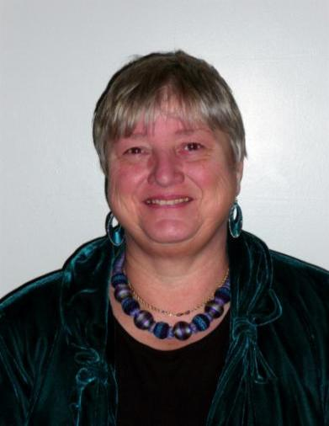
http://sally-brown.net

