Slide 1
A marked improvement Anglia Ruskin University LAIBS
November 26th 2014
Sally Brown and Margaret Price
NTF, PFHEA, SFSEDA
Emerita Professor, Leeds Metropolitan University
Visiting Professor University of Plymouth & Liverpool John Moores University.

Slide 2
‘A Marked Improvement’ aims to improve assessment practice
Stems from firm evidence that assessment is not ‘fit for purpose’ (Race 2010, Brown, 2010);
Aims to take a radical approach, recognising that it is time for significant reappraisal of assessment policy and practice (ASKe, Weston Manor Manifesto);
Builds on expertise, evidence, perspectives, and previous work;
Takes an evidence-informed approach;
Encourages for assessment to be seen as an integral part of the learning experience.
The work aligns with the expectations of the new B6 section of the QAA code of practice, JISC initiatives and other current developments;
Together we are seeking to make assessment contribute to student achievement, engagement and retention by being fit-for-purpose and fully integrated into the learning process.

Slide 3
Two major current UK initiatives on assessment to consider
The UK Quality Assurance Agency (QAA) Code of practice B6 on Assessment and APL.
The Higher Education Academy ‘A marked improvement’ project on bringing about change to institutional strategies on assessment.
Both groups have overlapping membership and therefore aligned perspectives.
Both initiatives draw on the work of previous generations of thinkers on assessment, and particularly the two Centres for Excellence in Teaching and Learning (CETLs) that focused on assessment, Oxford Brookes’ Assessment Knowledge Exchange (ASKe) and Northumbria's Assessment for Learning (A4L).

Slide 4
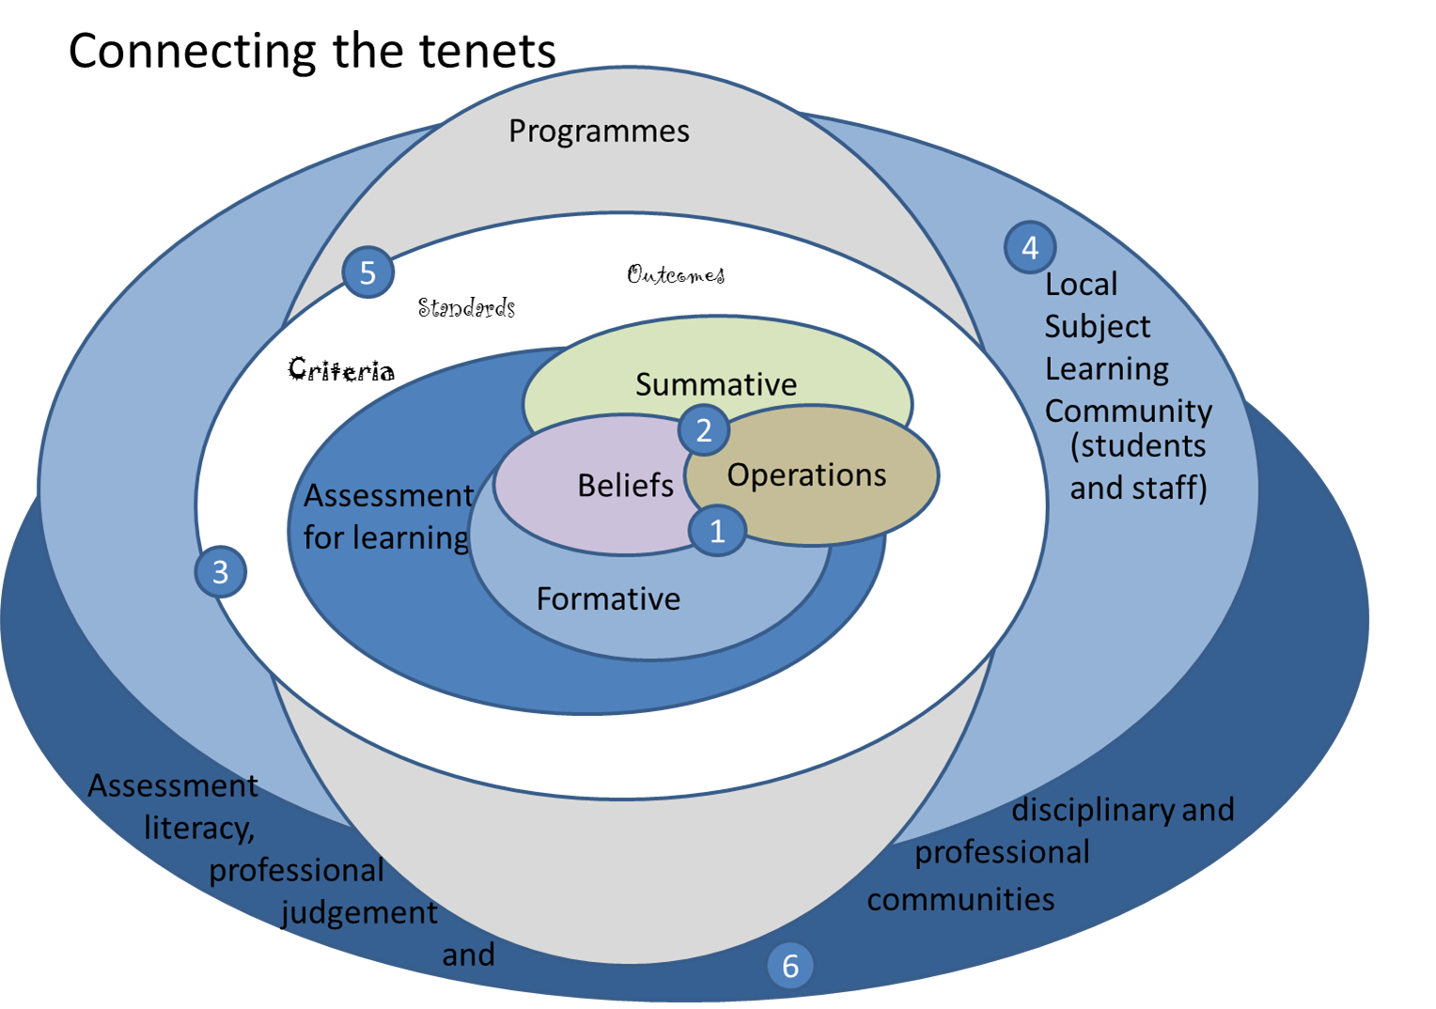

Slide 5
Progress of ARU project so far
Events, away days and workshops held involving:
Course leaders
Academics across all faculties
Managers
Quality assurance staff
Summary of priorities identified
Developing programme approaches to assessment
Developing assessment literacy
Rebalancing summative and formative assessment

Slide 6
Key features of the project
Strategic transformation of assessment across the university is the key aim;
Improved NSS scores is not the specific aim of the project but better scores may well result;
Sharing expertise between course leaders, including those in the 85+ group is important;
Activity has been informed by Vision Visits to other universities;
External expertise from the ‘Marked Improvement’ team is supporting internal expertise.

Slide 7
Why change is needed
QAA subject reviews
Burgess Report - “system no longer fit for purpose” (p5)
QAA - “…it cannot be assumed students graduating …. will have achieved similar standards” (2007)
Media accusations of dumbing down & grade inflation
National Student Satisfaction Survey
“There is considerable scope for professional development in the area of assessment” (Yorke et al, 2000, p7)
Students become more interested in the mark and less interested in the subject over the course of their studies (Newstead 2002, p2)

Slide 8
The manifesto for change concentrates on six tenets:
Assessment for learning;
Ensuring assessment is fit for purpose;
Recognition of the imprecision of many assessment practices;
Constructing standards in assessment communities;
Integrating assessment literacy into course design;
Ensuring professional judgments are reliable.

Slide 9
Some emergent themes from work to date
The importance of balancing formative and summative feedback, and embedding formative feedback, using it for diagnostic purposes
Linking assessment to professional practice, and linking this in turn to employability (fit for purpose)
The importance of assessing group work well;
Seeking ways to foster assessment literacy: familiarising students with the vocabulary and practices of assessment;

Slide 10
More thoughts
Balancing ambitions for incremental assessment and making the volume of assessment manageable;
The importance of integrating PSRBs requirements;
Discussions around what works well when giving assessors feedback on their assessment (including a traffic light system (RAG sheet) as used in the health Faculty;
The importance of letting students know when they are getting informal feedback that it is feedback
The value of group feedback via vodcasts

Slide 11
And still more
The value of real life/ authentic assessment
The importance of ‘feed forward’ as a way of integrating assessment as learning
The value of using a variety of assessment formats;
A desire to make assessment exciting, interesting and instilling a sense of pride in achievement;
The importance of using appropriate new technologies to support assessment, including assessment management systems, and making them work well.

Slide 12
The major success factors identified by the 85+ group were:
Motivation (Because student are working towards professional qualifications)
Authentic constructively aligned assessment;
Incremental review
Commitment to students’ success
Assessment literacy
Skills for learning
The value of using students to give a ‘sense check’ on planned assignments

Slide 13
More success factors
The value of immersive experiences where these are implemented;
Robust processes and practices to assure quality and enhance the student experience through good assessment;
Training to establish standards and to ensure all assessors are competent to undertake the task (QAA Code B6)
The importance of opening up the ‘black box’ of assessment ‘secrets’

Slide 14
Assessment literacy: students do better if they can:
Make sense of key terms such as criteria, weightings, and level;
Encounter a variety of assessment methods (e.g. presentations, portfolios, posters, assessed web participation, practicals, vivas etc.) and get practice in using them;
Be strategic in their behaviours, putting more work into aspects of an assignment with high weightings, interrogating criteria to find out what is really required and so on;
Gain clarity on how the assessment regulations work in their HEI, including issues concerning submission, resubmission, pass marks, condonement etc.

Slide 15
What does assessment for? What can it do? How much does it matter?
Many argue nowadays that assessment is crucially an integral part of the learning process rather than just a means of judging the extent to which learning has taken place;
Assessment activities can help students get the measure of their achievement and can motivate learning, but can also destroy confidence and undermine already disadvantaged students;
As far as I am concerned there is nothing we do for students that has as much impact as assessment and therefore it’s really worth thinking through how it adds value to the learning experience.

Slide 16
Assessment for learning
1. Tasks should be challenging, demanding higher order learning and integration of knowledge learned in both the university and other contexts;
2. Learning and assessment should be integrated, assessment should not come at the end of learning but should be part of the learning process;
3. Students are involved in self assessment and reflection on their learning, they are involved in judging performance;
4. Assessment should encourage metacognition, promoting thinking about the learning process not just the learning outcomes;
5. Assessment should have a formative function, providing ‘feedforward’ for future learning which can be acted upon. There is opportunity and a safe context for students to expose problems with their study and get help; there should be an opportunity for dialogue about students’ work;

Slide 17
Assessment for learning
6. Assessment expectations should be made visible to students as far as possible;
7. Tasks should involve the active engagement of students developing the capacity to find things out for themselves and learn independently;
8. Tasks should be authentic; worthwhile, relevant and offering students some level of control over their work;
9. Tasks are fit for purpose and align with important learning outcomes;
10. Assessment should be used to evaluate teaching as well as student learning.
(After Bloxham and Boyd)

Slide 18
Assessing students in groups: factors to consider
Choosing group size;
Choosing how groups are formed;
The importance of clear briefing for assessed group work
Devising appropriate rehearsal opportunities;
Negotiating/interrogating criteria;
Weighting group assessment marks (inter/intra peer assessment, self assessment through reflection, tutor assessment);
Managing peer assessment.

Slide 19
Some thoughts on assessment and feedback
Academic staff frequently use a fairly limited range of assessment and feedback methods for individuals and groups, but international pedagogic research suggests that diversity benefits students greatly.
To maximise the benefits of formative feedback, a range of streamlined approaches including statement banks and computer based assessments can supplement traditional forms.
Students do not always recognize or use feedback well, but assessment dialogues can enhance learning.

Slide 20
Improving feedback: good practice according to Nicol and Macfarlane-Dick (2006):
1. Helps clarify what good performance is (goals, criteria, expected standards);
2. Facilitates the development of self-assessment (reflection) in learning;
3. Delivers high quality information to students about their learning;
4. Encourages teacher and peer dialogue around learning;
5. Encourages positive motivational beliefs and self-esteem;
6. Provides opportunities to close the gap between current and desired performance;
7. Provides information to teachers that can be used to help shape the teaching.

Slide 21
Key issues when giving feedback
Students can’t read our writing.
There is too much emphasis on grades and marks at the expense of learning.
The feedback given is often not very useful and comes too late.
Students are not actively encouraged to self reflect.
Little or no use is made of peer/self assessment and feedback.
Little dialogue takes place around feedback.
Students have little opportunity to collate feedback over time and act upon it.
Most feedback does not feed forward, it only tell students what they have done that is incorrect.
Very little use is made of feedback as a normal part of the learning and teaching process.
Staff vary significantly in their approach to feedback.

Slide 22
Sadler, the most cited author on formative assessment argues:
“Students need to be exposed to, and gain experience in making judgements about, a variety of works of different quality... They need planned rather than random exposure to exemplars, and experience in making judgements about quality. They need to create verbalised rationales and accounts of how various works could have been done better. Finally, they need to engage in evaluative conversations with teachers and other students.”

Slide 23
Important aspects of complex, high-level learning outcomes can only be achieved when students are allowed time to ‘come to know’ the standards in use by the community
Slowly learnt academic literacies require rehearsal and practice throughout a programme (Knight and Yorke, 2004).
The achievement of high-level learning requires integrated and coherent progression based on programme outcomes.
Where there is a greater sense of the holistic programme students are likely to achieve higher standards than on more fragmented programmes (Havnes, 2007).
Students need to engage as interactive partners in a learning community, relinquishing the passive role of ‘the instructed’ within processes controlled by academic experts (Gibbs et al, 2004).

Slide 24
Course learning outcomes should reflect what students should achieve
Making it clear to students what is expected of them;
Making it clear to teachers what students are expected to learn in their own and other modules;
Helping teachers to select the most appropriate teaching strategy for the intended learning outcomes e.g. lecture, seminar, tutorial, group work, discussion, student presentation, laboratory work;
Helping teachers to select the most appropriate assessment style to assess the achievement of the learning outcomes, e.g. project, essay, performance assessment, multiple‐choice questions, exam;
Having a focus on programme learning outcomes – staff therefore need time to collaborate;
Are you confident that students being marked by different people or the same people at different times (inter & intra-tutor reliability) will achieve equivalent marks?

Slide 25
To what extent, and how do you evidence good assessment practice in LAIBS?
Is there an emphasis on assessment for learning over systems focused on marks, grades and reliability?
Does the assessment design process ensure valid assessment of the intended learning outcomes?
Is there a trade-off between reliability and validity of assessment?
Are assessment decisions in relation to design, development and variety made within a programme context and focused on learning outcomes?
(From ‘A marked improvement’)

Slide 26
Conclusions
Assessment strategies are often under-designed;
We need to consider the fitness for purpose of each element of the assessment programme;
This will include the assignment questions/tasks themselves, the briefings, the marking criteria, the moderation process and the feedback;
We also need to scrutinise how the assignments align with one another, whether we are over or under-assessing, whether we are creating log-jams for students and markers, whether we are assessing authentically, and whether our processes are fair and sensible.
If we do this, assessment can contribute to improving student learning, thereby making a marked improvement.

Slide 27
Useful references: 1
ASKe Weston Manor manifesto http://www.brookes.ac.uk/aske/Manifesto/ (accessed April 2012)
Assessment Reform Group (1999) Assessment for Learning : Beyond the black box, Cambridge UK, University of Cambridge School of Education.
Biggs, J. and Tang, C. (2007) Teaching for Quality Learning at University, Maidenhead: Open University Press.
Bloxham, S. Marking and moderation in the UK: false assumptions and wasted resources, Assessment & Evaluation in Higher Education 34.2 (2009): 209-220.
Bloxham, S. and Boyd, P. (2007) Developing effective assessment in higher education: a practical guide, Maidenhead, Open University Press.
Brown, S. Rust, C. & Gibbs, G. (1994) Strategies for Diversifying Assessment, Oxford: Oxford Centre for Staff Development.
Boud, D. (1995) Enhancing learning through self-assessment, London: Routledge.
Brown, S. (2011) First class: how assessment can enhance student learning in Blue Skies: new thinking about the future of higher education, London: Pearson.
Brown, S. and Glasner, A. (eds.) (1999) Assessment Matters in Higher Education, Choosing and Using Diverse Approaches, Maidenhead: Open University Press.
Brown, S. and Knight, P. (1994) Assessing Learners in Higher Education, London: Kogan Page.

Slide 28
Useful references 2
Brown, S. and Race, P. (2012) Using effective assessment to promote learning in Hunt, L. and Chambers, D. (2012) University Teaching in Focus, Victoria, Australia, Acer Press, pp.74-91
Carless, D., Joughin, G., Ngar-Fun Liu et al (2006) How Assessment supports learning: Learning orientated assessment in action Hong Kong: Hong Kong University Press.
Carroll, J. and Ryan, J. (2005) Teaching International students: improving learning for all. London: Routledge SEDA series.
Crosling, G., Thomas, L. and Heagney, M. (2008) Improving student retention in Higher Education, London and New York: Routledge
Crooks, T. (1988) Assessing student performance, HERDSA Green Guide No 8 HERDSA (reprinted 1994).
Falchikov, N. (2004) Improving Assessment through Student Involvement: Practical Solutions for Aiding Learning in Higher and Further Education, London: Routledge.
Gibbs, G. (1999) Using assessment strategically to change the way students learn, in Brown S. & Glasner, A. (eds.), Assessment Matters in Higher Education: Choosing and Using Diverse Approaches, Maidenhead: SRHE/Open University Press.
Havnes, A. (2007), ‘What can feedback practices tell us about variation in grading across fields?’ Presented at the ASKe Seminar Series, Oxford Brookes University, 19th September.

Slide 29
Useful references 3
Higher Education Academy (2012) A marked improvement; transforming assessment in higher education, York: HEA.
Knight, P. and Yorke, M. (2003) Assessment, learning and employability Maidenhead, UK: SRHE/Open University Press.
Mentkowski, M. and associates (2000) p.82 Learning that lasts: integrating learning development and performance in college and beyond, San Francisco: Jossey-Bass.
McDowell, L. and Brown, S. (1998) Assessing students: cheating and plagiarism, Newcastle: Red Guide 10/11 University of Northumbria.
Nicol, D. J. and Macfarlane-Dick, D. (2006) Formative assessment and self-regulated learning: A model and seven principles of good feedback practice, Studies in Higher Education Vol 31(2), 199-218.
Newstead, S. E. and Dennis, I. (1994), ‘Examiners examined: the reality of exam marking in psychology’, The Psychologist, 7, pp. 216-19.
O’Donovan, B., Price, M. and Rust, C. (2004), ‘Know what I mean? Enhancing student understanding of assessment standards and criteria’, Teaching in Higher Education, 9, pp. 325-335.
PASS project Bradford http://www.pass.brad.ac.uk/ Accessed November 2013
Pickford, R. and Brown, S. (2006) Assessing skills and practice, London: Routledge.

Slide 30
Useful references 4
Race, P. (2001) A Briefing on Self, Peer & Group Assessment, in LTSN Generic Centre Assessment Series No 9, LTSN York.
Race P. (2007) The lecturer’s toolkit (3rd edition), London: Routledge.
Rust, C., Price, M. and O’Donovan, B. (2003) Improving students’ learning by developing their understanding of assessment criteria and processes, Assessment and Evaluation in Higher Education. 28 (2), 147-164.
Stefani, L. and Carroll, J. (2001) A Briefing on Plagiarism http://www.ltsn.ac.uk/application.asp?app=resources.asp&process=full_record&section=generic&id=10
Sadler, D. R. (1987), ‘Specifying and Promulgating Achievement Standards’, Oxford Review of Education, 13, pp. 191–209.
Sadler, DR 1989, ‘Formative assessment and the design of instructional systems’, Instructional Science, vol. 18, pp. 119-144.
Sadler, R. (2008) Assessment of Higher Education, in International Encyclopaedia of Education
Sadler, D. Royce (2010) Beyond feedback: developing student capability in complex appraisal, Assessment & Evaluation in Higher Education, 35: 5, 535-550
Yorke, M. (1999) Leaving Early: Undergraduate Non-completion in Higher Education, London: Routledge.

