Slide 1
Making a difference through assessment
Pontificia Universidad Catolica de Chile, Santiago July 29th 2014
Sally Brown
Emerita Professor, Leeds Metropolitan University
Adjunct Professor, University of the Sunshine Coast, University of Central Queensland and James Cook University, Queensland
Visiting Professor University of Plymouth & Liverpool John Moores University.

Slide 2
Making a difference through assessment
By the end of the workshop, participants will have had a chance to:
review current assessment practices with a view to redesigning some elements of them;
consider how best to brief students to ensure best possible achievements;
discuss how assessment can be transformative within the student experience in terms of completion rates and engagement.

Slide 3
Why does assessment matter so much?
“Assessment methods and requirements probably have a greater influence on how and what students learn than any other single factor. This influence may well be of greater importance than the impact of teaching materials” (Boud 1988)

Slide 4
What is assessment for? What can it do?
How much does it matter?
Many argue nowadays that assessment is crucially an integral part of the learning process rather than just a means of judging the extent to which learning has taken place;
Assessment activities can help students get the measure of their achievement and can motivate learning, but can also destroy confidence and undermine already disadvantaged students;
As far as I am concerned there is nothing we do for students that has as much impact as assessment and therefore it’s really worth thinking through how it adds value to the learning experience.

Slide 5
Formative and summative assessment
Formative assessment is primarily concerned with feedback aimed at prompting improvement, is often continuous and usually involves words.
Summative assessment is concerned with making evaluative judgments, is often end point and involves numbers.

Slide 6
Assessment in context
If we want to improve students’ engagement with learning, a key locus of enhancement can be refreshing our approaches to assessment;
Sometimes we need to take a fresh look at our current practice to make sure assessment is for rather than just of learning;
Assessment is a complex, nuanced and highly important process;
We provide explicit and implicit messages to students and indeed all other stakeholders by how we assess.

Slide 7
Efficient assessment: we need to:
Stop marking, start assessing!
Explore ways to maximise student ‘time on task’ (Gibbs) and minimise staff drudgery;
Remember that feedback is crucial to student learning but the most time-consuming aspect of assessment: we need to explore ways of giving feedback effectively and efficiently;
Note that Computer-supported assessment can include use of audio feedback via digital sound files, video commentaries and other means of using course Virtual Learning Environments.

Slide 8
Some thoughts on assessment and feedback
Academic staff frequently use a fairly limited range of assessment and feedback methods for individuals and groups, but international pedagogic research suggests that diversity benefits students greatly.
To maximise the benefits of formative feedback, a range of streamlined approaches including assignment return sheets and computer based assessments can supplement traditional forms.
Students do not always recognize or use feedback well, but assessment dialogues can enhance learning.

Slide 9
Encouraging students to take assessment more seriously
All assessment needs to be seen to be fair, consistent, reliable, valid and manageable;
Many assessment systems fail to clarify for students the purposes of different kinds of assessment activity;
Low-stakes early formative assessment helps students, especially those from disadvantaged backgrounds, understand the rules of the game.

Slide 10
Sadler, the most cited author on formative assessment argues:
“Students need to be exposed to, and gain experience in making judgements about, a variety of works of different quality... They need planned rather than random exposure to exemplars, and experience in making judgements about quality. They need to create verbalised rationales and accounts of how various works could have been done better. Finally, they need to engage in evaluative conversations with teachers and other students.”

Slide 11
Sadler continues…
Together, these three provide the means by which students can develop a concept of quality that is similar in essence to that which the teacher possesses, and in particular to understand what makes for high quality. Although providing these experiences for students may appear to add more layers to the task of teaching, it is possible to organise this approach to peer assessment so that it becomes a powerful strategy for higher education teaching.
Sadler, D. Royce (2010)

Slide 12
Ensuring assessment promotes engagement means including reference to assessment:
methodologies: which methods and approaches are most appropriate and efficient for the arts and design context?
agency: who should be undertaking assessment? Tutors, peers, students themselves, employers and clients can all participate in student assessment to good effect, but which is right for particular assessment activities?
timing: end point and continuous assessment can both be valuable, when should we assess students to maximise impact on student learning?
orientation: to what extent in each task would we wish to focus particularly on process or outcomes, or both?
inclusivity: how can we enable all students to achieve their highest personal potential?
efficiency: what can we do to make assessment fully embedded in learning for students?

Slide 13
To improve assessment we should realign it by:
Exploring ways in which assessment can engage students and be integral to learning;
Constructively aligning (Biggs 2003) assignments with planned learning outcomes and the curriculum taught;
Providing realistic tasks: students are likely to put more energy into assignments they see as authentic and worth bothering with;
Maximise the dialogic opportunities of student feedback.

Slide 14
Leading assessment for learning in universities
Leaders can impact on the assessment context by
Reviewing student experiences of assessment and feedback, seeking opportunities for enhancement;
Establishing some clear and consistent ground rules (for example, that assessed work must be returned within 3 weeks working for continuing students);
Monitoring compliance with ground rules and following up when good practice is not being achieved;
Providing opportunities for colleagues to share their own good practice together with staff development on innovations.

Slide 15
Assessment for Learning
Develops students’ abilities to evaluate own progress, direct own learning
Emphasises authentic & complex assessment tasks
Is rich in informal feedback (e.g. peer review of draft writing, collaborative project work)
Uses high stakes summative assessment rigorously but sparingly
Offers extensive ‘low stakes’ confidence building opportunities and practice
Is rich in formal feedback (e.g. tutor comment, self-review logs)

Slide 16
Twelve useful questions on assessment

Slide 17
Assessment for learning: is assessment fully integrated within learning activities or is it an add-on that adds nothing to student engagement?
Preparation: are you developing students’ assessment literacy, so they understand fully what is required of them and can optimise their performances in a range of assessment contexts? Are staff inducted so they all share understandings of assessment practice.
Purpose: are you clear about why on each occasion you are assessing? Is it to give students guidance on how to improve or remediate work, or it is a scoring exercise to determine final grades? Is it focussing on theory or practise (or an integration of the two)?

Slide 18
Pacing and timing: are you offering feedback and assessment opportunities throughout the learning period or are assignments bunched together (particularly right at the end of the module)? Are you ensuring that students don’t have multiple assignments from different modules with the same submission date?
Volume of assessment: are you offering sufficient opportunities for students to learn through assessment without exhausting staff and putting excessive pressure on students in terms of workload?
Constructive alignment: is it clear how the assignments link to the learning outcomes, and do you offer good coverage of subject material and capabilities (or are you encouraging guessing of topics and risk taking activities)?

Slide 19
Variety: are you enabling students to demonstrate capability in diverse ways or are you reusing the same methods (essays, reports, unseen time-constrained exams) over and over again?
Inclusivity: Are students’ special needs in terms of assessment designed into assignments from the outset or do you have to make special arrangements for students with dyslexia, visual or aural impairments or other disabilities responsively rather than proactively?
Agency: is all your assessment undertaken by tutors or do you also use peers, students themselves, employers and clients?

Slide 20
Feedback: how fast can you provide it and what assurances can you give to students about its usefulness and ability to feed into future assignments?
Quality assurance: are you able to demonstrate that your assessment is fair, consistent and reliable? Will external scrutineers recognise the integrity of the assessment process?
Technology: are you using computer aided assessment where it is most useful (for drills and checking learning) enabling assessor time to be used most effectively where judgment is required?

Slide 21
Boud et al 2010: ‘Assessment 2020’:
Assessment has most effect when...:
It is used to engage students in learning that is productive.
Feedback is used to actively improve student learning.
Students and teachers become responsible partners in learning and assessment.
Students are inducted into the assessment practices and cultures of higher education.
Assessment for learning is placed at the centre of subject and program design.
Assessment for learning is a focus for staff and institutional development.
Assessment provides inclusive and trustworthy representation of student achievement.

Slide 22
Assessment linked to learning
Effective assessment significantly and positively impacts on student learning (Boud, Mentkowski, Knight and Yorke and many others).
Assessment shapes student behaviour (marks as money) and poor assessment encourages strategic behaviour (Kneale). Clever course developers utilise this tendency and design assessment tools that foster the behaviours we would wish to see (for example, logical sequencing, fluent writing, effective referencing and good time management) and discourage others (‘rummage-sale’ data sourcing, aimless cutting and pasting and plagiarism).

Slide 23
Assessment literacy: students do better if they can:
Make sense of key terms such as criteria, weightings, and level;
Encounter a variety of assessment methods (e.g. presentations, portfolios, posters, assessed web participation, practicals, vivas etc) and get practice in using them;
Be strategic in their behaviours, putting more work into aspects of an assignment with high weightings, interrogating criteria to find out what is really required and so on;
Gain clarity on how the assessment regulations work in their HEI, including issues concerning submission, resubmission, pass marks, condonement etc.

Slide 24
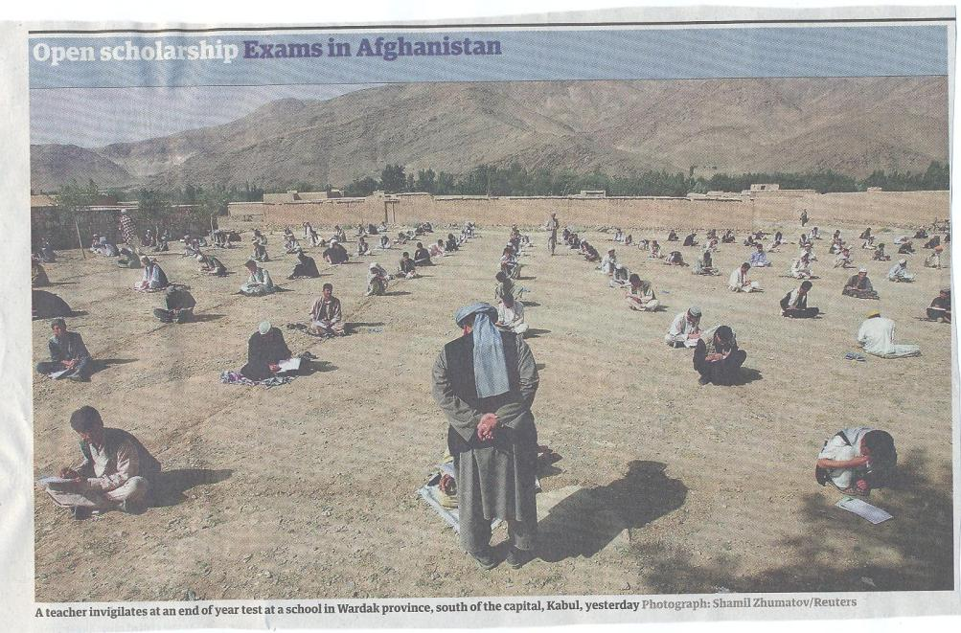

Slide 25
What really impacts on learning?
Concentrating on giving students detailed and developmental formative feedback is the single most useful thing we can do for our students, particularly those from disadvantaged backgrounds.
Summative assessment may have to be rethought to make it fit for purpose;
To do these things may require considerable imagination and re-engineering, not just of our assessment processes but also of curriculum design as a whole if we are to move from considering delivering content the most important thing we do.

Slide 26
The importance of dialogic assessment
Students need to be exposed to, and gain experience in making judgements about, a variety of works of different quality... They need planned rather than random exposure to exemplars, and experience in making judgements about quality. They need to create verbalised rationales and accounts of how various works could have been done better. Finally, they need to engage in evaluative conversations with teachers and other students.

Slide 27
Dialogic feedback continued
Together, these [elements] provide the means by which students can develop a concept of quality that is similar in essence to that which the teacher possesses, and in particular to understand what makes for high quality. Although providing these experiences for students may appear to add more layers to the task of teaching, it is possible to organise this approach to peer assessment so that it becomes a powerful strategy for higher education teaching. (Sadler 2010)

Slide 28
Sound and frequent assessment
Good assessment is valid, reliable, practical, developmental, manageable, cost-effective, fit for purpose, relevant, authentic, inclusive, closely linked to learning outcomes and fair.
Is it possible also to make it enjoyable for staff and students?
Incremental assessment has more value in promoting student learning than end-point ‘sudden death’ approaches.

Slide 29
Giving feedback effectively and efficiently. We can use:
Collective oral reports, with minimal in-script comments;
Collective written reports, with minimal in-script comments;
Model answers with ‘exploded’ text;
Statement banks;
Various kinds of Computer-Assisted Assessment to help with all of these approaches;
Assignment return sheets.

Slide 30
Sample assignment return proforma
Criterion no | Criterion | Mark (0-5 marks) | Tutor comments and suggestions for further work | Student response
1 | Demonstrates ability to present information clearly logically, accurately and fluently | 3 | This work is written reasonably fluently but there are some typos that would not slip in if spell checker used properly. Also note you don’t use the definite and indefinite articles (‘a’ and ‘the’ appropriately: please refer to the language guidance 17.3 on the VLE | This is something I’ve had problems with over the years but am still working on it
2 | Demonstrates ability to choose and use appropriate software | 5 | Made excellent choices and used it well to suit the context of the problem being addressed | Thank you
3 | Demonstrates ability to use a range of reference materials and cite them appropriately | 1 | Cited only one reference and did so inaccurately Please refer to the ifs referencing guide on the VLE and ensure that you provide all the information required | I've checked it out and see where I was going wrong

Slide 31
Putting this in to practice: we need to:
design an assessment strategy that involves a diverse range of methods of assessment (as all forms of assessment disadvantage some students);
consider when designing assessment tasks how any students might be disadvantaged;
maximise the opportunities for each student to achieve at the highest possible level;
ensure the assurance of appropriate standards for all students.

Slide 32
Conclusions: good assessment can:
Help to clarify what is expected of students, and the quality of their work which is necessary for them to succeed;
Help to equalise the experiences of students from very diverse backgrounds;
Maximise the achievement of all students, helping the less-able and stretching the most-able;
Significantly enhance students’ experiences, not only of study, but of life.

Slide 33

These and other slides will be available on my website at www.sally-brown.net

Slide 34
Useful references: 1
Assessment Reform Group (1999) Assessment for Learning : Beyond the black box, Cambridge UK, University of Cambridge School of Education.
Biggs, J. and Tang, C. (2007) Teaching for Quality Learning at University, Maidenhead: Open University Press.
Bloxham, S. and Boyd, P. (2007) Developing effective assessment in higher education: a practical guide, Maidenhead, Open University Press.
Brown, S. Rust, C. & Gibbs, G. (1994) Strategies for Diversifying Assessment, Oxford: Oxford Centre for Staff Development.
Boud, D. (1995) Enhancing learning through self-assessment, London: Routledge.
Brown, S. and Glasner, A. (eds.) (1999) Assessment Matters in Higher Education, Choosing and Using Diverse Approaches, Maidenhead: Open University Press.
Brown, S. and Knight, P. (1994) Assessing Learners in Higher Education, London: Kogan Page.
Brown, S. and Race, P. (2012) Using effective assessment to promote learning in Hunt, L. and Chambers, D. (2012) University Teaching in Focus, Victoria, Australia, Acer Press. P74-91

Slide 35
Useful references 2
Carless, D., Joughin, G., Ngar-Fun Liu et al (2006) How Assessment supports learning: Learning orientated assessment in action Hong Kong: Hong Kong University Press.
Carroll, J. and Ryan, J. (2005) Teaching International students: improving learning for all. London: Routledge SEDA series.
Crosling, G., Thomas, L. and Heagney, M. (2008) Improving student retention in Higher Education, London and New York: Routledge
Crooks, T. (1988) Assessing student performance, HERDSA Green Guide No 8 HERDSA (reprinted 1994).
Falchikov, N. (2004) Improving Assessment through Student Involvement: Practical Solutions for Aiding Learning in Higher and Further Education, London: Routledge.
Gibbs, G. (1999) Using assessment strategically to change the way students learn, in Brown S. & Glasner, A. (eds.), Assessment Matters in Higher Education: Choosing and Using Diverse Approaches, Maidenhead: SRHE/Open University Press.
Higher Education Academy (2012) A marked improvement; transforming assessment in higher education, York: HEA.

Slide 36
Useful references 3
Knight, P. and Yorke, M. (2003) Assessment, learning and employability Maidenhead, UK: SRHE/Open University Press.
Mentkowski, M. and associates (2000) p.82 Learning that lasts: integrating learning development and performance in college and beyond, San Francisco: Jossey-Bass.
McDowell, L. and Brown, S. (1998) Assessing students: cheating and plagiarism, Newcastle: Red Guide 10/11 University of Northumbria.
Nicol, D. J. and Macfarlane-Dick, D. (2006) Formative assessment and self-regulated learning: A model and seven principles of good feedback practice, Studies in Higher Education Vol 31(2), 199-218.
PASS project Bradford http://www.pass.brad.ac.uk/ Accessed November 2013
Pickford, R. and Brown, S. (2006) Assessing skills and practice, London: Routledge.

Slide 37
Useful references 4
Race, P. (2001) A Briefing on Self, Peer & Group Assessment, in LTSN Generic Centre Assessment Series No 9, LTSN York.
Race P. (2007) The lecturer’s toolkit (3rd edition), London: Routledge.
Rust, C., Price, M. and O’Donovan, B. (2003) Improving students’ learning by developing their understanding of assessment criteria and processes, Assessment and Evaluation in Higher Education. 28 (2), 147-164.
Ryan, J. (2000) A Guide to Teaching International Students, Oxford Centre for Staff and Learning Development
Stefani, L. and Carroll, J. (2001) A Briefing on Plagiarism http://www.ltsn.ac.uk/application.asp?app=resources.asp&process=full_record&section=generic&id=10
Sadler, D. Royce (2010) Beyond feedback: developing student capability in complex appraisal,
Assessment & Evaluation in Higher Education, 35: 5, 535-550
Yorke, M. (1999) Leaving Early: Undergraduate Non-completion in Higher Education, London: Routledge.

Slide 38


Slide 39
Criteria for sketches of cats
item | Criteria |  | Marking scheme
1 | 2 eyes |  | 5 items | 7
2 | 2 ears |  | 4 items | 6
3 | 4 paws |  | 3 items | 5
4 | Curly tail |  | 2 items | 4
5 | Whiskers |  | 1 item | 3
 |  |  | Cat without these | 2
 |  |  | Just a drawing | 1
 |  |  | No image | 0

Slide 40
Your (better) subjective criteria
Is it beautiful?
Attitude of real cat
Dynamic – sense of movement
Shape of size: proportions
Anatomically correct position for attitude
Creative

Slide 41
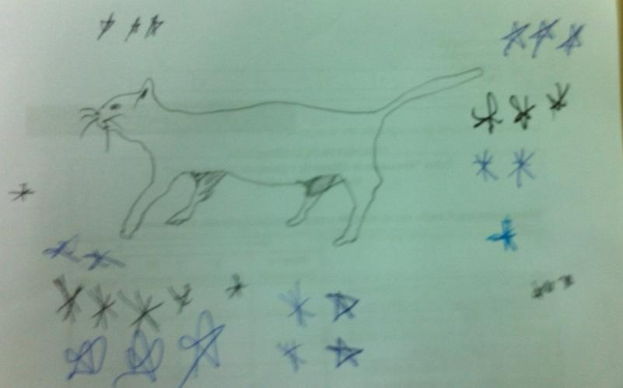
Your winning cat

Slide 42
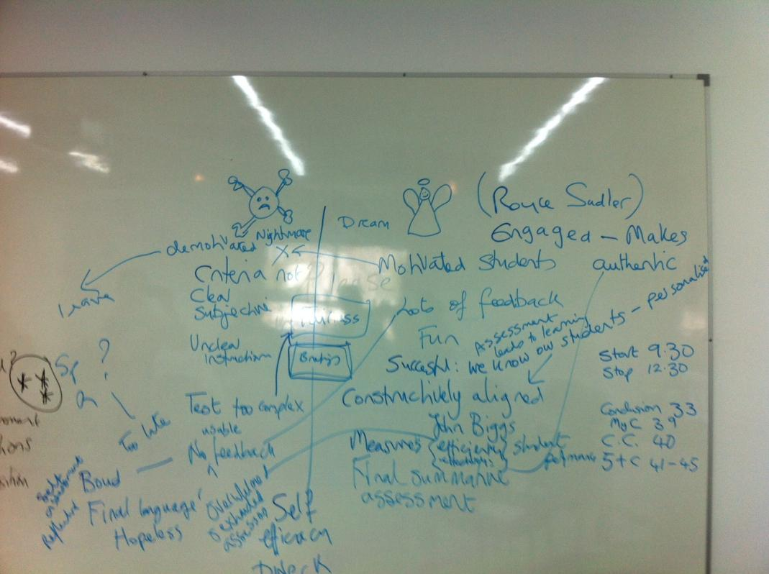

Slide 43
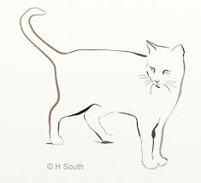

Slide 44


Slide 45


Slide 46


Slide 47


