Slide 1
Qualifications mapping workshop: Conceptualising assessment strategies at the qualification level
The Open University
15 July 2014
Sally Brown
sally-brown.net s.brown@leedsmet.ac.uk @ProfSallybrown

Slide 2
A rationale for designing and implementing a good assessment strategy:
The OU’s move towards assessment at qualification level is a key imperative;
Programme level assessment is integrative in nature, and assesses the knowledge, understanding and skills that represent key programme aims;
Good assessment can act as a positive lever for learning where it is fully integrated within the teaching process (‘Assessment for Learning’);
The highest levels of student dissatisfaction tend to be around assessment and feedback and most student complaints and grievances are concerned with perceived poor assessment practice.

Slide 3
Towards programme level assessment
Curriculum designers do well to move beyond a cantonised curriculum, where each module or unit behaves like a semi-autonomous canton within the Swiss government to a more federated approach where assessments are not only constructively aligned (Biggs and Tang, 2007) but also aligned within and between levels across a whole programme of study making for a more satisfying and fulfilling student experience.

Slide 4
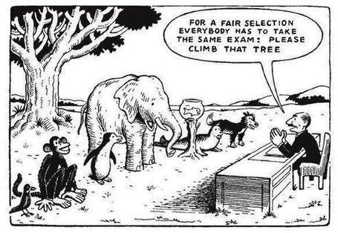

Slide 5
The PASS project
PASS was a UK National Teaching Fellowship-funded project led by Peter Hartley, which has been highly influential in advancing thinking about programme focused assessment (McDowell, 2012).
The project sought to redress imbalances whereby assessment issues are primarily investigated and discussed at module or unit level, with some staff focusing solely on their direct responsibilities at module level, by providing evidence-based guidance and exemplars and examples to help programme leaders develop and implement effective programme focused assessment strategies.

Slide 6
The major assessment problems and issues PASS set out to address included:
Students and staff failing to see the links between elements of the programme, and treating each as a separate item, with no perceptible coherence within an atomized curriculum;
A realisation that in many cases modules were considered to be too short to focus on and provide feedback on slowly learnt literacies and/or complex learning;
Over-assessment, with an associated potential overload of marking, data management and quality assurance procedures;
A failure to assess over-arching programme outcomes;
Too much summative, and not enough formative assessment. (PASS, pp1-2)

Slide 7
The PASS team argued that:
‘The first and most critical point is that the assessment is specifically designed to address major programme outcomes rather than very specific or isolated components of the course. It follows then that such assessment is integrative in nature, trying to bring together understanding and skills in ways which represent key programme aims. As a result, the assessment is likely to be more authentic and meaningful to students, staff and external stakeholders.’ (PASS, p.3)

Slide 8
Some possible solutions they suggest include:
having an integrated curriculum where any of the learning activities could contribute to any of the assessment strands across several years of the programme;
synoptic problem-based assessment and extended year-long modules;
capstone modules, where a substantive assignment can provide a cumulative assessment, bringing together disparate elements of learning across a number of modules;
a separation of assessment blocks and study blocks, enabling formative assessment to be given during the intensive study periods and summative assessment addressed subsequently; and
using portfolios or e-portfolios, linked to personal and professional development.

Slide 9
Two major current UK initiatives on assessment to consider
The UK Quality Assurance Agency (QAA) Code of practice B6 on Assessment and APL.
The Higher Education Academy ‘A marked improvement’ project on bringing about change to institutional strategies on assessment.
Both groups have overlapping membership and therefore aligned perspectives.
Both initiatives draw on the work of previous generations of thinkers on assessment, and particularly the two Centres for Excellence in Teaching and Learning (CETLs) that focused on assessment, Oxford Brookes’ Assessment Knowledge Exchange (ASKe) and Northumbria's Assessment for Learning (A4L).

Slide 10
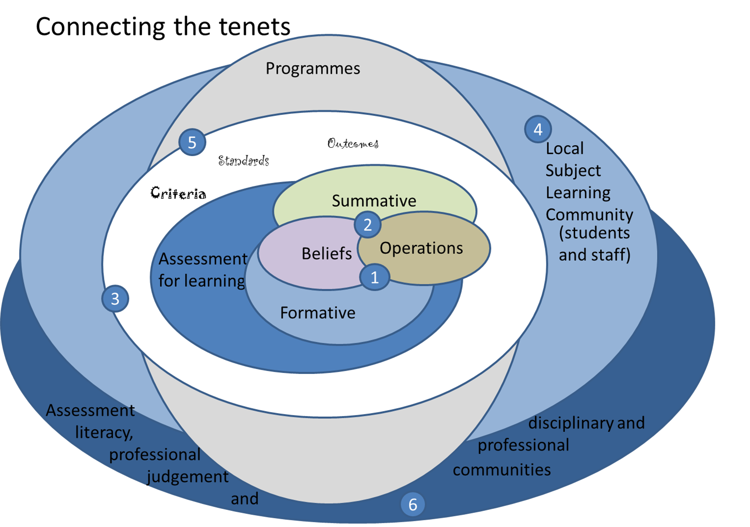

Slide 11
Engagement with the HEA project: A marked improvement
It was designed to transform assessment in higher education strategically at an institutional level;
The Oxford Brookes CETL ASKe produced the Weston Manor Manifesto which provides a framework for A Marked Improvement;
The publication provides a rationale and groundwork for transformation, together with templates enabling institutions to review their own practices and implement change at a university level;
Eight universities worked with the HEA and their associates over a year to pilot the project.

Slide 12
The manifesto for change concentrates on six tenets:
Assessment for learning;
Ensuring assessment is fit for purpose;
Recognition of the imprecision of many assessment practices;
Constructing standards in assessment communities;
Integrating assessment literacy into course design;
Ensuring professional judgments are reliable.

Slide 13
‘Assessment of student learning is a fundamental function of higher education. It is the means by which we assure and express academic standards and has a vital impact on student behaviour, staff time, university reputations, league tables and, most of all, students’ future lives. The [UK] National Student Survey, despite its limitations, has made more visible what researchers in the field have known for many years: assessment in our universities is far from perfect.’ (HEA, 2012 p.7)

Slide 14
Assessment practices in most universities have not kept pace with the vast changes in the context, aims and structure of higher education. They can no longer do justice to the outcomes we expect from a university education in relation to wide-ranging knowledge, skills and employability. In a massified higher education sector where tutor-student ratios have gradually been eroded, students can remain confused about what is expected of them in assessment. Efforts to make this transparent through learning outcomes, assessment criteria and written feedback have proved no substitute for tutor-student interaction and newer groups of students are particularly likely to need this contact.’ (HEA, op cit p.7).

Slide 16
UK Quality Code for Higher Education Part B: Assuring and enhancing academic quality
Chapter B6: Assessment of students and the recognition of prior learning
The Indicators of Sound Practice: these provide an important agenda for action

Slide 17
The basis for effective assessment (1)
Indicator 1
Higher education providers operate effective policies, regulations and processes which ensure that the academic standard for each award of credit or a qualification is rigorously set and maintained at the appropriate level, and that student performance is equitably judged against this standard.
Indicator 2
Assessment policies, regulations and processes, including those for the recognition of prior learning, are explicit, transparent and accessible to all intended audiences.
Indicator 3
Those who might be eligible for the recognition of prior learning are made aware of the opportunities available, and are supported throughout the process of application and assessment for recognition.

Slide 18
The basis for effective assessment (2)
Indicator 4
Higher education providers assure themselves that everyone involved in the assessment of student work, including prior learning, and associated assessment processes is competent to undertake their roles and responsibilities.
Indicator 5
Assessment and feedback practices are informed by reflection, consideration of professional practice, and subject-specific and educational scholarship.

Slide 19
Developing assessment literacy
Indicator 6
Staff and students engage in dialogue to promote a shared understanding of the basis on which academic judgements are made.
Indicator 6
Staff and students engage in dialogue to promote a shared understanding of the basis on which academic judgements are made.
Indicator 7
Students are provided with opportunities to develop an understanding of, and the necessary skills to demonstrate, good academic practice.

Slide 20
Designing assessment
Indicator 8
The volume, timing and nature of assessment enable students to demonstrate the extent to which they have achieved the intended learning outcomes.
Indicator 9
Feedback on assessment is timely, constructive and developmental.
Indicator 10
Through inclusive design wherever possible, and through individual reasonable adjustments wherever required, assessment tasks provide every student with an equal opportunity to demonstrate their achievement.

Slide 21
Conducting assessment
Indicator 11
Assessment is carried out securely.
Indicator 12
Degree-awarding bodies assure themselves that the standards of their awards are not compromised as a result of conducting assessment in a language other than English.

Slide 22
Marking and moderation
Indicator 13
Processes for marking assessments and for moderating marks are clearly articulated and consistently operated by those involved in the assessment process.
Indicator 14
Higher education providers operate processes for preventing, identifying, investigating and responding to unacceptable academic practice.

Slide 23
Examination boards and assessment panels
Indicator 15
Degree-awarding bodies specify clearly the membership, procedures, powers and accountability of examination boards and assessment panels, including those dealing with the recognition of prior learning; this information is available to all members of such boards.
Indicator 16
Boards of examiners/assessment panels apply fairly and consistently regulations for progression within, and transfer between, programmes and for the award of credits and qualifications.
Indicator 17
The decisions of examination boards and assessment panels are recorded accurately, and communicated to students promptly and in accordance with stated timescales.

Slide 24
Enhancement of assessment
processes
Indicator 18
Degree-awarding bodies systematically evaluate and enhance their assessment policies, regulations and processes.

Slide 25
Assessment for Learning
Emphasises authentic & complex assessment tasks
Develops students’ abilities to evaluate own progress, direct own learning
Is rich in informal feedback (e.g. peer review of draft writing, collaborative project work)
Uses high stakes summative assessment rigorously but sparingly
Offers extensive ‘low stakes’ confidence building opportunities and practice
Is rich in formal feedback (e.g. tutor comment, self-review logs)

Slide 26
Assessment for learning
1. Tasks should be challenging, demanding higher order learning and integration of knowledge learned in both the university and other contexts;
2. Learning and assessment should be integrated, assessment should not come at the end of learning but should be part of the learning process;
3. Students are involved in self assessment and reflection on their learning, they are involved in judging performance;
4. Assessment should encourage metacognition, promoting thinking about the learning process not just the learning outcomes;
5. Assessment should have a formative function, providing ‘feedforward’ for future learning which can be acted upon. There is opportunity and a safe context for students to expose problems with their study and get help; there should be an opportunity for dialogue about students’ work;

Slide 27
Assessment for learning
6. Assessment expectations should be made visible to students as far as possible;
7. Tasks should involve the active engagement of students developing the capacity to find things out for themselves and learn independently;
8. Tasks should be authentic; worthwhile, relevant and offering students some level of control over their work;
9. Tasks are fit for purpose and align with important learning outcomes;
10. Assessment should be used to evaluate teaching as well as student learning.
(Bloxham and Boyd)

Slide 28
Boud et al 2010: ‘Assessment 2020’:
Assessment has most effect when...:
It is used to engage students in learning that is productive.
Feedback is used to actively improve student learning.
Students and teachers become responsible partners in learning and assessment.
Students are inducted into the assessment practices and cultures of higher education.
Assessment for learning is placed at the centre of subject and program design.
Assessment for learning is a focus for staff and institutional development.
Assessment provides inclusive and trustworthy representation of student achievement.

Slide 29
The importance of dialogic assessment
Students need to be exposed to, and gain experience in making judgements about, a variety of works of different quality... They need planned rather than random exposure to exemplars, and experience in making judgements about quality. They need to create verbalised rationales and accounts of how various works could have been done better. Finally, they need to engage in evaluative conversations with teachers and other students. Together, these three provide the means by which students can develop a concept of quality that is similar in essence to that which the teacher possesses, and in particular to understand what makes for high quality. Although providing these experiences for students may appear to add more layers to the task of teaching, it is possible to organise this approach to peer assessment so that it becomes a powerful strategy for higher education teaching. (Sadler 2010)

Slide 30
In conclusion: some questions
Can you perceive a progressive pathway through assignments within a qualification that demonstrate cumulative added value to students’ knowledge and capabilities'?
How can you ensure that is assessment fully integrated within learning activities rather than being an add-on that adds nothing to student engagement?
How are you developing students’ assessment literacy, so they understand fully what is required of them and can optimise their performances in a range of assessment contexts?
Is it clear how the assignments link to the learning outcomes within and across levels of the qualification?

Slide 31
Some more questions
Are you offering a diversity of assessment types across the qualification enabling students to demonstrate capability in diverse ways without excessively requiring them to get used to too many types of assignment?
Does feedback from each assignment and between levels provide ‘feedforward’ to help students consolidate learning and improve on previous performance?
Are you confident that the assessment strategy aligns with national and international expectations (e.g. the UK Code of practice section B6) as well as with appropriate professional, Subject and Regulatory Body requirements?

Slide 32
Some systemic questions
How can you resolve the key issues associated with qualification level assessment, when modules are offered on a number of programmes?
How can development teams best resolve differences about assessment within shared pathways when traditionally they have had autonomy in design and execution?
What are the key prioritis for future action?

