Slide 1
A marked improvement Anglia Ruskin FST away days
July 2014
Sally Brown
NTF, PFHEA, SFSEDA
Emerita Professor, Leeds Metropolitan University
Visiting Professor University of Plymouth & Liverpool John Moores University.

Slide 2
Two major current UK initiatives on assessment to consider
The UK Quality Assurance Agency (QAA) Code of practice B6 on Assessment and APL.
The Higher Education Academy ‘A marked improvement’ project on bringing about change to institutional strategies on assessment.
Both groups have overlapping membership and therefore aligned perspectives.
Both initiatives draw on the work of previous generations of thinkers on assessment, and particularly the two Centres for Excellence in Teaching and Learning (CETLs) that focused on assessment, Oxford Brookes’ Assessment Knowledge Exchange (ASKe) and Northumbria's Assessment for Learning (A4L).

Slide 3
‘A Marked Improvement’ aims to improve assessment practice
Stems from firm evidence that assessment is not ‘fit for purpose’ (Race 2010, Brown, 2010);
Aims to take a radical approach, recognising that it is time for significant reappraisal of assessment policy and practice (ASKe, Weston Manor Manifesto);
Builds on expertise, evidence, perspectives, and previous work;
Takes an evidence-informed approach;
Encourages for assessment to be seen as an integral part of the learning experience.
The work aligns with the expectations of the new B6 section of the QAA code of practice, JISC initiatives and other current developments;
Together we are seeking to make assessment contribute to student achievement, engagement and retention by being fit-for-purpose and fully integrated into the learning process.

Slide 4
Origins of the Weston manor manifesto on which the tenets were based – November 2007
40 National and international experts in assessment involved over 2 days
Triggered by the Burgess Report on degree classifications and implications of assessment elements of NSS Results
Outcomes
Six tenets in the manifesto for change to assessment practice
These were shared with HEFCE, HEA, QAA, UUK, GuildHE, NUS

Slide 5
A Marked Improvement comprises 6 tenets
Summarised as:
Assessment for learning
Ensuring assessment is fit for purpose
Recognise that assessment lacks precision
Constructing standards in communities
Integrating assessment literacy into course design
Ensuring professional judgements are reliable
(See marked improvement document for exact wording and further explanation)

Slide 6
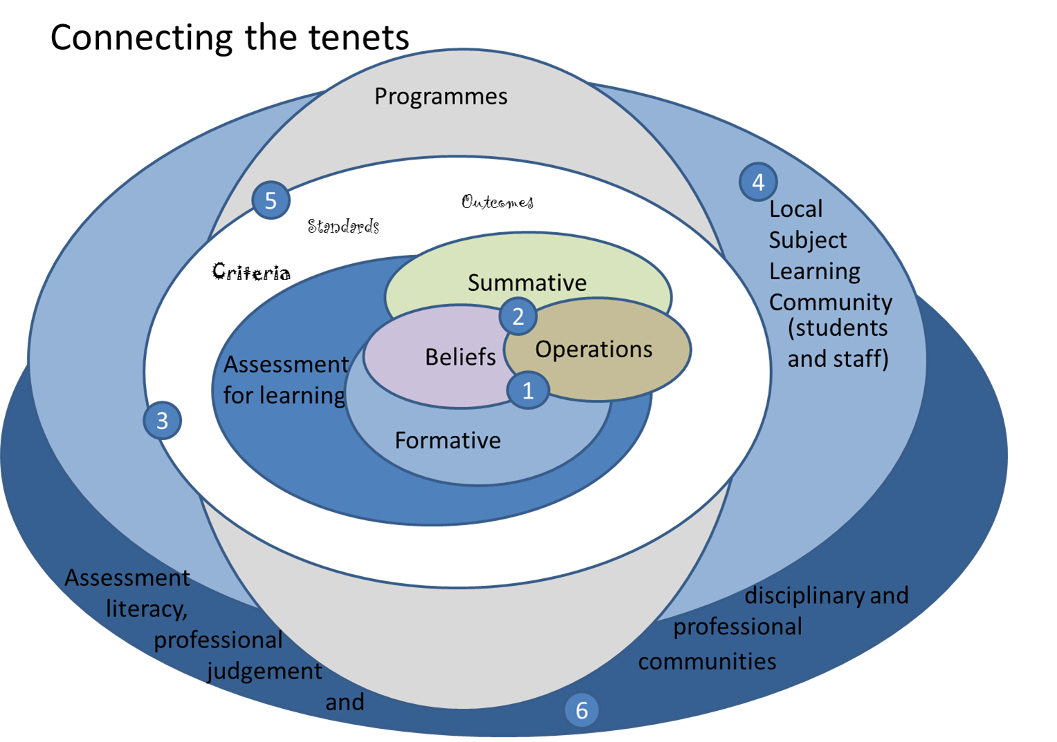

Slide 7
Progress of ARU project so far
5 workshops held involving:
Course leaders
Academics
Managers
Quality assurance staff
Summary of priorities identified
Developing programme approaches to assessment
Developing assessment literacy
Rebalancing summative and formative assessment

Slide 8
Key features of the project
Strategic transformation of assessment across the university is the key aim;
Improved NSS scores is not the specific aim of the project but better scores may well result;
Sharing expertise between course leaders, including those in the 85+ group is important;
Activity is being informed by Vision Visits to other universities;
External expertise from the ‘Marked Improvement’ team is supporting internal expertise.

Slide 9
Why change is needed
QAA subject reviews
Burgess Report - “system no longer fit for purpose” (p5)
QAA - “…it cannot be assumed students graduating …. will have achieved similar standards” (2007)
Media accusations of dumbing down & grade inflation
National Student Satisfaction Survey
“There is considerable scope for professional development in the area of assessment” (Yorke et al, 2000, p7)
Students become more interested in the mark and less interested in the subject over the course of their studies (Newstead 2002, p2)

Slide 10
The manifesto for change concentrates on six tenets:
Assessment for learning;
Ensuring assessment is fit for purpose;
Recognition of the imprecision of many assessment practices;
Constructing standards in assessment communities;
Integrating assessment literacy into course design;
Ensuring professional judgments are reliable.

Slide 12
Sharing across the faculty and the wider university

Slide 13
Some thoughts from the working groups
The importance of both formative and summative feedback, and getting the balance right, and embedding formative feedback, using it for diagnostic purposes
Linking assessment to professional practice, and linking this in turn to professional practice (fit for purpose)
Issues around assessing group work
Feedback on exam scripts (some gave it, some didn’t)

Slide 14
More thoughts
Multiple/incremental assessment
Problems around giving extensions for course work;
The need for academic packages to support failing students;
Constraints around PSRBs requirements;
Discussions around what works well when giving assessors feedback on their assessment (including a traffic light system (RAG sheet)
The importance of letting students know when they are getting informal feedback that it is feedback
The value of group feedback via vodcasts

Slide 15
And still more
The value of real life/ authentic assessment
Feed forward as a way of integrating assessment as learning
The value of using a variety of assessment formats;
A desire to make assessment exciting, interesting and instilling a sense of pride in achievement;
The importance of assessment literacy: familiarising students with the vocabulary of assessment;
The importance of using appropriate new technologies (and some issues with the ARU VLE)

Slide 16
The major success factors identified were:
Motivation (Because student are working towards professional qualifications)
Authentic constructively aligned assessment;
Incremental review
Commitment to students’ success
Assessment literacy
Skills for learning
The value of using students to give a ‘sense check’ on planned assignments

Slide 17
More success factors
The value of immersive experiences
Robust processes
Training to establish standards
The importance of opening up the ‘black box’ of assessment ‘secrets’

Slide 18
Key emergent issues
The difficulty of balancing the restricted number of assessments allowed within the ARU scheme and the desire to give incremental feedback;
Potentially regressive internal validation chairs who insisted on assignments with long word counts
Courses with shared modules where Course leaders have no control over them
The potential of academic regulations to get in the way of good assessment
The potential of PSRB requirements to restrict freedom of movement in setting good assignments (e.g. by insisting on exams)

Slide 19
More issues
Turnitin seems not to be used for submission of assignments other than text based ones
Course leaders have much responsibility and little power and this can impact on the student experience;
Course leaders cannot control who teaches/assesses on their courses.

Slide 20
FST Inputs

Slide 21
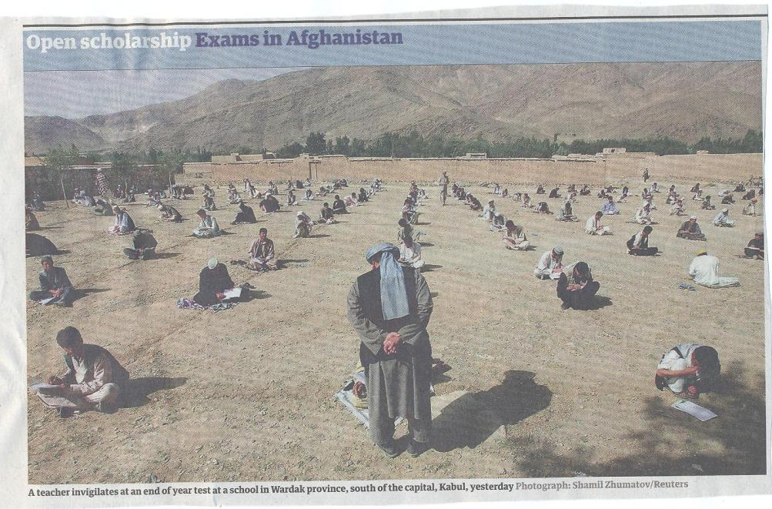

Slide 22
Prioritisation task
What are the key interventions you need to build into your development programmes?
How can you involve students further in a dialogue about assessment?
Using the sample programme assessment strategy, can you identify:
Priorities for change?
Goals for the short, medium and long term?
What further information and resources you require to improve your assessment? …….

Slide 23
To what extent does your assessment strategy:
Maximise fast, formative feedback opportunities without driving your markers into the ground?
Support student transition and retention by making assessment integral to learning?
Enable the development of digital literacy by providing tasks that use social and digital media?
Make the process of assessing and being assessed enjoyable for staff and students?
Assure the standards of assessment against national and PSRB benchmarks?

Slide 24
And…
Provide incremental assessment opportunities?
Use assessment activities that can engage students and be integral to learning?
Constructively align (Biggs 2003) assignments with planned learning outcomes and the curriculum taught?
Provide realistic tasks: students are likely to put more energy into assignments they see as authentic and worth bothering with?
Maximise the dialogic opportunities of student feedback?

Slide 25
Improving assessment at course level

Slide 26
To what extent, and how do you evidence good assessment practice at ARU?
Is there an emphasis on assessment for learning over systems focused on marks, grades and reliability?
Does the assessment design process ensure valid assessment of the intended learning outcomes?
Is there a trade-off between reliability and validity of assessment?
Are assessment decisions in relation to design, development and variety made within a programme context and focused on learning outcomes?
(From ‘A marked improvement’)

Slide 27
Formative and summative assessment
Formative assessment is primarily concerned with feedback aimed at prompting improvement, is often continuous and usually involves words.
Summative assessment is concerned with making evaluative judgments, is often end point and involves numbers.
Notes:
La evaluación formativa concentra en el feedback.
La evaluación sumativa trata de una nota final.

Slide 28
Assessment literacy: students do better if they can:
Make sense of key terms such as criteria, weightings, and level;
Encounter a variety of assessment methods (e.g. presentations, portfolios, posters, assessed web participation, practicals, vivas etc.) and get practice in using them;
Be strategic in their behaviours, putting more work into aspects of an assignment with high weightings, interrogating criteria to find out what is really required and so on;
Gain clarity on how the assessment regulations work in their HEI, including issues concerning submission, resubmission, pass marks, condonement etc.

Slide 29
What does assessment for? What can it do? How much does it matter?
Many argue nowadays that assessment is crucially an integral part of the learning process rather than just a means of judging the extent to which learning has taken place;
Assessment activities can help students get the measure of their achievement and can motivate learning, but can also destroy confidence and undermine already disadvantaged students;
As far as I am concerned there is nothing we do for students that has as much impact as assessment and therefore it’s really worth thinking through how it adds value to the learning experience.

Slide 30
Assessment in context
If we want to improve students’ engagement with learning, a key locus of enhancement can be refreshing our approaches to assessment;
Sometimes we need to take a fresh look at our current practice to make sure assessment is for rather than just of learning;
Assessment is a complex, nuanced and highly important process;
We provide explicit and implicit messages to students and indeed all other stakeholders by how we assess.

Slide 31
Why does assessment matter so much?
“Assessment methods and requirements probably have a greater influence on how and what students learn than any other single factor. This influence may well be of greater importance than the impact of teaching materials” (Boud 1988)
Notes:
Los métodos de evaluación influyen más en el aprendizaje del estudients que cualquier otro factor.

Slide 32
Assessment for learning
1. Tasks should be challenging, demanding higher order learning and integration of knowledge learned in both the university and other contexts;
2. Learning and assessment should be integrated, assessment should not come at the end of learning but should be part of the learning process;
3. Students are involved in self assessment and reflection on their learning, they are involved in judging performance;
4. Assessment should encourage metacognition, promoting thinking about the learning process not just the learning outcomes;
5. Assessment should have a formative function, providing ‘feedforward’ for future learning which can be acted upon. There is opportunity and a safe context for students to expose problems with their study and get help; there should be an opportunity for dialogue about students’ work;

Slide 33
Assessment for learning
6. Assessment expectations should be made visible to students as far as possible;
7. Tasks should involve the active engagement of students developing the capacity to find things out for themselves and learn independently;
8. Tasks should be authentic; worthwhile, relevant and offering students some level of control over their work;
9. Tasks are fit for purpose and align with important learning outcomes;
10. Assessment should be used to evaluate teaching as well as student learning.
(After Bloxham and Boyd)

Slide 34
Twelve questions on assessment. You can:
Use these to help to design an authentic assessment approach at course design stage;
Use them also as an aid to curriculum refreshment activity and prior to periodic review.

Slide 35
Assessment for learning: is assessment fully integrated within learning activities or is it an add-on that adds nothing to student engagement?
Preparation: are you developing students’ assessment literacy, so they understand fully what is required of them and can optimise their performances in a range of assessment contexts? Are staff inducted so they all share understandings of assessment practice.
Purpose: are you clear about why on each occasion you are assessing? Is it to give students guidance on how to improve or remediate work, or it is a scoring exercise to determine final grades? Is it focussing on theory or practise (or an integration of the two)?

Slide 36
Pacing and timing: are you offering feedback and assessment opportunities throughout the learning period or are assignments bunched together (particularly right at the end of the module)? Are you ensuring that students don’t have multiple assignments from different modules with the same submission date?
Volume of assessment: are you offering sufficient opportunities for students to learn through assessment without exhausting staff and putting excessive pressure on students in terms of workload?
Constructive alignment: is it clear how the assignments link to the learning outcomes, and do you offer good coverage of subject material and capabilities (or are you encouraging guessing of topics and risk taking activities)?

Slide 37
Variety: are you enabling students to demonstrate capability in diverse ways or are you reusing the same methods (essays, reports, unseen time-constrained exams) over and over again?
Inclusivity: Are students’ special needs in terms of assessment designed into assignments from the outset or do you have to make special arrangements for students with dyslexia, visual or aural impairments or other disabilities responsively rather than proactively?
Agency: is all your assessment undertaken by tutors or do you also use peers, students themselves, employers and clients?

Slide 38
Feedback: how fast can you provide it and what assurances can you give to students about its usefulness and ability to feed into future assignments?
Quality assurance: are you able to demonstrate that your assessment is fair, consistent and reliable? Will external scrutineers recognise the integrity of the assessment process?
Technology: are you using computer aided assessment where it is most useful (for drills and checking learning) enabling assessor time to be used most effectively where judgment is required?

Slide 39
Assessing students in groups: factors to consider
Choosing group size;
Choosing how groups are formed;
The importance of clear briefing for assessed group work
Devising appropriate rehearsal opportunities;
Negotiating/interrogating criteria;
Weighting group assessment marks (inter/intra peer assessment, self assessment through reflection, tutor assessment);
Managing peer assessment.

Slide 40
A fit-for-purpose model of assessment: the key questions
Why are we assessing?
What is it we are actually assessing?
How are we assessing?
Who is best placed to assess?
When should we assess?
Notes:
40

Slide 41
Encouraging students to take assessment more seriously
All assessment needs to be seen to be fair, consistent, reliable, valid and manageable;
Many assessment systems fail to clarify for students the purposes of different kinds of assessment activity;
Low-stakes early formative assessment helps students, especially those from disadvantaged backgrounds, understand the rules of the game.

Slide 42
Some thoughts on assessment and feedback
Academic staff frequently use a fairly limited range of assessment and feedback methods for individuals and groups, but international pedagogic research suggests that diversity benefits students greatly.
To maximise the benefits of formative feedback, a range of streamlined approaches including statement banks and computer based assessments can supplement traditional forms.
Students do not always recognize or use feedback well, but assessment dialogues can enhance learning.

Slide 43
Making a difference through assessment

Slide 44
Improving feedback: good practice according to Nicol and Macfarlane-Dick (2006):
1. Helps clarify what good performance is (goals, criteria, expected standards);
2. Facilitates the development of self-assessment (reflection) in learning;
3. Delivers high quality information to students about their learning;
4. Encourages teacher and peer dialogue around learning;
5. Encourages positive motivational beliefs and self-esteem;
6. Provides opportunities to close the gap between current and desired performance;
7. Provides information to teachers that can be used to help shape the teaching.

Slide 45
Key issues when giving feedback
Students can’t read our writing.
There is too much emphasis on grades and marks at the expense of learning.
The feedback given is often not very useful and comes too late.
Students are not actively encouraged to self reflect.
Little or no use is made of peer/self assessment and feedback.
Little dialogue takes place around feedback.
Students have little opportunity to collate feedback over time and act upon it.
Most feedback does not feed forward, it only tell students what they have done that is incorrect.
Very little use is made of feedback as a normal part of the learning and teaching process.
Staff vary significantly in their approach to feedback.

Slide 46
How can you engage students who think strategically about assessment?
According to Kneale, assessment shapes student behaviour (marks as money) and poor assessment encourages strategic behaviour;
Clever course developers utilise this tendency and design assessment tools that foster the behaviours we would wish to see (for example, logical sequencing, fluent writing, effective referencing and good time management) and discourage others (‘rummage-sale’ data sourcing, aimless cutting and pasting, and plagiarism).

Slide 47
Sadler, the most cited author on formative assessment argues:
“Students need to be exposed to, and gain experience in making judgements about, a variety of works of different quality... They need planned rather than random exposure to exemplars, and experience in making judgements about quality. They need to create verbalised rationales and accounts of how various works could have been done better. Finally, they need to engage in evaluative conversations with teachers and other students.”

Slide 48
Important aspects of complex, high-level learning outcomes can only be achieved when students are allowed time to ‘come to know’ the standards in use by the community
Slowly learnt academic literacies require rehearsal and practice throughout a programme (Knight and Yorke, 2004).
The achievement of high-level learning requires integrated and coherent progression based on programme outcomes.
Where there is a greater sense of the holistic programme students are likely to achieve higher standards than on more fragmented programmes (Havnes, 2007).
Students need to engage as interactive partners in a learning community, relinquishing the passive role of ‘the instructed’ within processes controlled by academic experts (Gibbs et al, 2004).

Slide 49
Sadler continues…
Together, these ... provide the means by which students can develop a concept of quality that is similar in essence to that which the teacher possesses, and in particular to understand what makes for high quality. Although providing these experiences for students may appear to add more layers to the task of teaching, it is possible to organise this approach to peer assessment so that it becomes a powerful strategy for higher education teaching.
Sadler, D. Royce (2010)

Slide 50
Course learning outcomes should reflect what students should achieve
Making it clear to students what is expected of them;
Making it clear to teachers what students are expected to learn in their own and other modules;
Helping teachers to select the most appropriate teaching strategy for the intended learning outcomes e.g. lecture, seminar, tutorial, group work, discussion, student presentation, laboratory work;
Helping teachers to select the most appropriate assessment style to assess the achievement of the learning outcomes, e.g. project, essay, performance assessment, multiple‐choice questions, exam;
Having a focus on programme learning outcomes – staff therefore need time to collaborate;
Are you confident that students being marked by different people or the same people at different times (inter & intra-tutor reliability) will achieve equivalent marks?

Slide 51
Giving feedback effectively and efficiently. We can use:
Collective oral reports, with minimal in-script comments;
Collective written reports, with minimal in-script comments;
Model answers with ‘exploded’ text;
Statement banks;
Various kinds of computer-assisted assessment to help with all of these approaches;
Assignment return sheets.

Slide 52
Sample assignment return proforma
Criterion no | Criterion | Mark (0-5 marks) | Tutor comments and suggestions for further work | Student response
1 | Demonstrates ability to present information clearly logically, accurately and fluently | 3 | This work is written reasonably fluently but there are some typos that would not slip in if spell checker used properly. Also note you don’t use the definite and indefinite articles (‘a’ and ‘the’ appropriately: please refer to the language guidance 17.3 on the VLE | This is something I’ve had problems with over the years but am still working on it
2 | Demonstrates ability to choose and use appropriate software | 5 | Made excellent choices and used it well to suit the context of the problem being addressed | Thank you
3 | Demonstrates ability to use a range of reference materials and cite them appropriately | 1 | Cited only one reference and did so inaccurately Please refer to the ifs referencing guide on the VLE and ensure that you provide all the information required | I've checked it out and see where I was going wrong

Slide 53
Efficient assessment; we need to:
Stop marking, start assessing!
Explore ways to maximise student ‘time on task’ (Gibbs) and minimise staff drudgery;
Remember that feedback is crucial to student learning but is the most time-consuming aspect of assessment: we need to explore ways of giving feedback effectively and efficiently;
Consider how computer-supported assessment can include use of audio feedback via digital sound files, video commentaries and other means of using course Virtual Learning Environments.

Slide 54
Putting this in to practice. We need to:
design an assessment strategy that involves a diverse range of methods of assessment (as all forms of assessment disadvantage some students);
consider when designing assessment tasks how any students might be disadvantaged;
maximise the opportunities for each student to achieve at the highest possible level;
ensure the assurance of appropriate standards for all students.

Slide 55
Action planning for change
What changes are you planning?
Who needs to take responsibility?
What are your timelines and milestones?
What help do you need?
Are there further workshop topics you would welcome at a university level?
What does success in strategically improving assessment look like for you?
How will you know when you have been successful?

Slide 56
Conclusions
Assessment strategies are often under-designed;
We need to consider the fitness for purpose of each element of the assessment programme;
This will include the assignment questions/tasks themselves, the briefings, the marking criteria, the moderation process and the feedback;
We also need to scrutinise how the assignments align with one another, whether we are over or under-assessing, whether we are creating log-jams for students and markers, whether we are assessing authentically, and whether our processes are fair and sensible.
If we do this, assessment can contribute to improving student learning, thereby making a marked improvement.

Slide 57
Useful references: 1
ASKe Weston Manor manifesto http://www.brookes.ac.uk/aske/Manifesto/ (accessed April 2012)
Assessment Reform Group (1999) Assessment for Learning : Beyond the black box, Cambridge UK, University of Cambridge School of Education.
Biggs, J. and Tang, C. (2007) Teaching for Quality Learning at University, Maidenhead: Open University Press.
Bloxham, S. Marking and moderation in the UK: false assumptions and wasted resources, Assessment & Evaluation in Higher Education 34.2 (2009): 209-220.
Bloxham, S. and Boyd, P. (2007) Developing effective assessment in higher education: a practical guide, Maidenhead, Open University Press.
Brown, S. Rust, C. & Gibbs, G. (1994) Strategies for Diversifying Assessment, Oxford: Oxford Centre for Staff Development.
Boud, D. (1995) Enhancing learning through self-assessment, London: Routledge.
Brown, S. (2011) First class: how assessment can enhance student learning in Blue Skies: new thinking about the future of higher education, London: Pearson.
Brown, S. and Glasner, A. (eds.) (1999) Assessment Matters in Higher Education, Choosing and Using Diverse Approaches, Maidenhead: Open University Press.
Brown, S. and Knight, P. (1994) Assessing Learners in Higher Education, London: Kogan Page.

Slide 58
Useful references 2
Brown, S. and Race, P. (2012) Using effective assessment to promote learning in Hunt, L. and Chambers, D. (2012) University Teaching in Focus, Victoria, Australia, Acer Press, pp.74-91
Carless, D., Joughin, G., Ngar-Fun Liu et al (2006) How Assessment supports learning: Learning orientated assessment in action Hong Kong: Hong Kong University Press.
Carroll, J. and Ryan, J. (2005) Teaching International students: improving learning for all. London: Routledge SEDA series.
Crosling, G., Thomas, L. and Heagney, M. (2008) Improving student retention in Higher Education, London and New York: Routledge
Crooks, T. (1988) Assessing student performance, HERDSA Green Guide No 8 HERDSA (reprinted 1994).
Falchikov, N. (2004) Improving Assessment through Student Involvement: Practical Solutions for Aiding Learning in Higher and Further Education, London: Routledge.
Gibbs, G. (1999) Using assessment strategically to change the way students learn, in Brown S. & Glasner, A. (eds.), Assessment Matters in Higher Education: Choosing and Using Diverse Approaches, Maidenhead: SRHE/Open University Press.
Havnes, A. (2007), ‘What can feedback practices tell us about variation in grading across fields?’ Presented at the ASKe Seminar Series, Oxford Brookes University, 19th September.

Slide 59
Useful references 3
Higher Education Academy (2012) A marked improvement; transforming assessment in higher education, York: HEA.
Knight, P. and Yorke, M. (2003) Assessment, learning and employability Maidenhead, UK: SRHE/Open University Press.
Mentkowski, M. and associates (2000) p.82 Learning that lasts: integrating learning development and performance in college and beyond, San Francisco: Jossey-Bass.
McDowell, L. and Brown, S. (1998) Assessing students: cheating and plagiarism, Newcastle: Red Guide 10/11 University of Northumbria.
Nicol, D. J. and Macfarlane-Dick, D. (2006) Formative assessment and self-regulated learning: A model and seven principles of good feedback practice, Studies in Higher Education Vol 31(2), 199-218.
Newstead, S. E. and Dennis, I. (1994), ‘Examiners examined: the reality of exam marking in psychology’, The Psychologist, 7, pp. 216-19.
O’Donovan, B., Price, M. and Rust, C. (2004), ‘Know what I mean? Enhancing student understanding of assessment standards and criteria’, Teaching in Higher Education, 9, pp. 325-335.
PASS project Bradford http://www.pass.brad.ac.uk/ Accessed November 2013
Pickford, R. and Brown, S. (2006) Assessing skills and practice, London: Routledge.

Slide 60
Useful references 4
Race, P. (2001) A Briefing on Self, Peer & Group Assessment, in LTSN Generic Centre Assessment Series No 9, LTSN York.
Race P. (2007) The lecturer’s toolkit (3rd edition), London: Routledge.
Rust, C., Price, M. and O’Donovan, B. (2003) Improving students’ learning by developing their understanding of assessment criteria and processes, Assessment and Evaluation in Higher Education. 28 (2), 147-164.
Stefani, L. and Carroll, J. (2001) A Briefing on Plagiarism http://www.ltsn.ac.uk/application.asp?app=resources.asp&process=full_record&section=generic&id=10
Sadler, D. R. (1987), ‘Specifying and Promulgating Achievement Standards’, Oxford Review of Education, 13, pp. 191–209.
Sadler, DR 1989, ‘Formative assessment and the design of instructional systems’, Instructional Science, vol. 18, pp. 119-144.
Sadler, R. (2008) Assessment of Higher Education, in International Encyclopaedia of Education
Sadler, D. Royce (2010) Beyond feedback: developing student capability in complex appraisal, Assessment & Evaluation in Higher Education, 35: 5, 535-550
Yorke, M. (1999) Leaving Early: Undergraduate Non-completion in Higher Education, London: Routledge.

