Slide 1
Making a difference through assessment Anglia Ruskin University: Music and Performing Arts & Cambridge School of Art
January 2014
Sally Brown
http://sally-brown.net
Emerita Professor, Leeds Metropolitan University,
Adjunct Professor, University of the Sunshine Coast, Central Queensland and James Cook University Queensland
Visiting Professor, University of Plymouth and Liverpool John Moores University.

Slide 2
By the end of the workshop, participants will have had a chance to:
review current assessment practices with a view to redesigning some elements of them;
consider how best to brief students to ensure best possible achievements;
discuss the impact of changes to mitigate inherent risks and maximise impact.

Slide 3
Rationale for the workshop
Students are more likely to be unsatisfied with assessment than any other aspect of the student experience;
If we want to improve students’ engagement with learning, a key locus of quality enhancement can be refreshing our approaches to assessment.
Sometimes we need to take a fresh look at our current practice to make sure assessment is for rather than just of learning.

Slide 4
My predictions for the future
The move away from educational organisations being the guardians of content, where everything is about delivery, towards having two major functions:
Recognising and accrediting achievement, wherever such learning has taken place;
Supporting student learning and engagement.
Notes:
En el futuro las universidades tendrán dos funciones clave
El reconocimiento y la homologación del rendimiento, logros, éxitos del estudiante aunque fueran conseguidos fuera de la universidad
El apoyo del aprendizaje y del compromiso del estudiante

Slide 5
What is assessment for? What can it do? How much does it matter?
Many argue nowadays that assessment is crucially an integral part of the learning process rather than just a means of judging the extent to which learning has taken place;
Assessment activities can help students get the measure of their achievement and can motivate learning, but can also destroy confidence and undermine already disadvantaged students;
As far as I am concerned there is nothing we do for students that has as much impact as assessment and therefore it’s really worth thinking through how it adds value to the learning experience.

Slide 6
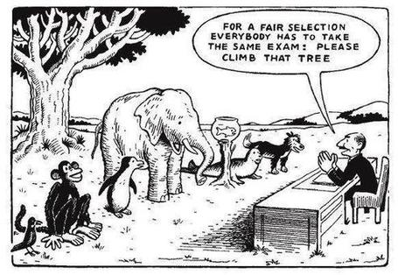

Slide 7
In this workshop we will consider
methodology: which methods and approaches would be most appropriate and efficient for particular contexts and purposes;
agency: who should be undertaking assessment? Tutors, peers, students themselves, employers and clients can all participate in student assessment to good effect.
timing: end point and continuous assessment can both be valuable, but choosing when to assess students can have an impact on how they address the task
weighting: if we want to demonstrate the value we attribute to the demonstration of particular competences and skills, we can do so by higher or lower weightings a different points in the programme depending on desired outcomes.
orientation: in some assignments we may wish to focus particularly on process and in others we may instead focus on outcomes.

Slide 8
Two major current UK initiatives on assessment to consider
The UK Quality Assurance Agency (QAA) Code of practice B6 on Assessment and APL.
The Higher Education Academy ‘A marked improvement’ project on bringing about change to institutional strategies on assessment.
Both groups have overlapping membership and therefore aligned perspectives.
Both initiatives draw on the work of previous generations of thinkers on assessment, and particularly the two Centres for Excellence in Teaching and Learning (CETLs) that focused on assessment, Oxford Brookes’ Assessment Knowledge Exchange (ASKe) and Norhtumbria’s Assessment for Learning (A4L).

Slide 9
Extracts from the UK Quality Code for Higher Education
Part B: Assuring and enhancing academic quality
Chapter B6: Assessment of students and the recognition of prior learning
The Indicators of Sound Practice: these provide an important agenda for action

Slide 10
The basis for effective assessment (1)
Indicator 1
Higher education providers operate effective policies, regulations and processes which ensure that the academic standard for each award of credit or a qualification is rigorously set and maintained at the appropriate level, and that student performance is equitably judged against this standard.
Indicator 2
Assessment policies, regulations and processes, including those for the recognition of prior learning, are explicit, transparent and accessible to all intended audiences.
.

Slide 11
The basis for effective assessment (2)
Indicator 4
Higher education providers assure themselves that everyone involved in the assessment of student work, including prior learning, and associated assessment processes is competent to undertake their roles and responsibilities.
Indicator 5
Assessment and feedback practices are informed by reflection, consideration of professional practice, and subject-specific and educational scholarship.

Slide 12
Developing assessment literacy
Indicator 6
Staff and students engage in dialogue to promote a shared understanding of the basis on which academic judgements are made.
Indicator 7
Students are provided with opportunities to develop an understanding of, and the necessary skills to demonstrate, good academic practice.

Slide 13
Designing assessment
Indicator 8
The volume, timing and nature of assessment enable students to demonstrate the extent to which they have achieved the intended learning outcomes.
Indicator 9
Feedback on assessment is timely, constructive and developmental.
Indicator 10
Through inclusive design wherever possible, and through individual reasonable adjustments wherever required, assessment tasks provide every student with an equal opportunity to demonstrate their achievement.

Slide 14
Marking and moderation
Indicator 13
Processes for marking assessments and for moderating marks are clearly articulated and consistently operated by those involved in the assessment process.
Indicator 14
Higher education providers operate processes for preventing, identifying, investigating and responding to unacceptable academic practice.

Slide 15
Enhancement of assessment
processes
Indicator 18
Degree-awarding bodies systematically evaluate and enhance their assessment policies, regulations and processes.

Slide 16
Assessment for Learning: see http://www.northumbria.ac.uk/sd/central/ar/academy/cetl_afl/
Emphasises authenticity and complexity in the content and methods of assessment rather than reproduction of knowledge and reductive measurement.
Uses high-stakes summative assessment rigorously but sparingly rather than as the main driver for learning.
Offers students extensive opportunities to engage in the kinds of tasks that develop and demonstrate their learning, thus building their confidence and capabilities before they are summatively assessed.
Is rich in feedback derived from formal mechanisms e.g. tutor comments on assignments, student self-review logs.
Is rich in informal feedback e.g. peer review of draft writing, collaborative project work, which provides students with a continuous flow of feedback on ‘how they are doing’.
Develops students’ abilities to direct their own learning, evaluate their own progress and attainments and support the learning of others. (my emphasis)

Slide 17
Assessment for Learning
Emphasises authentic & complex assessment tasks
Develops students’ abilities to evaluate own progress, direct own learning
Is rich in informal feedback (e.g. peer review of draft writing, collaborative project work)
Uses high stakes summative assessment rigorously but sparingly
Offers extensive ‘low stakes’ confidence building opportunities and practice
Is rich in formal feedback (e.g. tutor comment, self-review logs)

Slide 18
Assessment for learning implications
1. Tasks should be challenging, demanding higher order learning and integration of knowledge learned in both the university and other contexts;
2. Learning and assessment should be integrated, assessment should not come at the end of learning but should be part of the learning process;
3. Students are involved in self assessment and reflection on their learning, they are involved in judging performance;
4. Assessment should encourage metacognition, promoting thinking about the learning process not just the learning outcomes;
5. Assessment should have a formative function, providing ‘feedforward’ for future learning which can be acted upon. There is opportunity and a safe context for students to expose problems with their study and get help; there should be an opportunity for dialogue about students’ work;

Slide 19
Assessment for learning
6. Assessment expectations should be made visible to students as far as possible;
7. Tasks should involve the active engagement of students developing the capacity to find things out for themselves and learn independently;
8. Tasks should be authentic; worthwhile, relevant and offering students some level of control over their work;
9. Tasks are fit for purpose and align with important learning outcomes;
10. Assessment should be used to evaluate teaching as well as student learning.
(Bloxham and Boyd)

Slide 20
Boud et al 2010: ‘Assessment 2020’:
Assessment has most effect when...:
It is used to engage students in learning that is productive.
Feedback is used to actively improve student learning.
Students and teachers become responsible partners in learning and assessment.
Students are inducted into the assessment practices and cultures of higher education.
Assessment for learning is placed at the centre of subject and program design.
Assessment for learning is a focus for staff and institutional development.
Assessment provides inclusive and trustworthy representation of student achievement.

Slide 21
Assessment linked to learning
Effective assessment significantly and positively impacts on student learning, (Boud, Mentkowski, Knight and Yorke and many others).
Assessment shapes student behaviour (marks as money) and poor assessment encourages strategic behaviour (Kneale). Clever course developers utilise this tendency and design assessment tools that foster the behaviours we would wish to see (for example, logical sequencing, fluent writing, effective referencing and good time management) and discourage others (‘jumble-sale’ data sourcing, aimless cutting and pasting and plagiarism).
Notes:
La evaluación influye sobre el comportamiento del estudiante (Refs)

Slide 22
A fit-for-purpose model of assessment: the key questions
Why are we assessing?
What is it we are actually assessing?
How are we assessing?
Who is best placed to assess?
When should we assess?
Notes:
22

Slide 23
Why are we assessing?
Choosing the reasons for assessment: these may include:
Enabling students to get the measure of their achievement;
Helping them consolidate their learning;
Providing feedback so they can improve and remedy any deficiencies;
motivating students to engage in their learning;
providing them with opportunities to relate theory and practice, especially in HE and FE.
Notes:
23

Slide 24
more purposes...
Helping students make sensible choices about option alternatives and directions for further study;
demonstrating student employability;
providing assurance of fitness to practice (in HE);
giving feedback to teachers on effectiveness;
providing statistics for internal and external agencies.
Notes:
24

Slide 25
Choosing what we assess
product or process?
theory or practice (HE particularly);
knowledge, skills and attitude (all sectors)?
subject knowledge or application?
what we’ve always assessed?
what it’s easy to assess?
Notes:
25

Slide 26
Being imaginative by choosing diverse assessment methods?
essays, unseen written exams, reports
portfolios, projects, vivas, assessed seminars, poster presentations, annotated bibliographies, blogs, diaries, reflective journals, critical incident accounts, artefacts, productions, case studies, field studies, exhibitions, critiques, theses…….
Notes:
26

Slide 27
Alternatives to traditional exams
Open-book exams Take-away papers
Case studies Simulations
Objective Structured Clinical Examinations (OSCEs)
Short answer questions
In-tray exercises Live assignments
Multiple choice Questions
Notes:
27

Slide 28
Diverse and innovative assessment helps
Traditional assessment methods tend to reinforce rather limited approaches to learning by students, by encouraging memorisation, unproductive rote learning and attitude to knowledge acquisition that are reminiscent of the language of eating disorders (stuffing in and regurgitation of facts). We need to utilise a wide range of assessment methods and approaches.
Innovative assessment approaches can foster a spirit of enquiry, encourage curiosity and promote autonomy where they encourage students to become closely involved with evaluating their own and each others’ learning. (Falchikov, Pickford and Brown, 2006).
Notes:
La evaluación debe ser diversa e innovadora.

Slide 29
Choosing who is best placed to assess
tutor assessment
self-assessment
peer assessment, (either inter or intra peer)
employers, practice tutors and line managers
client assessment
Notes:
29

Slide 30
When should assessment take place?
No sudden death.
end point or incrementally?
when students have finished learning or when there is still time for improvement?
when it is convenient to our systems?
when it is manageable for students? (avoiding assessment log jams).
Notes:
30

Slide 31
Assessment literacy: students do better if they can:
Make sense of key terms such as criteria, weightings, and level;
Encounter a variety of assessment methods (e.g. presentations, portfolios, posters, assessed web participation, practicals, vivas etc) and get practice in using them;
Be strategic in their behaviours, putting more work into aspects of an assignment with high weightings, interrogating criteria to find out what is really required and so on;
Gain clarity on how the assessment regulations work in their HEI, including issues concerning submission, resubmission, pass marks, condonement etc.

Slide 32
Giving constructive and formative feedback
Concentrating on giving students detailed and developmental formative feedback is the single most useful thing we can do for our students, particularly those from disadvantaged backgrounds.
The language we use for feedback impacts highly on achievement: beware of what Boud calls ‘final language’ (‘disastrous’, ‘appalling’, hopeless’, or even ‘superlative’);
Feedback which is ephemeral has less impact than that which is recorded in some way (consider using audio or video files or insisting students take notes and reflect on them).

Slide 33
Formative and summative assessment
Formative assessment is primarily concerned with feedback aimed at prompting improvement, is often continuous and usually involves words.
Summative assessment is concerned with making evaluative judgments, is often end point and involves numbers.
Notes:
La evaluación formativa concentra en el feedback.
La evaluación sumativa trata de una nota final.

Slide 34
Good feedback practice:
1. Helps clarify what good performance is (goals, criteria, expected standards);
2. Facilitates the development of self-assessment (reflection) in learning;
3. Delivers high quality information to students about their learning;
4. Encourages teacher and peer dialogue around learning;
5. Encourages positive motivational beliefs and self-esteem;
6. Provides opportunities to close the gap between current and desired performance;
7. Provides information to teachers that can be used to help shape the teaching.

Slide 35
Sadler, the most cited author on formative assessment argues:
“Students need to be exposed to, and gain experience in making judgements about, a variety of works of different quality... They need planned rather than random exposure to exemplars, and experience in making judgements about quality. They need to create verbalised rationales and accounts of how various works could have been done better. Finally, they need to engage in evaluative conversations with teachers and other students.”

Slide 36
Sadler continues…
Together, these three provide the means by which students can develop a concept of quality that is similar in essence to that which the teacher possesses, and in particular to understand what makes for high quality. Although providing these experiences for students may appear to add more layers to the task of teaching, it is possible to organise this approach to peer assessment so that it becomes a powerful strategy for higher education teaching.
Sadler, D. Royce (2010)

Slide 37
Students benefit if we can make feedback timely
Aim to get feedback on work back to students very quickly, while they still care and while there is till time for them to do something with it.
The longer students have to wait to get work back, especially if they have moved into another semester by the time they receive their returned scripts, the less likely it is that they will do something constructive with lecturer’s hard-written comments.

Slide 38
Assessment and confidence
Crudely, student achievement is linked to students own beliefs about their abilities, whether these are fixed or malleable;
Students who subscribe to an entity (fixed) theory of intelligence need ‘a diet of easy successes’ (Dweck, 2000:15) to confirm their ability and are fearful of learning goals as this involves an element of risk and personal failure. Assessment for these students is an all-encompassing activity that defines them as people. If they fail at the task, they are failures.

Slide 39
Students who believe that intelligence is malleable may be more robust
Students who believe that intelligence is incremental have little or no fear of failure. A typical response from such a student is ‘The harder it gets, the harder I need to try’. These students do not see failure as an indictment of themselves and [can] separate their self-image from their academic achievement. When faced with a challenge, these students are more likely to continue in the face of adversity because they have nothing to prove. (after Clegg in Peelo and Wareham, 2002).

Slide 40
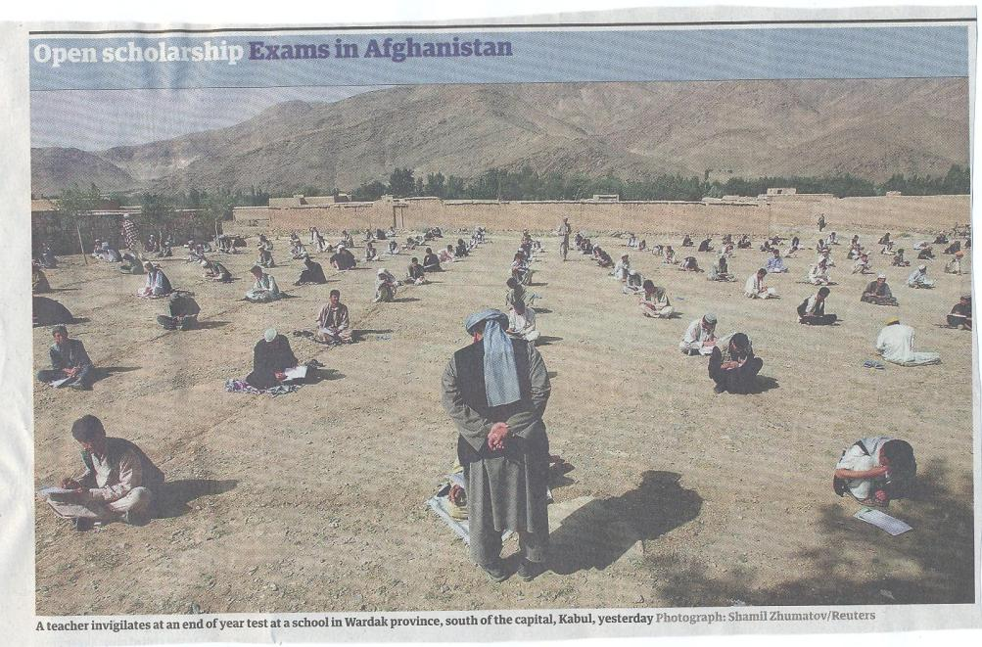

Slide 41
Efficient assessment: we need to:
Stop marking, start assessing!
Explore ways to maximise student ‘time on task’ (Gibbs) and minimise staff drudgery;
Remember that feedback is crucial to student learning but the most time-consuming aspect of assessment: we need to explore ways of giving feedback effectively and efficiently;
Note that Computer-supported assessment can include use of audio feedback via digital sound files, video commentaries and other means of using course Virtual Learning Environments.

Slide 42
To give feedback more effectively
& efficiently, we can:
Use model answers;
Use assignment return sheets;
Write an assignment report;
Feedback to groups of students;
Use statement banks;
Use computer-assisted assessment;
Involve students in their own assessment.

Slide 43
Sample assignment return proforma
Criterion no | Criterion | Mark (0-5 marks) | Tutor comments and suggestions for further work | Student response
1 | Demonstrates ability to present information clearly logically, accurately and fluently | 3 | This work is written reasonably fluently but there are some typos that would not slip in if spell checker used properly. Also note you don’t use the definite and indefinite articles (‘a’ and ‘the’ appropriately: please refer to the language guidance 17.3 on the VLE | This is something I’ve had problems with over the years but am still working on it
2 | Demonstrates ability to choose and use appropriate software | 5 | Made excellent choices and used it well to suit the context of the problem being addressed | Thank you
3 | Demonstrates ability to use a range of reference materials and cite them appropriately | 1 | Cited only one reference and did so inaccurately Please refer to the ifs referencing guide on the VLE and ensure that you provide all the information required | I've checked it out and see where I was going wrong

Slide 44
Conclusions
Assessment strategies are often under-designed;
We need to consider the fitness for purpose of each element of the assessment programme;
This will include the assignment questions/tasks themselves, the briefings, the marking criteria, the moderation process and the feedback;
We also need to scrutinise how the assignments align with one another, whether we are over or under-assessing, whether we are creating log-jams for students and markers, whether we are assessing authentically, and whether our processes are fair and sensible.
If we do this, assessment can contribute to improving student learning.

Slide 45

These and other slides will be available on my website at www.sally-brown.net

Slide 46
Useful references: 1
Assessment Reform Group (1999) Assessment for Learning : Beyond the black box, Cambridge UK, University of Cambridge School of Education.
Biggs, J. and Tang, C. (2007) Teaching for Quality Learning at University, Maidenhead: Open University Press.
Bloxham, S. and Boyd, P. (2007) Developing effective assessment in higher education: a practical guide, Maidenhead, Open University Press.
Brown, S. Rust, C. & Gibbs, G. (1994) Strategies for Diversifying Assessment, Oxford: Oxford Centre for Staff Development.
Boud, D. (1995) Enhancing learning through self-assessment, London: Routledge.
Brown, S. and Glasner, A. (eds.) (1999) Assessment Matters in Higher Education, Choosing and Using Diverse Approaches, Maidenhead: Open University Press.
Brown, S. and Knight, P. (1994) Assessing Learners in Higher Education, London: Kogan Page.
Brown, S. and Race, P. (2012) Using effective assessment to promote learning in Hunt, L. and Chambers, D. (2012) University Teaching in Focus, Victoria, Australia, Acer Press. P74-91

Slide 47
Useful references 2
Carless, D., Joughin, G., Ngar-Fun Liu et al (2006) How Assessment supports learning: Learning orientated assessment in action Hong Kong: Hong Kong University Press.
Carroll, J. and Ryan, J. (2005) Teaching International students: improving learning for all. London: Routledge SEDA series.
Crosling, G., Thomas, L. and Heagney, M. (2008) Improving student retention in Higher Education, London and New York: Routledge
Crooks, T. (1988) Assessing student performance, HERDSA Green Guide No 8 HERDSA (reprinted 1994).
Falchikov, N. (2004) Improving Assessment through Student Involvement: Practical Solutions for Aiding Learning in Higher and Further Education, London: Routledge.
Gibbs, G. (1999) Using assessment strategically to change the way students learn, in Brown S. & Glasner, A. (eds.), Assessment Matters in Higher Education: Choosing and Using Diverse Approaches, Maidenhead: SRHE/Open University Press.
Godfrey, J. (2013) The student phrase book: vocabulary for writing at University, Basingstoke, Palgrave

Slide 48
Useful references 3
Higher Education Academy (2012) A marked improvement; transforming assessment in higher education, York: HEA.
Knight, P. and Yorke, M. (2003) Assessment, learning and employability Maidenhead, UK: SRHE/Open University Press.
Mentkowski, M. and associates (2000) p.82 Learning that lasts: integrating learning development and performance in college and beyond, San Francisco: Jossey-Bass.
McDowell, L. and Brown, S. (1998) Assessing students: cheating and plagiarism, Newcastle: Red Guide 10/11 University of Northumbria.
Nicol, D. J. and Macfarlane-Dick, D. (2006) Formative assessment and self-regulated learning: A model and seven principles of good feedback practice, Studies in Higher Education Vol 31(2), 199-218.
PASS project Bradford http://www.pass.brad.ac.uk/ Accessed November 2013
Pickford, R. and Brown, S. (2006) Assessing skills and practice, London: Routledge.

Slide 49
Useful references 4
Race, P. (2001) A Briefing on Self, Peer & Group Assessment, in LTSN Generic Centre Assessment Series No 9, LTSN York.
Race P. (2007) The lecturer’s toolkit (3rd edition), London: Routledge.
Rust, C., Price, M. and O’Donovan, B. (2003) Improving students’ learning by developing their understanding of assessment criteria and processes, Assessment and Evaluation in Higher Education. 28 (2), 147-164.
Ryan, J. (2000) A Guide to Teaching International Students, Oxford Centre for Staff and Learning Development
Stefani, L. and Carroll, J. (2001) A Briefing on Plagiarism http://www.ltsn.ac.uk/application.asp?app=resources.asp&process=full_record&section=generic&id=10
Sadler, D. Royce (2010) Beyond feedback: developing student capability in complex appraisal,
Assessment & Evaluation in Higher Education, 35: 5, 535-550
Yorke, M. (1999) Leaving Early: Undergraduate Non-completion in Higher Education, London: Routledge.

