Slide 1
Small group teaching and mentoring
University of Luxembourg
December 5th 2013
Sally Brown
@ProfSallyBrown
Emerita Professor, Leeds Metropolitan University
Adjunct Professor, University of the Sunshine Coast, University of Central Queensland and James Cook University, Queensland
Visiting Professor University of Plymouth & Liverpool John Moores University.

Slide 2
Introduction
Teaching in small groups can be a highly effective means of engendering learning particularly when purposeful and systematic approaches are used.
The role of the facilitator of small group work is crucial in fostering student understanding and engagement in social learning.
Staff support and mentoring can be targeted to enhance students’ academic literacies, enabling them to become more effective learners, which in turn is likely to result in improvement retention and student achievement.

Slide 3
By the end of this workshop, participants should be better able to:
Use a range of techniques in small group teaching that encourage all students to contribute and gain benefit from the learning opportunities provided;
Foster effective academic behaviours among students that enhance academic, digital, social and assessment literacies;
Support students individually and in small groups, encouraging them to be open to suggestions for improvement and better prepared for employment and continuing study.

Slide 4
Why get students working in small groups?
Teaching in small groups requires a range of skills different from those used in lecturing, particularly in terms of managing student inputs and activities. Group size and means of formation can influence student behaviors, hence the importance of tutor choices.
Effective tutoring can engender positive student behaviours and study habits, to ensure that all students are well prepared as learners.
Most employers expect graduates to be able to perform well in team situations, and so effective in-course support for skills development is key.

Slide 5
How to engage and motivate students?

Slide 6
Group work and employability
Students on graduation will usually work in teams and so employers expect graduates to have enhanced group work skills;
Such skills need to be developed and honed, with students able to make good judgments about their own group work skills;
Assessed group tasks in the curriculum provide opportunities for rehearsal and learning through experience about balancing personal contribution with facilitating others’ participation.

Slide 7
Getting to grips with group work
Although employers are keen to recruit graduates who are effective team members, universities don’t always prepare students as effectively as they could to work and be assessed in groups. Poorly designed assessed group work can be divisive and unpopular with students. Here we can consider:
What kinds of things go wrong in group work, particularly when it is assessed?
How can we prepare students for working in groups through appropriate briefing and rehearsal?
What ways of assessing students in groups are there that are fit- for-purpose depending on the scale and scope of the assignment?

Slide 8
Implicit values in group work
Respect for the opinions and viewpoints of others, listening and responding appropriately;
Respect for valid reasoning. The ability to detect poor argument and to engage in respectful dialogue;
A commitment to regular attendance and to cooperation with others in independent group work involving debate and dialogue;
Active use of concepts and modes of reasoning introduced in the module content;
A commitment to shared reflection on course processes.
(Foreman-Peck and Winch, 2010)

Slide 9
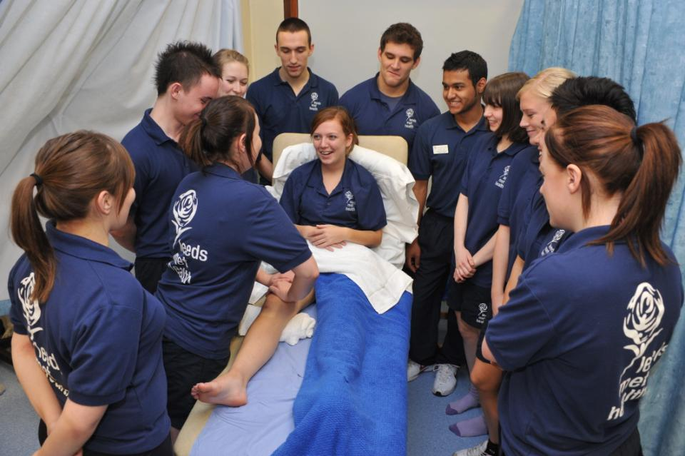
Authentic assessment helps learning

Slide 10
To engage students we need to foster the key literacies that students need:
Academic literacy: understanding how higher education works;
Information literacy: understanding how to locate and, most importantly, select information;
Social literacy: understanding how to work with others using emotional intelligence
Digital literacy: the ability effectively to use a wide range of media;
Assessment literacy: understanding how assessment systems work in universities.

Slide 11
Academic literacy: understanding how higher education works. This includes:
What comprises poor academic conduct;
What plagiarism looks like and how to avoid it;
How to apply for late submission of work and what extenuating circumstances comprise
Writing for academic purposes (when to use third person or first person, active or passive voice, register, tone and vocabulary);
Reading for academic purposes (including reading for understanding, reading for information, skim reading and seeking quotes to back up arguments.

Slide 12
Helping students understand writing conventions
Devote energy to helping students understand what is required of them in terms of writing;
Work with them to understand the various academic discourses that are employed within the subject/institution;
Help them to understand when writing needs to be personal and based on individual experience, such as in a reflective log, and when it needs to be formal and using academic conventions like passive voice and third person, as in written reports and essays.

Slide 13
Help students understand what is required with reading
Help them also to understand that there are different kinds of approaches needed for reading depending on whether they are reading for pleasure, for information, for understanding or reading around a topic;
Help them to become active readers with a pen and Post-its in hand, rather than passive readers, fitting the task in alongside television and other noisy distractions;
Give them clear guidance in the early stages about how much they need to read and what kinds of materials they need to focus on.

Slide 14
Information literacy is crucial

Slide 15
Fostering Information literacy involves helping students to:
Understand what kinds of information sources are trustworthy and how important peer review is as a means of quality assurance of information i.e. what differentiates a peer-reviewed journal article from, for example, a vanity publication;
Use trusted web systems (e.g. using Google Scholar rather than just Google, recognising the limits to the trustworthiness Wikipedia, and considering carefully the value of personal postings on websites);
Use and cite references appropriately using standard conventions;...

Slide 16
And also to:
Make sense of the mass of information available to them in text, image and sound, through hard copy and digital means and on the university site as well as virtually;
Make judgments on issues such as how current information needs to be and how generalist or specialist sources for particular tasks should be.

Slide 17
Social literacy involves
Understanding the importance of professionalism within working groups;
Recognising that this involves putting personal preferences/prejudices and friendships/ enmities apart when working collaboratively;
Learning how to work through conflicts and impasses in collective activity;
Being collegiate, and accepting collective responsibility for tasks and decisions;
Being emotionally intelligent.

Slide 18
Emotional intelligence helps students
Better understand and work with others;
Employ empathy to achieve the ends they are seeking;
Notice and use non-verbal cues from others;
Productively consider how their own non-verbal cues are being perceived;
Understand, express and regulate their own of emotions;
Improve their own capacities for flexible planning and creative thinking.
(after Mortiboys, 2005)

Slide 19
Digital literacy: potential inequalities that may need redressing
While most students bring high levels of digital capability to the classroom nowadays, arising from familiarity developed throughout childhood and beyond, some will be less capable of using the wide range of available technologies;
The concept of BYOD (Bring Your Own Device) implies that some students will have top of the range equipment while others will struggle by with lesser devices and be consequently disadvantaged;
Some but not all students are likely to be using a range of social media including Twitter, Facebook and other means to network and communicate for academic purposes.

Slide 20
Assessment literacy: students do better if they can:
Make sense of key terms such as criteria, weightings, and level;
Encounter a variety of assessment methods (e.g. presentations, portfolios, posters, assessed web participation, practicals, vivas etc) and get practice in using them;
Be strategic in their behaviours, putting more work into aspects of an assignment with high weightings, interrogating criteria to find out what is really required and so on;
Gain clarity on how the assessment regulations work in their HEI, including issues concerning submission, resubmission, pass marks, condonement etc

Slide 21
Assessment and confidence
Crudely, student achievement is linked to students own beliefs about their abilities, whether these are fixed or malleable;
Students who subscribe to an entity (fixed) theory of intelligence need ‘a diet of easy successes’ (Dweck, 2000:15) to confirm their ability and are fearful of learning goals as this involves an element of risk and personal failure. Assessment for these students is an all-encompassing activity that defines them as people. If they fail at the task, they are failures.

Slide 22
Students who believe that intelligence is malleable may be more robust
Students who believe that intelligence is incremental have little or no fear of failure. A typical response from such a student is ‘The harder it gets, the harder I need to try’. These students do not see failure as an indictment of themselves and [can] separate their self-image from their academic achievement. When faced with a challenge, these students are more likely to continue in the face of adversity because they have nothing to prove. (after Clegg in Peelo and Wareham, 2002)

Slide 23
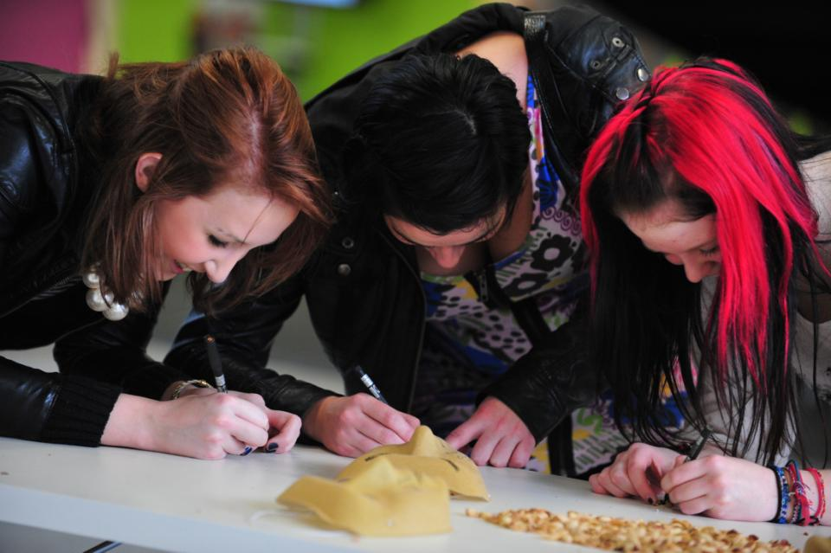
It’s all about fostering engagement

Slide 24
Strategies for assessing students in groups
If the task is small and early and the weighting of marks in relation to the overall module mark is minor, give the students a group mark with no differentiation (but then talk to them about the implications of this);
Break up the group task into separate equivalent elements and assess students individually on these tasks;
Give an overall mark to the group assignment, but give each student an additional individual task (for example, a reflection) to differentiate effort;...

Slide 25
Further strategies
Give an overall mark to the group assignment outcome, and then viva the students individually on their learning from the task;
Give an overall mark to the group assignment outcome, and then set an exam question at the end of the module to enable students individually to demonstrate their learning from the group task.

Slide 26
Further strategies
Give an overall mark to the group assignment outcome and then get students to additionally peer assess each other’s contribution to the group task using agreed criteria like active engagement in the task, the ability to facilitate the participation of others, commitment to group success etc.
Give an overall mark to the group assignment outcome, divide that mark by the number of students in the group and then ask the students to decide whether each student in the group merits the average mark, the average +1 or +2 or the average -1 or 2
(Brown, Rust and Gibbs, (1994) Strategies for Diversifying Assessment)

Slide 27
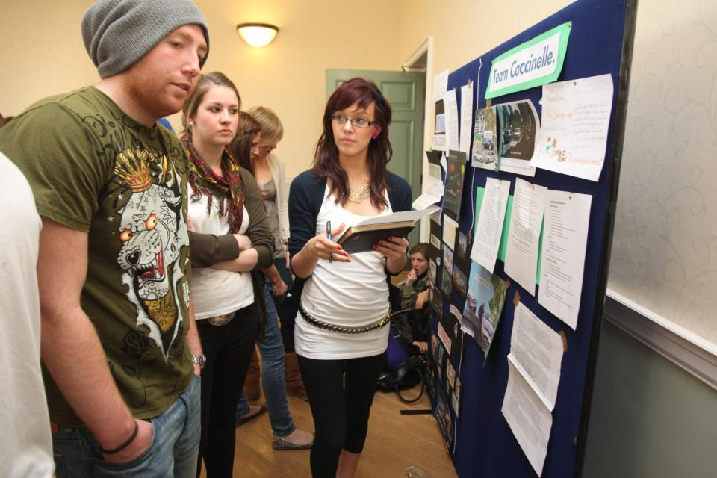
Involve students in their own assessment

Slide 28
Involving students in assessing peers in groups. Why?
Available research indicates that involving students in their own assessment makes them better learners (deep not surface learning);
If students feel they can get away with a free ride, then engagement may be harder to promote;
Assessing group participation really needs the involvement of peers to be meaningful;
Students can get inside the criteria and start to work out what they really mean in practice.

Slide 29
However:
Criteria need to be explicit and clear to all concerned from the outset;
Assessment must use evidence matched against the criteria;
Students and staff need training and rehearsal before it is implemented ‘for real’;
Rehearsal implies having the opportunity to practice giving marks and feedback in a non-threatening and supportive environment where issues can be raised and discussed freely and productively.

Slide 30
Implementing self and peer assessment
There are no quick fixes in assessment;
Effective implementation needs careful briefing of all parties, rehearsal and unpacking;
Self and peer assessment rely on the provision of appropriate evidence against clear explicit and readily-available criteria;
You need to decide who (self, intra-peer, inter-peer) and how (formatively or summatively) you will assess any element of group work.

Slide 31
Potential cultural issues related to group work:
Students from cultures where the genders are usually strictly segregated may find activities like group work and presentations challenging initially;
There can be issues around students who are not prepared to ask questions in class or seek support, for fear of ‘losing face’, or causing the teacher to ‘lose face’ ;
There is diversity in the extent to which robust discussion is valued, with students from some cultures preferring to focus on the importance of harmony and co-operation within the group rather the interests of the individual within it (Ryan op cit 2000).

Slide 32
Mentoring students: some issues for discussion. Is it better to:
Adopt an ‘open door’ policy to enable students to drop in when they have a problem they want to discuss, or to ask students to sign up for timed slots?
Encourage students to come to talk to you individually, or in small groups?
Meet up with students in informal contexts or always require face-to-face meetings to be on campus?

Slide 33
More mentoring questions
Should mentoring/personal tutoring be mandatory or voluntary?
How can you best manage email enquiries from students without degenerating into ‘email tennis’ with lengthy correspondence with individual students?
How can you encourage students from all national groups to make equal use of your mentoring time/skills?
How can you best use the course Virtual Learning Environment (VLE) for supporting students?

Slide 34
Planning to maximize the effectiveness of small group work
Which of the ideas you have discussed today would you like to implement in your practice?
Are these likely to be individual or course team activities?
What support might you need to make this happen? (Timetable flexibility, space swap, financial support?)
How will you know if you have been successful?
How can you share your success?

Slide 35
Conclusions
Group work is a necessary approach in Higher Education nowadays and has many benefits for students in relation to personal development and employability;
However, it is the locus of much student dissatisfaction and complaints;
As with other pedagogic issues, fairness, transparency, inclusivity and equity are prerequisites for successful group work and assessment.

Slide 36
These and other slides will be available on my website at www.sally-brown.net

Slide 37
Useful references: 1
Biggs, J. and Tang, C. (2007) Teaching for Quality Learning at University, Maidenhead: Open University Press.
Brown, S. (September 2006 and January 2007) ‘The art of small group teaching’ in the ‘New Academic’, Birmingham: SEDA
Brown, S. (2001)New at this, Case study in Lecturing: case studies, experience and practice from Higher education (eds. Edwards, H., Smith, B. and Webb, G.) London: Kogan Page.
Brown, S. Rust, C. & Gibbs, G. (1994) Strategies for Diversifying Assessment, Oxford: Oxford Centre for Staff Development.
Brown, S. and Knight, P. (1994) Assessing Learners in Higher Education, London: Kogan Page.
Brown, S. and Race, P. (2012) Using effective assessment to promote learning in Hunt, L. and Chambers, D. (2012) University Teaching in Focus, Victoria, Australia: Acer Press, p.74-91.
Falchikov, N. (2004) Improving Assessment through Student Involvement: Practical Solutions for Aiding Learning in Higher and Further Education, London: Routledge.

Slide 38
Useful references 2
Foreman-Peck, L. and Winch, C. (2010) Using Educational Research to Inform Practice: A Practical Guide to practitioner research in universities and colleges. London: Routledge
Jaques, D. and Salmon, G. (2007) Learning in groups: a handbook for face-to-face and on-line environments (4th edition) London: Routledge.
Nicol, D. J. and Macfarlane-Dick, D. (2006) Formative assessment and self-regulated learning: A model and seven principles of good feedback practice. Studies in Higher Education Vol 31(2), 199-218.
Pickford, R. and Brown, S. (2006) Assessing skills and practice, London: Routledge.
Race, P. (2001) A Briefing on Self, Peer & Group Assessment in LTSN Generic Centre Assessment Series No 9 LTSN York.
Race, P. and Pickford, R. (2007) Making Teaching work: Teaching smarter in post-compulsory education, London: Sage.
Race, P. (2006) The lecturer’s toolkit (3rd edition), London: Routledge.
Ryan, J. (2000) A Guide to Teaching International Students, Oxford: Oxford Centre for Staff and Learning Development.

