Slide 1
Why does teaching and learning matter to European Universities in the 21st Century?
Luxembourg University
4 December 2013
Phil Race and Sally Brown
phil@phil-race.co.uk
sally@sally-brown.net

Slide 2
What’s this session about?
Globally universities are becoming more student-centred, with teaching, learning, feedback and assessment foregrounded alongside research. Where students pay significant tuition fees to attend university, they unsurprisingly expect value for money and elsewhere a sustained focus on quality assurance requires similar attention to pedagogy.
This presentation will explore how higher education is changing, with the advent of innovative forms of curriculum design and delivery, including Massive Open Online Courses (Moocs) and the need to recognise and manage the changing expectations of today’s students.

Slide 3
By the end of the session we hope that you will be better able to:
Discuss the changes in university education in recent years, with student learning increasingly foregrounded, and with student satisfaction data becoming ever more important;
Address the implications of students’ expectations that the teaching, learning support, and particularly assessment they meet at university will be fit for purpose in the 21st century;
Consider what changes academic staff might need to make to address the needs of learners in the current highly competitive international context.

Slide 4
Do we currently have a global Higher Education environment?
Do we have, for example:
shared concepts of pedagogy?
equivalent and mutually accreditable assessment systems?
compatible technologies for learning?
comparable learning contexts?
shared languages for learning?
shared concepts of student support compared with our target markets?

Slide 5
Some introductory comments
In many countries, students are now widely regarded as ‘customers’ / consumers of higher education, and universities need to adapt and enhance provision so that students are satisfied with their experience of higher education;
In our age of rapid digital communication of information, we need to work out how best to use the ‘new technologies’ to enhance student learning, and especially feedback and assessment for learning;
It is timely to work out exactly how student-centred learning can be offered by European universities.

Slide 6

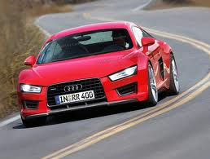




Slide 7
Our predictions for the future
The move away from educational organisations being the guardians of content, where everything is about delivery, towards having two major functions:
Recognising and accrediting achievement, wherever such learning has taken place;
Supporting student learning and engagement.
Notes:
En el futuro las universidades tendrán dos funciones clave
El reconocimiento y la homologación del rendimiento, logros, éxitos del estudiante aunque fueran conseguidos fuera de la universidad
El apoyo del aprendizaje y del compromiso del estudiante

Slide 8
MOOCs and higher education in 2013
We are now in an era of mass education with significantly increasing sizes of Higher Education Institutions – but some already with fewer students!!
Distance education is seen as a panacea in some areas with the increasing promotion of Massive Open On-line Courses (MOOCs) currently gaining much publicity;
Higher Education Institutions including Harvard, MIT and the UK OU offer free on-line content, with some offering peer review opportunities for assignments;
Currently most MOOCs don’t offer assessment or credit opportunities and retention can be a significant problem: but this will change.

Slide 9

Massive, Open Online Courses

Slide 10
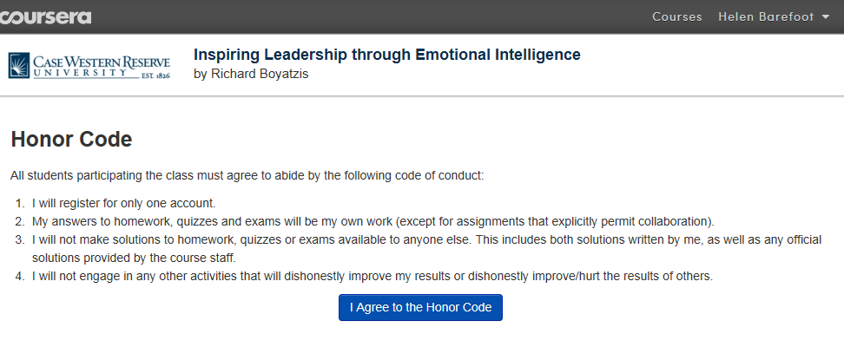
This is what MOOC users commit to:

Slide 11
An ‘honor’ code...
All students participating the class must agree to abide by the following code of conduct:
I will register for only one account.
My answers to homework, quizzes and exams will be my own work (except for assignments which explicitly permit collaboration).
I will not make solutions to homework, quizzes or exams available to anyone else. This includes both solutions written by me, as well as any official solutions written by the course staff.
I will not engage in any other activities that will dishonestly improve my results or dishonestly improve/hurt the results of others.
Validation – the only validation on this MOOC was online acceptance of an honor code. If MOOCs are to provide credit with any currency, then this will have to change. (Martin Hall)

Slide 12
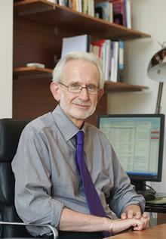
Prof Martin Hall on MOOCs
They could finish off the lecture as a form of conveying information, and the teacher becomes an expert guide in a world of abundance rather than a lecturer passing down wisdom from the podium.

Slide 13
Seven factors underpinning successful learning
These factors are based on the answers to six questions which I have asked 170,000 people in the last twenty years.

Slide 14
Wanting to
Learn
Assessing: making judgements
Factors underpinning learning
Needing to
Learn
Verbalising orally
Learning by doing
Learning through feedback
Making sense

Slide 15
Ripples on a pond….
Coaching,
explaining, teaching
Assessing
making informed judgements
Wanting/
Needing
Doing
Making sense
Feedback

Slide 16

Surface learners?
Deep learners?
Rote
learners?
What kinds of learners have we got?
Strategic learners?
Cue-conscious learners?
Cue-oblivious learners?
Cue-seeking learners?

Slide 17
Surface learners?
Deep learners?
Rote
learners?
What kinds of learners have we got?
Strategic learners?
Cue-conscious learners?
Cue-oblivious learners?
Cue-seeking learners?

Slide 18
How do we know if we are offering excellent teaching?
Students are satisfied, learn well, achieve highly and have fulfilling learning experiences;
We as teachers are satisfied, motivated and find their workloads manageable;
Quality assurers and Professional and Subject bodies like what we do and have no complaints about systems and processes;
University managers are confident that the student experience offered is of high quality (and deal with few complaints).

Slide 19
Characteristics of excellent university teachers:
Knows subject material thoroughly
Adopts a scholarly approach to the practice of teaching
Is reflective and regularly reviews own practice
Is well organised and plans curriculum effectively
Is passionate about teaching
Has a student-centred orientation to teaching
Regularly reviews innovations in learning and teaching and tries out ones relevant to own context
Ensures that assessment practices are fit for purpose and contribute to learning
Demonstrates empathy and emotional intelligence

Slide 20
High quality teaching…
…“implies recognising that students must be engaged with the content of learning tasks in a way that is likely to enable them to reach understanding…Sharp engagement, imaginative inquiry and finding of a suitable level and style are all more likely to occur if teaching methods that necessitate student energy, problem solving and cooperative learning are employed”. (Ramsden, 2003, p97)

Slide 21
Good teachers help students develop their skills and capabilities including:
Academic literacy;
Information management literacy;
Digital literacy;
Assessment literacy;
Social literacy.
We argue that fostering these literacies is more important nowadays than simply delivering content (what some call ‘knowledge transfer’).

Slide 22
And now thinking about assessment…

Slide 23
Drives most learning
Is assessment broken?
Some assessment
issues
What students think
Assessment as learning
Validity
Whodunit?
Fairness

Slide 24
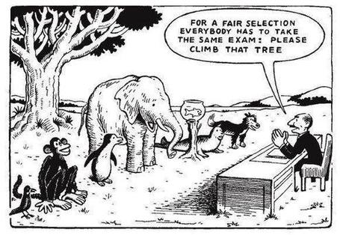

Slide 25
Some key concerns...
We still tend to try to measure...
...what’s in students’ heads, and what they can do with what’s there, in terms of two unsatisfactory proxies ...
what comes out of students’ pens in exams;
what comes out of their keyboards in essays and reports.

Slide 26
Validity
Fairness
Whodunit?
Six
aspects of ‘quality’ of assessment
Real-world
links
Transparency
Manageability

Slide 27
Assessment for Learning
(A4L CETL)
Emphasises authentic & complex assessment tasks
Develops students’ abilities to evaluate own progress, direct own learning
Is rich in informal feedback (e.g. peer review of draft writing, collaborative project work)
Uses high stakes summative assessment rigorously but sparingly
Offers extensive ‘low stakes’ confidence building opportunities and practice
Is rich in formal feedback (e.g. tutor comment, self-review logs)

Slide 28
There are huge disparities in the ways in which different nations deal with assessment including:
The types and duration of exams and the conditions under which they are taken;
The extent to which course work is accepted/ encouraged/ permitted;
The amount that Computer Based Assessment is used, and for what, with what kinds of questions;
The extent to which group assessment is required/allowed;
The extent to which oral assessment replaces/ supplements written assessment
Who undertakes the assessment design and execution (the people who teach the programme, national/ international agencies, peers, self…)….

Slide 29
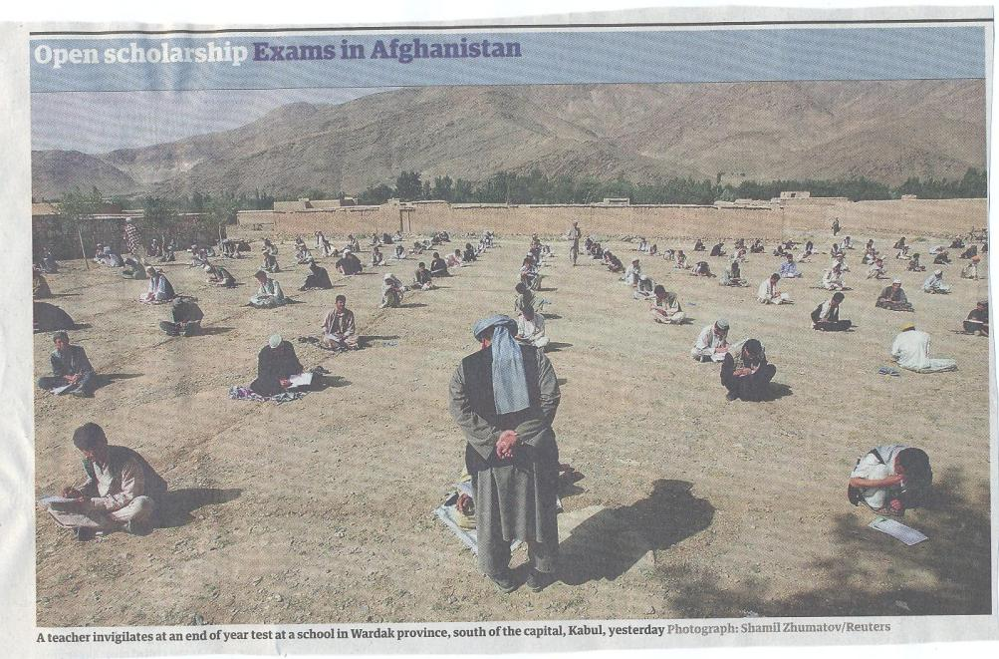

Slide 30
Sadler, D. Royce (2010) ‘Beyond feedback: developing student capability in complex appraisal’,
Assessment & Evaluation in Higher Education, 35: 5, 535-550
Students need to be exposed to, and gain experience in making judgements about, a variety of works of different quality... They need planned rather than random exposure to exemplars, and experience in making judgements about quality. They need to create verbalised rationales and accounts of how various works could have been done better. Finally, they need to engage in evaluative conversations with teachers and other students. Together, these three provide the means by which students can develop a concept of quality that is similar in essence to that which the teacher possesses, and in particular to understand what makes for high quality. Although providing these experiences for students may appear to add more layers to the task of teaching, it is possible to organise this approach to peer assessment so that it becomes a powerful strategy for higher education teaching.

Slide 31
Using what comes out of their pens?
Using how they assess each others’
learning?
Using how they assess their own learning?
Using what they say?
How can we assess what students have learned?
Using how they solve problems?
Using things they make?
Using how they answer our questions?
Using how they work with each other?
Using how they do practical things?
Using what they put online?

Slide 32
1 Tutor designs assignment and briefs students about assessment requirements
10 Students each write (e.g.) 200 words reflecting on learning from assignment, to include with next assignment
9 Tutor confirms mark, adding (e.g.) 5% if student within (e.g.) 5% of tutor’s mark
2 Students draft assignments individually
8 Student estimates mark from feedback on own and others’ assignments
Learning from feedback from tutors, peers, and self-assessing
3 Tutor gives generic feedback and guidance to whole group
7 Tutor provides feedback (and keeps record of mark)
4 Students give feedback to peers (before submitting, must review work of x peers)
5 Student reviews own assignment following peer feedback having seen x other assignments
6 Student submits assignment to tutor for marking

Slide 33
Some conclusions
University education is changing fast and it is important to plan strategically to address key imperatives for staff and students;
Curriculum design and delivery must take into account global developments, particularly in relation to how we manage student learning and engagement processes if the university is to keep pace with current trends;
Helping students develop key literacies to cope with a changing context is crucial;
The biggest locus for change in assessment is likely to be moving towards dialogic assessment rather than treating students as passive recipients.

Slide 34
Some key sources about assessment, feedback and learning in higher education
Knight, P. and Yorke, M. (2003) Assessment, learning and employability, Maidenhead, UK SRHE/Open University Press.
Bloxham, S. and Boyd, P. (2007) Developing effective assessment in higher education: a practical guide, Maidenhead, Open University Press
Brown, S. and Glasner, A. (eds.) (1999) Assessment Matters in Higher Education, Choosing and Using Diverse Approaches, Maidenhead: Open University Press.
Brown, S. and Knight, P. (1994) Assessing Learners in Higher Education, London: Kogan Page.
Higher Education Academy (2012) A marked improvement; transforming assessment in higher education, York: HEA.
Pickford, R. and Brown, S. (2006) Assessing skills and practice,London: Routledge.
Rust, C., Price, M. and O’Donovan, B. (2003) Improving students’ learning by developing their understanding of assessment criteria and processes, Assessment and Evaluation in Higher Education. 28 (2), 147-164.

Slide 35
Some key sources about assessment, feedback and learning in higher education
Sadler, D. Royce (2010) Beyond feedback: developing student capability in complex appraisal,
Assessment & Evaluation in Higher Education, 35: 5, 535-550
Bowl, M. (2003) Non-traditional entrants to higher education ‘they talk about people like me, Stoke on Trent, UK, Trentham Books.
Flint, N. R. and Johnson, B. (2011) Towards fairer university assessment – recognising the concerns of students, London: Routledge.
Gibbs, G. (2010) Using assessment to support student learning, Leeds: Leeds Met Press.
Boud, D. and Associates (2010) Assessment 2020: seven propositions for assessment reform in higher education Sydney: Australian Learning and Teaching Council.
Joughin, G. (2010) A short guide to oral assessment, Leeds: Leeds Met Press.

Slide 36
Some key sources about assessment, feedback and learning in higher education
Petty, G. (2009) Evidence-Based Teaching: A Practical Approach (Second Edition) Cheltenham UK: Nelson Thornes
Race, P. (2010) Making learning happen: 2nd edition London: Sage Publications.
Blue Skies (2011) new thinking about the future of higher education: download free from http://pearsonblueskies.com/
Hunt, D. and Chalmers, L. (eds) (2012) University Teaching in Focus: a learning-centred approach see Chapter 5: Using effective assessment to promote learning, Sally Brown and Phil Race Australia: ACER Press, and London: Routledge.
Price, M., Rust, C., O’Donovan, B. and Handley, K. (2012) Assessment Literacy, Oxford: the Oxford Centre for Staff and Learning Development (based on the ‘ASKe’ Project).
Sambell, K., McDowell, L. and Montgomery, C. (2013) Assessment for Learning in Higher Education, London: Routledge.

Slide 37
Assessment in context
If we want to improve students’ engagement with learning, a key locus of enhancement can be refreshing our approaches to assessment;
Sometimes we need to take a fresh look at our current practice to make sure assessment is for rather than just of learning;
Assessment is a complex, nuanced and highly important process;
We provide explicit and implicit messages by how we assess.

