Slide 1
Making a good start: academic induction
Plymouth University October 2013
Sally Brown
http://sally-brown.net
Twitter @ProfSallyBrown
Emerita Professor, Leeds Metropolitan University,
Visiting Fellow, University of Northumbria
Adjunct Professor, University of the Sunshine Coast, Central Queensland and James Cook University Queensland
Visiting Professor, University of Plymouth and Liverpool John Moores University.

Slide 2
The workshop
In this workshop colleagues will start to devise and plan activities for your own students suitable for your local context and subject areas.
This session is designed to help first year teams improve incoming students' transition into university;
These activities take note of Mantz Yorke’s research (1999) indicating that the early weeks of the first semester can be hugely influential on students achievement and retention;
It aligns to the Curriculum Refreshment project 2013-2015

Slide 3
The curriculum enrichment project 2013-2015: Ambition
To provide ‘excellent learning and stimulating student experience’ (Plymouth University Strategy 2013-20) that is genuinely at the national cutting edge of student learning and delivers the University Teaching, Learning and Student Experience Strategy initiatives.
To support all our students consistently with curricula and co-curricular opportunities across a 30 week learning year, through alignment of the academic year in semesters.
To prioritise inclusive assessments, and minimise our MAP (modified assessment provision) needs, so that all our students are treated as equally as possible in all aspects of their programme.

Slide 4
The curriculum enrichment project 2013-2015: Overview 1
The Plymouth University Curriculum Enrichment Project (PUCEP) will review and revise the level 4, year 1 curriculum to offer a full 30 week learning experience including opportunities for a broad menu of co-curricular activities and the introduction of interdisciplinary Plymouth Plus modules. A priority is to enable all level 4, first year students to complete and pass two modules before the Christmas break. Benefits will include greater student engagement with their learning, active learning and research experience opportunities, and improved student retention.

Slide 5
The curriculum enrichment project 2013-2015:
Overview 2
At levels 5 and 6 we will introduce a two semester structure, where programme can choose to teach in sequence or parallel to enable placements, performance, fieldwork elements to be undertaken in term time. The opportunity for a four or five week term-time research placement with a member of staff or off-campus is enabled through the revised timetable patterns.

Slide 6
The curriculum enrichment project 2013-2015:
Overview 3
This proposal recognises that knowledge in the 21st-century is easily available, what matters is developing the personal and IT skills to work with it. Modules will probably address less ‘stuff’, covering fewer topics but in greater depth. Students will develop their ability to be critically engaged with the material and to tackle larger and more difficult problems through group research. Working full-time on one module at one time will allow double loop learning to be more explicit, engagement with alumni and community groups, and greater opportunities for students to reinforce practical experience.

Slide 7
The curriculum enrichment project 2013-2015:
Overview 4
This proposal recognises that modern academic research in most disciplines is a team activity benefiting from shared discussion, argument and debate. It also recognises that businesses need people who can be flexible, innovative and confident in team settings (CBI 2011).
These changes will affect all undergraduate learning from September 2014. Parallel changes to Taught Masters programmes should follow in 2015-16.

Slide 8
The curriculum enrichment project 2013-2015: Some Issues driving this proposal: 1
Our students do not have a ‘30 week’ value for money learning experience. Student and parent dissatisfaction.
Level 4 student engagement, and class attendance is not good in many programmes ‘there's no real reason to attend unless it really engages you, or it’s a compulsory assessment session’. First year isn't consistently developing good practice study habits in preparation for second and third year. First-year academic experience is perceived to be of limited value.

Slide 9
The curriculum enrichment project 2013-2015:
Some Issues driving this proposal: 2
Many students are not receiving feedback until after Christmas of year 1, and have few marks by which they can assess their progress. In some cases first feedback is after Easter. This affects students’ confidence in their academic ability and retention.
Plymouth has a very high proportion of disabled students; we should aim to provide everyone with the same learning, support and inclusive assessment opportunities.

Slide 10
The curriculum enrichment project 2013-2015:
Some Issues driving this proposal: 3
Arguably there is over assessment in some modules, and over-reliance on terminal examinations in some Faculties. Returning to Plymouth for August resit examinations is very expensive for our students.
Co-curricular activities need timetabled weeks to encourage student engagement. (Co-curricular activities are ‘not for credit’, recognised through the Plymouth Award and transcript).

Slide 11
The curriculum enrichment project 2013-2015:
Some Issues driving this proposal: 4
We don’t have opportunities for students to learn outside their programmes. Introducing inter-disciplinary Plymouth Plus assessed modules in level 4 will also enable some staff to teach with colleagues from other Faculties. The time table structure could allow Plymouth Plus modules to be available for level 5 where desired. Current six modules in parallel teaching pattern makes in-term work and research-placements, theatre, performance, and fieldwork activities impossible to timetable.
Many staff have horrendous marking loads in May-June, which currently means teaching stops for most students at Easter.

Slide 12
In this workshop, we aim to :
consider what are some of the barriers to effective transition into Higher education;
review some strategies to ease transitions;
think through how students can be supported to be active agents in their own successful progress through their undergraduate studies;
Plan some activities for the first module under the Curriculum Enrichment project with Plymouth University

Slide 13
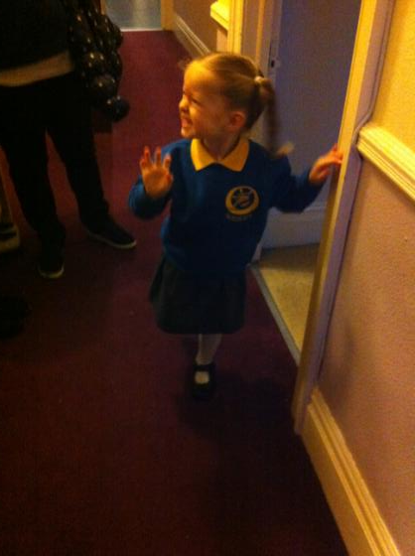
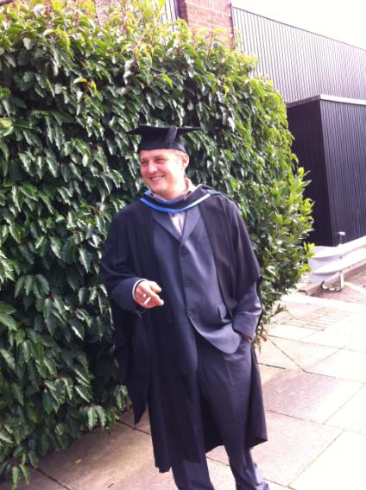
So how do we get from here… to here?

Slide 14
Without….
Stripping out all the joy and enthusiasm with which many enter higher education;
Pushing them into strategic behaviour (Kneale) through which they become progressively focused on modest outcomes? (‘Just tell me what I have got to do to pass: I can’t afford the time to go for a First’);
Filling them with dissatisfaction around their learning experiences, potentially driving them to grievances and litigation;
Making students feel their investment in higher education has been a waste of three years.

Slide 15
Instead
Building each student’s confidence in what they can do, enabling them to have a genuine and positive measure of their capabilities;
Ensuring that the disadvantages with which students enter a course of study are addressed and to some extent redressed during their academic careers;
Enabling intellectual growth, so that graduates are changed for the good by the experience of studying;
Building the foundations for future life experiences including employment, social engagement and personal fulfilment.

Slide 16
The early weeks offer an opportunity for us to:
Engage students and help them to feel excited about the subjects they are studying;
Offer early opportunities for research-based learning;
Get them to establish good patterns of study behaviour;
Build confidence, while sometimes going beyond their comfort zones;
Support the development of cohort cohesion
Help students develop their key literacies to support successful study.

Slide 17
Engaging students; let’s not:
Overwhelm them with endless ‘vital’ information in paper form or on the web, without helping them to interrogate and internalise what we are telling them;
Offer them tasks that make them feel isolated, alone, stupid and out of their depths;
Make them feel as if they are just numbers and that their presence or absence is of little importance;
That they are learning very little about the topics they have chosen to study at degree level.

Slide 18
The early weeks: six things we can do to diminish their chances of success
Give them an exam on day one or two to work out who needs remedial help;
Avoid teaching them anything while they ‘settle in’;
Give them a group task which provides opportunities for them to make fools of themselves in front of their peers;
Load them up with masses of information/ paperwork, all of which is deemed essential;
Give them a library orientation that focuses on what they can’t do and how complicated everything is;
Avoid taking registers until the numbers have settled down.

Slide 19
Instead you might consider
Using some regular, formative computer-based assessment tasks they can undertake privately which give them feedback on why answers are right or wrong answers;
Giving them group activities where they model the real working lives of the professions/roles they are likely to enter on graduation;
Maximising the amount of guidance on the first assessed tasks with some opportunities for rehearsal and feedback before submission;
Providing information literacy training helping them locate and judge subject-relevant resources;
Monitor live and virtual engagement.

Slide 20
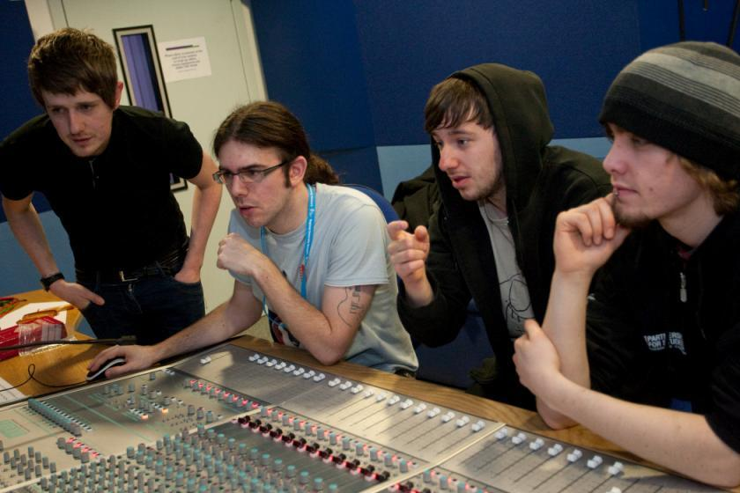
This is what we are seeking to achieve

Slide 21
Disengaged students
Don’t live up to their potential and fail to achieve their very best;
Make life more difficult for the staff who teach and support them;
Drop out of higher education, thereby damaging their own prospects and HEIs’ performance indicators;
HEIs suffer both financially and in terms of their status and reputation from high attrition rates.

Slide 22
How might they feel?
I don’t belong here
I’ve made a bad decision
I’m not as clever as everyone else
I don’t know anyone
I just can’t live in a place that’s so noisy
I feel homesick
I can’t find food here to eat that I like
I don’t know anyone and they all seem to know each other already
I am terrified I won’t be able to manage my money
No one knows or cares whether I go in to uni or not

Slide 23
What kind of activities might we want to provide for students in the early weeks? Ones that:
Enable every student to learn to the highest level, stretched so each achieves their personal best;
Are inclusive, with equal opportunities for all, whatever their previous backgrounds in learning and life;
Offer each student the chance to thrive in a context of challenge and support;
Provide transformative opportunities which encourages students to grow as people;
Engender a collegiate atmosphere where students make valuable friendships and networks that last throughout their lives.

Slide 24
Immersive experiences can really work:
Where they get a real sense of the subject they are studying, with intense, authentic learning experiences;
In contexts where they establish sensible patterns of sufficient weekly hours of study to enable them to succeed;
Where they develop a range of key literacies;
Where students are engaged together in rotating group tasks so that they mix with lots of different people and get to know some better;
Being assessed early in low-stakes, non-threatening ways, enabling them to get the measure of what they can and cannot do.

Slide 25
To engage students we need to foster the key literacies that students need:
Academic literacy: understanding how higher education works;
Information literacy: understanding how to locate and, most importantly, select information;
Assessment literacy: understanding how assessment systems work in universities;
Social literacy: understanding how to work with others using emotional intelligence.

Slide 26
Academic literacy: understanding how higher education works. This includes:
What comprises poor academic conduct:
What plagiarism looks like and how to avoid it;
How to apply for late submission of work and what extenuating circumstances comprise
Writing for academic purposes (when to use third person or first person, active or passive voice, register, tone and vocabulary);
Reading for academic purposes (including reading for understanding, reading for information, skim reading and seeking quotes to back up arguments.

Slide 27
Helping students understand writing conventions
Devote energy to helping students understand what is required of them in terms of writing;
Work with them to understand the various academic discourses that are employed within the subject/institution;
Help them to understand when writing needs to be personal and based on individual experience, such as in a reflective log, and when it needs to be formal and using academic conventions like passive voice and third person, as in written reports and essays.

Slide 28
Help students understand what is required with reading
Help them also to understand that there are different kinds of approaches needed for reading depending on whether they are reading for pleasure, for information, for understanding or reading around a topic;
Help them to become active readers with a pen and Post-its in hand, rather than passive readers, fitting the task in alongside television and other noisy distractions;
Give them clear guidance in the early stages about how much they need to read and what kinds of materials they need to focus on.

Slide 29

Information literacy is crucial

Slide 30
Information literacy includes the capacity to:
Reference texts and other sources appropriately;
Select from the vast number of sources available;
Understanding how the quality of information is assured;
Using trusted web systems (e.g. using Google Scholar rather than just Google, limits to the trustworthiness Wikipedia, considering the value of personal postings on websites);
The importance of peer review i.e. what differentiates a peer-reviewed journal article from, for example, a vanity publication;

Slide 31
Assessment literacy: students do better if they can:
Make sense of key terms such as criteria, weightings, and level;
Encounter a variety of assessment methods (e.g. presentations, portfolios, posters, assessed web participation, practicals, vivas etc) and get practice in using them;
Be strategic in their behaviours, putting more work into aspects of an assignment with high weightings, interrogating criteria to find out what is really required and so on;
Gain clarity on how the assessment regulations work in their HEI, including issues concerning submission, resubmission, pass marks, condonement etc

Slide 32
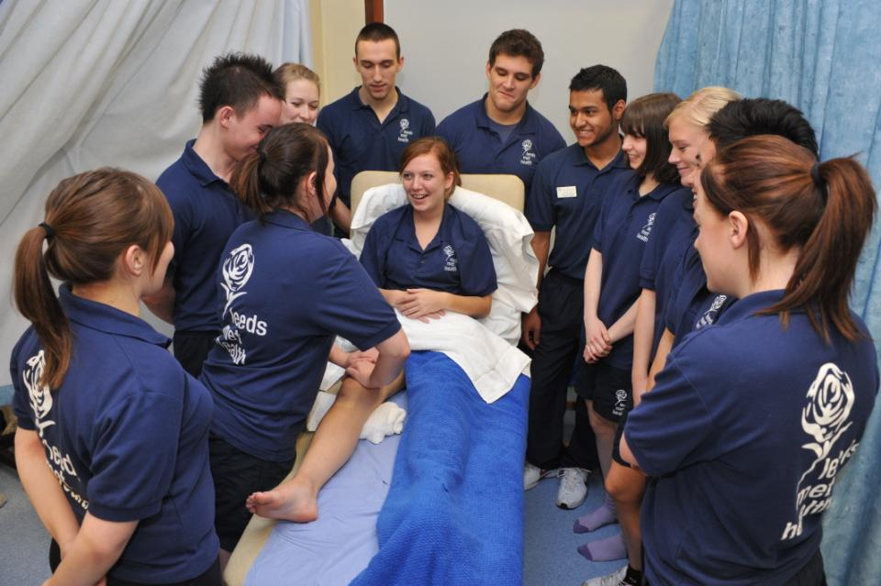
Authentic assessment helps learning

Slide 33
Social literacy: students using emotional intelligence can:
Perceive accurately, appraise and express their own emotions;
Access and/or generate feelings when they facilitate thought;
Understand emotions and emotional thought;
Regulate emotions to promote emotional and intellectual growth.
(after Salovey and Meyer)

Slide 34
Emotional intelligence helps students
Better understand and work with others;
Employ empathy to achieve the ends they are seeking;
Notice and use non-verbal cues from others;
Productively consider how their own non-verbal cues are being perceived;
Understand, express and regulate their own of emotions;
Improve their own capacities for flexible planning and creative thinking.

Slide 35
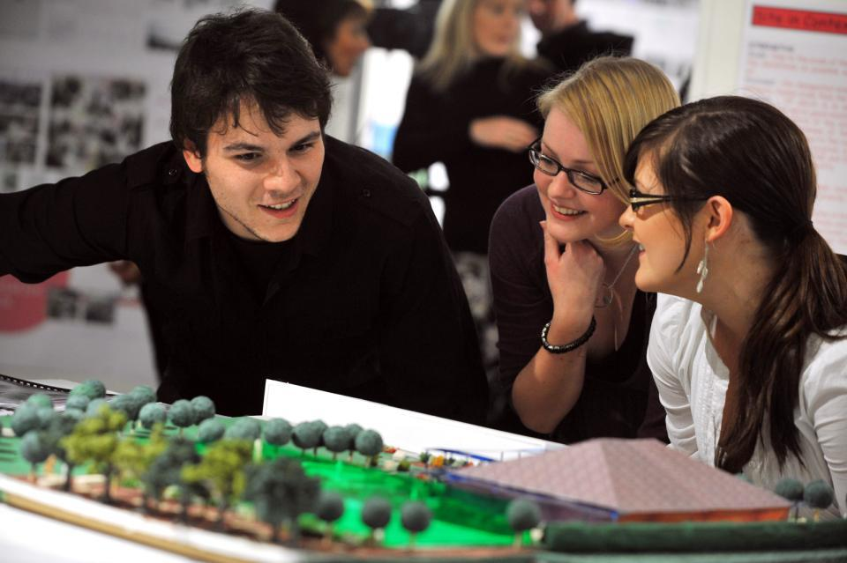
Students working well together

Slide 36
Teachers using emotional intelligence in the classroom can:
Recognise and respond to your own and your students feelings in the classroom, in order to make you both more effective;
Encourage an emotional state in your learners that is conducive to learning, working beyond face-toface classroom time.
(after Mortiboys, 2005)

Slide 37
Using technologies to promote effective learning. We can:
Explore technologies to support administration of programmes, for example, using direct links between assessment activities, gradebooks and student records;
Make resources available through the VLE including reference materials and texts, activities, students individual or shared work;
Provide feedback to students by creating rubrics with marking schemes, including criteria, weighting and other essential elements. Then on screen you can highlight the relevant boxes for each student, add commentaries and feedback (including from a statement bank) as required and click to deliver it directly to students automatically

Slide 38
Seeking to offer personalised learning pathways
Personalised learning is difficult to achieve in mass higher education (particularly when many are moving to Massive Open Online courses) but are likely to be more helpful than delivering lots of ‘stuff’ too early;
We will need to systematise our approaches to achieve this effectively and efficiently, largely by using technologies;
Conditional activities within a VLE can provide learning pathways which are offered depending on a student’s marks achieved in the last interaction, with successive branching pathways of tasks for each student to complement class activities;
HEIs worldwide are already achieving this.

Slide 39
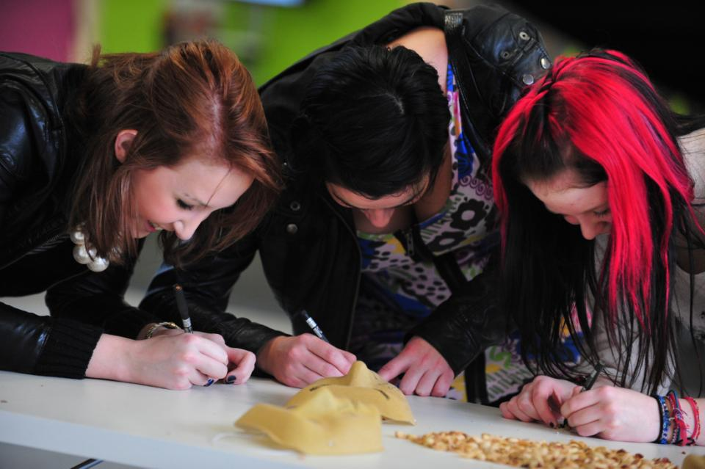
In the end, it’s all about engagement

Slide 40
Task:
Working with colleagues, and imagining for the time being that money is no object (!), devise a programme of activities for your students for a pre-Christmas module in the first year that will engage and motivate students;
Present this programme on a flip chart sheet for review by your colleagues;
Review your colleagues’ sheets and identify which features of each others’ ideas to which you are most attracted.

Slide 41
Now, working with reality
Work out what are the barriers to you achieving the ‘ideal’ programme you’ve envisaged;
Look at what are the barriers to you doing this, and see if you can devise any ‘work-arounds’;
See how many of those features you could incorporate into a programme that you could actually make work in September 2014

Slide 42
Conclusions
The first week of the first semester of the first year can be ‘make or break’ time for our students;
Thinking through induction and the student experience at this time can pay high dividends
Induction is a process not an event, so the approaches we initiate in the first weeks must be carried through into the rest of the academic year.

Slide 43

These and other slides will be available on my website at www.sally-brown.net

Slide 44
Useful references
Bowl, M (2003) Non-traditional entrants to higher education ‘they talk about people like me’ Stoke on Trent, UK: Trentham Books.
Hilton A (2003) Saving our Students (SoS) embedding successful projects across institutions, Project Report York: Higher Education Academy.
Morgan, M (Ed) (2011) Improving the student experiince: a practical guide, Abingdon, Routledge.
Mortiboys, A. (2005) Teaching with emotional intelligence, Abingdon: Routledge.

Slide 45
Further references
Peelo, M. and Wareham, T. (eds.) (2002) Failing Students in higher education, Maidenhead:, UK, SRHE/Open University Press.
Salovey, P. and Meyer, J. (1990) Emotional Intelligence, Imagination, Cognition and Personality Vol 9 (3) 185-211.
Yorke, M. (1999) Leaving Early: Undergraduate Non-Completion in Higher Education, London: Taylor and Francis.
Yorke, M. and Longden, B. (2004) Retention and Student Success in Higher Education, Maidenhead, Open University Press.

