Slide 1
Making the most of Masters Level assessment Cumbria assessment conference June 2013 Sally Brown, Liz McDowell and Phil Race
Here we plan to introduce the project & discuss:
How assessment for learning underpins effective assessment practice at all levels;
Perceptions of differences between undergraduate and M-level assessment;
Some alternatives to the most commonly used assessment methods at M-level;
How authentic assessment can promote skills development to enhance employability.

Slide 2
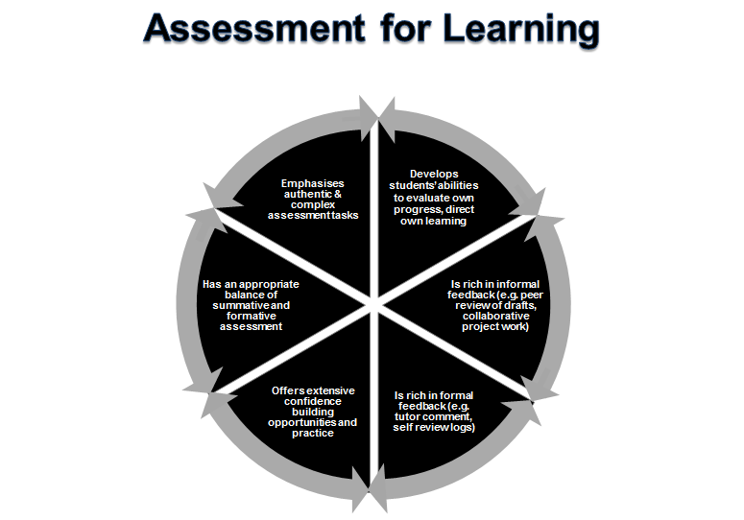

Slide 3
Assessment for Learning
Emphasises authentic & complex assessment tasks
Develops students’ abilities to evaluate own progress, direct own learning
Is rich in informal feedback (e.g. peer review of draft writing, collaborative project work)
Uses high stakes summative assessment rigorously but sparingly
Offers extensive ‘low stakes’ confidence building opportunities and practice
Is rich in formal feedback (e.g. tutor comment, self-review logs)

Slide 4
Assimilate has been a 3-year NTFS funded project which:
Explored innovative assessment at Masters level using research funding from the National Teaching Fellowship scheme to seek out good practice;
Used data from 45 interviews and further conversations to produce a compendium including 44 case studies from the UK and internationally illustrating diverse M-level assessment together with 7 vignettes and 3 national overviews;
Led to the publication of multiple and diverse publications illustrating the outcomes of the project;
Enabled us to offer workshops in the UK and internationally focused on innovations at M-level.

Slide 5
Differences noted between UG and M-level assessment often referred to:
The extent of use of critical thinking and critical analysis;
The ability to work independently, autonomously, with minimal support;
Ability to work with incomplete information, away from a ‘recipe book’, to produce ‘masterpieces’;
Breadth/ narrowness, depth, scope, specialisation/ overview;
Pace of study, volume of work, amount of reading, amount of writing;
Creativity, innovation, originality;
How much student pay.

Slide 6
Good practice M-level Assessment examples include:
Highly authentic assignments, which relate closely to programme outcomes;
Multiple assessments which build incrementally to final submission;
Good feedback opportunities, giving students the chance to benefit from advice to improve performance;
Assignments that require teamwork and group activity;
Assignments that foster employability and that foster employer engagement;
Assignments that are enhanced and supported by technology;
Assignements requiring peer engagement / peer assessment.

Slide 7
Phil’s ‘musts’ for assessment
Assessment must be:
Valid
Reliable
fair, consistent;
Transparent
Authentic
Manageable
Inclusive

Slide 8
Assessment must be authentic
(1) ‘self’ authenticity
We need to know that we are assessing the work of the candidate – their own work rather than that of others.
This has caused some institutions to move back towards the use of unseen time-constrained written exams for undergraduate assessment.
‘Self’ authenticity can in fact be tested quite efficiently by oral exams – vivas, even ‘micro-vivas’, and is of course tested when there is a ‘normal’ viva for a Master’s degree.

Slide 9
Assessment must be authentic
(2) ‘real-world’ authenticity
Assessment needs to be closer to the real-world that students are heading towards.
For example, lawyers, accountants, managers, doctors don’t often write about models and theories.
In medical education, OSCEs (objective, structured clinical exams) aim to replicate the things doctors need to do every day.

Slide 10
Selected references and further reading
Brown, S. (2012) Assimilate compendium, Leeds, Leeds Met Press https://sites.google.com/a/teams.leedsmet.ac.uk/assimilate-2012/dissemination/compendium
Brown, S. (2013) ‘What are the perceived differences between assessing at Masters level and undergraduate level assessment? Some findings from an NTFS–funded project’ Innovations in Education and Teaching International, forthcoming
Brown, S. (2013) Assimilate work pack https://docs.google.com/a/phil-race.co.uk/file/d/0BzEN3_s1ig4Sb2QtR01hOFczSUE/edit?usp=sharing
Brown, S., Deignan, T. Race, P. and Priestley, J. (2012) ‘Assessing students at Masters Level: learning points for Educational Developers’ Educational Developments, SEDA, Birmingham.
Brown, S (2012) ‘Diverse and innovative assessment at Masters Level: alternatives to conventional written assignments’ in AISHE-J: The All Ireland Journal of Teaching and Learning in Higher Education Vol 4, No 2.

Slide 11
References (contd.)
Casey, J. (2002) On-line assessment in a masters-level policy subject: participation in an on-line forum as part of assessment, Centre for the study of higher education, Charles Sturt University, Australia.
Dunn, S. and Singh, K. A. (2009) Analysis of M-level modules in interdisciplinary nanotechnology education, Nanotechnology Centre, Department of Materials, School of Applied Sciences, Cranfield University.
Fry, H., Pearce, R. and Bright, H. (2007) Re-working resource-based learning - a case study from a masters programme. Innovations in Education and Teaching International, 44(1), pp.79-91.
Geographical Association. (no date) GTIP Think Piece - Writing at Masters Level. Available online: http://www.geography.org.uk/gtip/thinkpieces/writingatmasterslevel/
Haworth, A., Perks, P. and Tikly, C. (no date) Developments with Mathematics M-Level PGCE Provision and Assessment, University of Manchester, University of Birmingham, University of Sussex.
Institute of Education (2006) Masters level criteria for Geography PGCE http://www.geography.org.uk/download/GA_PRGTIPBrooksMLevelCriteria.pdf Accessed March 2012

Slide 12
References (contd.)
Lord, D. (2008) Learning to Teach a Specialist Subject: Using New Technologies and Achieving Masters Level Criteria. In: MOTIVATE conference 2008, 11 - 12th November 2008, Dunaujvaros, Budapest. (Unpublished) This version is available at http://eprints.hud.ac.uk/10892/ Accessed march 2012
NZQA (2007) http://www.nzqa.govt.nz/assets/Studying-in-NZ/New-Zealand-Qualification-Framework/theregister-booklet.pdf (accessed March 2012
M level PGCE. (2007) ESCalate ITEM level PGCE seminar at the University of Gloucestershire on January 9th 2007.
QAA (2010) Masters Degree Characteristics
http://www.qaa.ac.uk/academicinfrastructure/benchmark/masters/MastersDegreeCharacteristics.pdf
Seymour, D. (2005) Learning Outcomes and Assessment: developing assessment criteria for Masters-level dissertations. Brookes eJournal of Learning and Teaching 1(2).
Van Eeten, Michel J.G. (2001) Recasting Intractable Policy Issues: The Wider Implications of the Netherlands Civil Aviation Controversy, Journal of Policy Analysis and Management, 20(3):391-414
Wharton, S. (2003) Defining appropriate criteria for the assessment of master's level TESOLAssignments. Assessment & Evaluation in Higher Education, 28(6), pp.649-664.

