Slide 1
Assessing skills and practice Evaluacion de Habilidades y compotencias Espana Abril 2013
Sally Brown
Emerita Professor, Leeds Metropolitan University
Adjunct Professor, University of the Sunshine Coast, University of Central Queensland and James Cook University, Queensland
Visiting Professor University of Plymouth & Liverpool John Moores University.

Slide 2
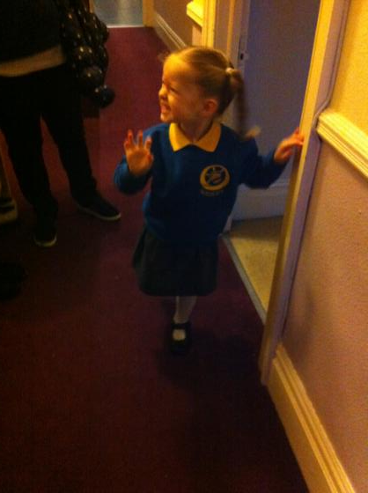
How do we get from here… to here?

Slide 3
Assessment for learning
1. Tasks should be challenging, demanding higher order learning and integration of knowledge learned in both the university and other contexts;
2. Learning and assessment should be integrated, assessment should not come at the end of learning but should be part of the learning process;
3. Students are involved in self assessment and reflection on their learning, they are involved in judging performance;
4. Assessment should encourage metacognition, promoting thinking about the learning process not just the learning outcomes;
5. Assessment should have a formative function, providing ‘feedforward’ for future learning which can be acted upon. There is opportunity and a safe context for students to expose problems with their study and get help; there should be an opportunity for dialogue about students’ work;

Slide 4
Assessment for learning
6. Assessment expectations should be made visible to students as far as possible;
7. Tasks should involve the active engagement of students developing the capacity to find things out for themselves and learn independently;
8. Tasks should be authentic; worthwhile, relevant and offering students some level of control over their work;
9. Tasks are fit for purpose and align with important learning outcomes;
10. Assessment should be used to evaluate teaching as well as student learning.
(Sue Bloxham)

Slide 5
Que valores estan implicitos en nuestra enfoque de la evaluacion
La tareas para poner a prueba las destrezas y habilidades de los estudiantes deben tener una orientacion practica y estar disenades para que responden directamente a los resultados de aprendizaje del programa;
La tareas deben ajustarse a lo que se pida, teniendo en cuenta el contexto, el nivel, el tema y a los propios estudiantes;
Los estudiantes deben se informados con claridad acerca de los fines y resultados esperados de un tarea, sin dirigismo;

Slide 6
Implicitos 2
Deben utilizarse distintos metodes y enfoques para oportunidades de desenvolverse a la perfecction a estudiantes de caracteristicas diversas;
La evaluacion de la destrezas practicas debe ser inclusiva desde el principio, con alternivativas para los estudiantes con discapacadad, incluidas en la validacion;
Cuandao sea posible, ha de incluirse un elemento de autoevaluacion y/o de evaluacion de companeros para ayudar los estudiantes a promover sus destrezas evaluadores y aprendizaje a lo largo de la vida en un curriculo centrado en el estudiante;

Slide 7
Implicitos 3
Deben idearse las tareas para maximar la retroinformacion formaiva e integrarla en la procesa de aprendizaje tanto en el estudio como en el laboratario, en el interpretacion o en las practicas en el centro de trabajo:
Las tareas deben ser exigentes para los estudientes, permitiendo que cada uno maximice su potencial y facilitando que los professores distingan entre diferentes estandares de rendimiento, con justicia y transparencia;
Las tareas deben ser justas y equivitativas, y percibirse como tales, sin preguntas trampa, para que caigan en ellas las personas confiadas, incautas o desfavorecidas;

Slide 8
Implicitos 4
Las tareas deben ser eficientes con respecto al tiempo del professorado y permitir a los profesores concentrarse en los componentes esecializados de la evaluacion, en vez de en una correccion repetitiva y mecanica;
Las tareas deben estar bien escalonadas, con oportunidades de retroinformacion en cada nivel. Deben ser una opporunidad para que los estudiantes solucionenen cada fallo, sin caer en una especie de “muerte subita” en la que se pierda todo si una unica tarea o ejercicio practico es desastroso.

Slide 9
Implicitos 5
La autenticidad debe ser la caracteristica de la evaluacion de destrezas y de la practica, otorgandose unas calificiones elevadas a los autenticos logros y no a los sucedaneos de logros.
Las destrezas practicas debe evaluarlas el evaluador mas adecuando en el lugar mas apropiado, pero debe disenarse cuando sea posible de manera que permita la moderacion del proceso de evaluacion por parte del profesor;
El diseno de las tareas debe promover el desarrollo del aprendizaje autonomo;
Las tareas deben ser interesantes y motivadoras.

Slide 10
Assessment linked to learning
Effective assessment significantly and positively impacts on student learning, (Boud, Mentkowski, Knight and Yorke and many others).
Assessment shapes student behaviour (marks as money) and poor assessment encourages strategic behaviour (Kneale). Clever course developers utilise this tendency and design assessment tools that foster the behaviours we would wish to see (for example, logical sequencing, fluent writing, effective referencing and good time management) and discourage others (‘jumble-sale’ data sourcing, aimless cutting and pasting and plagiarism).
Notes:
La evaluación influye sobre el comportamiento del estudiante (Refs)

Slide 11
Formative and summative assessment
Formative assessment is primarily concerned with feedback aimed at prompting improvement, is often continuous and usually involves words.
Summative assessment is concerned with making evaluative judgments, is often end point and involves numbers.
Notes:
La evaluación formativa concentra en el feedback.
La evaluación sumativa trata de una nota final.

Slide 13
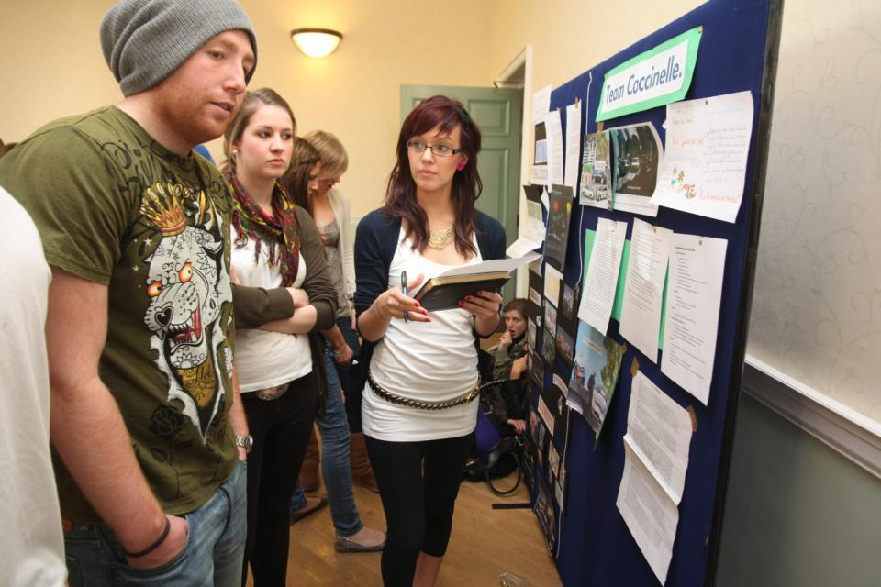
Involve students in their own assessment

Slide 14
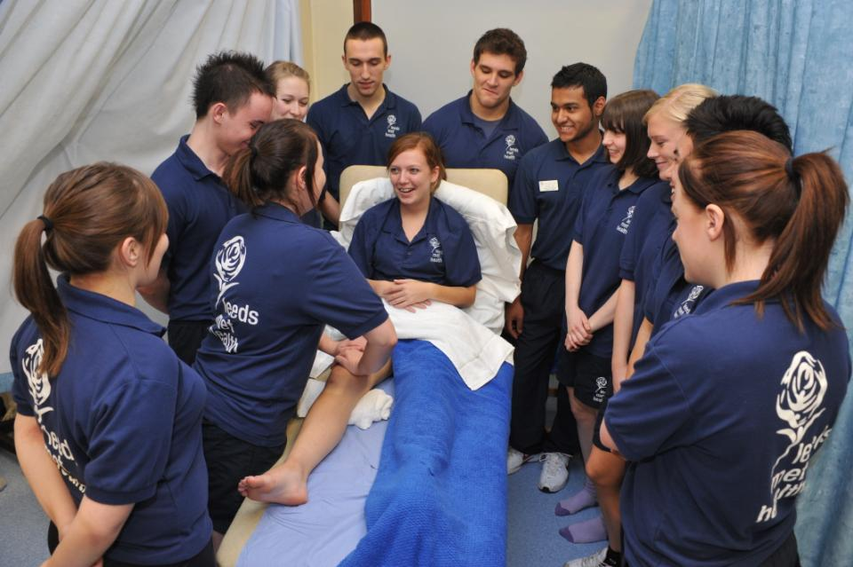
Authentic assessment helps learning

Slide 15
Boud et al 2010: ‘Assessment 2020’:
Assessment has most effect when...:
It is used to engage students in learning that is productive.
Feedback is used to actively improve student learning.
Students and teachers become responsible partners in learning and assessment.
Students are inducted into the assessment practices and cultures of higher education.
Assessment for learning is placed at the centre of subject and program design.
Assessment for learning is a focus for staff and institutional development.
Assessment provides inclusive and trustworthy representation of student achievement.

Slide 16
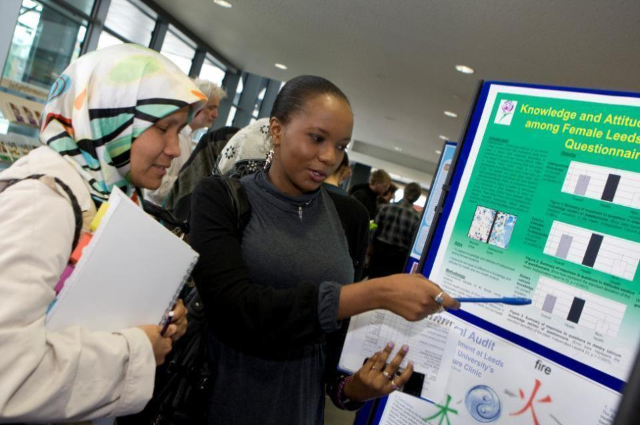
Assessment formats can challenge students

Slide 17
Inclusive practices in assessment
For 10 years or more in the UK and elsewhere, legislative drivers, moral imperatives and pressures from disabled staff and students have driven HEIs to make assessment inclusive;
Recent advances in technologies have improved the accessibility of curriculum materials;
HEIs are not good at advanced planning when arranging alternative assessments;
Disabled students want an equivalent experience, fair assessment and the maintenance of standards of achievement.

Slide 18
Putting this in to practice. We need to:
design an assessment strategy that involves a diverse range of methods of assessment (as all forms of assessment disadvantage some students);
consider when designing assessment tasks how any students might be disadvantaged;
maximise the opportunities for each student to achieve at the highest possible level;
ensure the assurance of appropriate standards for all students.

Slide 19
Efficient assessment; we need to:
Stop marking, start assessing!
Explore ways to maximise student ‘time on task’ (Gibbs) and minimise staff drudgery;
Remember that feedback is crucial to student learning but the most time-consuming aspect of assessment: we need to explore ways of giving feedback effectively and efficiently;
Note that Computer-supported assessment in Art and Design can include use of audio feedback via digital sound files, video commentaries, conventional MCQs, use of statement banks when commenting digitally on written work, ‘exploded’ model answers and other means.

Slide 20
How to engage and motivate students?

Slide 21
Sound and frequent assessment
Good assessment is valid, reliable, practical, developmental, manageable, cost-effective, fit for purpose, relevant, authentic, inclusive, closely linked to learning outcomes and fair.
Is it possible also to make it enjoyable for staff and students?
Incremental assessment has more value in promoting student learning than end-point ‘sudden death’ approaches.
Notes:
La evaluación eficaz es divertida para estudiantes y profesores.

Slide 22
Ten useful questions on assessment
Sally Brown
April 2013

Slide 23
Assessment for learning: is assessment fully integrated within learning activities or is it an add-on that adds nothing to student engagement?
Preparation: are you developing students’ assessment literacy, so they understand fully what is required of them and can optimise their performances in a range of assessment contexts? Are staff inducted so they all share understandings of assessment practice.
Purpose: are you clear about why on each occasion you are assessing? Is it to give students guidance on how to improve or remediate work, or it is a scoring exercise to determine final grades? Is it focussing on theory or practise (or an integration of the two)?

Slide 24
Pacing and timing: are you offering feedback and assessment opportunities throughout the learning period or are assignments bunched together (particularly right at the end of the module)? Are you ensuring that students don’t have multiple assignments from different modules with the same submission date?
Volume of assessment: are you offering sufficient opportunities for students to learn through assessment without exhausting staff and putting excessive pressure on students in terms of workload?
Constructive alignment: is it clear how the assignments link to the learning outcomes, and do you offer good coverage of subject material and capabilities (or are you encouraging guessing of topics and risk taking activities)?

Slide 25
Variety: are you enabling students to demonstrate capability in diverse ways or are you reusing the same methods (essays, reports, unseen time-constrained exams) over and over again?
Inclusivity: Are students’ special needs in terms of assessment designed into assignments from the outset or do you have to make special arrangements for students with dyslexia, visual or aural impairments or other disabilities responsively rather than proactively?
Agency: is all your assessment undertaken by tutors or do you also use peers, students themselves, employers and clients?

Slide 26
Feedback: how fast can you provide it and what assurances can you give to students about its usefulness and ability to feed into future assignments?
Quality assurance: are you able to demonstrate that your assessment is fair, consistent and reliable? Will external scrutineers recognise the integrity of the assessment process?
Technology: are you using computer aided assessment where it is most useful (for drills and checking learning) enabling assessor time to be used most effectively where judgment is required?

Slide 27
Conclusions
Assessment strategies are often under-designed;
We need to consider the fitness for purpose of each element of the assessment programme;
This will include the assignment questions/tasks themselves, the briefings, the marking criteria, the moderation process and the feedback;
We also need to scrutinise how the assignments align with one another, whether we are over or under-assessing, whether we are creating log-jams for students and markers, whether we are assessing authentically, and whether our processes are fair and sensible.
If we do this, assessment can contribute to improving student learning.

Slide 28
Conclusion espanol
No hay nada que encierre mayor potencial al respecto que la evaluacion bien disenada de las destrezas, y los enfoques imginativos de la evaluacion de las destrezas y de la practica pueden influir significativamente en el compromiso y el rendimiento del estudiante.

Slide 29
Gracias. These and other slides will be available on my website at www.sally-brown.net

Slide 30
Useful references: 1
Assessment Reform Group (1999) Assessment for Learning : Beyond the black box, Cambridge UK, University of Cambridge School of Education.
Biggs, J. and Tang, C. (2007) Teaching for Quality Learning at University, Maidenhead: Open University Press.
Brown, S. Rust, C. & Gibbs, G. (1994) Strategies for Diversifying Assessment, Oxford: Oxford Centre for Staff Development.
Boud, D. (1995) Enhancing learning through self-assessment, London: Routledge.
Brown, G. with Bull, J. and Pendlebury, M. (1997) Assessing Student Learning in Higher Education, London: Routledge.
Brown, S. and Glasner, A. (eds.) (1999) Assessment Matters in Higher Education, Choosing and Using Diverse Approaches, Maidenhead: Open University Press.
Brown, S. and Knight, P. (1994) Assessing Learners in Higher Education, London: Kogan Page.
Brown, S. and Race, P. (2012) Using effective assessment to promote learning in Hunt, L. and Chambers, D. (2012) University Teaching in Focus, Victoria, Australia, Acer Press. P74-91
.

Slide 31
Useful references 2
Carless, D., Joughin, G., Ngar-Fun Liu et al (2006) How Assessment supports learning: Learning orientated assessment in action Hong Kong: Hong Kong University Press.
Carroll, J. and Ryan, J. (2005) Teaching International students: improving learning for all London: Routledge SEDA series.
Crosling, G., Thomas, L. and Heagney, M. (2008) Improving student retention in Higher Education London and New York: Routledge
Crooks, T. (1988) Assessing student performance, HERDSA Green Guide No 8 HERDSA (reprinted 1994)
Falchikov, N. (2004) Improving Assessment through Student Involvement: Practical Solutions for Aiding Learning in Higher and Further Education, London: Routledge.
Gibbs, G. (1999) Using assessment strategically to change the way students learn, in Brown S. & Glasner, A. (eds.), Assessment Matters in Higher Education: Choosing and Using Diverse Approaches, Maidenhead: SRHE/Open University Press.
Gibbs, G. (2008) Designing assessment to support student learning Keynote at Leeds Met staff Development festival.

Slide 32
Useful references 3
Kneale, P. E. (1997) The rise of the "strategic student": how can we adapt to cope? in Armstrong, S., Thompson, G. and Brown, S. (eds) Facing up to Radical Changes in Universities and Colleges, 119-139 London: Kogan Page.
Knight, P. and Yorke, M. (2003) Assessment, learning and employability Maidenhead, UK: SRHE/Open University Press.
Mentkowski, M. and associates (2000) p.82 Learning that lasts: integrating learning development and performance in college and beyond San Francisco: Jossey-Bass.
McDowell, L. and Brown, S. (1998) Assessing students: cheating and plagiarism, Newcastle: Red Guide 10/11 University of Northumbria.
Nicol, D. J. and Macfarlane-Dick, D. (2006) Formative assessment and self-regulated learning: A model and seven principles of good feedback practice. Studies in Higher Education Vol 31(2), 199-218.
Pickford, R. and Brown, S. (2006) Assessing skills and practice, London: Routledge.

Slide 33
Useful references 4
Race, P. (2001) A Briefing on Self, Peer & Group Assessment, in LTSN Generic Centre Assessment Series No 9 LTSN York.
Race P. (2006) The lecturer’s toolkit (3rd edition), London: Routledge.
Rust, C., Price, M. and O’Donovan, B. (2003) Improving students’ learning by developing their understanding of assessment criteria and processes, Assessment and Evaluation in Higher Education. 28 (2), 147-164.
Ryan, J. (2000) A Guide to Teaching International Students, Oxford Centre for Staff and Learning Development
Stefani, L. and Carroll, J. (2001) A Briefing on Plagiarism http://www.ltsn.ac.uk/application.asp?app=resources.asp&process=full_record&section=generic&id=10
Sadler, R. (2008) Assessment of Higher Education, in International Encyclopaedia of Education
Yorke, M. (1999) Leaving Early: Undergraduate Non-completion in Higher Education, London: Routledge.

