Slide 1
Transformative assessment in higher education
Dublin City University
School of Nursing and Human Science
January 2013
Sally Brown
Emerita Professor, Leeds Metropolitan University,
Adjunct Professor, University of the Sunshine Coast, University of Central Queensland and James Cook University Queensland
Visiting Professor University of Plymouth & Liverpool John Moores University.

Slide 2
Without….
Stripping out all the joy and enthusiasm with which many enter higher education;
Pushing them into strategic behaviour (Kneale) through which they become progressively focused on modest outcomes? (‘Just tell me what I have got to do to pass: I can’t afford the time to go for a First’);
Filling them with dissatisfaction around their learning experiences, potentially driving them to grievances and litigation;
Making students feel their investment in higher education has been a waste of three years.

Slide 3
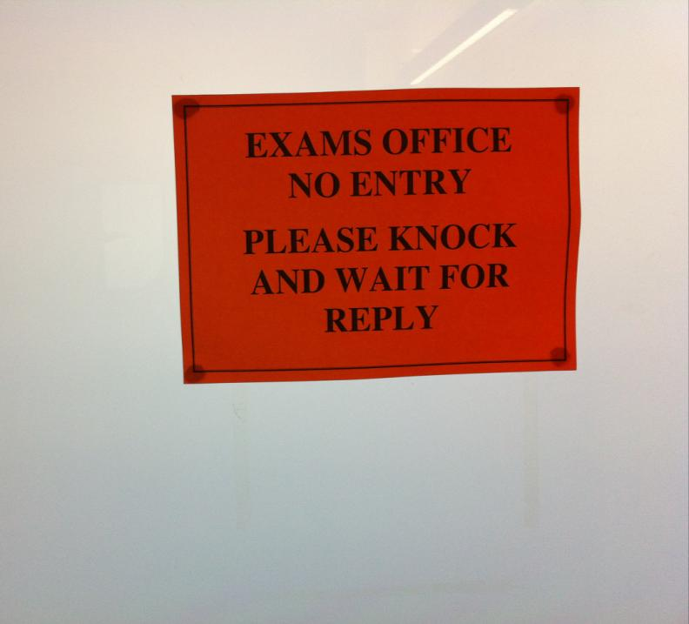

Slide 4
Instead
Building each student’s confidence in what they can do, enabling them to have a genuine and positive measure of their capabilities;
Ensuring that the disadvantages with which students enter a course of study are addressed and to some extent redressed during their academic careers;
Enabling intellectual growth, so that graduates are changed for the good by the experience of studying;
Building the foundations for future life experiences including employment, social engagement and personal fulfilment.

Slide 5
What kind of student experience? Here’s my highest hope. One that:
Enables every student to learn to the highest level, stretched so each achieves their personal best;
Is inclusive, with equal opportunities for all, whatever their previous backgrounds in learning and life;
Offers each student the chance to thrive in a context of challenge and support;
Provides transformative opportunities which encourages students to grow as people;
Engenders a collegiate atmosphere where students make valuable friendships and networks that last throughout their lives.

Slide 6
Assessment can be transformative if we do it well
Effective assessment significantly and positively impacts on student learning, (Boud, Mentkowski, Knight and Yorke and many others).
Assessment shapes student behaviour (marks as money) and poor assessment encourages strategic behaviour (Kneale).
Clever course developers utilise this tendency and design assessment tools that foster the behaviours we would wish to see (for example, logical sequencing, fluent writing, effective referencing and good time management) and discourage others (‘jumble-sale’ data sourcing, aimless cutting and pasting and plagiarism).

Slide 7
The current context
A changing climate for ITs in Ireland ;
Increasing importance of various national student surveys and various league tables on perceptions of quality and student recruitment;
Major rethinking taking place about the purposes and nature of curriculum design, delivery and assessment;
Intense international competition.

Slide 8
My predictions for the future
The move away from educational organisations being the guardians of content, where everything is about delivery, towards having two major functions:
Recognising and accrediting achievement, wherever such learning has taken place;
Supporting student learning and engagement.
Notes:
En el futuro las universidades tendrán dos funciones clave
El reconocimiento y la homologación del rendimiento, logros, éxitos del estudiante aunque fueran conseguidos fuera de la universidad
El apoyo del aprendizaje y del compromiso del estudiante

Slide 9
Why does assessment matter so much?
“Assessment methods and requirements probably have a greater influence on how and what students learn than any other single factor. This influence may well be of greater importance than the impact of teaching materials” (Boud 1988)
Notes:
Los métodos de evaluación influyen más en el aprendizaje del estudients que cualquier otro factor.

Slide 10
To improve assessment we should realign it by:
Exploring ways in which assessment can engage students and be integral to learning.
Constructively aligning (Biggs 2003) assignments with planned learning outcomes and the curriculum taught:
Providing realistic tasks: students are likely to put more energy into assignments they see as authentic and worth bothering with.
Notes:
La evaluación dbe ser parte íntegra del aprendizaje.
“Alineamiento constructivo” según Biggs
Los estudiantes prefieren tareas auténticas.

Slide 11
Assessment for learning: is assessment fully integrated within learning activities or is it an add-on that adds nothing to student engagement?
Preparation: are you developing students’ assessment literacy, so they understand fully what is required of them and can optimise their performances in a range of assessment contexts? Are staff inducted so they all share understandings of assessment practice.
Purpose: are you clear about why on each occasion you are assessing? Is it to give students guidance on how to improve or remediate work, or it is a scoring exercise to determine final grades? Is it focussing on theory or practise (or an integration of the two)?

Slide 12
Pacing and timing: are you offering feedback and assessment opportunities throughout the learning period or are assignments bunched together (particularly right at the end of the module)? Are you ensuring that students don’t have multiple assignments from different modules with the same submission date?
Volume of assessment: are you offering sufficient opportunities for students to learn through assessment without exhausting staff and putting excessive pressure on students in terms of workload?
Constructive alignment: is it clear how the assignments link to the learning outcomes, and do you offer good coverage of subject material and capabilities (or are you encouraging guessing of topics and risk taking activities)?

Slide 13
Variety: are you enabling students to demonstrate capability in diverse ways or are you reusing the same methods (essays, reports, unseen time-constrained exams) over and over again?
Inclusivity: Are students’ special needs in terms of assessment designed into assignments from the outset or do you have to make special arrangements for students with dyslexia, visual or aural impairments or other disabilities responsively rather than proactively?
Agency: is all your assessment undertaken by tutors or do you also use peers, students themselves, employers and clients?

Slide 14
Feedback: how fast can you provide it and what assurances can you give to students about its usefulness and ability to feed into future assignments?
Quality assurance: are you able to demonstrate that your assessment is fair, consistent and reliable? Will external scrutineers recognise the integrity of the assessment process?
Technology: are you using computer aided assessment where it is most useful (for drills and checking learning) enabling assessor time to be used most effectively where judgment is required?

Slide 15
What really impacts on learning?
Concentrating on giving students detailed and developmental formative feedback is the single most useful thing we can do for our students, particularly those from disadvantaged backgrounds.
Summative assessment may have to be rethought to make it fit for purpose;
To do these things may require considerable imagination and re-engineering, not just of our assessment processes but also of curriculum design as a whole if we are to move from considering delivering content the most important thing we do.

Slide 16
Formative and summative assessment
Formative assessment is primarily concerned with feedback aimed at prompting improvement, is often continuous and usually involves words.
Summative assessment is concerned with making evaluative judgments, is often end point and involves numbers.
Notes:
La evaluación formativa concentra en el feedback.
La evaluación sumativa trata de una nota final.

Slide 17
A fit-for-purpose model of assessment: the key questions
Why are we assessing?
What is it we are actually assessing?
How are we assessing?
Who is best placed to assess?
When should we assess?
Notes:
17

Slide 18
Diverse and innovative assessment helps
Traditional assessment methods tend to reinforce rather limited approaches to learning by students, by encouraging memorisation, unproductive rote learning and attitude to knowledge acquisition that are reminiscent of the language of eating disorders (stuffing in and regurgitation of facts). We need to utilise a wide range of assessment methods and approaches.
Innovative assessment approaches can foster a spirit of enquiry, encourage curiosity and promote autonomy where they encourage students to become closely involved with evaluating their own and each others’ learning. (Falchikov, Pickford and Brown, 2006).
Notes:
La evaluación debe ser diversa e innovadora.

Slide 19
Setting good patterns
Students rarely respond positively to exhortation or vague threats of poor marks: we need to change the assessment practices so that they make routine these behaviours very early on in their learning careers.
Yorke (1999) encourages us to believe that the first six weeks of the first semester of the first year of university are crucial and that how we assess within that period can make a difference to student success or failure. Similar factors apply in other sectors.
Avoidance of early assessment doesn’t solve the problem. Designing a really coherent first six weeks for students, which includes assessment opportunities can be very helpful.
Notes:
Prácticas eficaces en las primeras 6 semanas son la clave.

Slide 20
Assessment for learning
1. Tasks should be challenging, demanding higher order learning and integration of knowledge learned in both the university and other contexts;
2. Learning and assessment should be integrated, assessment should not come at the end of learning but should be part of the learning process;
3. Students are involved in self assessment and reflection on their learning, they are involved in judging performance;
4. Assessment should encourage metacognition, promoting thinking about the learning process not just the learning outcomes;
5. Assessment should have a formative function, providing ‘feedforward’ for future learning which can be acted upon. There is opportunity and a safe context for students to expose problems with their study and get help; there should be an opportunity for dialogue about students’ work;

Slide 21
Assessment for learning
6. Assessment expectations should be made visible to students as far as possible;
7. Tasks should involve the active engagement of students developing the capacity to find things out for themselves and learn independently;
8. Tasks should be authentic; worthwhile, relevant and offering students some level of control over their work;
9. Tasks are fit for purpose and align with important learning outcomes;
10. Assessment should be used to evaluate teaching as well as student learning.
(Sue Bloxham, unpublished paper for HEA)

Slide 22
Boud et al 2010: ‘Assessment 2020’:
Assessment has most effect when...:
It is used to engage students in learning that is productive.
Feedback is used to actively improve student learning.
Students and teachers become responsible partners in learning and assessment.
Students are inducted into the assessment practices and cultures of higher education.
Assessment for learning is placed at the centre of subject and program design.
Assessment for learning is a focus for staff and institutional development.
Assessment provides inclusive and trustworthy representation of student achievement.

Slide 23
Sound and frequent assessment
Good assessment is valid, reliable, practical, developmental, manageable, cost-effective, fit for purpose, relevant, authentic, inclusive, closely linked to learning outcomes and fair.
Is it possible also to make it enjoyable for staff and students?
Incremental assessment has more value in promoting student learning than end-point ‘sudden death’ approaches.
Notes:
La evaluación eficaz es divertida para estudiantes y profesores.

Slide 24
Transformative assessment to improve learning needs to be:
Rewarding: students need to feel they are involved in authentic activities that have value and relevance;
Inclusive: so that students feel part of the programme rather than marginalised. Inclusive assessment uses cross-cultural case studies, references and examples, and mainstreams disability provision;
Engaging: without pandering to the lowest common denominator, designers of assignments need to consider how best to get students at all levels excited about the tasks being undertaken.
Notes:
Es mejor la evaluación PARA el aprendizaje que DEL aprendizaje.

Slide 25
Can we also make assessment:
Developmental so students are demonstrating the skills they need for future employment, research and life?
Personalised: even with huge cohorts can we aim to build in elements of one-to-one interaction and choice within assessment?
Enjoyable: both for the students being assessed and the staff doing the marking?
Notes:
La evaluación es aun más eficaz si es divertida.

Slide 26
The people doing the assessment need to be:
Professional: staff should be professionally trained at the right level to undertake assessment and moderation and need to undertake professional development regularly;
Recognised and rewarded: we need to work out the true costs of assessment in time and money and plan accordingly.
Current: regularly updated, on emergent appropriate assessment methods;
Research-informed: using the best information available on what methods and approaches work well;
Creative: seeking out innovative assessment methods that are fit for purpose;
Inclusive: designing alternative assessments for disabled students from the outset.
Notes:
Los que preparan la evaluación deben ser formados en las mejores técnicas.

Slide 27
Conclusions
Assessment strategies are often under-designed;
We need to consider the fitness for purpose of each element of the assessment programme;
This will include the assignment questions/tasks themselves, the briefings, the marking criteria, the moderation process and the feedback;
We also need to scrutinise how the assignments align with one another, whether we are over or under-assessing, whether we are creating log-jams for students and markers, whether we are assessing authentically, and whether our processes are fair and sensible.
If we do this, assessment can transform student learning and student lives.

Slide 28
These and other slides will be available on my website at www.sally-brown.net

Slide 29
Useful references: 1
Assessment Reform Group (1999) Assessment for Learning : Beyond the black box, Cambridge UK, University of Cambridge School of Education.
Biggs, J. and Tang, C. (2007) Teaching for Quality Learning at University, Maidenhead: Open University Press.
Brown, S. Rust, C. & Gibbs, G. (1994) Strategies for Diversifying Assessment, Oxford: Oxford Centre for Staff Development.
Boud, D. (1995) Enhancing learning through self-assessment, London: Routledge.
Brown, G. with Bull, J. and Pendlebury, M. (1997) Assessing Student Learning in Higher Education, London: Routledge.
Brown, S. and Glasner, A. (eds.) (1999) Assessment Matters in Higher Education, Choosing and Using Diverse Approaches, Maidenhead: Open University Press.
Brown, S. and Knight, P. (1994) Assessing Learners in Higher Education, London: Kogan Page.
Brown, S., Race, P. and Bull, J. (eds.) (1999) Computer Assisted Assessment in Higher Education, London: Routledge.
.

Slide 30
Useful references 2
Carless, D., Joughin, G., Ngar-Fun Liu et al (2006) How Assessment supports learning: Learning orientated assessment in action Hong Kong: Hong Kong University Press.
Carroll, J. and Ryan, J. (2005) Teaching International students: improving learning for all London: Routledge SEDA series.
Crosling, G., Thomas, L. and Heagney, M. (2008) Improving student retention in Higher Education London and New York: Routledge
Crooks, T. (1988) Assessing student performance, HERDSA Green Guide No 8 HERDSA (reprinted 1994)
Falchikov, N. (2004) Improving Assessment through Student Involvement: Practical Solutions for Aiding Learning in Higher and Further Education, London: Routledge.
Gibbs, G. (1999) Using assessment strategically to change the way students learn, in Brown S. & Glasner, A. (eds.), Assessment Matters in Higher Education: Choosing and Using Diverse Approaches, Maidenhead: SRHE/Open University Press.
Gibbs, G. (2008) Designing assessment to support student learning Keynote at Leeds Met staff Development festival.

Slide 31
Useful references 3
Kneale, P. E. (1997) The rise of the "strategic student": how can we adapt to cope? in Armstrong, S., Thompson, G. and Brown, S. (eds) Facing up to Radical Changes in Universities and Colleges, 119-139 London: Kogan Page.
Knight, P. and Yorke, M. (2003) Assessment, learning and employability Maidenhead, UK: SRHE/Open University Press.
Mentkowski, M. and associates (2000) p.82 Learning that lasts: integrating learning development and performance in college and beyond, San Francisco: Jossey-Bass.
McDowell, L. and Brown, S. (1998) Assessing students: cheating and plagiarism, Newcastle: Red Guide 10/11 University of Northumbria.
Nicol, D. J. and Macfarlane-Dick, D. (2006) Formative assessment and self-regulated learning: A model and seven principles of good feedback practice. Studies in Higher Education Vol 31(2), 199-218.
Pickford, R. and Brown, S. (2006) Assessing skills and practice, London: Routledge.

Slide 32
Useful references 4
Race, P. (2001) A Briefing on Self, Peer & Group Assessment, in LTSN Generic Centre Assessment Series No 9 LTSN York.
Race, P. (2006) The lecturer’s toolkit (3rd edition), London: Routledge.
Rust, C., Price, M. and O’Donovan, B. (2003) Improving students’ learning by developing their understanding of assessment criteria and processes, Assessment and Evaluation in Higher Education. 28 (2), 147-164.
Ryan, J. (2000) A Guide to Teaching International Students, Oxford Centre for Staff and Learning Development
Stefani, L. and Carroll, J. (2001) A Briefing on Plagiarism http://www.ltsn.ac.uk/application.asp?app=resources.asp&process=full_record&section=generic&id=10
Sadler, R. (2008) Assessment of Higher Education, in International Encyclopaedia of Education
Yorke, M. (1999) Leaving Early: Undergraduate Non-completion in Higher Education, London: Routledge.

