Slide 1
Differentiating the student experience
Liverpool John Moores University
January 17th 2013
Sally Brown
Emerita Professor, Leeds Metropolitan University
Adjunct Professor, University of the Sunshine Coast, University of Central Queensland and James Cook University, Queensland
Visiting Professor University of Plymouth & Liverpool John Moores University.

Slide 2
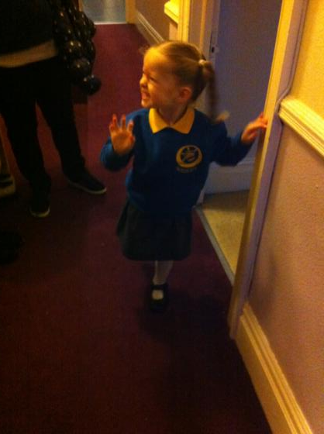
So how do we get from here… to here?

Slide 3
What kind of student experience? Here’s my highest hope. An experience that:
Enables every student to learn to the highest level, stretched so each achieves their personal best;
Is inclusive, with equal opportunities for all, whatever their previous backgrounds in learning and life;
Offers each student the chance to thrive in a context of challenge and support;
Provides transformative opportunities which encourages students to grow as people;
Engenders a collegiate atmosphere where students make valuable friendships and networks that last throughout their lives.

Slide 4
Without….
Stripping out all the joy and enthusiasm with which many enter higher education;
Pushing them into strategic behaviour (Kneale) through which they become progressively focused on modest outcomes? (‘Just tell me what I have got to do to pass: I can’t afford the time to go for a First’);
Filling them with dissatisfaction around their learning experiences, potentially driving them to grievances and litigation;
Making students feel their investment in higher education has been a waste of three years.

Slide 5
Instead
Building each student’s confidence in what they can do, enabling them to have a genuine and positive measure of their capabilities;
Ensuring that the disadvantages with which students enter a course of study are addressed and to some extent redressed during their academic careers;
Enabling intellectual growth, so that graduates are changed for the good by the experience of studying;
Building the foundations for future life experiences including employment, social engagement and personal fulfilment.

Slide 6
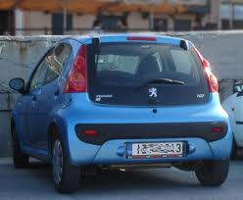
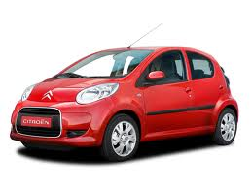

Slide 7
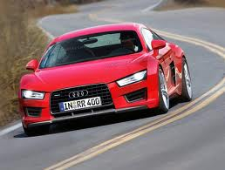

Slide 8
What do you get for £9k or £27k?
£9000 buys you:
Ford Ka, Fiat Panda, Citroen C1, Peugeot 107
£27,000 buys you:
BMW 3 series, Audi TT, Mercedes C Class, Land Rover Freelander, Ford Galaxy
What kinds of service standards, warranties and guarantees are you going to want?

Slide 9
What is differentiation?
Differentiated instruction and assessment (also known as differentiated learning or, in education, simply, differentiation) is a framework or philosophy for effective teaching that involves providing students with different avenues to acquire content; to processing, constructing, or making sense of ideas; and to developing teaching materials and assessment measures so that all students within a classroom can learn effectively, regardless of differences in ability.
(Wikipedia definition)

Slide 10
To foster engagement when students are highly diverse may imply rethinking:
How content is delivered;
How assessment is undertaken;
How personal support is given;
The uses being made of technology enhanced learning (TEL).

Slide 11
Rethinking how content is delivered: we need to
Review the balance of lectures and on-line flexible content, and particularly reviewing what students actually do in lectures.
Further explore the use of open educational resources (OERs), making use of the vast amount of curriculum materials designed by others e.g. MIT and the OU.
Learn from the experiences of those who are developing Massive Open On-line Courses (MOOCs), where content is provided free but students pay for engagement with staff and assessment.

Slide 12
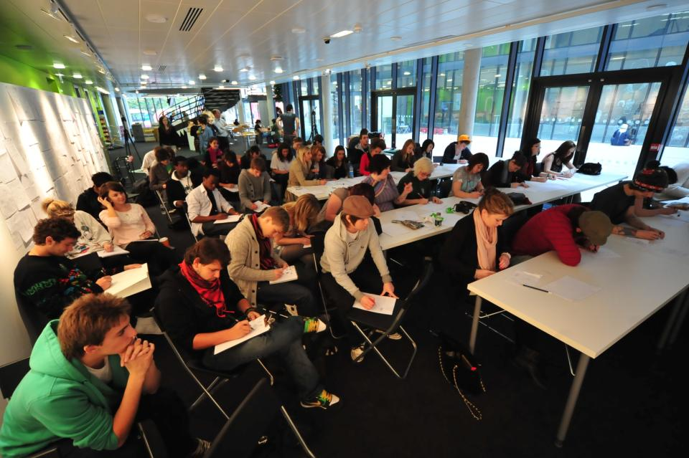
Engagement is crucial

Slide 13
Rethinking how assessment is undertaken:
To what extent is negotiated assessment feasible on large programmes?
Must all students undertake the same assignments in the same order?
Do we assess when students are ready or when it fits our systems?
If we are designing alternative assignments for students with disabilities, can we make these options available to other students?
How can TEL support assessment more effectively?
Can we emulate the ways that MOOCs use unmediated peer review while maintaining quality?
(I think probably not, but we can learn from them).

Slide 14
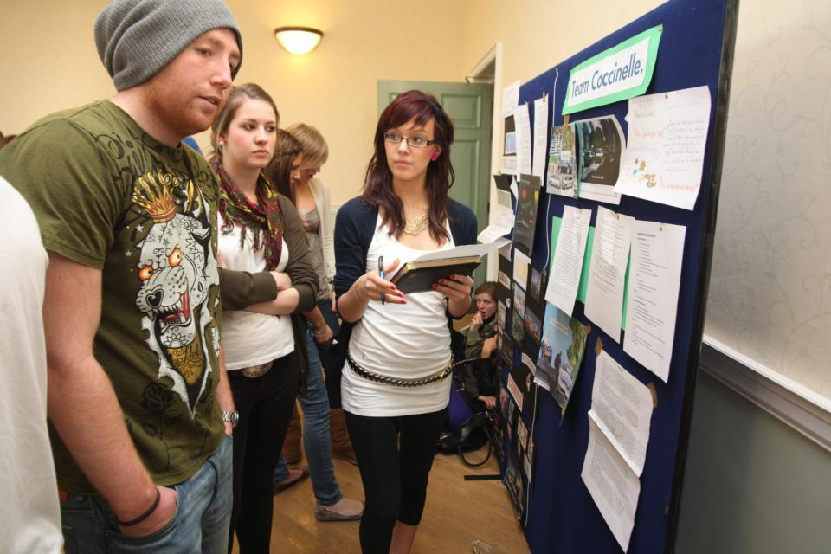
How can we involve students in their own and each other’s assessment?

Slide 15
Rethinking how personal support is given; we need to:
Review the function, organisation of and the value ascribed to personal tutors (so they become closer in role to Directors of Study, and less like chummy uncles and aunts!);
Foreground the role of the tutor as a locus of personalised learning opportunities;
Actively enable tutors to offer guidance through individual learning pathways, offering guidance on assignment timing, curriculum options and future pathways;
Think through how academic literacy, assessment literacy and information literacy are fostered and supported.

Slide 16
Rethinking the uses being made of Technology Enhanced Learning (TEL).
Technologies can support not just content delivery but also assessment and the efficient management of university processes. (Let’s stop staff wasting time inputting grades!);
Virtual learning Environments, as they continuously improve in functionality, will play an increasingly important role in the student experience;
Assignment submission, feedback and return will all be undertaken on-line I predict in the next five years;
It is likely also that ensuring that learning outcomes match Professional and Subject Body requirements and QAA standards will all be part of a systematised curriculum management process.

Slide 17
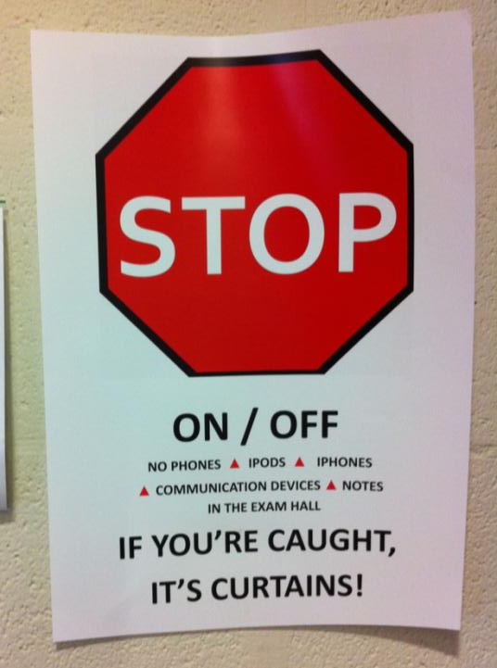

Slide 18
We need to be aware of the messages we give to students about, for example:
How we perceive them within the university community (as partners, as subjects, as clients, as customers……?)
What kinds of things we value (particularly the signals we give through curriculum and assessment design), for example, do we encourage steady continuous study or intermittent bursts of effort alternating with episodes of inertia?
The extent to which we value collaboration, competition, mutual support, inclusiveness…
Good academic conduct (including cheating, plagiarism, academic literacy and mutual support).

Slide 19
Diversification implies inclusive assessment practices for disabled students
For 10 years or more in the UK and elsewhere, legislative drivers, moral imperatives and pressures from disabled staff and students have driven HEIs to make assessment inclusive;
Recent advances in technologies have improved the accessibility of curriculum materials;
HEIs are not good at advanced planning when arranging alternative assessments;
Disabled students want an equivalent experience, fair assessment and the maintenance of standards of achievement.

Slide 20
Putting this in to practice. We need to:
design an assessment strategy that involves a diverse range of methods of assessment (as all forms of assessment disadvantage some students);
consider when designing assessment tasks how any students might be disadvantaged;
maximise the opportunities for each student to achieve at the highest possible level;
ensure the assurance of appropriate standards for all students.
But of course good practice for disabled students is good practice for all

Slide 21
What other kinds of diversity need we consider when aiming for inclusivity?
Diverse cultural, faith and social backgrounds;
Diverse capabilities, for example, with understandings of learning, information literacies and language;
Diversity of experience and backgrounds: mature students often bring a wealth of life experiences with them;
Diversities of expectations: social and cultural capital: (understandings of higher education gained from films?)
Diversities of experiences of assessment.

Slide 22
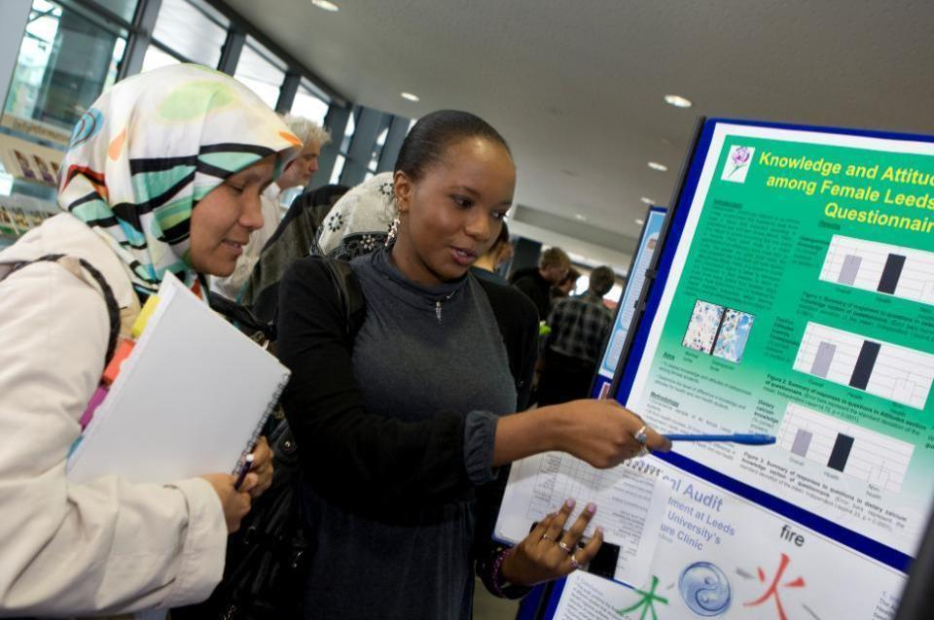
Assessment formats can challenge students

Slide 23
Students coming from abroad and studying in the UK may be challenged by:
A substantially different learning context where the relationship between staff and students (and students with fellow students) is often surprising to them (particularly power relationships);
Different expectations about technologies in use, particularly in nations where power supplies are intermittent;
Diverse experiences of the ways in which content is delivered and expectations about behaviour in lectures;
Different expectations about how they will be assessed including timing, duration, formats and contexts for assessment.

Slide 24
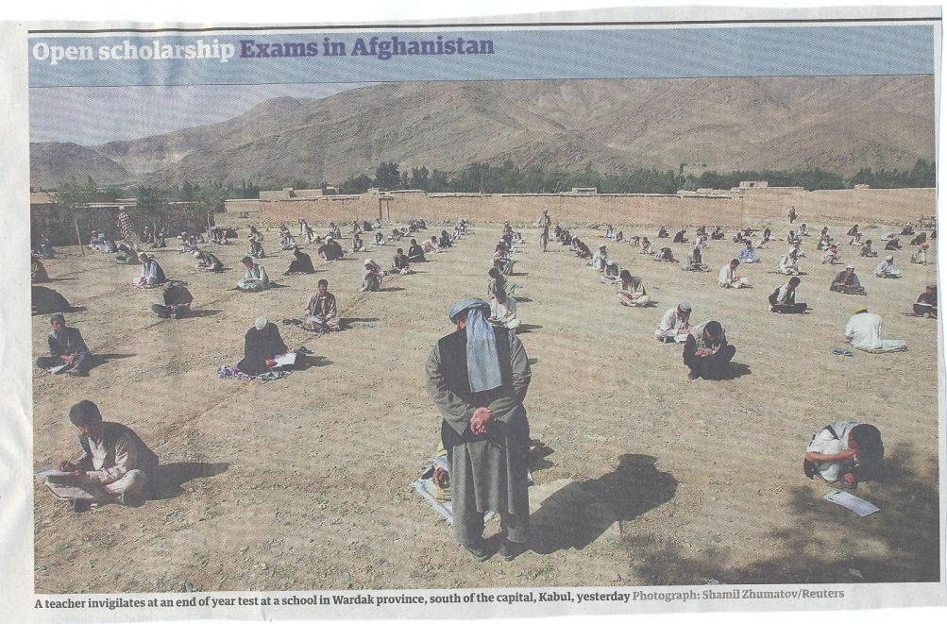

Slide 25
Diversification implies making assessment more efficient and effective so we need to:
Stop marking, start assessing!
Explore ways to maximise student ‘time on task’ (Gibbs) and minimise staff drudgery;
Remember that feedback is crucial to student learning but the most time-consuming aspect of assessment: we need to explore ways of giving feedback effectively and efficiently;
Use Computer-supported assessment including use of audio feedback via digital sound files, video commentaries, conventional MCQs, use of statement banks when commenting digitally on written work, ‘exploded’ model answers and other means.

Slide 26
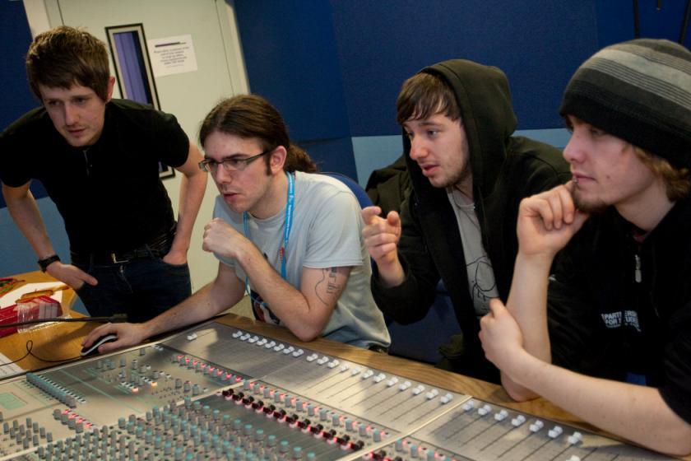
Personalised learning engages and motivates students

Slide 27
Conclusions
We are currently in the heart of some of the biggest changes to pedagogic practices in higher education any of us will have seen in our lifetimes;
Student expectations in the UK of what higher education should look like are changing rapidly in the light both of radically increased fees and current global developments in learning environments;
It is hard to predict where new technologies will take us next, but extrapolation form other contexts suggests that personalised learning pathways are likely to be crucial;
As these are labour-intensive, these are only viable if we radically review how and what we teach and assess.

Slide 28
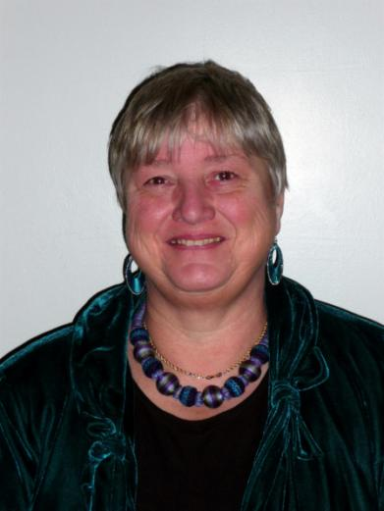
These and other slides will be available on my website at www.sally-brown.net

Slide 29
Useful references: 1
Biggs, J. and Tang, C. (2007) Teaching for Quality Learning at University, Maidenhead: Open University Press.
Boud, D. (1995) Enhancing learning through self-assessment, London: Routledge.
Brown, S. and Glasner, A. (eds.) (1999) Assessment Matters in Higher Education, Choosing and Using Diverse Approaches, Maidenhead: Open University Press.
Brown, S. and Race, P. (2012) Using effective assessment to promote learning in Hunt, L. and Chambers, D. (2012) University Teaching in Focus, Victoria, Australia, Acer Press. P74-91
Carless, D., Joughin, G., Ngar-Fun Liu et al (2006) How Assessment supports learning: Learning orientated assessment in action, Hong Kong: Hong Kong University Press.
Carroll, J. and Ryan, J. (2005) Teaching International students: improving learning for all, London: Routledge SEDA series.
Falchikov, N. (2004) Improving Assessment through Student Involvement: Practical Solutions for Aiding Learning in Higher and Further Education, London: Routledge.

Slide 30
Useful references 2
Gibbs, G. (1999) Using assessment strategically to change the way students learn, in Brown S. & Glasner, A. (eds.), Assessment Matters in Higher Education: Choosing and Using Diverse Approaches, Maidenhead: SRHE/Open University Press.
Kneale, P. E. (1997) The rise of the "strategic student": how can we adapt to cope? in Armstrong, S., Thompson, G. and Brown, S. (eds) Facing up to Radical Changes in Universities and Colleges, 119-139 London: Kogan Page.
Race P. (2006) The lecturer’s toolkit (3rd edition), London: Routledge.
Rust, C., Price, M. and O’Donovan, B. (2003) Improving students’ learning by developing their understanding of assessment criteria and processes, Assessment and Evaluation in Higher Education. 28 (2), 147-164.
Ryan, J. (2000) A Guide to Teaching International Students, Oxford Centre for Staff and Learning Development

