Slide 1
Effective and inclusive assessment design in the Art & Design context
University of the Arts
January 16th 2013
Sally Brown
Emerita Professor, Leeds Metropolitan University
Adjunct Professor, University of the Sunshine Coast, University of Central Queensland and James Cook University, Queensland
Visiting Professor University of Plymouth & Liverpool John Moores University.

Slide 2
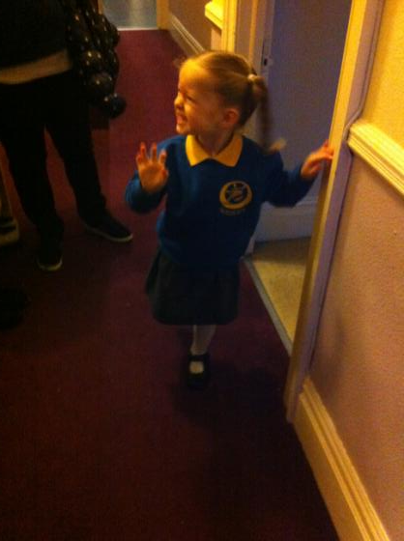

How do we get from here… to here?

Slide 3


Slide 4
My predictions for the future
The move away from educational organisations being the guardians of content, where everything is about delivery, towards having two major functions:
Recognising and accrediting achievement, wherever such learning has taken place;
Supporting student learning and engagement.
Notes:
En el futuro las universidades tendrán dos funciones clave
El reconocimiento y la homologación del rendimiento, logros, éxitos del estudiante aunque fueran conseguidos fuera de la universidad
El apoyo del aprendizaje y del compromiso del estudiante

Slide 5
Assessment in context
If we want to improve students’ engagement with learning, a key locus of enhancement can be refreshing our approaches to assessment;
Sometimes we need to take a fresh look at our current practice to make sure assessment is for rather than just of learning;
Assessment in Art and Design is a complex, nuanced and highly important process;
We provide explicit and implicit messages by how we assess.

Slide 6
This keynote will include reference to assessment
methodologies: which methods and approaches are most appropriate and efficient for the arts and design context?
agency: who should be undertaking assessment? Tutors, peers, students themselves, employers and clients can all participate in student assessment to good effect, but which is right for particular assessment activities?
timing: end point and continuous assessment can both be valuable, when should we assess students to maximise impact on student learning?
orientation: to what extent in each task would we wish to focus particularly on process or outcomes, or both?
inclusivity: how can we enable all students to achieve their highest personal potential?
efficiency: what can we do to make assessment fully embedded in learning for students, while

Slide 7
Assessment for learning
1. Tasks should be challenging, demanding higher order learning and integration of knowledge learned in both the university and other contexts;
2. Learning and assessment should be integrated, assessment should not come at the end of learning but should be part of the learning process;
3. Students are involved in self assessment and reflection on their learning, they are involved in judging performance;
4. Assessment should encourage metacognition, promoting thinking about the learning process not just the learning outcomes;
5. Assessment should have a formative function, providing ‘feedforward’ for future learning which can be acted upon. There is opportunity and a safe context for students to expose problems with their study and get help; there should be an opportunity for dialogue about students’ work;

Slide 8
Assessment for learning
6. Assessment expectations should be made visible to students as far as possible;
7. Tasks should involve the active engagement of students developing the capacity to find things out for themselves and learn independently;
8. Tasks should be authentic; worthwhile, relevant and offering students some level of control over their work;
9. Tasks are fit for purpose and align with important learning outcomes;
10. Assessment should be used to evaluate teaching as well as student learning.
(Sue Bloxham)

Slide 9
Issues that impact on the current context
Unmodelled and differentiated student fees structure for 2012;
Increasing importance of National Student Survey and various league tables on perceptions of quality and student recruitment;
New roles for students in quality assurance and enhancement;
Uncertainties about the genuineness of government WP imperatives;
International student visa restrictions;
Intense international competition.

Slide 10


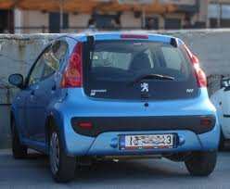
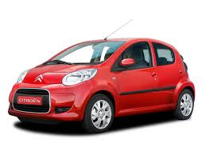

Slide 11






Slide 12
What do you get for £9k or £27k?
£9000 buys you:
Ford Ka, Fiat Panda, Citroen C1, Peugeot 107
£27,000 buys you:
BMW 3 series, Audi TT, Mercedes C Class, Land Rover Freelander, Ford Galaxy
What kinds of service standards, warranties and guarantees are you going to want?

Slide 13
Why does assessment matter so much?
“Assessment methods and requirements probably have a greater influence on how and what students learn than any other single factor. This influence may well be of greater importance than the impact of teaching materials” (Boud 1988)
Notes:
Los métodos de evaluación influyen más en el aprendizaje del estudients que cualquier otro factor.

Slide 14
To improve assessment we should realign it by:
Exploring ways in which assessment can engage students and be integral to learning.
Constructively aligning (Biggs 2003) assignments with planned learning outcomes and the curriculum taught:
Providing realistic tasks: students are likely to put more energy into assignments they see as authentic and worth bothering with.
Notes:
La evaluación dbe ser parte íntegra del aprendizaje.
“Alineamiento constructivo” según Biggs
Los estudiantes prefieren tareas auténticas.

Slide 15


Engagement is crucial

Slide 16
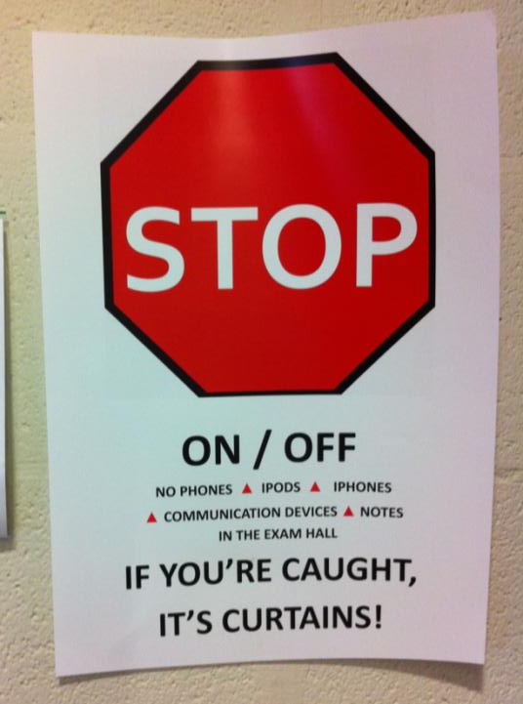

Slide 17
Assessment linked to learning
Effective assessment significantly and positively impacts on student learning, (Boud, Mentkowski, Knight and Yorke and many others).
Assessment shapes student behaviour (marks as money) and poor assessment encourages strategic behaviour (Kneale). Clever course developers utilise this tendency and design assessment tools that foster the behaviours we would wish to see (for example, logical sequencing, fluent writing, effective referencing and good time management) and discourage others (‘jumble-sale’ data sourcing, aimless cutting and pasting and plagiarism).
Notes:
La evaluación influye sobre el comportamiento del estudiante (Refs)

Slide 18
Formative and summative assessment
Formative assessment is primarily concerned with feedback aimed at prompting improvement, is often continuous and usually involves words.
Summative assessment is concerned with making evaluative judgments, is often end point and involves numbers.
Notes:
La evaluación formativa concentra en el feedback.
La evaluación sumativa trata de una nota final.

Slide 19
What really impacts on learning?
Concentrating on giving students detailed and developmental formative feedback is the single most useful thing we can do for our students, particularly those from disadvantaged backgrounds.
Summative assessment may have to be rethought to make it fit for purpose;
To do these things may require considerable imagination and re-engineering, not just of our assessment processes but also of curriculum design as a whole if we are to move from considering delivering content the most important thing we do.

Slide 20
A fit-for-purpose model of assessment: the key questions
Why are we assessing?
What is it we are actually assessing?
How are we assessing?
Who is best placed to assess?
When should we assess?
Notes:
20

Slide 21
Why are we assessing?
Choosing the reasons for assessment: these may include:
Enabling students to get the measure of their achievement;
Helping them consolidate their learning;
Providing feedback so they can improve and remedy any deficiencies;
motivating students to engage in their learning;
providing them with opportunities to relate theory and practice, especially in HE and FE.
Notes:
21

Slide 22
more purposes...
Helping students make sensible choices about option alternatives and directions for further study;
demonstrating student employability;
providing assurance of fitness to practice (in HE);
giving feedback to teachers on effectiveness;
providing statistics for internal and external agencies.
Notes:
22

Slide 23
Orientation: choosing what we assess
product or process?
theory or practice (HE particularly);
knowledge, skills and attitude (all sectors)?
subject knowledge or application?
what we’ve always assessed?
what it’s easy to assess?
Notes:
23

Slide 24
Methodology: being imaginative by choosing diverse assessments
essays, unseen written exams, reports
artefacts, critiques, exhibitions, the Final show, portfolios, projects, vivas, assessed seminars, poster presentations, annotated bibliographies, blogs, diaries, reflective journals, critical incident accounts, productions, case studies, field studies, theses…….
Notes:
24

Slide 25
Alternatives to traditional exams
Open-book exams Take-away papers
Case studies Simulations
Objective Structured Clinical Examinations (OSCEs)
Short answer questions
In-tray exercises Live assignments
Multiple choice Questions
Notes:
25

Slide 26
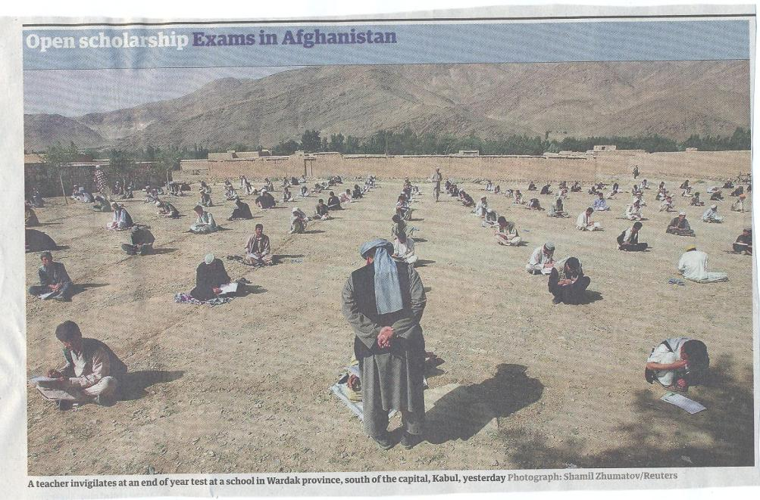

Slide 27
Agency: choosing who is best placed to assess
tutor assessment
self-assessment
peer assessment, (either inter or intra peer)
employers, practice tutors and line managers
client assessment
Notes:
27

Slide 28
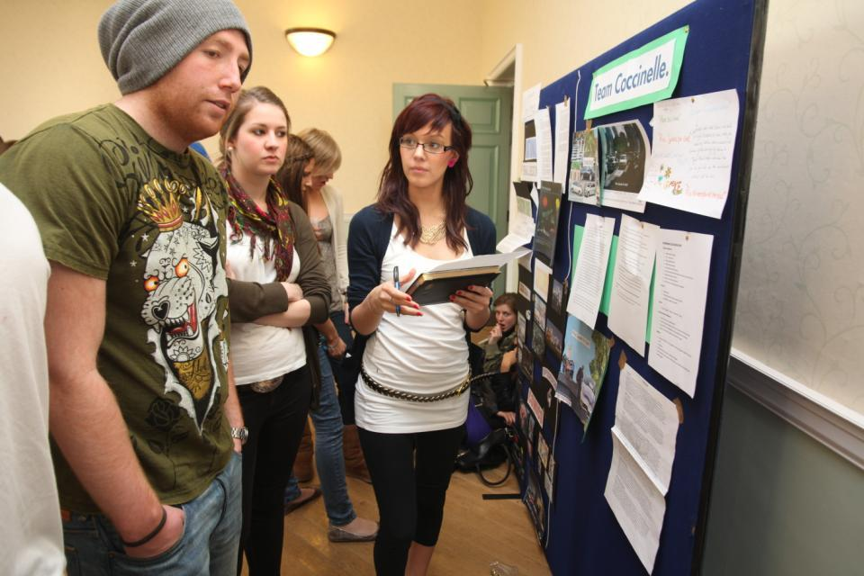
Involve students in their own assessment

Slide 29
Timing: when should assessment take place?
No sudden death.
end point or incrementally?
when students have finished learning or when there is still time for improvement?
when it is convenient to our systems?
when it is manageable for students? (avoiding assessment log jams).
Notes:
29

Slide 30
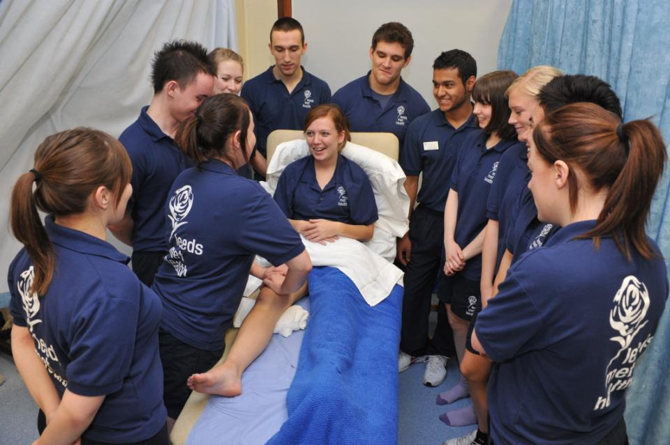
Authentic assessment helps learning

Slide 31
Boud et al 2010: ‘Assessment 2020’:
Assessment has most effect when...:
It is used to engage students in learning that is productive.
Feedback is used to actively improve student learning.
Students and teachers become responsible partners in learning and assessment.
Students are inducted into the assessment practices and cultures of higher education.
Assessment for learning is placed at the centre of subject and program design.
Assessment for learning is a focus for staff and institutional development.
Assessment provides inclusive and trustworthy representation of student achievement.

Slide 32
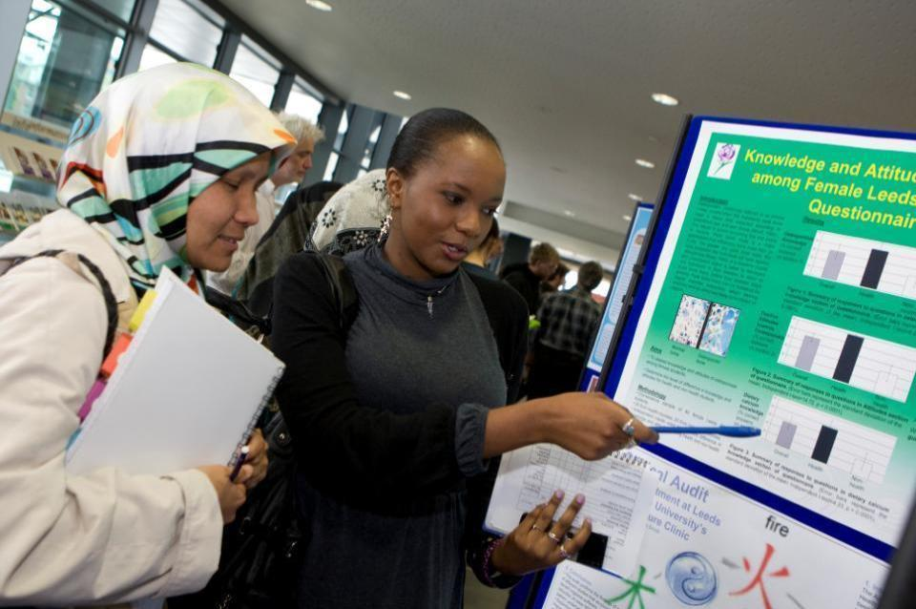
Assessment formats can challenge students

Slide 33
Inclusive practices in assessment
For 10 years or more in the UK and elsewhere, legislative drivers, moral imperatives and pressures from disabled staff and students have driven HEIs to make assessment inclusive;
Recent advances in technologies have improved the accessibility of curriculum materials;
HEIs are not good at advanced planning when arranging alternative assessments;
Disabled students want an equivalent experience, fair assessment and the maintenance of standards of achievement.

Slide 34
What other kinds of diversity need we consider when aiming for inclusivity?
Diverse cultural, faith and social backgrounds;
Diverse capabilities, for example, with understandings of learning, information literacies and language;
Diversity of experience and backgrounds: mature students often bring a wealth of life experiences with them;
Diversities of expectations: social and cultural capital: understandings of higher education gained from films?
Diversities of experiences of assessment.

Slide 35
Putting this in to practice. We need to:
design an assessment strategy that involves a diverse range of methods of assessment (as all forms of assessment disadvantage some students);
consider when designing assessment tasks how any students might be disadvantaged;
maximise the opportunities for each student to achieve at the highest possible level;
ensure the assurance of appropriate standards for all students.

Slide 36
Efficient assessment; we need to:
Stop marking, start assessing!
Explore ways to maximise student ‘time on task’ (Gibbs) and minimise staff drudgery;
Remember that feedback is crucial to student learning but the most time-consuming aspect of assessment: we need to explore ways of giving feedback effectively and efficiently;
Note that Computer-supported assessment in Art and Design can include use of audio feedback via digital sound files, video commentaries, conventional MCQs, use of statement banks when commenting digitally on written work, ‘exploded’ model answers and other means.

Slide 37
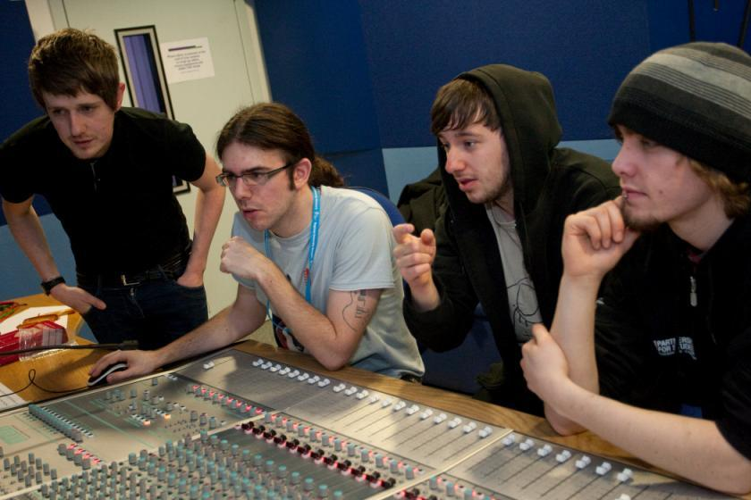
How to engage and motivate students?

Slide 38
Sound and frequent assessment
Good assessment is valid, reliable, practical, developmental, manageable, cost-effective, fit for purpose, relevant, authentic, inclusive, closely linked to learning outcomes and fair.
Is it possible also to make it enjoyable for staff and students?
Incremental assessment has more value in promoting student learning than end-point ‘sudden death’ approaches.
Notes:
La evaluación eficaz es divertida para estudiantes y profesores.

Slide 39
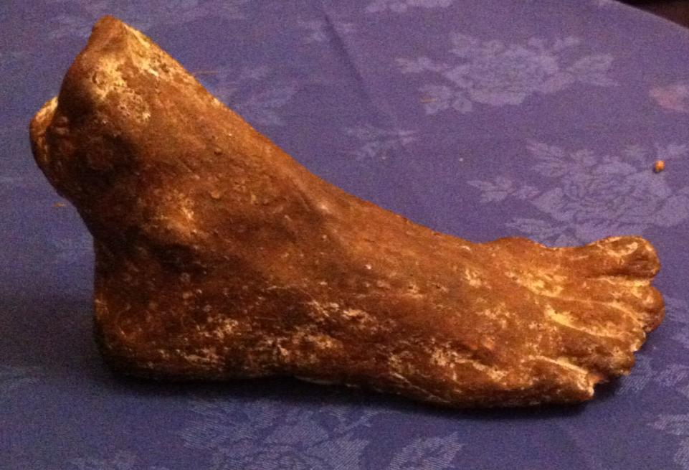

Slide 40
Conclusions
Assessment strategies are often under-designed;
We need to consider the fitness for purpose of each element of the assessment programme;
This will include the assignment questions/tasks themselves, the briefings, the marking criteria, the moderation process and the feedback;
We also need to scrutinise how the assignments align with one another, whether we are over or under-assessing, whether we are creating log-jams for students and markers, whether we are assessing authentically, and whether our processes are fair and sensible.
If we do this, assessment can contribute to improving student learning.

Slide 41
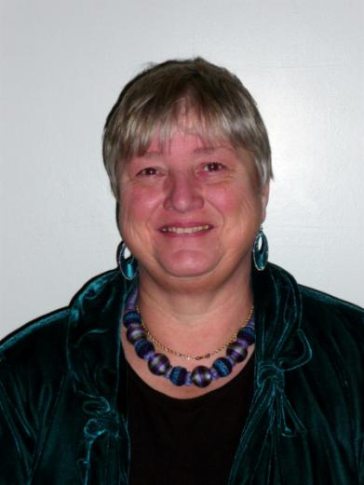
These and other slides will be available on my website at www.sally-brown.net

Slide 42
Useful references: 1
Assessment Reform Group (1999) Assessment for Learning : Beyond the black box, Cambridge UK, University of Cambridge School of Education.
Biggs, J. and Tang, C. (2007) Teaching for Quality Learning at University, Maidenhead: Open University Press.
Brown, S. Rust, C. & Gibbs, G. (1994) Strategies for Diversifying Assessment, Oxford: Oxford Centre for Staff Development.
Boud, D. (1995) Enhancing learning through self-assessment, London: Routledge.
Brown, G. with Bull, J. and Pendlebury, M. (1997) Assessing Student Learning in Higher Education, London: Routledge.
Brown, S. and Glasner, A. (eds.) (1999) Assessment Matters in Higher Education, Choosing and Using Diverse Approaches, Maidenhead: Open University Press.
Brown, S. and Knight, P. (1994) Assessing Learners in Higher Education, London: Kogan Page.
Brown, S. and Race, P. (2012) Using effective assessment to promote learning in Hunt, L. and Chambers, D. (2012) University Teaching in Focus, Victoria, Australia, Acer Press. P74-91
.

Slide 43
Useful references 2
Carless, D., Joughin, G., Ngar-Fun Liu et al (2006) How Assessment supports learning: Learning orientated assessment in action Hong Kong: Hong Kong University Press.
Carroll, J. and Ryan, J. (2005) Teaching International students: improving learning for all London: Routledge SEDA series.
Crosling, G., Thomas, L. and Heagney, M. (2008) Improving student retention in Higher Education London and New York: Routledge
Crooks, T. (1988) Assessing student performance, HERDSA Green Guide No 8 HERDSA (reprinted 1994)
Falchikov, N. (2004) Improving Assessment through Student Involvement: Practical Solutions for Aiding Learning in Higher and Further Education, London: Routledge.
Gibbs, G. (1999) Using assessment strategically to change the way students learn, in Brown S. & Glasner, A. (eds.), Assessment Matters in Higher Education: Choosing and Using Diverse Approaches, Maidenhead: SRHE/Open University Press.
Gibbs, G. (2008) Designing assessment to support student learning Keynote at Leeds Met staff Development festival.

Slide 44
Useful references 3
Kneale, P. E. (1997) The rise of the "strategic student": how can we adapt to cope? in Armstrong, S., Thompson, G. and Brown, S. (eds) Facing up to Radical Changes in Universities and Colleges, 119-139 London: Kogan Page.
Knight, P. and Yorke, M. (2003) Assessment, learning and employability Maidenhead, UK: SRHE/Open University Press.
Mentkowski, M. and associates (2000) p.82 Learning that lasts: integrating learning development and performance in college and beyond San Francisco: Jossey-Bass.
McDowell, L. and Brown, S. (1998) Assessing students: cheating and plagiarism, Newcastle: Red Guide 10/11 University of Northumbria.
Nicol, D. J. and Macfarlane-Dick, D. (2006) Formative assessment and self-regulated learning: A model and seven principles of good feedback practice. Studies in Higher Education Vol 31(2), 199-218.
Pickford, R. and Brown, S. (2006) Assessing skills and practice, London: Routledge.

Slide 45
Useful references 4
Race, P. (2001) A Briefing on Self, Peer & Group Assessment, in LTSN Generic Centre Assessment Series No 9 LTSN York.
Race P. (2006) The lecturer’s toolkit (3rd edition), London: Routledge.
Rust, C., Price, M. and O’Donovan, B. (2003) Improving students’ learning by developing their understanding of assessment criteria and processes, Assessment and Evaluation in Higher Education. 28 (2), 147-164.
Ryan, J. (2000) A Guide to Teaching International Students, Oxford Centre for Staff and Learning Development
Stefani, L. and Carroll, J. (2001) A Briefing on Plagiarism http://www.ltsn.ac.uk/application.asp?app=resources.asp&process=full_record&section=generic&id=10
Sadler, R. (2008) Assessment of Higher Education, in International Encyclopaedia of Education
Yorke, M. (1999) Leaving Early: Undergraduate Non-completion in Higher Education, London: Routledge.

