Slide 1
Changing the experiences of Masters level learning through improving assessment: learning from a UK National Teaching Fellowship project Society for Research in Higher Education December 2012
Sally Brown, Tim Deignan & Janice Priestley
http://sally-brown.net
Emerita Professor, Leeds Metropolitan University,
Visiting Fellow, University of Northumbria
Adjunct Professor, University of the Sunshine Coast, Central Queensland and James Cook University Queensland
Visiting Professor, University of Plymouth and Liverpool John Moores University.

Slide 2
Assimilate has been a 3-year NTFS funded project
We’ve been exploring innovative assessment at Masters level using research funding from the National Teaching Fellowship scheme.
Recognising that limited prior research had been undertaken in this area, we’ve been reviewing assessment methods used to assess at this level, particularly exploring authentic assessment.
Interviews were undertaken in the UK and internationally by students and team members to elicit information about diverse approaches and to produce case studies showcasing innovations.

Slide 3
Emergent outcomes
Using data from 45 interviews undertaken by the project team, and from conversations with other people we’ve encountered who have an interest in the area, we’ve produced 44 case studies illustrating diverse M-level assessment together with seven vignettes and three national overviews as included in the Compendium;
We have been impressed by the diversity and creativity of many of the approaches adopted;
We’ve also encountered much traditional written assessment, especially dissertations, unseen time-constrained exams, essays and project reports.

Slide 4
Good practice M-level Assessment examples include:
Highly authentic assignments, which relate closely to programme outcomes;
Multiple assessments which build incrementally to final submission;
Good feedback opportunities, giving students the chance to benefit from advice to improve performance;
Assignments that require teamwork and group activity;
Assignments that foster employability and that foster employer engagement;
Assignments that are enhanced and supported by technology;
Assignements requiring peer engagement / peer assessment.

Slide 5
Other learning points
It’s been interesting to observe how fuzzy are common understandings of the differences between M-level and undergraduate level assessment;
The importance of authentic assessment to professionally-orientated Masters programmes has been highlighted;
We’ve learned about variations in practice at M-level between different national systems, especially in terms of duration of programmes and funding arrangements;
We’ve also developed as individuals and as members of the project team, learning particularly about project management.

Slide 6
Analysing our data
We have used Activity Theory and Q Methodology to help us make sense of the case study data and to conduct a follow-up study on educator viewpoints.
The initial research study used Activity Theory to investigate practitioners’ experiences of introducing innovative assessment methods at Masters level.
We then designed a Q-study using 48 statements which were rank-ordered by 39 participants.
Using statistical analysis of these data we have interpreted five distinct factors, or viewpoints, relating to Masters level assessment issues.

Slide 7
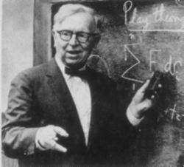
Q Methodology
William Stephenson (1902-1989)
Psychologist and Physicist
Q is used for establishing patterns within and across individuals, rather than across individual traits.
(Barry & Proops, 1999)

Slide 8
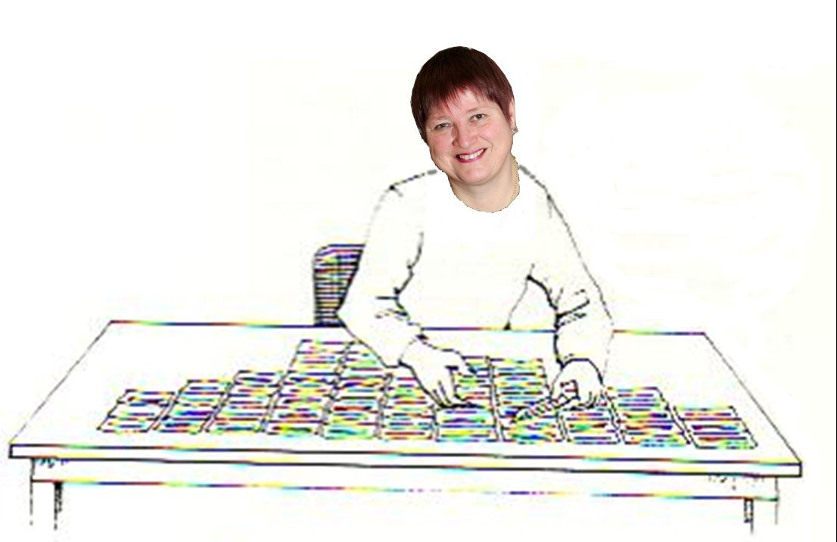
User-friendly: a Q-sort underway
Acknowledgement: Thanks to Wendy Stainton Rogers for sharing this graphic, which was adapted from an original paper by Stainton Rogers, W. (2011) Social Psychology. OUP.

Slide 9
Stages in a Q-study
Identifying and sampling the concourse
Developing a set of statements that is representative of the concourse
Selecting participants for a diversity of views on the issues
Q-sorting and post-sort interviews
Pattern analysis – data reduction and interpretation

Slide 10
Example statements
-3 -2 -1 0 +1 +2 +3
Disagree Agree
Strongly Strongly
Essays and exams should be ‘the gold standard’ in terms of Masters assessment methods. (3)
Improving assessment methods requires a shift in how learning is viewed. (41)
Writing assessment criteria is an easy job for academics. (26)

Slide 11
Findings – system voices
Five different viewpoints on the issues were interpreted, relating to different aspects of M-level assessment activity
Areas of consensus or near-consensus among the viewpoints were also interpreted

Slide 12
Viewpoints 1, 2 and 3
The innovative assessment and accreditation of learning for complex real life / workplace applications requires assessment training for both staff and students.
Standards and consistency can not be guaranteed by any means, but flexible assessment criteria and innovative assessment methods have their uses.
Introducing innovative assessment methods can be powerful but requires new perspectives on learning with institutional support and encouragement for successful wholesale change.

Slide 13
Viewpoints 4 and 5
Clear guidance to students in the form of high quality assessment criteria and timely tutor assessment feedback can help students to develop the skills that they and also employers want.
Improving assessment methods does not necessarily require a paradigm shift in thinking, but stakeholder consultation is important as benefits are not guaranteed and one size does not fit all.

Slide 14
Project overview
The project has yielded more variety and diversity than we expected at the outset;
It has excited considerable interest, with requests to disseminate outcomes to date at eight universities and seven conferences to date (with more in prospect);
It has been fascinating to explore practice in the UK, Denmark, Ireland, Spain, the Netherlands, Singapore, Australia and New Zealand;
We are modestly confident that we have added helpfully to understanding of M-level assessment, particularly through our compendium and our analysis of data to identify viewpoints.

Slide 15
Selected references and further reading
Brown, S. (2012) ‘What are the perceived differences between assessing at Masters level and undergraduate level assessment? Some findings from an NTFS–funded project’ Innovations in Education and Teaching International, forthcoming
Brown, S., Deignan, T. Race, P. and Priestley, J. (2012) ‘Assessing students at Masters Level: learning points for Educational Developers’ Educational Developments, SEDA, Birmingham.
Brown, S (2012) ‘Diverse and innovative assessment at Masters Level: alternatives to conventional written assignments’ in AISHE-J: The All Ireland Journal of Teaching and Learning in Higher Education Vol 4, No 2.
Casey, J. (2002) On-line assessment in a masters-level policy subject: participation in an on-line forum as part of assessment, Centre for the study of higher education, Charles Sturt University, Australia.
Dunn, S. and Singh, K. A. (2009) Analysis of M-level modules in interdisciplinary nanotechnology education, Nanotechnology Centre, Department of Materials, School of Applied Sciences, Cranfield University.

Slide 16
References (contd.)
Engeström, Y. (2010). Studies of expansive learning: Foundations, findings and future challenges. Educational Research Review, (5):1-24
Fry, H., Pearce, R. and Bright, H. (2007) Re-working resource-based learning - a case study from a masters programme. Innovations in Education and Teaching International, 44(1), pp.79-91.
Geographical Association. (no date) GTIP Think Piece - Writing at Masters Level. Available online: http://www.geography.org.uk/gtip/thinkpieces/writingatmasterslevel/
Haworth, A., Perks, P. and Tikly, C. (no date) Developments with Mathematics M-Level PGCE Provision and Assessment, University of Manchester, University of Birmingham, University of Sussex.
Institute of Education (2006) Masters level criteria for Geography PGCE http://www.geography.org.uk/download/GA_PRGTIPBrooksMLevelCriteria.pdf Accessed March 2012
Lord, D. (2008) Learning to Teach a Specialist Subject: Using New Technologies and Achieving Masters Level Criteria. In: MOTIVATE conference 2008, 11 - 12th November 2008, Dunaujvaros, Budapest. (Unpublished) This version is available at http://eprints.hud.ac.uk/10892/ Accessed December2012

Slide 17
References (contd.)
NZQA (2007) http://www.nzqa.govt.nz/assets/Studying-in-NZ/New-Zealand-Qualification-Framework/theregister-booklet.pdf (accessed March 2012
M level PGCE. (2007) ESCalate ITEM level PGCE seminar at the University of Gloucestershire on January 9th 2007.
QAA (2010) Masters Degree Characteristics
http://www.qaa.ac.uk/academicinfrastructure/benchmark/masters/MastersDegreeCharacteristics.pdf
Seymour, D. (2005) Learning Outcomes and Assessment: developing assessment criteria for Masters-level dissertations. Brookes eJournal of Learning and Teaching 1(2).
Van Eeten, Michel J.G. (2001) Recasting Intractable Policy Issues: The Wider Implications of the Netherlands Civil Aviation Controversy, Journal of Policy Analysis and Management, 20(3):391-414
Wharton, S. (2003) Defining appropriate criteria for the assessment of master's level TESOLAssignments. Assessment & Evaluation in Higher Education, 28(6), pp.649-664.

Slide 18
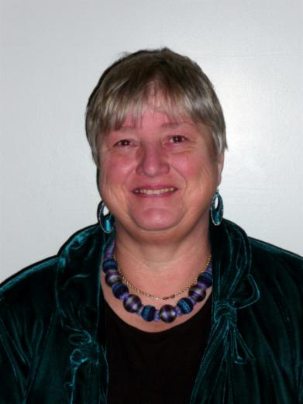
These and other slides will be available on my website at www.sally-brown.net

