Slide 1
Cork Institute of Technology
Strategies for student engagement and success
15th November2012
Sally Brown
http://sally-brown.net
Emerita Professor, Leeds Metropolitan University,
Adjunct Professor, University of the Sunshine Coast, Central Queensland and James Cook University Queensland
Visiting Professor, University of Plymouth and Liverpool John Moores University.

Slide 2
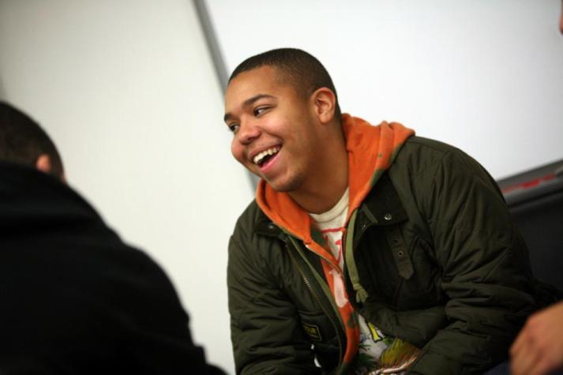
Students often arrive at university keen and raring to go

Slide 3
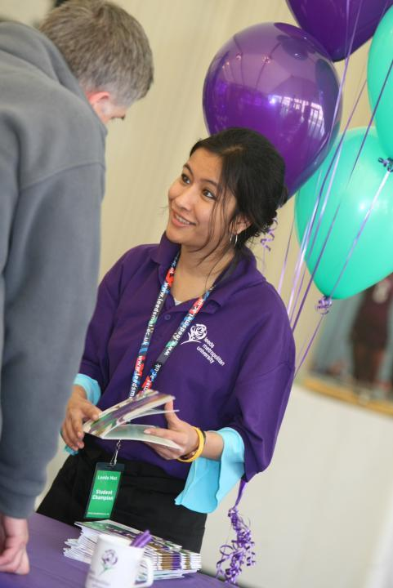
But reality may not live up to this

Slide 4
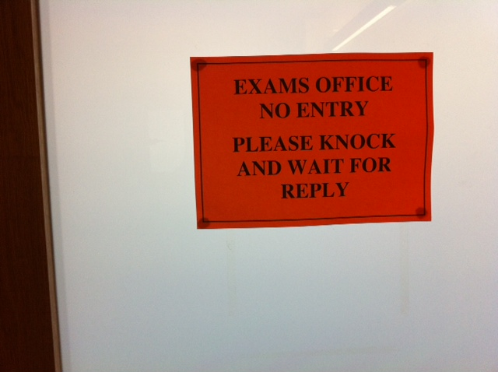

Slide 5

Students paying high fees in the UK (and Ireland?) expect much for their money

Slide 6

It’s fun at first but easy to feel lost

Slide 7
UK HESA stats advise us that student drop out is likely to be linked with
Coming from low-participation neighbourhoods;
Being in receipt of Disabled students allowance;
Being mature undergraduate students.

Slide 8
Retention rates also correlate with social class
There are higher rates of non-completion among students from lower SEGs;
Post-1992 universities tend to recruit more students from diverse backgrounds and generally their retention rates are lower;
The relationship between entry characteristics and non-completion is very strong.
Source: HEFCE data cited in Yorke 2004

Slide 9
Social class is linked to the kind of universities students attend
Elite universities generally recruit students with higher A level scores who are more likely to be from middle-class backgrounds;
They recruit fewer mature students, with entry dominated by school-leavers;
They have larger endowments and often more substantial and better maintained estates and resources.

Slide 10
Students at these universities are likely to possess
The cultural and social capital that are supportive of success;
Sources of financial support that are less available to those from lower socio-economic groups;
Less fear of debt than students from disadvantaged backgrounds.
(Yorke 2004 op cit)

Slide 11
However, it’s worth noting that
Some traditonaluniversities have outstanding records on recruitment of non-traditional students and on retention;
Some modern HEIs perform well below their ‘benchmarks’;
You can’t always trust the statistics (eg post-codes/ free school meals are not always reliable indicators of social class, art-schools do not necessarily do better than music conservatoires in WP, the data on which PIs are calculated is not always consistent).

Slide 12
Yorke (1999:53) reported that for full-time and sandwich students, factors which influenced drop out were
Poor quality of experience
Inability to cope with course demands
Unhappy with social environment
Wrong choice of course
Financial need
Dissatisfaction with some part of university provision.
Yorke, M (1999) p8 Leaving early: undergraduate non-completion in higher education London, Falmer press.

Slide 13
Additionally, withdrawal of failure is more probable when:
Students have chosen ‘the wrong programme’;
Students lack commitment and/or interest;
Students’ expectations are not met;
The quality of teaching is poor;
The academic culture is unsupportive (even hostile) to learning;
Students experience financial difficulty; and
Demands for other commitments supervene.
Peelo and Wareham p 34-5

Slide 14

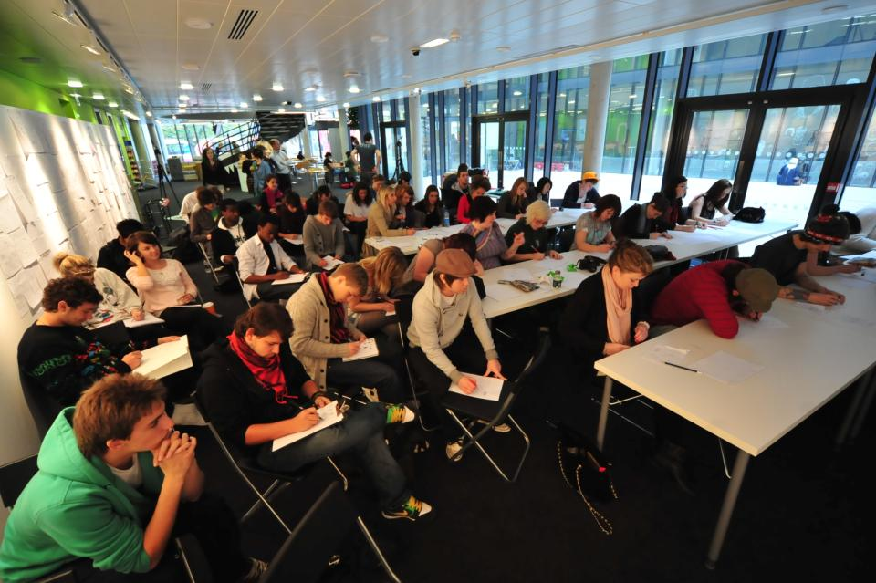
Polysemic activities: how can we engage and excite students’ attention in classes?

Slide 15
Poor attendance also correlates with drop out:
Research at Southampton institute (Lim), Glasgow Caledonian University (Begg) and University of Kent (Van der Velden) shows associations between weak attendance patterns and attrition;
Whatever the cause, not being there exacerbates other problems with study;
Endeavours to monitor and follow-up poor attendance has high pay off in terms of improving retention.

Slide 16

How to engage and motivate students?

Slide 17
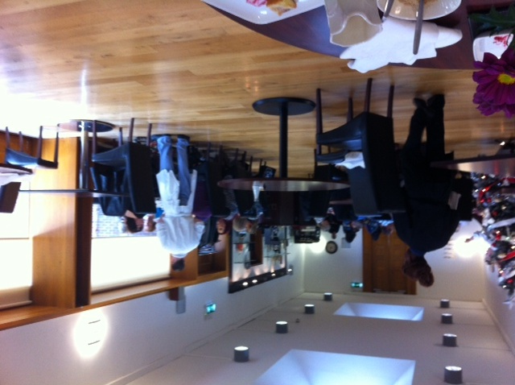

Slide 18
Further factors identified by Peelo and Wareham
The pressures of rising student numbers and reduced state funding have led to a decline in opportunities for staff-student interchange;
Higher education is becoming more impersonal;
Modularisation has led to semester-end (rather than year-end) assessment, which has led to a reduction in the amount of formative assessment being given to students - and formative assessment is a critically important part of the learning process.

Slide 19
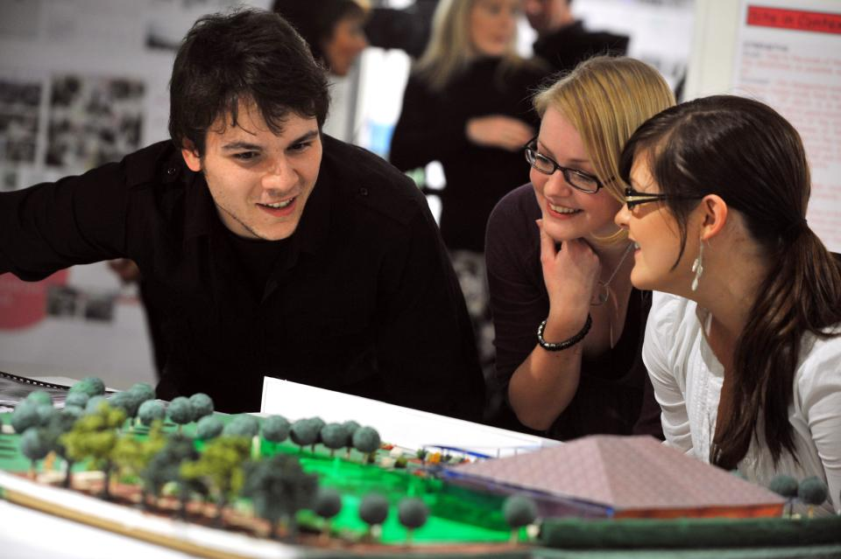
Peer support really helps retention

Slide 20

But group working can be problematic

Slide 21

Students are not a single cohesive group

Slide 22
Mature students drop out too
The older female students were less likely than their younger peers were less likely to cite matters related to wrong choice of field of study. 'Mature' entrants tend to have taken time over a decision that is often buttressed by their experience of life outside the educational system. Basically, they know what they want to do. On the evidence of this study, however, these students more frequently run into difficulty with finance and family. Peelo and Wareham p33

Slide 23

Their expectations of staff are high

Slide 24

They yearn for ( and expect) personalised learning experiences

Slide 25

And they really want personalised feedback

Slide 26

I-society: it’s all about me!

Slide 27
What can universities do?
“Whereas a higher education institution can not do much about students’ background circumstances, it is probable that there is more academic failure in UK higher education than there should be. There seems to be scope in institutions for improving the ways in which they support students’ learning – and hence for reducing the incidence of academic failure. In the end, this comes down to an orientation towards the enhancement of the quality of the student experience.” (Yorke 2002 op cit p39).

Slide 28
What can HEIs do at a strategic level to minimise failure?
Have an institution-wide policy commitment to students' development;
Have in place structures and processes consistent with this policy;
Ensure that new students enter with, or have the opportunity to acquire, the skills needed for academic success;
Run programmes in which the emphasis is on maximising students' development;

Slide 29
Other institutional tactics
Acknowledge through practice that support for students' academic development needs to be augmented by support for their personal development; and
See retention as an integral part of educational policy and practice, and not a freestanding initiative.
From Peelo, M and Wareham, T (eds) (2002) adapted from Tinto,

Slide 30
Drop out and assessment
“Roughly two-thirds of premature departures take place in, or at the end of, the first year of full-time study in the UK. Anecdotal evidence from a number of institutions indicates that early poor performance can be a powerful disincentive to continuation, with students feeling that perhaps they were not cut out for higher education after all – although the main problems are acculturation and acclimatisation to studying. “ (Yorke p37)
Implications: assessment in the first semester is critical: it should be formative, informative, developmental and remediable

Slide 31
What can HEIs do about assessment?
Having recognised that deleterious consequences of early summative assessment and that the first year of full-time study is typically only a kind of qualifying year for an honours degree, some institutions are removing from their assessment regulations the requirement that students pass summative assessments at the end of the first semester. This should allow students more of an opportunity to build confidence and to come to terms with academic study, and ought to allow more of the vital formative assessment to take place. (Yorke op cit)

Slide 32

Ruth Pickford’s First year Learning and Assessment Project (FLAP)

Slide 33

Student-centred assessment can improve retention, but…

Slide 34
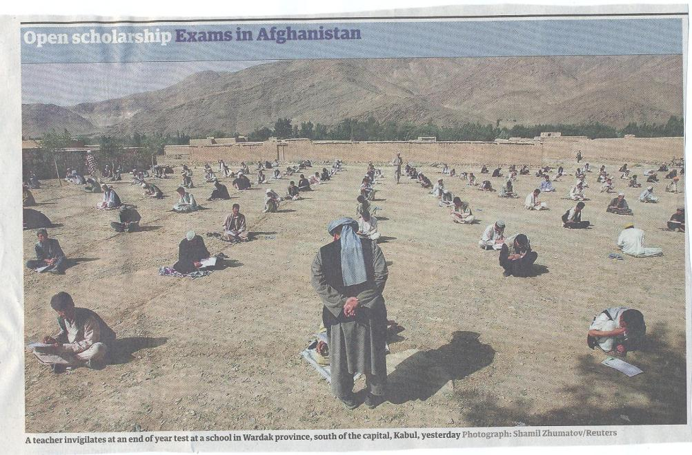

Slide 35
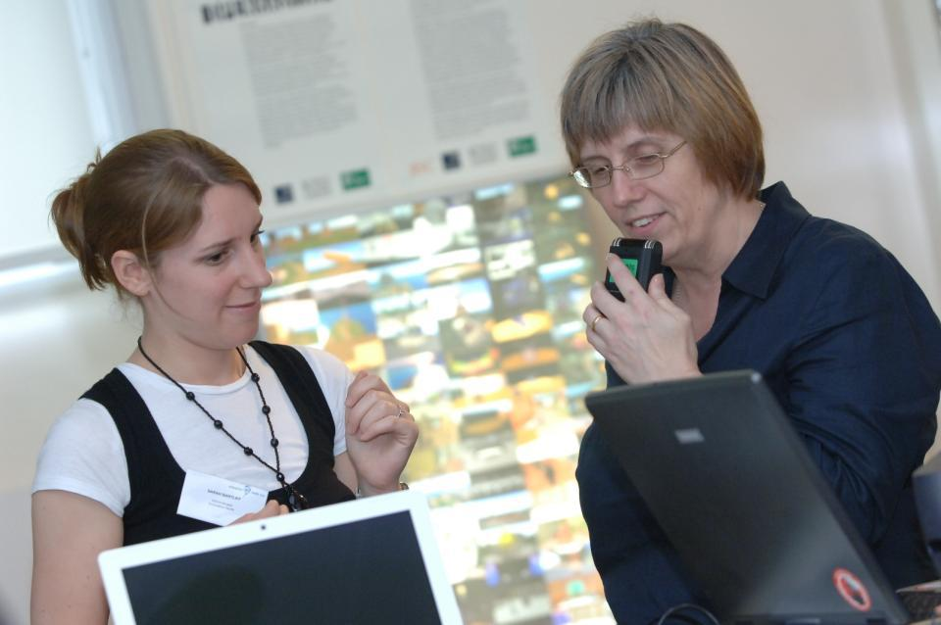
Technologies can support giving feedback

Slide 36

Bob Rotheram’s ‘Sounds good’ project

Slide 37
The uses of computer-assisted formative assessment.
While CAA is used in some contexts summatively, many would argue that it is most powerfully used to support formative feedback, especially where automatically generated by email.
Students seem to really like having the chance to find out how they are doing, and attempt tests several times in an environment where no one else is watching how they do.
Another benefit is that CAA systems allow you to monitor what is going on across a cohort, enabling you to concentrate your energies either on students who are repeatedly doing badly or those who are not engaging at all in the activity.

Slide 38

Authentic assessment helps learning

Slide 39

Assessment successes breed confidence

Slide 40
Assessment, confidence and retention
Crudely, student achievement is linked to students own beliefs about their abilities, whether these are fixed or malleable;
Students who subscribe to an entity (fixed) theory of intelligence need ‘a diet of easy successes’ (Dweck, 2000:15) to confirm their ability and are fearful of learning goals as this involves an element of risk and personal failure. Assessment for these students is an all-encompassing activity that defines them as people. If they fail at the task, they are failures.

Slide 41
Students who believe that intelligence is malleable may be more robust
Students who believe that intelligence is incremental have little or no fear of failure. A typical response from such a student is ‘The harder it gets, the harder I need to try’. These students do not see failure as an indictment of themselves and [can] separate their self-image from their academic achievement. When faced with a challenge, these students are more likely to continue in the face of adversity because they have nothing to prove. (after Clegg in Peelo and Wareham 2002)

Slide 42

Students really need to understand what is acceptable academic conduct

Slide 43

Information literacy is crucial

Slide 44
Helping students understand the rules of the game
The hardship was not understanding. When they give you an assignment and say it was on this handout. But my difficulty is not understanding what to do at first… I think that there’s a lack of my reading ability, which I can’t blame anyone for. I can only blame myself because I don’t like reading. And if you don’t read, you’re not going to learn certain things. So I suppose that’s to do with me…..it’s reading as well as putting what you read into your essay. You can read it and understand it. I can read and understand it, but then you have to incorporate it into your own words. But in the words they want you to say it in, not just: She said this, and this is the way it should be. The words, the proper language. (Bowl op cit 2003 p90).

Slide 45
Problems associated with reading
If 25% of your marks is from reading, you’ve got to try and show that, even if you haven’t read. I’m not going to sit there and read a chapter, and I’m certainly not going to read a book. But I’ll read little paragraphs that I think are relevant to what I’m writing, and it’s got me through, and my marks have been fine. But I can’t read. If I read too much, it goes over my head. If I’m writing something, I know what I want to say and I need something to back me up… then I will find something in a book that goes with that. I’m not going to try to take in the whole book just for one little bit. I have my book next to me and then I can pick out the bits. (Jenny, full-time community and youth work student). (Marion Bowl Non-traditional entrants to Higher Education 2003 p89).

Slide 46
Help students understand what is required with reading
Help them also to understand that there are different kinds of approaches needed for reading depending on whether they are reading for pleasure, for information, for understanding or reading around a topic;
Help them to become active readers with a pen and Post-its in hand, rather than passive readers, fitting the task in alongside television and other noisy distractions;
Give them clear guidance in the early stages about how much they need to read and what kinds of materials they need to focus on.

Slide 47

Students may need guidance on what to do with feedback

Slide 48
Making the most of feedback
Plan to maximise the impact of formative feedback. Make extra time helping students to understand the importance of feedback and the value of spending some of their time after receiving work back to learn from the experience.
Provide opportunities for students to respond to our feedback, for example, by giving students follow-up task or give them ‘feed-forward’ comments to improve their next piece of work.
Think about the means by which we deliver feedback, since this can be vital in determining how much notice students take of what you say.

Slide 49
Use formative assessment to help students with writing
Devote energy to helping students understand what is required of them in terms of writing;
Work with them to understand the various academic discourses that are employed within the subject/institution;
Help them to understand when writing needs to be personal and based on individual experience, such as in a reflective log, and when it needs to be formal and using academic conventions like passive voice and third person, as in written reports and essays.

Slide 50
The relationship between part-time work and student success
Considerable research suggests that students who work more than about 12 hours per week are likely to be academically disadvantaged;
Students from lower SEGS are more likely to need to work part-time and are less able to stop working at peak times of study;
Disabled students may well be less well placed to find and keep part-time work, with inevitable financial repercussions.

Slide 51

Employing students ourselves helps retention

Slide 52
What can we do as individuals?
Set small early assessed tasks (formative or summative) and turn them round fast in the crucial first semester;
Monitor student attendance and take action when students disappear and particularly when work is not handed in;
Make time available for student support, but know when to refer matters on when the problems are beyond our capabilities;
Do what we can to personalise the learning experience.

Slide 53

We need to explore wholesale curriculum re-engineering to make it fit-for-purpose

Slide 54
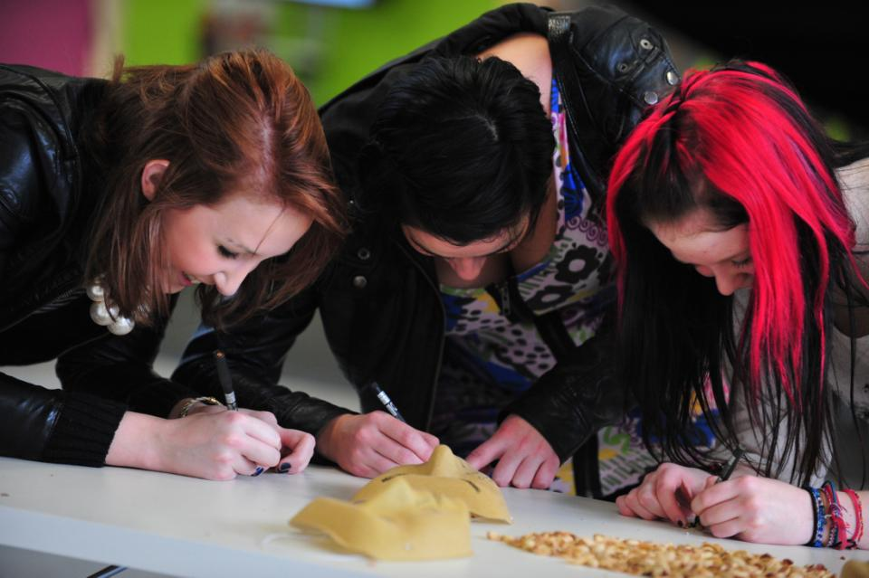
In the end, it’s all about engagement

Slide 55

These and other slides will be available on my website at www.sally-brown.net

Slide 56
Useful references
Bowl, M (2003) Non-traditional entrants to higher education ‘they talk about people like me’ Stoke on Trent, UK, Trentham Books.
Boud, D (1995) Enhancing learning through self-assessment London, Routledge.
Higher Education Statistics Agency http://www.hesa.ac.uk/pi/default.htm
Hilton A (2003) Saving our Students (SoS) embedding successful projects across institutions, Project Report York: Higher Education Academy.

Slide 57
Further references
Peelo, M and Wareham, T (eds.) (2002) Failing Students in higher education Maidenhead, UK, SRHE/Open University Press.
Sadler, D R (1989) Formative assessment and the design of instructional systems Instructional Science 18, 119-144.
Yorke M, 1999, Leaving Early: Undergraduate Non-Completion in Higher Education, London, Taylor and Francis.
Yorke M and Longden B, 2004, Retention and Student Success in Higher Education, Maidenhead, Open University Press

