Slide 1
Internationalising the curriculum
University of East Anglia
12th October 2012
Sally Brown
http://sally-brown.net
Emerita Professor, Leeds Metropolitan University,
Adjunct Professor, University of the Sunshine Coast, Central Queensland and James Cook University Queensland
Visiting Professor, University of Plymouth and Liverpool John Moores University.

Slide 2
Today's workshop will enable you to:
Consider some of the diverse approaches to assessment, learning and teaching that our international students and staff are likely to encounter;
Discuss some ways to avoid potential problems around learning cultures, including academic conduct;
Review our curricula to make them focused on international rather than just UK issues;
Consider how we can make our programmes more globally attractive in a highly competitive HE context.

Slide 3
Do we currently have a global Higher Education environment?
Do we have, for example:
shared concepts of pedagogy?
equivalent and mutually accreditable assessment systems?
compatible technologies for learning?
comparable learning contexts?
shared languages for learning?
shared concepts of student support compared with our target markets?

Slide 4
The purposes of internationalisation
Much of what is written about internationalising higher education focuses on how universities can maximise income by being welcoming to students who will come to universities paying high international fees.
It is commonplace for university staff to regard international students as ‘other’ and problematic.

Slide 5
Problematising the international student
In writing about ‘The welcome package’ to be used when indicting international students, Humfrey (1999) advises:
“Most problems occur when mores are misunderstood or their importance misinterpreted. An institution confident in its own care and concern for international students can talk to newcomers with insight, frankness and kindness about bathroom and toilet habits, and what is likely to give rise to friction and offence”.

Slide 6
Furthermore
“It is just as important, but easier, to discuss for example, the British view on the use of ‘please’ and ‘thank you’ (they like frequent repetition of these words); the attitude to women in authority (it is the person, not the gender that matters); the approach to manual or catering staff (they are employees not servants); the expectation on receiving a social invitation (reply and then stick to it); and the custom with regard to punctuality (lectures, appointments and meals begin on time unless otherwise stated).”
Humfrey, 1999, pp. 89-90

Slide 7
Surprises in the international context
Students studying away from home often find approaches, methods, content and context very different from what they are used to;
Staff with diverse student cohorts are often surprised by student attributes and behaviours;
Institutions are not always well set up to support international students and recognise their achievements.

Slide 8
What do students say?
The following comments are typical of what international students say when they study in the UK and what UK students say when they study abroad.
Which do you think are which?
Do any of these surprises sound familiar to you?

Slide 9
On dealing with unfamiliar assessment formats
“I couldn’t believe it when they told me there was no written exam. At first I thought it was wonderful but now I’m really worried because I don’t know what I am supposed to be doing.”
“I’ve never given an oral presentation before. Back home all our exams were written ones, so it was very nerve-wracking for me to have to stand up in front of everyone, with them all looking at me. It made it really hard for me to concentrate on what I was saying, even though I had done lots of preparation.”

Slide 10
More unfamiliar formats
“In my country, you only really get to do a viva for a post-graduate qualification so it was a shock to me to find that I was expected to do them for my course on my year abroad.”
“Back home exams only last a couple of hours, or three at the most. Here they are six hour marathons, sometimes more. It’s really exhausting.”

Slide 11
Surprises about the assessment context
“I can’t imagine anyone back home bringing their families along to watch them presenting university course work, but here they all come along, aunties and cousins and grannies. I felt rather lonely doing mine all on my own”.
“He gave me a B- for my essay. Back home I never got less than an A or maybe an A- so I went to see what the problem was, and he more or less brushed me off, saying it was fine. But it’s not fine! It’ll play hell with my Grade Point Average when I go back home”.
A real problem with US students in the UK.

Slide 12
On right answers
“They tell us to read around the topic and give us long book lists to help us prepare for writing essays, but how do you know where to start? I wanted to know which was the best book for me to concentrate on but no one would help me find it. In my country the books we need to study properly are indicated and everyone knows what they are”.
“In the lecture she gave us information about three different approaches to the subject, but she never told us which one was the right one. When I asked her about it, she said it was up to me to decide. How am I supposed to do that? She is the expert! So now I just don’t know what to write in my essay”.

Slide 13
On language
“I’ve never been asked to write an essay as long as this before. Back home I was getting on really well with my written English, but what they asked for was usually only around 1,000 words long. This just takes so much time to get it right.”
“I went to my tutor and asked him to proof read my dissertation but he refused to help me. I am paying so much money as an overseas student here and I expected them to be more helpful to me.”

Slide 14
On the authoritative role of the tutor
“It was a shock for me to find that I wasn’t going to be marked by the tutor but by other students. How can they possibly be able to do that? The tutors should be doing this because they have the knowledge that we don’t have”.
“In our OSCEs [Objective Structured Clinical Examinations], we had to examine a patient whose comments on my proficiency formed part of the assessment. How can that be right? They know nothing of clinical matters.”

Slide 15
On religious issues
“We had two exams in one day, both lasting three hours. I had difficulty concentrating in the second one as I had been fasting since dawn. I didn’t really feel I did my best.”
“It was very uncomfortable for me taking an exam on a Saturday morning”.

Slide 16
On ways of relating to others
“Home students are at such a great advantage over us. They seem to laugh and chat with the teachers in a very familiar way. We feel like outsiders and I think we are disadvantaged when it comes to the tests”.
“The tutor went through the criteria for the presentation with us, emphasising things like body language and eye contact but he didn’t understand that that would be a problem for me to look straight at all the male students”.

Slide 17
On expectations of a supportive relationship
“He told us we could come to his office if there was something we didn’t understand, so I went, but after only half an hour, he said he had to go off to meeting, so I didn’t feel he had really helped me much”.

Slide 18
What do UK teachers say international students do that they find surprising?
Students giving generous presents
Answering all my questions with ‘yes’
Handing in 4,000 words for an essay with a 2,500 word limit
Writing very personal coursework with the main point on page 3 and lots of ‘unnecessary’ background
Repeating verbatim my lecture notes in the coursework

Slide 19
Variations in approaches based on cultural factors
These can centre on the extent to which historical texts and previously accumulated knowledge is respected and how much students are expected to have their own ideas, , how far authority figures, including teachers are respected (or not) and in particular, how far it is acceptable to be overtly critical of authoritative texts or figures and whether a ‘correct’ answer is sought and the extent to which alternative responses are acceptable.
(Ryan 2000)

Slide 20
Cultural mores can impact on expectations
“Eastern, Latin American and some Carribean cultures can, for example, deem it rude to make firm eye contact: while in the Uk it is often thought rude not too.” (Grace and Gravestock, 2009, p. 61)
This can be problematic where the assessment criteria for a presentation specifically mention eye contact, which may be difficult for some female students from the Indian sub-continent and others.

Slide 21
Further cultural issues:
There can be issues around students who are not prepared to ask questions in class or seek support, for fear of ‘losing face’, or causing the teacher to ‘lose face’;
There is diversity in the extent to which robust discussion is valued, with students from some cultures preferring to focus on the importance of harmony and co-operation within the group rather the interests of the individual within it (Ryan, op cit, 2000).

Slide 22
Diverse assessment approaches
There are likely to be differences in emphasis on unseen time-constrained exams, multiple choice questions and oral defences, vivas and presentations, which are much more common in Northern Europe and Scandinavia than in the UK;
Group assessment is strongly encouraged in some nations , where problem based learning is commonplace and is frowned on or banned in others (Denmark for example currently).

Slide 23
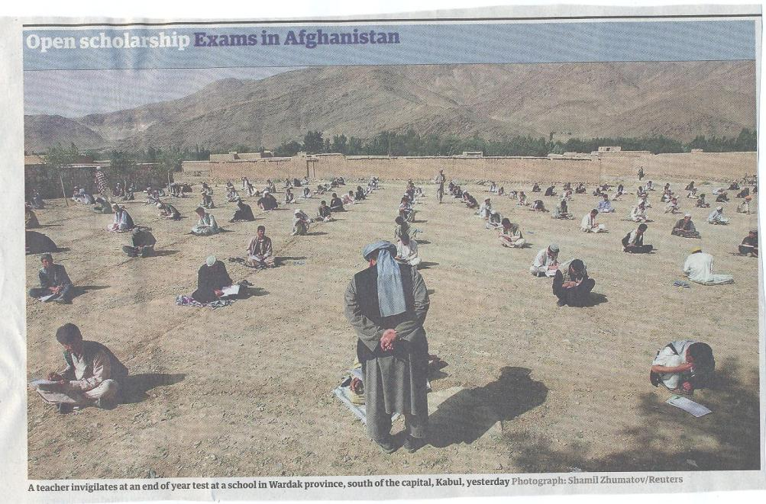

Slide 24
Contested terms which do not automatically translate include:
Assessment and evaluation,
Compensation,
Faculty/staff/administration,
Internationalising Higher Education,
Inclusive learning.

Slide 25
Diversity in classroom teaching approaches
Some HEIs in Pacific Rim nations providing substantially more one-to-one support than they might expect in the UK;
Some nations provide substantially less support than is common in the UK (for example, in some HEIs in Italy is not uncommon for the (very low) fees to cover only mass lectures, with seminars and personal tutoring available as extras.

Slide 26
Teaching and technologies
The traditional lecture with little interaction is much more common in some nations than others;
Students can expect different modes of delivery and diversity in the level of provision of support materials including handouts, electronic texts and social learning environments, depending where they are studying.
Up-to-date IT equipment and even continuous electricity supplies to power computers are not ubiquitous.

Slide 27
Diverse expectations concerning feedback
There are considerable differences in expectations internationally about the type, timing and purpose of feedback;
There is diversity in the explicitness of criteria and the amount of support students can expect if they are struggling with work.
In some nations, multiple assessment opportunities are provided, and students failing modules simply pick up credits else where (in Australia and New Zealand for example) and other nations, like the UK have much more hidebound regulations on progression issues.

Slide 28
Ryan and Carroll (2005) note common problems about students complying with word length regulations: for some African students, starting into the main body of the essay without a preamble is considered impolite, for example, meaning they frequently go considerably over length, while other students whose first language is not English comment on the problem of writing at length when their previous writing assignments have been 1,000 words long or so.

Slide 29
Some key questions on student support
Is recruitment undertaken to ensure students have the potential to succeed?
Is induction framed appropriately to welcome international students?
Are steps taken proactively to ensure international students have a good chance of integrating with their study cohorts?
Is the right kind of support offered (language, crisis support, befriending etc?)

Slide 30
Conclusions
Working in a global context, we need to familiarise ourselves with diverse expectations and practices in relation to assessment, learning and teaching if we are to successfully recruit and retain international students;
Students are less likely to experience unpleasant surprises if the university staff who teach and support them familiarise ourselves with diverse international practice;
Learning more about international higher education is likely to illuminate and enhance our own practices too.

Slide 31
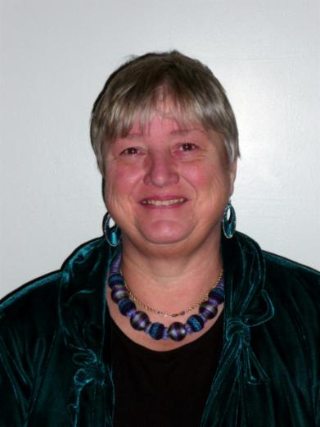
These and other slides will be available on my website at www.sally-brown.net

Slide 32
References and further reading
Carless, D., Joughin, G., Ngar-Fun, Liu. et al (2006) How Assessment supports learning: Learning orientated assessment in action, Hong Kong University Press.
Carroll, J. and Ryan, J. (2005) Teaching International students: improving learning for all, London: Routledge SEDA series.
Grace, S. and Gravestock, P. (2009) Inclusion and Diversity: meeting the needs of all students. Key guides for effective teaching in Higher Education, London: Routledge.
Humfrey C (1999) Managing International students Maidenhead: Open University Press.

Slide 33
More references
Jones, E. and Brown, S. (Eds) (2008) Internationalising higher Education, London: Routledge.
McNamara, D. and Harris, R. (1997) Overseas students in Higher Education: issues in teaching and learning, London: Routledge.
Ryan, J. (2000) A Guide to Teaching International Students, Oxford: Oxford Centre for Staff and Learning Development.
Wisker, G. (2001) Good practice working with international students, SEDA paper 110, the Staff and educational Development Association Birmingham.

