Slide 1
Developing an inclusive approach to learning in Higher Education
University of East Anglia
12th October 2012
Sally Brown
http://sally-brown.net
Emerita Professor, Leeds Metropolitan University,
Adjunct Professor, University of the Sunshine Coast, Central Queensland and James Cook University Queensland
Visiting Professor, University of Plymouth and Liverpool John Moores University.

Slide 2
Today's workshop will enable you to:
Review your own teaching through the lense of inclusivity;
Discuss how best to ensure diverse students have opportunities to maximise their achievement;
Consider how traditionally disadvantaged students can be supported to reduce attrition;
Consider how best to design alternative assessments for students with specific disabilities.

Slide 3
Contextual issues
Universities around the world are recruiting more diverse students;
Engaging them fully in learning can provide real benefits;
Too often we over-focus on the problems and the challenges;
Diversity in the classroom enriches learning.

Slide 4
What kinds of diversity?
Diverse cultural, faith and social backgrounds;
Diverse capabilities, for example, with understandings of learning, information literacies and language;
Diversity of experience and backgrounds: mature students often bring a wealth of life experiences with them;
Diversities of expectations: social and cultural capital: understandings of higher education gained from films?
Diversities of experiences of assessment.

Slide 5
What are the implications of diversity in HE classrooms?
The importance of the First Year Experience, particularly the first six weeks of the first year;
As the context changes, we need to be flexible and adaptable to maintain an inclusive approach;
Induction into academic practices and language is crucial (e.g. Andy Northedge).

Slide 6
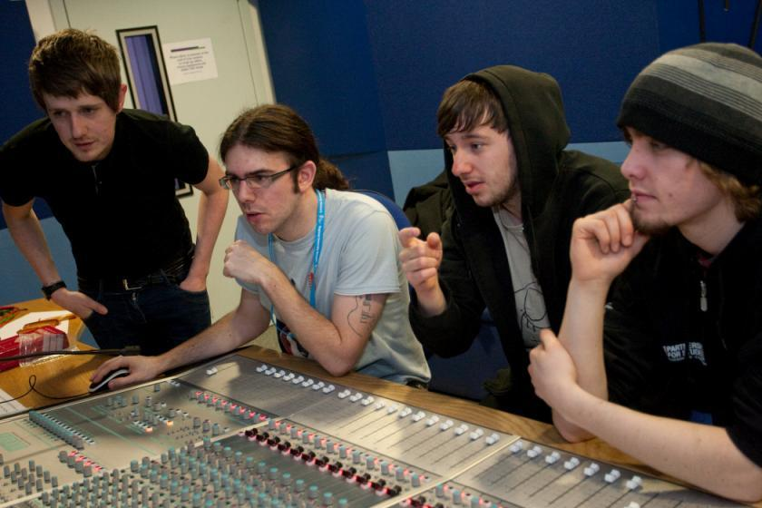
How to engage and motivate students?

Slide 7
The Medical/Social Boundary
The boundary between the medical and the social is a shifting one, constructed in complex ways that reflect both institutional and ideological factors. (Twigg, 1998, p. 227)
What does this sentence mean to a newcomer to care discourse? In everyday life a ‘medical’ is a physical examination and a ‘social’ is a gathering. Why would a boundary need to be constructed between them – let alone a complex and shifting one? What is an institutional factor, let alone an ideological one? To most beginning students this sentence is impenetrable. Yet it makes immediate sense to experienced members of the care community. (Northedge, 2003)

Slide 8
Inclusive practices
For at least ten years in the UK and elsewhere, legislative drivers, moral imperatives and pressures from disabled staff and students have driven universities to improve inclusive provision;
Recent advances in technologies have improved the accessibility of curriculum materials;
There is still a substantial way to go in changing teaching and assessment practices.

Slide 9
Research and staff development towards inclusive practice in UK HEIs
Quality assurance and quality enhancement drivers have both been important;
The English and Scottish funding Councils inter alia have funded a number of projects on improving inclusive HE practice;
These include work on inclusive field work at Gloucester and Plymouth Universities, work on disabled postgraduates at Newcastle University and programmes of Curriculum change at the university of central Lancashire;
Extensive sharing and dissemination is supported by organisations including the UK Higher Education Academy and TechDis.

Slide 10
The big issue: assessment
This is often the area where good inclusive practice breaks down;
HEIs do not tend to be good at advanced planning when arranging alternative assessments for disabled students;
Disabled students want an equivalent experience, fair assessment and the maintenance of standards of achievement.

Slide 11

Student-centred assessment can improve retention

Slide 12
Assessment practices
The majority of UK, NZ and Australian assessment comprises written assignments (course work or exams) with much less emphasis on oral assessment than in Scandinavia for example;
This is likely to disadvantage students with dyslexia and visual impairments;
Oral tests and vivas present problems for students with hearing impairments;
Traditional exams are stressful for students with mental health impairments as well as being difficult for students who have problems sitting for long periods;
Practical tests and field work can be problematic for students with mobility impairments.

Slide 13
The UK QAA codes of practice on disability and assessment focus on
Addressing the full range of disabilities;
Providing alternative assessment arrangements that are appropriate, flexible widely publicised, easy to follow, rigorous, consistently applied, not dependent on students’ individual funding arrangements;
Providing equivalent opportunities to demonstrate the achievement of learning outcomes;
Enabling students’ strengths and weaknesses to be demonstrated.

Slide 14
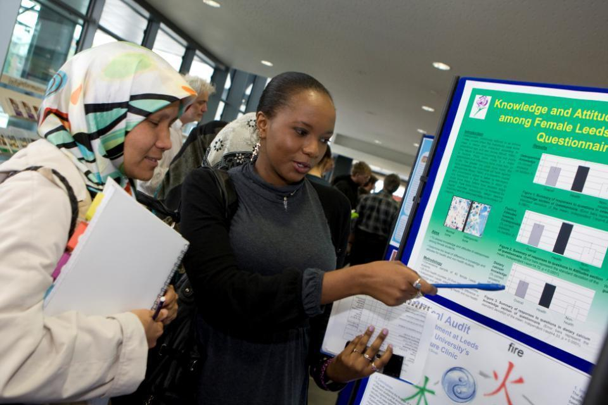
Assessment formats can challenge students

Slide 15
Institutions are expected to offer appropriate adjustments for example:
flexibility in the balance between assessed course work and examinations;
demonstration of achievement in alternative ways, such as through signed presentations or viva voce examinations;
additional time allowances, rest breaks and re-scheduling of examinations;
the use of computers, amanuenses, readers and other support in examinations.

Slide 16
Putting this in to practice. We need to:
design an assessment strategy that involves a diverse range of methods of assessment (as all forms of assessment disadvantage some students);
consider when designing assessment tasks how any students might be disadvantaged;
maximise the opportunities for each student to achieve at the highest possible level;
ensure the assurance of appropriate standards for all students.

Slide 17
Some further tips on making assessment inclusive: we should:
Undertake a needs analysis for assessment requirements as soon as students are involved. This will maximise time available for additional idiosyncratic adjustments to be made for students whose needs had not been foreseen
Consider the health and safety requirements of disabled students who are to be engaged in practicals and field trips from the outset. Considerable work has been done in this area by the University of Gloucestershire.

Slide 18
You could even be really radical!
Consider abolishing formal unseen time-constrained exams altogether! You probably already use critiques, vivas, take-away papers, portfolios and other forms of assessment anyway but sometimes course teams feel compelled to include some traditional exams to satisfy institutional requirements and external assessors.
Your course design process should be seeking fit-for-purpose assessment methods that constructively align with your learning outcomes. These do not necessarily include traditional exams.

Slide 19
Mini case
SPACE (Staff-Student Partnership for Assessment Change and Evaluation) is a three-year HEFCE funded Project, based at the University of Plymouth, developing and promoting alternative forms of assessment as a way of facilitating a more inclusive approach to assessment. They have found that 71% of the 100 disabled students they surveyed were in receipt of special examination arrangements. Of these, 67% of the disabled students surveyed received extra time to complete work.

Slide 20
Mini case part 2
The SPACE team argue that this may not necessarily be the best way of supporting disabled students undertaking assessment and are developing an Inclusive Assessment toolkit. Guidelines developed by SPACE suggest for example, involving students themselves in designing special examination arrangements and offering alternatives to traditional dissertations including video and oral assessments. Details of the SPACE project can be accessed at:
http://www.plymouth.ac.uk/pages/view.asp?page=10494

Slide 21
Dyslexia is a huge issue in HE assessment: some tips for inclusive assessment
Try to separate the assessment of the content from the assessment of the expression of language.
When marking students with dyslexia, decide the extent to which spelling / grammar/ logical ordering should impact on the marks given.
Decide the extent to which these aspects of work should be the subject of formative feedback and how it will impact on summative grades.

Slide 22
Provide printed instructions for all assignments in advance. Check with individual students which print fonts, sizes and paper colours are easiest for them to handle.
Find out whether affected students may work best on-screen rather than on paper.
Consider the suitability of mind maps and other alternatives to written communication when students are being assessed on how well they can organise ideas.

Slide 23
In making tutor comments on students’ work, pay particular attention to the legibility of your own writing.
Remember that different dyslexic students will be helped by different adjustments.
Extracted from Pickford, R. and Brown, S. (2006) Assessing live and practical skills, London: Routledge

Slide 24
Designing an inclusive curriculum
Inclusivity must start at the first stage of curriculum design (with checks at each subsequent stage and at revalidation);
Practical activities will need needs-analyses and advance planning for inclusivity;
Don’t forget about the postgraduate experience (Farrar in Adams and Brown 2006);
Professional and subject bodies may need explicit ‘guidance’ (Tynan in Adams and Brown 2006).

Slide 25
Fostering inclusive classroom practice
Arguably the commonest locus of discrimination against disabled students can be fellow students e.g. in group work;
Student induction and modelling of good practice are crucial;
Use all available sources of information and advice: disability officers, national agencies, specialist groups and charities and disabled students themselves.

Slide 26

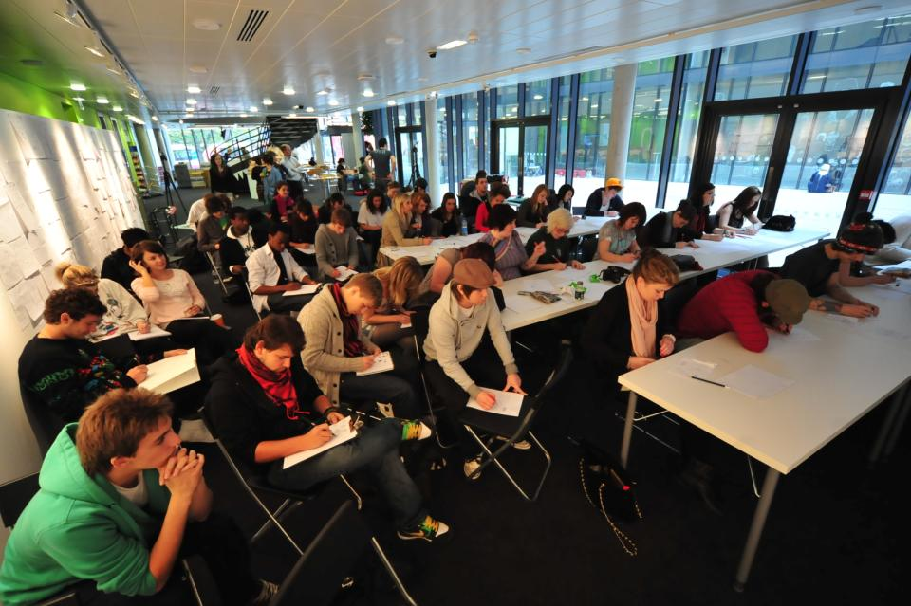
Polysemic activities: how can we engage and excite students’ attention in classes?

Slide 27
Designing inclusive learning spaces
Disability provision isn’t all just about wheelchair spaces;
Audio loops only work when the kit is used properly;
Classroom furniture should be selected by people with training in disability issues;
Rules on food and drink in lecture theatres may need to be reconsidered;
Take advise locally on acceptable cultural practices;
Involve all categories of staff in thinking about inclusivity, including future planning.

Slide 28
Inclusive curriculum delivery
Staff may need weaning off excessively flashy presentations with split screens, lots of moving pictures, tiny text and masses of colour (however much they love it!);
Staff must review their own practices in relation to audibility and visibility;
Inclusive curriculum materials recognise social and cultural differences;
Course teams should scrutinise all course materials with a specific eye for inclusivity.

Slide 29
Designing inclusive e-learning experiences
Make use of the experts! (This includes organisations like TechDis as well as disabled users);
Professional web designers may need reining in (trendy look and fell is often disabling)!
Individual maverick curriculum designers should be discouraged from going it alone!
Good design for disability is good design for all.

Slide 30
For inclusive practice we should:
Build in awareness of inclusivity issues in induction for staff and students;
Include relevant elements in Post Graduate courses in HE learning and teaching;
Include robust requirements re inclusive practice in institutional assessment, learning and teaching strategies;
Make questions re inclusivity part of validation and review of all programmes.

Slide 31
We must also:
Consult and involve diverse students and staff in our programmes of activity;
Build in alternative assessments for disabled students at the design stage, rather than making them ad hoc arrangements at the last minute;
Make best use of University colleagues with specialist knowledge to promote inclusivity

Slide 32
We can also:
Make sure that EO/inclusivity/disability committees/working parties are fully integrated into HEI’s systems;
Use staff development workshops to foster awareness of specific issues;
Encourage discussion of the language used when describing inclusivity issues.

Slide 33
And
Lobby national agencies and Professional and Subject Bodies (PSBs) to keep inclusivity issues foregrounded;
Write, publish and read extensively about inclusivity.

Slide 34
Conclusions
Good practice for disadvantaged students often represents good practice for all students;
It is important to involve disabled students and staff in planning at all stages;
Technological solutions can be helpful but are not the complete answer;
Designing in inclusive practice is easier than coping with issues on an ad hoc basis;
Of all the curriculum issues, developing inclusive assessment is paramount (and the toughest issue to crack).

Slide 35
References
Adams, M. and Brown, S. (eds) (2006) Disabled students in Higher Education: working towards inclusive learning, London: Routledge.
Doyle, C. and Robson, K. (2002) in Ball, S. and Campy, D (eds.) Accessible curricula: good practice for all. Cardiff: UWIC Press.
Grimaldi, C. and Goette, T. (1999) The internet and the independence of individuals with disabilities. Internet research: Electronic networking applications and policy. 9(4)
Koppi, A. J, and Pearson, E. J, (2002) Design and development of a flexible online course for making accessible online courses, AACE World Conference on Educational Multimedia (EDMEDIA2002), Denver, USA.

Slide 36
Further references
Newland, B., Pavey, J. and Boyd, V. (2005) Influencing inclusive practice: The role of VLEs. Improving Student Learning: Diversity and Inclusivity, 12th Improving Student Learning Symposium proceedings.
Northedge, A. (2003) Teaching in Higher Education, Vol. 8, No. 2, 2003, pp. 169–180
Pickford, R. and Brown, S. (2006) Assessing live and practical skills, London: Routledge.
Pearson, E. and Koppi, T, (2003) Developing inclusive practices: Evaluation of a staff development course in accessibility, Australian Journal of Educational Technology, 19,3.
SENDA (2001) The Special Educational Needs and Disability Act, The Stationery Office.
Wiles, K. (2002 ) Accessibility and computer-based assessment: a whole new set of issues?, in Phipps, L., Sutherland, A. and Seale, J. (ed.) Access all areas: disability, technology and learning. JISC TechDis Service and ALT.

Slide 37
Useful websites
QAA codes of practice on students with disabilities and assessment:
http://www.qaa.ac.uk/academicinfrastructure/codeOfPractice/section3/default.asp
http://www.qaa.ac.uk/academicinfrastructure/codeOfPractice/section6/default.asp

Slide 38
More websites
Ommerborn R & Schuemer R, (2001) “Using Computers in Distance Study: Results of a Survey amongst Disabled Distance Students”. FernUniversität – Gesamthochschule in Hagen, Zentrales Institut für Fernstudienforschung (ZIFF), Hagen, July 2001 http://www.fernuni-hagen.de/ZIFF/ommsch4.doc (accessed 8.8.10);
Skill: (the National Bureau for Students with Disabilities) http://www.skill.org.uk
SPACE project http://www.plymouth.ac.uk/pages/view.asp?page=10494
TechDis http://www.techdis.ac.uk

Slide 39
Appendix: issues & interventions 1
Steve grew up in foster care, after an abusive early childhood. Never much motivated at school, he just managed to qualify to attend university. In his second year he started falling behind with his studies and losing momentum. Tutors identified him as being at real risk of failure.
What do you see as the key issues? What would you suggest is an appropriate intervention?

Slide 40
Issues & Interventions 2
Janet is studying Computing with Mathematics and has real difficulties working in groups with other students. She has told the university she has Aspergers syndrome. The other students get annoyed with her because she is intolerant of their ideas and always thinks hers are best.
What do you see as the key issues? What would you suggest is an appropriate intervention?

Slide 41
Issues & Interventions 3
Nasreen is a student on a one-year work placement which is a compulsory element of her Events Management degree. Her employer is finding her very difficult to manage as she is very unwilling to do menial tasks like photocopying and checking out venues. When challenged she says these tasks are secretarial jobs, not ones an undergraduate should do.
What do you see as the key issues? What would you suggest is an appropriate intervention?

Slide 42
Issues & Interventions 4
Bekky is a very shy student living away from home for the first time. Her student accommodation is in a rough part of town and she is becoming progressively less willing to come to college as she hates going back there once it starts getting dark.
What do you see as the key issues? What would you suggest is an appropriate intervention?

Slide 43
Issues & Interventions 5
Pat is a mature student having real troubles juggling her study and home commitments. Her husband is a high powered judge and she can’t rely on him for childcare or transport support. As a result her studies are suffering and she is missing deadlines.
What do you see as the key issues? What would you suggest is an appropriate intervention?

Slide 44
Issues & Interventions 6
Kim had good IELTs grades prior to admission but on arrival really doesn’t seem to have the functional English language skills to be able to get the most from her studies. She rejects suggestions that she might like to get some help with her written and oral English.
What do you see as the key issues? What would you suggest is an appropriate intervention?

Slide 45
Issues & Interventions 7
Max is something of a perfectionist and wants to do really well on his Creative Arts course. He gets disheartened when he doesn’t get top marks and loses enthusiasm quickly if his performance doesn’t live up to his ideals. He gets very stressed out, seems really low from time to time, and his attendance starts dropping off worryingly.
What do you see as the key issues? What would you suggest is an appropriate intervention?

