Slide 1
Assessment at Masters Level
University of East Anglia
11th October 2012
Sally Brown
http://sally-brown.net
Emerita Professor, Leeds Metropolitan University,
Adjunct Professor, University of the Sunshine Coast, Central Queensland and James Cook University Queensland
Visiting Professor, University of Plymouth and Liverpool John Moores University.

Slide 2
Today's workshop will enable you to:
Discuss issues concerning the boundaries between Masters and undergraduate level assessment;
Consider some innovative approaches to assessing at masters level;
Review options for enhancing assessment in masters programmes at UEA.
The workshop builds on the outcomes of a three year project reviewing masters level assessment.

Slide 3
The context for reviewing M-level assessment
Most HEIs are aiming to increase the number of post-graduate students they recruit;
In many nations, undergraduate recruitment is at, or close to saturation;
In a competitive global environment, Masters programmes need to have a competitive edge;
Authentic assessment can be a Unique Selling Point for Masters Programmes.

Slide 4
At Masters level, assessment really matters!
Many Masters programmes are professionally-orientated or vocational hence the need for a strong focus on authentic assessment;
Students have high levels of expectation from their tutors at Masters level;
Most M-level programmes are assessed very conservatively, using written assignments including dissertations, unseen time constrained exams and essays;
We need to distinguish our programmes from those offered by our competitors worldwide.

Slide 5


Slide 6


Slide 7
Masters level programmes according to QAA
The next slides are taken from Master’s Degree Characteristics see http://www.qaa.ac.uk/academicinfrastructure/benchmark/masters/mastersdegreecharacteristics.pdf
All UK courses at Master’s level need to take account of this document which cover purposes, differentiation from UG programmes, guidance on academic credit and European Credit Transfer, teaching and learning, T&L strategies, methods, assessment, quality and qualifications.

Slide 8
M level qualifications
Masters degrees are awarded after completion of taught courses, programmes of research, or a mixture of both. Longer, research-based programmes often lead to the degree of MPhil. Most Masters courses last at least one year (if taken full-time), and are taken by persons with Honours degrees (or equivalent achievement).
Some Masters degrees in science and engineering are awarded after extended undergraduate programmes that last, typically, a year longer than Honours degree programmes. Also at this level are advanced short courses, often forming parts of Continuing Professional Development programmes, leading to Postgraduate Certificates and Postgraduate Diplomas.
(Note: the MAs granted by the Universities of Oxford and Cambridge are not academic qualifications.)

Slide 9
Higher education providers may offer a Master's degree with the specific intention of:
Enabling students to focus on a particular aspect of a broader subject area in which they have prior knowledge or experience through previous study or employment; and/or
Enabling students to focus on a particular subject area or field of study in greater depth than they encountered during the course of previous study or experience. This may include enabling students to develop knowledge of a new discipline or field of study in combination with a relevant subject area in which they have prior knowledge or experience; and/or
Enabling students to learn how to conduct research, often linked to a particular discipline or field of study.

Slide 10
QAA in Scotland: guidance on level 11 qualifications (I like this)
Characteristic outcomes of Masters degrees
i A systematic understanding of knowledge, and a critical awareness of current problems and/or new insights, much of which is at, or informed by, the forefront of their academic discipline, field of study, or area of professional practice.
ii A comprehensive understanding of techniques applicable to their own research or advanced scholarship.
iii Originality in the application of knowledge, together with a practical understanding of how established techniques of research and enquiry are used to create and interpret knowledge in the discipline.
iv Conceptual understanding that enables the student:
to evaluate critically current research and advanced scholarship in the discipline; and
to evaluate methodologies and develop critiques of them and, where appropriate, to propose new hypotheses.

Slide 11
Typically, holders of the qualification will be able to:
deal with complex issues both systematically and creatively, make sound judgements in the absence of complete data, and communicate their conclusions clearly to specialist and non-specialist audiences;
demonstrate self-direction and originality in tackling and solving problems, and act autonomously in planning and implementing tasks at a professional or equivalent level;
continue to advance their knowledge and understanding, and develop new skills to a high level; and will have:
the qualities and transferable skills necessary for employment requiring: (i) the exercise of initiative and personal responsibility; (ii) decision-making in complex and unpredictable situations; and (iii) the independent learning ability required for continuing professional development.

Slide 12
QAA Assessment expectations
Appropriate and effective assessment will enable students to demonstrate the outcomes of learning intended for the programme.
Assessment methods may be based on any or all of the following:
essay assignments
practical reports or portfolios
a dissertation or other output from research/project work, which may include artefacts, performances or compositions
written examinations
oral examinations
problem-solving exercises
oral presentations
posters
placement reports. (And others…..)

Slide 13


Slide 14
My questions: mapping the student experience at Master’s Level
Will students feel from the outset that they are on a Master’s programme?
Are you ensuring that students are immersed in the subject they have come to study from the outset?
Is induction a valuable and productive introduction to the course (or just the distribution of bags and bags of paper)?
Do students have a positive and balanced experience across the programme?
Are there points in the academic year when there doesn’t seem to be much going on?

Slide 15


Slide 16
Assimilate has been a 3-year NTFS funded project
We’ve been exploring innovative assessment at Masters level using research funding from the National Teaching Fellowship scheme.
Recognising that limited prior research had been undertaken in this area, we’ve been reviewing assessment methods used to assess at this level, particularly exploring authentic assessment.
Interviews were undertaken in the UK and internationally by students and team members to elicit information about diverse approaches and to produce case studies showcasing innovations.

Slide 17
Emergent outcomes
Using data from 45 interviews undertaken by the project team, and from conversations with other people we’ve encountered who have an interest in the area, we’ve produced 44 case studies illustrating diverse M-level assessment together with seven vignettes and three national overviews as included in the Compendium;
We have been impressed by the diversity and creativity of many of the approaches adopted;
We’ve also encountered much traditional written assessment, especially dissertations, unseen time-constrained exams, essays and project reports.

Slide 18
Literature and background information on M-level assessment
We’ve confirmed that publications on this topic are relatively limited;
There are some areas where much has been written (for example on language learning) but there are significant gaps and little in the way of generic literature;
Nations, Institutions, Professional and Subject Bodies and other accrediting organisations often provide detailed guidance on what they expect in terms of assessment criteria and standards at this level, but this doesn’t always translate directly into practice in the field.

Slide 19
Good practice M-level Assessment examples include:
Highly authentic assignments, which relate closely to programme outcomes;
Multiple assessments which build incrementally to final submission;
Good feedback opportunities, giving students the chance to benefit from advice to improve performance;
Assignments that require teamwork and group activity;
Assignments that foster employability and that foster employer engagement;
Assignments that are enhanced and supported by technology;
Assignements requiring peer engagement / peer assessment.

Slide 20
Other learning points
It’s been interesting to observe how fuzzy are common understandings of the differences between M-level and undergraduate level assessment;
The importance of authentic assessment to professionally-orientated Masters programmes has been highlighted;
We’ve learned about variations in practice at M-level between different national systems, especially in terms of duration of programmes and funding arrangements;
We’ve also developed as individuals and as members of the project team, learning particularly about project management.

Slide 21
Analysing our data
We have used Activity Theory and Q Methodology to help us make sense of the case study data and to conduct a follow-up study on educator viewpoints.
The initial research study used Activity Theory to investigate practitioners’ experiences of introducing innovative assessment methods at Masters level.
We then designed a Q-study using 48 statements which were rank-ordered by 39 participants.
Using statistical analysis of these data we have interpreted five distinct factors, or viewpoints, relating to Masters level assessment issues.

Slide 22
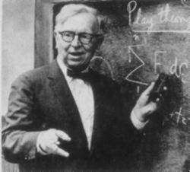
Q Methodology
William Stephenson (1902-1989)
Psychologist and Physicist
Q is used for establishing patterns within and across individuals, rather than across individual traits.
(Barry & Proops, 1999)

Slide 23
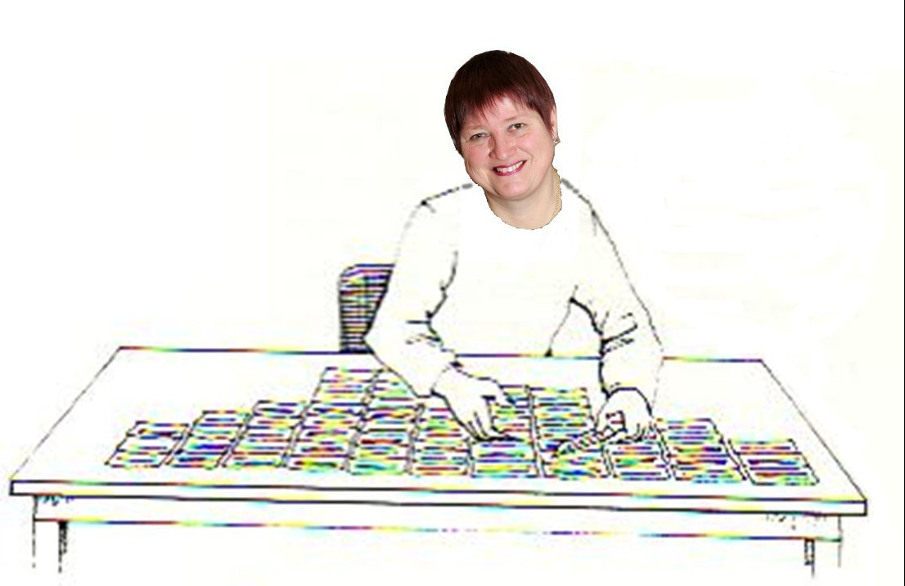
User-friendly: a Q-sort underway
Acknowledgement: Thanks to Wendy Stainton Rogers for sharing this graphic, which was adapted from an original paper by Stainton Rogers, W. (2011) Social Psychology. OUP.

Slide 24
Stages in a Q-study
Identifying and sampling the concourse
Developing a set of statements that is representative of the concourse
Selecting participants for a diversity of views on the issues
Q-sorting and post-sort interviews
Pattern analysis – data reduction and interpretation

Slide 25
Example statements
-3 -2 -1 0 +1 +2 +3
Disagree Agree
Strongly Strongly
Essays and exams should be ‘the gold standard’ in terms of Masters assessment methods. (3)
Improving assessment methods requires a shift in how learning is viewed. (41)
Writing assessment criteria is an easy job for academics. (26)

Slide 26
Findings – system voices
Five different viewpoints on the issues were interpreted, relating to different aspects of M-level assessment activity
Areas of consensus or near-consensus among the viewpoints were also interpreted

Slide 27
Viewpoints 1, 2 and 3
The innovative assessment and accreditation of learning for complex real life / workplace applications requires assessment training for both staff and students.
Standards and consistency can not be guaranteed by any means, but flexible assessment criteria and innovative assessment methods have their uses.
Introducing innovative assessment methods can be powerful but requires new perspectives on learning with institutional support and encouragement for successful wholesale change.

Slide 28
Viewpoints 4 and 5
Clear guidance to students in the form of high quality assessment criteria and timely tutor assessment feedback can help students to develop the skills that they and also employers want.
Improving assessment methods does not necessarily require a paradigm shift in thinking, but stakeholder consultation is important as benefits are not guaranteed and one size does not fit all.

Slide 29


Slide 30
Project overview
The project has yielded more variety and diversity than we expected at the outset;
It has excited considerable interest, with requests to disseminate outcomes to date at eight universities and seven conferences to date (with more in prospect);
It has been fascinating to explore practice in the UK, Denmark, Ireland, Spain, the Netherlands, Singapore, Australia and New Zealand;
We are modestly confident that we have added helpfully to understanding of M-level assessment, particularly through our compendium and our analysis of data to identify viewpoints.

Slide 31


Slide 32
Selected references and further reading
Casey, J. (2002) On-line assessment in a masters-level policy subject: participation in an on-line forum as part of assessment, Centre for the study of higher education, Charles Sturt University, Australia.
Dunn, S. and Singh, K. A. (2009) Analysis of M-level modules in interdisciplinary nanotechnology education, Nanotechnology Centre, Department of Materials, School of Applied Sciences, Cranfield University.
Engeström, Y. (2010). Studies of expansive learning: Foundations, findings and future challenges. Educational Research Review, (5):1-24
Fry, H., Pearce, R. and Bright, H. (2007) Re-working resource-based learning - a case study from a masters programme. Innovations in Education and Teaching International, 44(1), pp.79-91.
Geographical Association. (no date) GTIP Think Piece - Writing at Masters Level. Available online: http://www.geography.org.uk/gtip/thinkpieces/writingatmasterslevel/
Haworth, A., Perks, P. and Tikly, C. (no date) Developments with Mathematics M-Level PGCE Provision and Assessment, University of Manchester, University of Birmingham, University of Sussex.

Slide 33
References (contd.)
Institute of Education (2006) Masters level criteria for Geography PGCE http://www.geography.org.uk/download/GA_PRGTIPBrooksMLevelCriteria.pdf Accessed March 2012
Lord, D. (2008) Learning to Teach a Specialist Subject: Using New Technologies and Achieving Masters Level Criteria. In: MOTIVATE conference 2008, 11 - 12th November 2008, Dunaujvaros, Budapest. (Unpublished) This version is available at http://eprints.hud.ac.uk/10892/ Accessed march 2012
NZQA (2007) http://www.nzqa.govt.nz/assets/Studying-in-NZ/New-Zealand-Qualification-Framework/theregister-booklet.pdf (accessed March 2012
M level PGCE. (2007) ESCalate ITEM level PGCE seminar at the University of Gloucestershire on January 9th 2007.
QAA (2010) Masters Degree Characteristics
http://www.qaa.ac.uk/academicinfrastructure/benchmark/masters/MastersDegreeCharacteristics.pdf
Seymour, D. (2005) Learning Outcomes and Assessment: developing assessment criteria for Masters-level dissertations. Brookes eJournal of Learning and Teaching 1(2).

Slide 34
References (contd.)
Van Eeten, Michel J.G. (2001) Recasting Intractable Policy Issues: The Wider Implications of the Netherlands Civil Aviation Controversy, Journal of Policy Analysis and Management, 20(3):391-414
Wharton, S. (2003) Defining appropriate criteria for the assessment of master's level TESOLAssignments. Assessment & Evaluation in Higher Education, 28(6), pp.649-664.

