Slide 1
Supporting staff to make teaching sessions more inspiring Teaching
Waterford Institute of Technology
February 2012
Professor Sally Brown
Emeritus Professor, Leeds Metropolitan University
Adjunct Professor, University of the Sunshine Coast and James Cook University
Visiting Professor University of Plymouth

Slide 2
By the end of this workshop, you will have had opportunities to:
Discuss what comprises inspiring teaching;
Review some descriptions of outstanding teaching;
Debate how we can ‘breathe life’ into our teaching;
Consider how you can adapt your approaches to make your teaching (even) more inspiring.

Slide 3
Task
Think of an inspiring educator you’ve learned from (this could be a teacher, a peer or someone whose work you admire on television or elsewhere);
Identify up to five characteristics of an inspiring teacher using this role model as a case in point;
Now identify up to five characteristics of a disappointing or uninspiring teacher of your acquaintance;
Reflect on your own characteristics and identify a couple of areas for improvement.

Slide 4
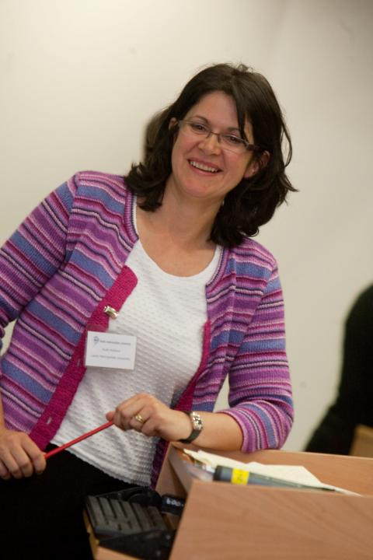
Here’s one! Ruth Pickford

Slide 5
Why is she a great teacher?
Unafraid to take risks but leaves nothing to chance;
Articulates a clear rationale of what she is trying to achieve in her teaching and makes detailed plans on how to achieve it;
Worries less about what students think about her than how much they are learning;
Capable of being seriously quirky without being ‘up herself’;
Continuously challenges students out of their comfort zones.

Slide 6
How do we know if we are offering excellent teaching?
Students are satisfied, learn well, achieve highly and have fulfilling learning experiences;
We as teachers are satisfied, motivated and find their workloads manageable;
Quality assurors and Professional and Subject bodies like what we do and have no complaints about systems and processes;
University managers are confident that the student experience offered is of high quality (and deal with few complaints).

Slide 7
What kinds of management interventions can foster inspiring teaching?
Promotion and reward systems that recognise the importance of teaching;
Identifying outstanding teachers and using them as advocates for commitment to teaching;
A culture of scholarship of teaching, that encourages evidence-based dissemination of good practice;
Dialogues around what makes for excellent teaching, particularly those associated with peer observation systems.

Slide 8
Characteristics of excellent university teachers:
Knows subject material thoroughly
Adopts a scholarly approach to the practice of teaching
Is reflective and regularly reviews own practice
Is well organised and plans curriculum effectively
Is passionate about teaching
Has a student-centred orientation to teaching
Regularly reviews innovations in learning and teaching and tries out ones relevant to own context
Ensures that assessment practices are fit for purpose and contribute to learning
Demonstrate empathy and emotional intelligence

Slide 9
Characteristics of excellent teachers: diamond-9
1
2
3
4
5
6
7
8
9

Slide 10
A tall order?
Effective lecturers combine the talents of a scholar, writer, producer, comedian, showman and teacher in ways that contribute to student learning. Nevertheless it is also true that few college professors combine these talents in optimal ways and that even the best lecturers are not always on top form
McKeachie et al p53

Slide 11
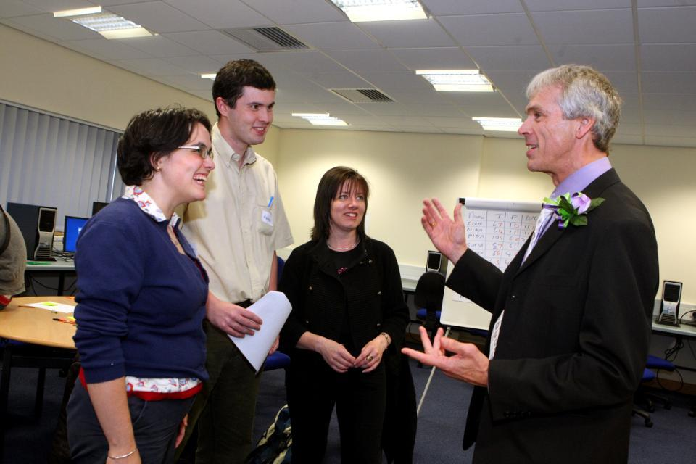

Slide 12
What kinds of questions might we ask ourselves before we prepare to teach?
If we want to be inspiring teachers, once we have drafted the learning outcomes, what kinds of questions might we ask ourselves about how we might set about ensuring our students achieve them?

Slide 13
Ken Bain says excellent teachers ask these questions as they prepare to teach:
1. What should my students be able to do intellectually, physically, or emotionally as a
result of their learning?
2. How can I best help and encourage them to develop those abilities and habits of the
heart and to use them?
3. How can my students and I best understand the nature, quality, and progress of their learning?
4. How can I evaluate my efforts to foster that learning? (Bain, 2004 p. 49)

Slide 14
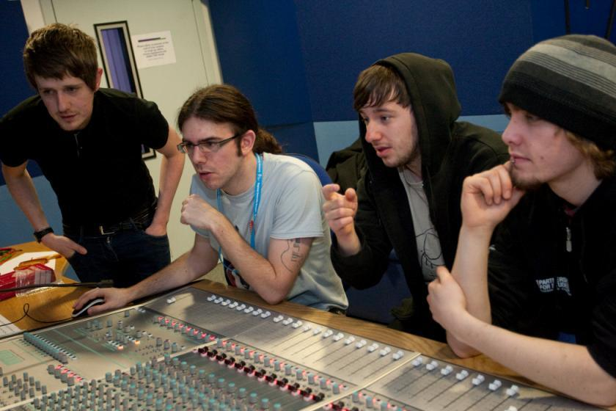

Slide 15
How can we get students to fully engage? Some suggestions
Provide opportunities for students to get involved in authentic learning environments on campus or off;
Keep the curriculum current and life-relevant, without losing historical perspectives;
Give them real problems to solve and issues with which to engage;
Identify the skills they need to succeed and provide opportunities to rehearse and develop them;
Never compromise on the quality of the demands we make of them.

Slide 16
Bain on how great teachers treat their students. They
Are willing to spend time with students, to nurture their learning.
Don’t foster a feeling of power over, but investment in, students.
Ensure their practices stem from a concern for learning.
Make the class user-friendly by fostering trust.
Employ various pedagogical tools in a search for the best way to help each student.
Have the attitude that “There is no such thing as a stupid question.”

Slide 17
More on how to treat students
Adapted and extracted from Bain (2004) p. 135
7. Ensure that everyone can contribute and each contribution is unique.
8. Do not behave as a “high priest of arcane mysteries.”
9. Do not make the classroom an “an arena for expertise, a ledger book for the ego.”
10. Don’t expect students to see science as a “frozen body of dogma” that must be memorized and regurgitated.
11. Foster the feeling that teachers are fellow students/ human beings struggling with mysteries of the universe.

Slide 18
How do inspiring teachers treat their students?
In pairs, formulate three more ways in which outstanding teachers treat their students.
Discuss which of Ken Bain’ eleven and your three are the most effective in fostering student learning.
Are there any reflection points for you in relation to your own teaching?

Slide 19
High quality teaching…
…“implies recognising that students must be engaged with the content of learning tasks in a way that is likely to enable them to reach understanding…Sharp engagement, imaginative inquiry and finding of a suitable level and style are all more likely to occur if teaching methods that necessitate student energy, problem solving and cooperative learning are employed”. (Ramsden, 2003, p97)

Slide 20
Fostering high quality teaching.
How can we integrate each of the following into our teaching?
student energy;
problem solving;
cooperative learning.
What else is important?

Slide 21
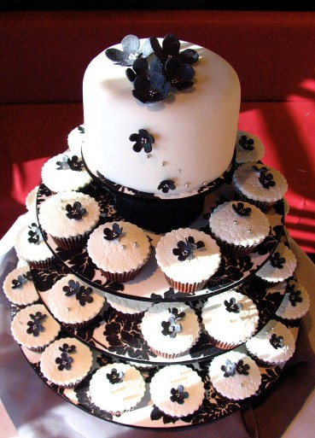

Slide 22
Conclusions
Inspiring teachers tend to be systematic, consistent, well-prepared and compelling: They can usually work well at different levels and in diverse contexts;
There are no standard recipes by which we can cook up inspiring teaching, but there are some features we can combine in imaginative ways to create tasty and satisfying outcomes;
Inspiring teaching comes in many different forms, and inspiring teachers develop their own styles and approaches that suit them (and their learners) well.

Slide 23
So what are you going to do?
To refresh your own practice?
To gain more satisfaction from teaching?
To mentor and support new colleagues?
To learn from the long-serving members of staff who may be about to leave?
To help your students to get the most out of their time at university?

Slide 24
References (1)
Alkema, A. (2011) A tertiary practitioner’s guide to collecting evidence of learner benefit, Ako Aotearoa New Zealand see http://akoaotearoa.ac.nz/download/ng/file/group-4/a-tertiary-practitioners-guide-to-collecting-evidence-of-learner-benefit.pdf (accessed March 2011).
Bain, K.(2004) What the Best College Teachers Do, Cambridge Massachusetts, Harvard University Press, http://www.vetmed.wsu.edu/courses-jmgay/documents/SynopsisWhatBestCollegeTeachersDo.pdf
Biggs, J. and Tang, C. (2007) Teaching for Quality Learning at University Maidenhead: Open University Press.
Brown, S. (2011) Bringing about positive change in higher education; a case study Quality Assurance in Education Vol 19 No 3 pp.195-207.
Brown, S. and Race, P. (2002) Lecturing – a practical guide, London: Kogan Page
Colin Bryson & Len Hand (2007): The role of engagement in inspiring teaching and learning, Innovations in Education and Teaching International, 44:4, 349-362
Boyer, E.L. (1990, reprinted 1997) Scholarship reconsidered: priorities of the professoriate, San Francisco: Jossey Bass, The Carnegie Foundation for the Advancement of Teaching.

Slide 25
Debowski, S., Stefani, L., Cohen, M. and Ho, A (2011) Sustaining and championing teaching and learning in good times or bad in Groccia, J., Alsudairi, M. and Bukist, B., (eds.) A handbook of College and University Teaching: global perspectives, London: Sage Publications.
Dweck, C. S. (2000) Self-theories: their role in motivation, personality, and development, London: Psychology PressFlint, N. R. and Johnson, B. (2011) Towards fairer university assessment – recognising the concerns of students, London: Routledge.
Kneale, P. E. (1997) The rise of the "strategic student": how can we adapt to cope? in Armstrong, S., Thompson, G. and Brown, S. (eds) Facing up to Radical Changes in Universities and Colleges, pp.119-139 London: Kogan Page.
McKeachie, W. J. (1951) Teaching Tips: Strategies, Research and Theory for College and University Teachers, Lexington MA: D. C. Heath and Company.
Mentkowski, M. and associates (2000) p.82 Learning that lasts: integrating learning development and performance in college and beyond, San Francisco: Jossey-Bass.

Slide 26
Northedge, A. (2003) Enabling participation in academic discourse, Teaching in Higher Education, Vol. 8, No. 2, pp.169-180.
Race, P. (2006) The lecturer’s toolkit (3rd edition) London: Routledge.
Ramsden , P.(2003) Learning to teach in higher education (2nd edition) London, Routledge Falmer
Scott, G. (2004) Change matters: making a difference in Higher Education, keynote given at the European Universities Association Leadership Forum in Dublin http://www.uws.edu.au/__data/assets/pdf_file/0007/6892/AUQF_04_Paper_Scott.pdf (Accessed April 2011)
Wenger, E., McDermott, R. and Snyder, W. (2002) Cultivating communities of practice: a guide to managing knowledge, Harvard: Harvard Business School Press.
Yorke, M. (1999) Leaving Early: Undergraduate Non-completion in Higher Education, London: Routledge.

