Slide 1
Lecturing to large classes
Sally Brown
Emeritus Professor:Leeds Metropolitan University,
Adjunct Professor :University of Sunshine Coast, Central Queensland University, James Cook University
Visiting Professor: University of Plymouth

Slide 2
Activities today will include (at some point) thinking about
The purposes of lectures: should we be doing it at all?
Voice and presence;
Interactivity and participation;
Technology enhanced learning to enhance large group teaching;
Quizzes and questions;
Dealing with disruptive behaviour in large groups;
Activities to promote improved attention span in large groups;
Using lectures for assessment briefings and feedback;
Action planning to enhance large group teaching.

Slide 3
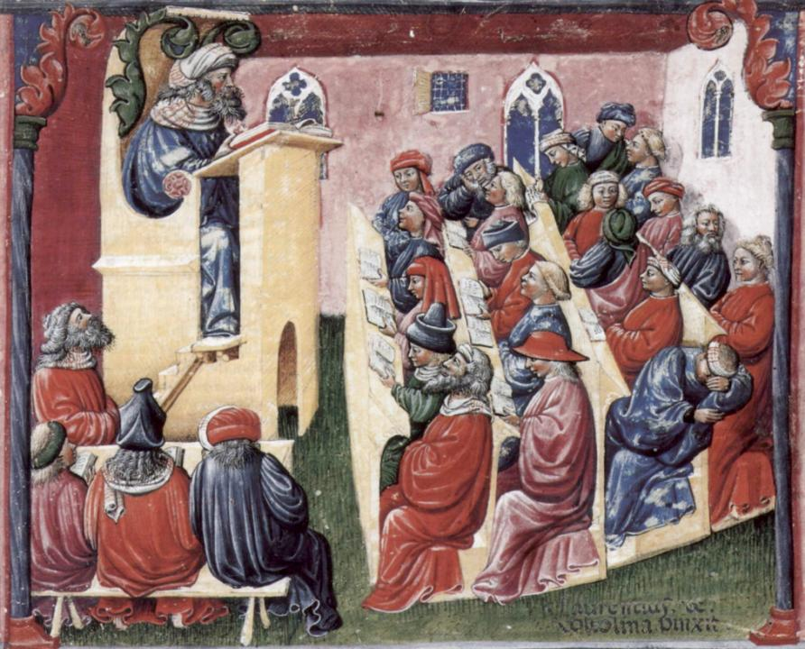
Laurentius de Voltolina
2nd half of 14th Century
Italian Painter

Slide 4
The context: What’s different nowadays?
The impact of IT in the classroom (PowerPoint, interactive opportunities e.g. Twitter and clickers, multimedia);
The impact of IT outside the classroom (access to web-based resources);
Changes in student expectations / experiences (MTV generation, paying customers, earning, caring responsibilities).

Slide 5
What is very much the same?
Large numbers of students;
Uncomfortable/unhelpful environments;
Poor liaison between building designers and users;
A dependency culture;
Timeslots of 1 hour or less;
Pressure to get through the material.

Slide 6
The Maieutic model
Maieutics is a complex procedure of research introduced bySocrates, embracing the Socratic method in its widest sense. It is based on the idea that the truth is latent in the mind of every human being due to her/his innate reason but has to be "given birth" by answering questions (or problems) intelligently proposed.The word is derived from the Greek "μαιευτικός," pertaining to midwifery midwifery.

Slide 7
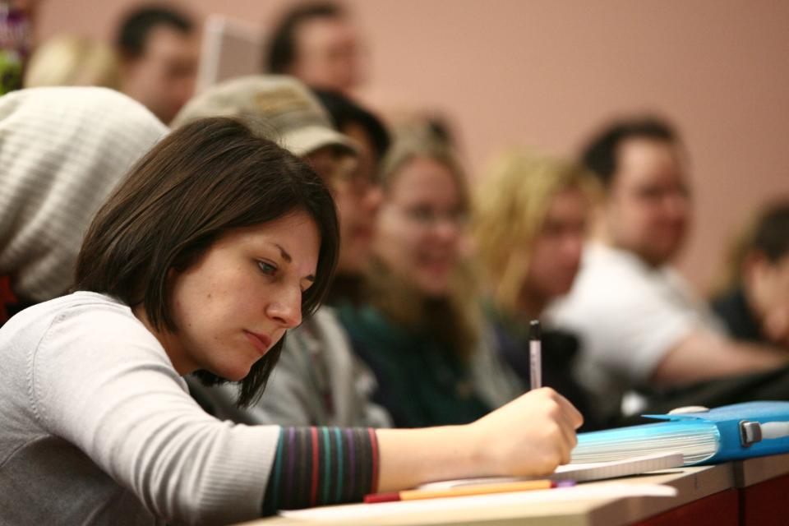

Slide 8
Delivering content…..
is less like delivering a parcel (the postman model) and more like delivering a baby (the midwife model).
University staff can advise, guide, intervene when things so wrong, but in the end only the student can bring learning into life!!
Content can be gleaned from many sources (e.g. MIT and our UK Open University are putting more and more content into open access areas).

Slide 9
What do students (say they) want?
A good set of notes?
The answers to the exam questions?
Explanations, illumination, inspiration?
The chance to feel part of the collective learning experience?
Opportunities to ask questions and seek clarification?

Slide 10
UK National Student Survey asks students to rate universities on whether…
Staff are good at explaining things
Staff have made the subject interesting
Staff are enthusiastic about what they are teaching
The course is intellectually stimulating

Slide 11
Why do we lecture?
To get a lot of info across to a lot of students?
To give students a framework into which they can integrate new material?
To highlight what we want students to be aware of?
To get them interested?
To pave the way towards them passing the assessment?

Slide 12
What are we trying to do?
Offer a shared learning experience;
Inspire and motivate students;
Provide a topical/relevant gloss to our material;
Help students make sense of what they are learning;
Provide course cohesion;
Brief students about what we expect of them;
Help them see the wood for the trees;
Tell them things.

Slide 13
Some less positive reasons
It’s what students expect.
It’s what I’m timetabled to do.
It’s the way it’s done round here.
I haven’t time/energy/resources to do it any other way.

Slide 14
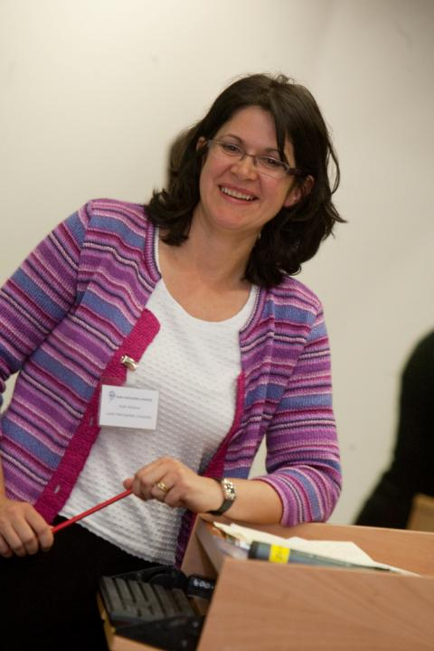
Ruth Pickford: the best lecturer I know

Slide 15
Characteristics of an effective lecturer (the research suggests)
Strong orientation towards student learning;
Well prepared;
Comfort with subject material;
Ability to perceive that some students find the subjects we love hard, and even uninteresting;
Passion (and sometimes quirkiness);
Ability to vary activities within a lecture to maximise student engagement.

Slide 16
Characteristics of an effective lecture
Students actively engage with the material being presented;
The period of time available is used constructively;
Students of all abilities are able to follow the train of thought of the lecturer to some extent and learn from the experience;
Learning happens.

Slide 17
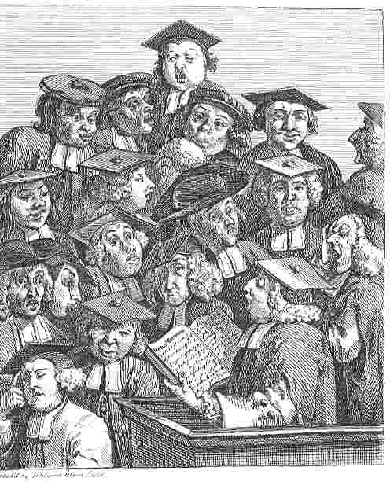
William Hogarth
1736
‘Scholars at a lecture’

Slide 18
Some views
The mediocre teacher tells. The good teacher explains. The superior teacher demonstrates. The great teacher inspires. William Arthur Ward.
The biggest enemy to learning is the talking teacher. John Holt.
Education is what survives when what has been learned has been forgotten. B. F. Skinner.
To know yet to think that one does not know is best; Not to know yet to think that one knows will lead to difficulty. Lao-Tzu (6th century B.C.)

Slide 19
More views about lectures
I would deliver lectures that got standing ovations, but later in the tests and essays, it was clear to me that the students just didn’t get it. (Daniel Greenberg)
The first duty of a lecturer – to hand you after an hour’s discourse a nugget of pure truth to wrap up between the pages of your notebooks and keep on the mantelpiece for ever. (Virginia Woolf)
The lecture should be the jewel in the crown of both the student and lecturer experience in the 21st century. Never before has there been such an opportunity to inspire in the lecture theatre. (Ruth Pickford).

Slide 20
Anxieties about large-group teaching…
Some people are ‘naturals’ at large-group teaching, and don’t mind working with hundreds of students at a time.
Some find it very stressful, particularly at first.
“I was sick. I threw up in the toilets before and after my first lecture. I’d done my preparation, but I walked into the room shaking”.
But if we concentrate on what learners do during our sessions, rather than on what we do, it often gets a great deal better.

Slide 21
What goes wrong? (students)
Boredom, attention deficit, alternative activities, getting lost, getting annoyed with other students, getting irritated by the lecturer, sleeping, struggling to make links, finding the material going over your head, failing to keep up with note making, copying things down wrongly, failing to see the point, writing down without understanding… (you can extend this list a lot!)

Slide 22
What goes wrong? (staff)
Anxiety, going too fast, going too slowly, losing your place, forgetting where you left off last week, interruptions from students, not knowing answers to questions, equipment failure, external interruptions, running out of material, getting tongue tied… (you can extend this list too!)

Slide 23
Voice and presence: my tips: Take great care of your voice:
Try warming up exercises to avoid injury;
Never use chalk (!)
Always have water with you and throat sweets if you have a cold);
Don’t strain your voice by shouting, instead learn to project from the diaphragm;
Modulate the tone: lower high voices and raise low ones;
Articulate clearly (practice in front of a mirror).

Slide 24
Taking care of your voice
Think about your breathing and use more breath than in ordinary conversation;
Always stand up if you are short;
Don’t aim to talk for the whole lecture period: intersperse tasks and interruptions to give your voice a break (it’s possible to give lectures when you have lost your voice!);
Always use a microphone other than in a tiny room whether you feel you need one or not as hearing impaired students may rely on it.

Slide 25
Work the space:
Move around in any space other than a tiny one (be a moving target);
Look at your students when talking to them: systematically address different parts of the auditorium, make eye contact with at elast some of them;
Get out and about to engage students (be careful on stairs);
Don’t allow yourself to be constrained by a podium mic (hold out for a radio mic!);

Slide 26
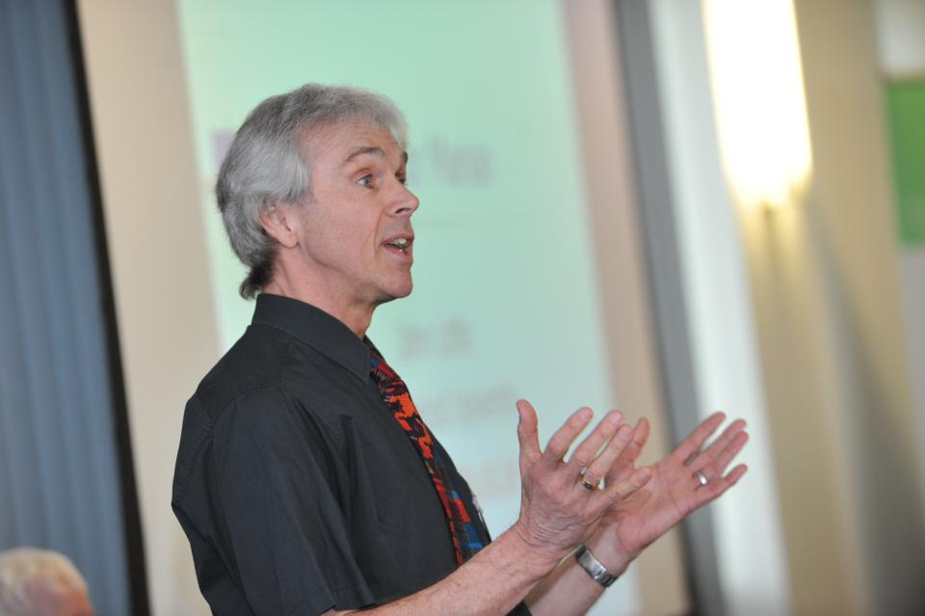

Slide 27
Overcoming nerves
Prepare thoroughly, thinking about the presentation of the material as much as the content;
Prepare more content than you know you will need;
Include elements of the lecture period where someone else is doing talking e.g. by using short video extracts or expert witnesses;
Think about your pace: practice delivery and build time checks into your lecture. Think about ‘elastic’ and ‘plasticene’.

Slide 28
Distractions and interruptions: what do you do about students in your lectures...
Answering mobile phone calls;
Sending and receiving texts;
Being on Facebook on their laptops;
Using Google and Wikipedia;
Falling asleep;
Having noisy private conversations;
Tweeting.

Slide 29
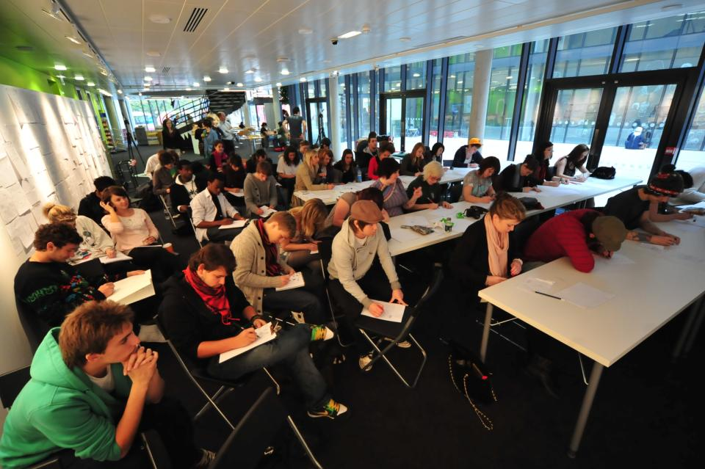

Slide 30
What kinds of activities foster engagement?
Providing learning outcomes of the session at the start of the lecture?
Indicating how the subject discussed in today’s lecture was assessed in last year’s examination?
Asking students questions (and using various means to garner responses rather than inviting individuals to respond orally)?
Returning to learning outcomes at the end to check whether students feel they have achieved them? (and doing something about it if they don’t)

Slide 31
Attention recall points can include
Including short, relevant video or audio clips;
Using brief role plays to illustrate key issues;
Providing tasks on handouts that each student needs to complete and share;
Giving short reading tasks and then using these to promote interaction;
Using individual tasks which lead to pair tasks and then small group discussions.

Slide 32
More attention recall points
Asking students to design an exam or assignment question based on the material covered so far;
Solicit multiple questions from students and respond to them in batches;
Using brief intervals of individual silent reflection, then asking students to discuss in pairs their views and outputs.

Slide 33
Things we can do to make lectures effective
Be enthusiastic
Do a variety of things
Prepare properly
Signpost the intended learning
Setting the scene about how the learning should happen
Be inspiring
Give added-value to person who bothers to turn up
Be accessible and approachable

Slide 34
And we can:
Make it relevant to students – use real examples
Adapt the lecture to the actual needs of the group at that time and the context
Be flexible
Challenge students’ thinking
Manage the time well
Give them practical examples
Relate their work to the forthcoming/ongoing assignment
Orientate and guide their thinking

Slide 35
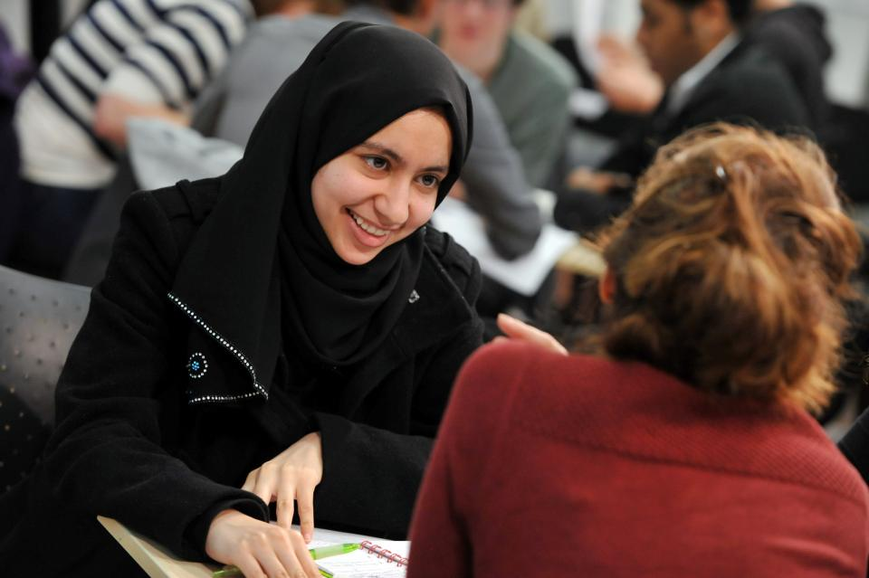

Slide 36
Gauging engagement: you can:
Ask questions that can be responded to with a show of hands (including two hands, one hand, zero hands);
Set small tasks/ quizzes and ask students to respond to whole cohort questions using clickers or low-tech alternatives;
Enabling tweets to be sent to you, to which you respond at intervals in the lecture.

Slide 37
Technology enhanced learning to enhance large group teaching
Insert mini-quizzes into the lecture to check understanding;
Use audio and video clips to illustrate your points;
Twitter can be used to receive and review students comments in class;
Use the technologies you have available to promote engagement: clickers if you have them, coloured paper if you haven’t.

Slide 38
Using lectures for assessment briefings and feedback
Whole group briefings offer the chance for students to raise queries and clarify intended outcomes;
It’s good, especially in the early days to show examples of what kinds of thing you are looking for;
Whole cohort feedback can save some time and energy when marking;
It’s good to stress the importance of attendance, but as a back up, routinely video the session and make them available to absentees.

Slide 39
Quizzes: some ideas
Use quick multi-choice tests in lectures to gauge engagement and understanding;
Ask questions and get students to consider the answers in groups before volunteering answers on request;
Keep the mood light and maybe use daft prizes to encourage participation;
Vary the question type (true or false, pick right answer from five, free response; best explanation etc) for diversity.

Slide 40
Questions
Asking all students to write the answer to a question and then asking volunteers to read out the answers will get more interaction than just picking on individuals;
Make clear your expectations about when and how students can ask questions in your lectures, rather than just asking ‘Any questions?’ as you pack up;
Consider using a questions box for students to pop questions in at the end of the lecture and then be sure to answer them at the start of the next lecture to provide a link to new material

Slide 41
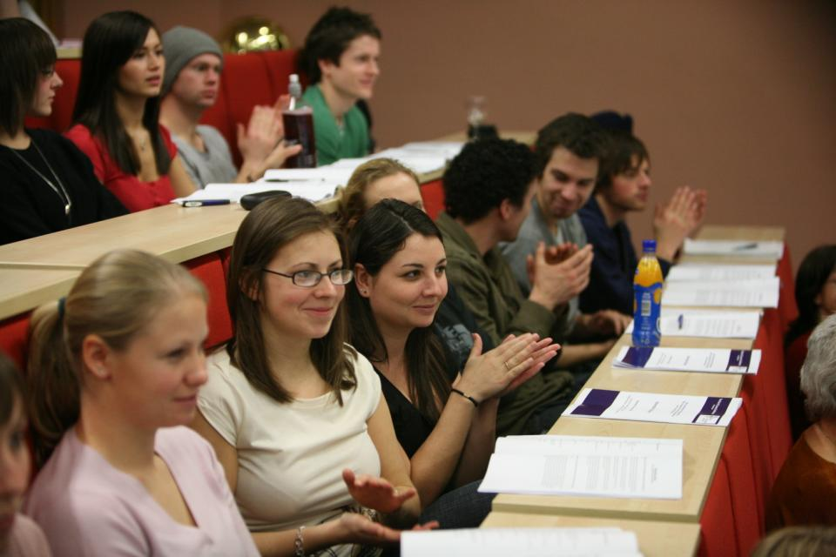

Slide 42
Conclusions
Lectures to large groups are likely to be used in universities for the foreseeable future;
Many managers regard them as highly cost effective, but they don’t have high learning payoff for students unless we work hard to engage students;
Students often remember excellent (and appalling) lectures for life;
It isn’t possible to turn a dreadful lecturer into an excellent one overnight, but it is possible to help someone in that position cease to do the things that really annoy students;
Ubiquitous, reflective non-judgmental peer observation of teaching is the best way for everyone to improve.

Slide 43
References
Bligh, D. (2002) What’s the use of lectures Jossey Bass San Francisco
Brown, S. and Race, P. (2002) Lecturing – a practical guide, London: Kogan Page.
Edwards, H., Smith, B. and Webb, G. (2001) Lecturing: case studies, experience and practice. London: Kogan Page.
Foreman-Peck, L. and McDowell, L. Aims, ethics and values in group work assessment , Newcastle: Northumbria University
Kneale, P. E. (1997) The rise of the "strategic student": how can we adapt to cope? in Armstrong, S., Thompson, G. and Brown, S. (eds.) Facing up to Radical Changes in Universities and Colleges, pp.119-139 London: Kogan Page.
Mentkowski, M. and associates (2000) Learning that lasts: integrating learning development and performance in college and beyond, p.82, San Francisco: Jossey-Bass.
Race, P. (2006) The lecturer’s toolkit (3rd edition) London: Routledge.
Race, P. and Pickford, R. (2007) Making Teaching work: Teaching smarter in post-compulsory education, London: Sage.

Slide 44
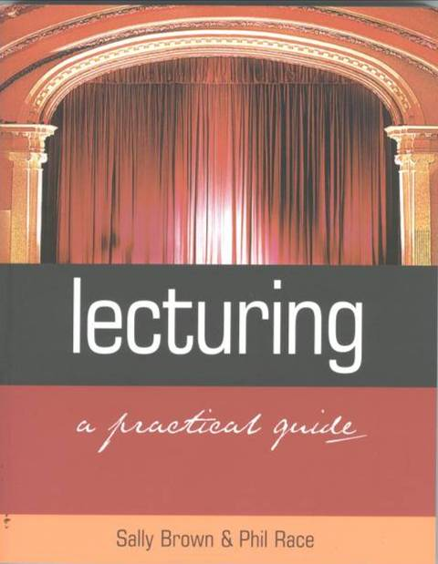
Lecturing – a Practical Guide
Sally Brown and Phil Race
Routledge, London, 2002

Slide 45
Tasks

Slide 46
What’s the use of lectures?
From your own experience of both lecturing and being lectured:
What can lectures do really well?
What are lectures poor at achieving?
In what ways do we need to change lectures to match students nowadays?

Slide 47
Task
Think about a lecturer who has really impressed you with his/her lecturing. What was that lecturer like?
Now think of an unimpressive lecturer. What was that lecturer like?
What does this tell you about the characteristics of a good lecturer?

Slide 48
What’s the worst thing that has ever happened to you in a lecture theatre?
In your groups, list the dreadful experiences on post-its;
(You may include your own appalling behaviour if you wish, as well as incidents you have experienced or witnessed!)
Exchange post-its and suggests ways to either prevent or ameliorate the situation.

Slide 49
Action planning to enhance large group teaching
Identify up to five actions you can take to enhance your lectures.
What could you do to make sure these changes have a real impact?
Who or what could block these changes?
How can you prevent these preventions?

